Slide 1
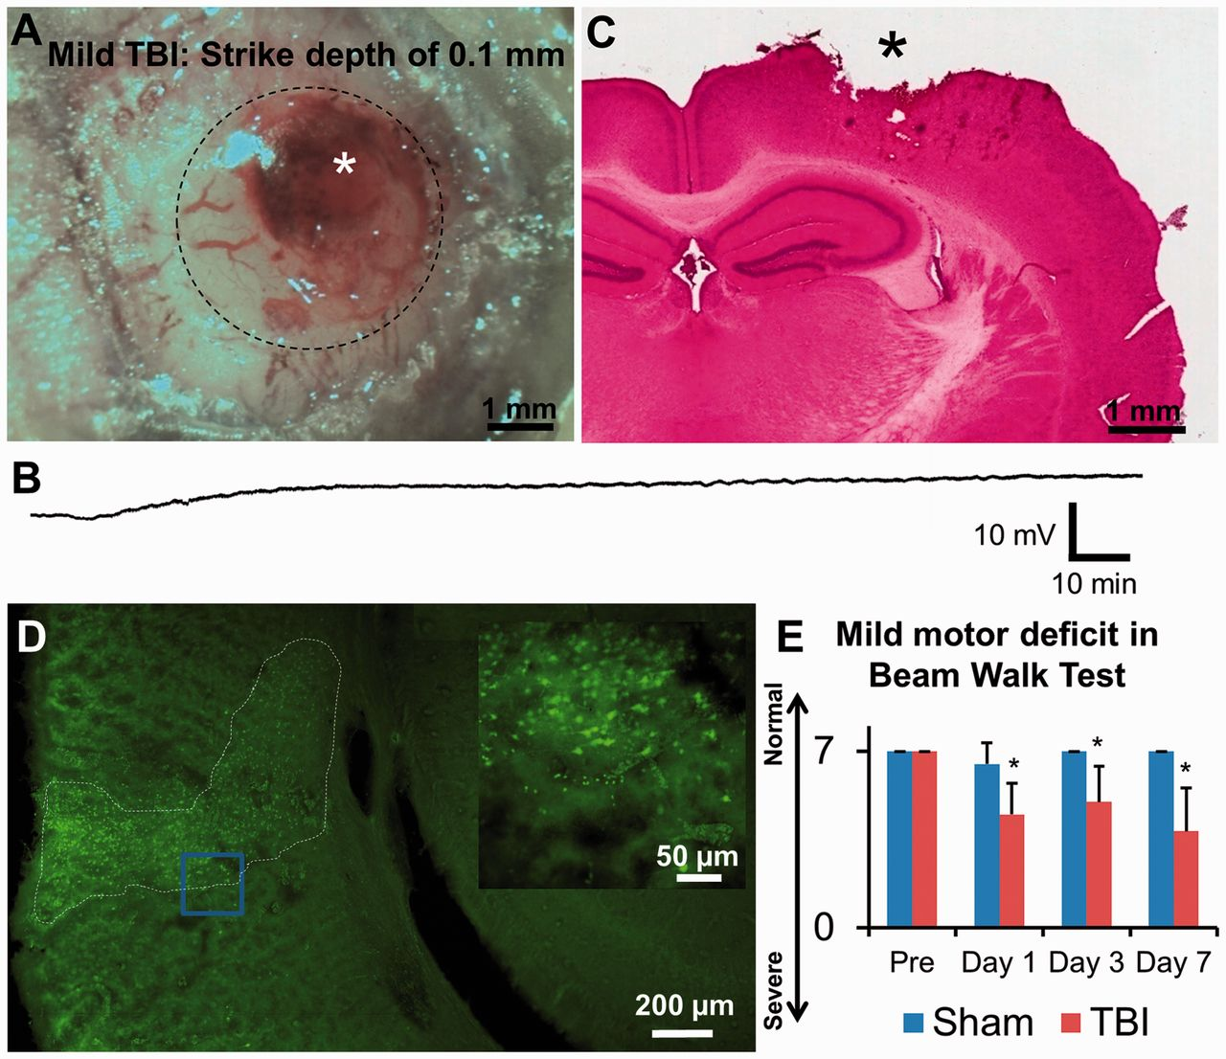
Figure 1 A mild cortical impact caused a mild TBI. (A) CCD camera image of cortical impact site over sensory-motor ...
Notes:
Figure 1 A mild cortical impact caused a mild TBI. (A) CCD camera image of cortical impact site over sensory-motor cortex. Craniotomy reveals a site of the primary impact (asterisk) and adjacent spared peri-contusional cortex. A sealed coverglass contained the effects of oedema. (B) Example recording from microelectrode placed within peri-contusional cortex 0.5 h after controlled cortical impact contusion. Note the lack of spontaneous spreading depolarizations during continuous recording in this representative case. (C) Haematoxylin and eosin staining at 8 h after TBI shows tissue injury (asterisk) localized to the cortex with the spared ipsilateral hippocampus. (D) Coronal brain section with Fluoro-Jade staining reveals dying neurons (bright green) in all layers of the peri-contusional cortex at 48 h after TBI in a wild-type mouse. The blue box indicates an area shown at higher magnification in the insert (top right). There were no dying neurons in the ipsilateral hippocampus (main image, right). (E) Behavioural testing confirmed a mild motor deficit. Summary of 12 animals showing scores of beam walk test performed before TBI and at Days 1, 3 and 7 after TBI. Mild TBI (n = 6, animals) resulted in mild motor dysfunction with significant difference as compared to before TBI and sham (n = 6 mice). *P < 0.05, relative to before TBI, Friedman one-way repeated measures ANOVA on Ranks; *P < 0.05, relative to the sham at each time point, Kruskal–Wallis ANOVA.
Unless provided in the caption above, the following copyright applies to the content of this slide: © The Author (2013). Published by Oxford University Press on behalf of the Guarantors of Brain. All rights reserved. For Permissions, please email: journals.permissions@oup.com

Slide 2
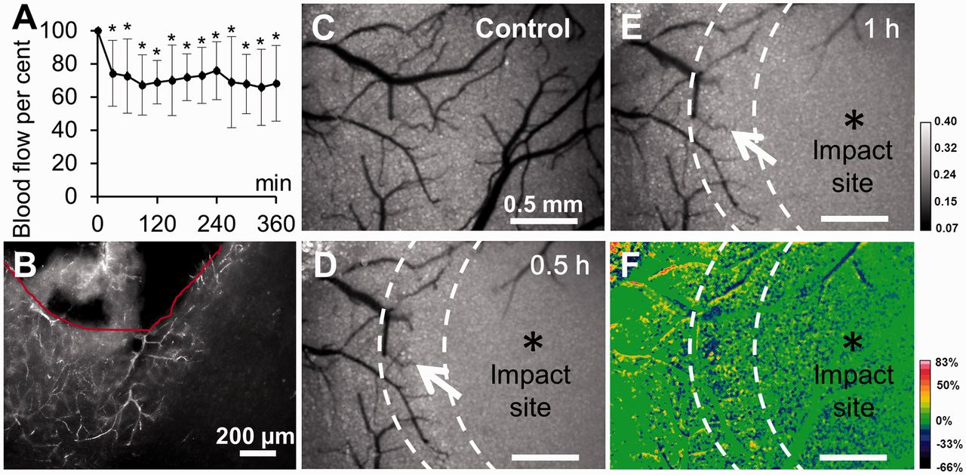
Figure 2 Decrease of blood flow in peri-contusional cortex confirmed by three methods. (A) Summary from six animals, ...
Notes:
Figure 2 Decrease of blood flow in peri-contusional cortex confirmed by three methods. (A) Summary from six animals, showing change in regional cerebral blood flow in peri-contusional cortex measured by conventional laser Doppler blood flowmetry. TBI resulted in mild decrease of regional cerebral blood flow in peri-contusional cortex as averaged over cross-sectional area of 1.0 mm diameter laser Doppler probe tip. *P < 0.02; indicate significant difference as compared to before TBI, one-way repeated measures ANOVA. (B) Coronal section from a mouse perfusion-fixed 8 h after TBI. Texas Red® dextran was flushed from flowing blood vessels during fixation, revealing non-flowing vessels with trapped dye. (C) Control greyscale image of laser speckle contrast reveals cortical vasculature directly below the craniotomy with flowing vessels appearing dark. (D and E) Severe loss of cerebral blood flow at the primary impact site (asterisk) and a decline of cerebral blood flow in adjacent peri-contusional cortex (arrow) are shown at 0.5 and 1 h after TBI, respectively. (F) Per cent of relative changes in cerebral blood flow between 0.5 and 1 h post-TBI, as indicated in the lower right corner. To facilitate comparison, the image of relative cerebral blood flow (percentage of baseline) at 0.5 h after TBI was subtracted from the corresponding image of relative cerebral blood flow at 1 h. Pseudocoloured image reveals reduction of cerebral blood flow at 1 h as compared to 0.5 h after TBI.
Unless provided in the caption above, the following copyright applies to the content of this slide: © The Author (2013). Published by Oxford University Press on behalf of the Guarantors of Brain. All rights reserved. For Permissions, please email: journals.permissions@oup.com

Slide 3
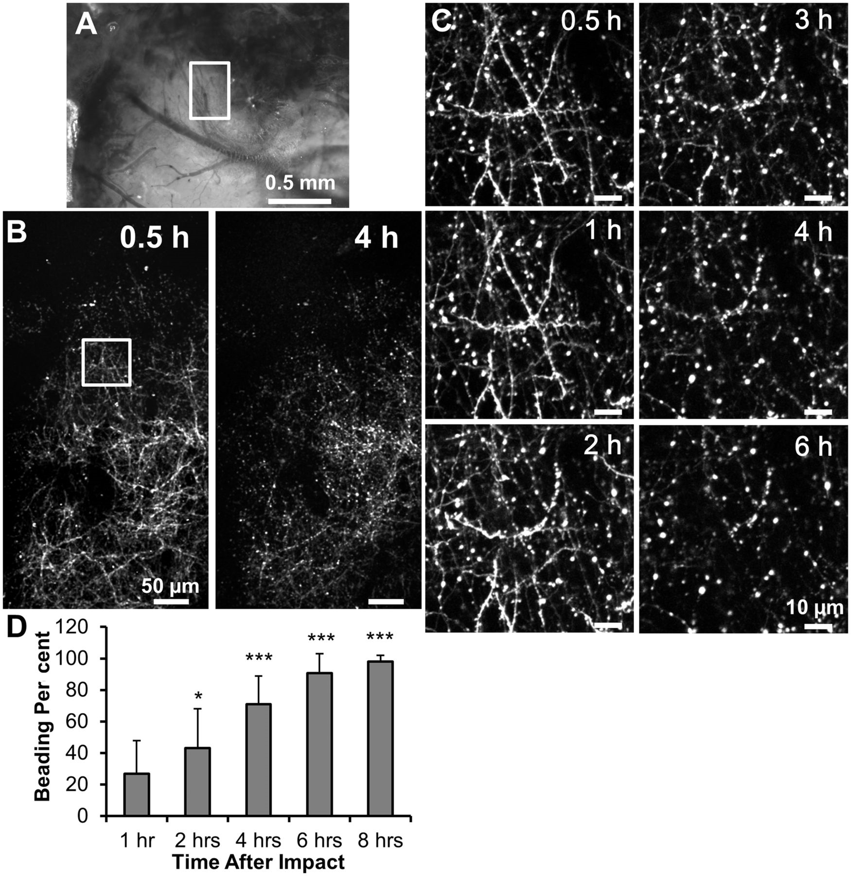
Figure 3 Development of dendritic beading in the peri-contusional cortex. (A) CCD camera image demonstrating a ...
Notes:
Figure 3 Development of dendritic beading in the peri-contusional cortex. (A) CCD camera image demonstrating a haematoma 30 min after TBI at the site of the primary impact and adjacent normal appearing peri-contusional cortex. The boxed area is shown in B. (B) 2PLSM low-magnification tiled maximum intensity projection image (left) acquired at 30 min after TBI shows beaded dendrites at the site of the primary impact (top) and spared dendrites in the peri-contusional cortex (bottom). Dendrites are beaded 4 h later (right). High magnification images in boxed area are shown in C. (C) 2PLSM time lapse imaging reveals the slowly progressing dendritic injury over several hours after TBI. (D) Time course of dendritic beading in the peri-contusional cortex from five mice shows ∼100% of dendrites were beaded by 8 h. Values are based on manually scored beading percentages in imaging fields using a 6 × 6 grid (Murphy et al., 2008). Asterisks indicate significant difference from 1 h after TBI. *P < 0.05, ***P < 0.001, one-way repeated measures ANOVA.
Unless provided in the caption above, the following copyright applies to the content of this slide: © The Author (2013). Published by Oxford University Press on behalf of the Guarantors of Brain. All rights reserved. For Permissions, please email: journals.permissions@oup.com

Slide 4
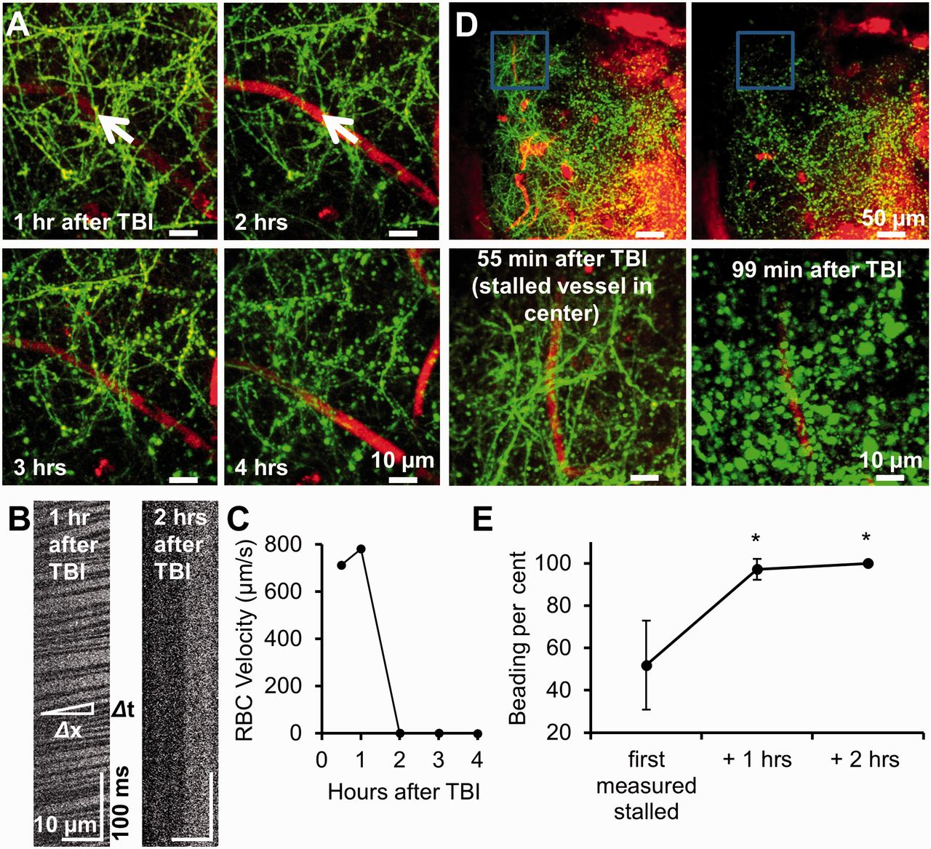
Figure 4 Loss of blood flow results in dendritic beading in the peri-contusional cortex. (A) Maximum intensity ...
Notes:
Figure 4 Loss of blood flow results in dendritic beading in the peri-contusional cortex. (A) Maximum intensity projections of image stacks of YFP-positive dendrites (green) and blood vessels (red; blood plasma labelled with Texas Red® dextran) at 1, 2, 3 and 4 h after TBI. Blood flow was recorded by repetitive line scans along blood vessel as indicated by arrow. At 2 h blood flow was lost and dendritic beading progressed. (B) Stacks of line scans from blood vessel shown in A at 1 h (left) and 2 h (right) after TBI with moving red blood cells (RBC) represented by dark bands at 1 h. The inverse of the slope of these bands is proportional to the instantaneous red blood cell velocity calculated as Δx/Δt (inset). Disappearance of dark bands at 2 h indicates a complete stall of blood flow. (C) Red blood cell velocity computed from line scans in images shown in A at 1, 2, 3 and 4 h after TBI. (D) Low-magnification 2PLSM images (top row) showing dendrites (green) as well as blood vessels (red) at 55 and 99 min after TBI. All vessels in the imaging field were stalled as confirmed visually by the loss of streaking in vessels (Zhang and Murphy, 2007) and verified by line scan. At 55 min after TBI dendrites were injured at the site of the primary impact, but many dendrites were still normal in the peri-contusional cortex as evident from high-magnification image of the boxed area shown below. At 99 min all dendrites in the low-magnification imaging field were injured. High-magnification image of the boxed region shown below reveals severe dendritic beading. (E) Summary from three animals showing development of dendritic beading in the peri-contusional cortex in the presence of non-flowing ischaemic vessels. There were 52 ± 12% of beaded dendrites in the imaging field at the beginning of time lapse imaging with a fraction of beaded dendrites increasing to 97 ± 3% at 1 h and to 100% at 2 h of monitoring. *P < 0.05, relative to the time point at the beginning of imaging, one-way repeated measures ANOVA.
Unless provided in the caption above, the following copyright applies to the content of this slide: © The Author (2013). Published by Oxford University Press on behalf of the Guarantors of Brain. All rights reserved. For Permissions, please email: journals.permissions@oup.com

Slide 5
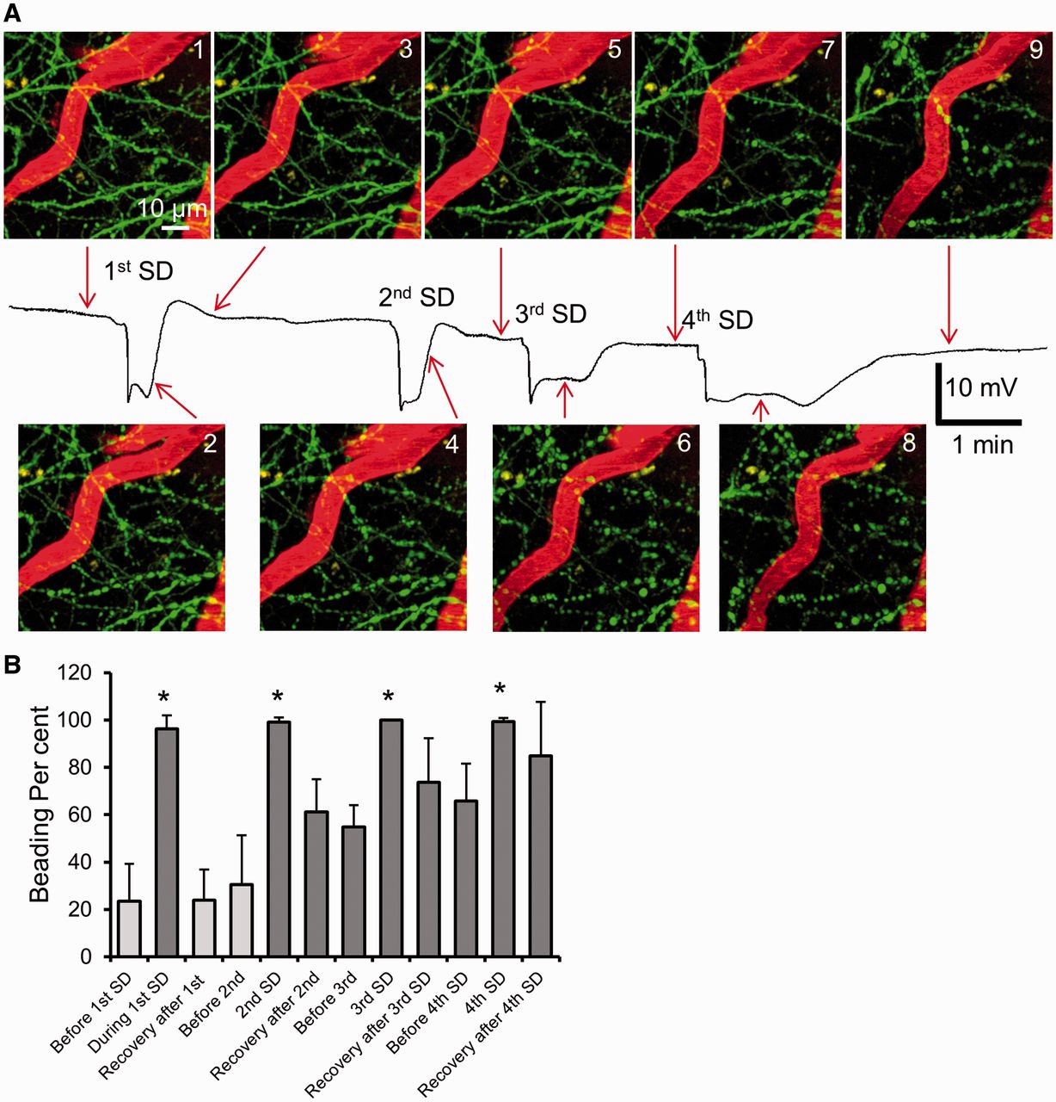
Figure 5 Several rounds of spreading depolarizations facilitate terminal dendritic injury in the peri-contusional ...
Notes:
Figure 5 Several rounds of spreading depolarizations facilitate terminal dendritic injury in the peri-contusional cortex. (A) Maximum intensity projection image sequence showing dendrites (green) and flowing blood vessels (red) as indicated by streaking caused by scanning of moving non-fluorescent red blood cells. Dendrites undergo a rapid beading (Images 2, 4, 6 and 8) during the passage of four subsequent spreading depolarizations (SD) with less recovery seen throughout repolarization (Images 3, 5, 7 and 9) while blood vessels continue to flow. Spreading depolarizations were induced with KCl microinjection away from the imaging field. Each numbered image corresponds with a time point indicated on the respective direct current potential recording from a glass microelectrode placed next to imaged dendrites. (B) Summary from 20 spreading depolarizations in five animals showing that dendrites in the peri-contusional cortex are incapable of recovery from several rounds of spreading depolarizations. Dendritic beading was reversible during the passage of the first induced spreading depolarization. Subsequent three rounds of spreading depolarizations progressively increased a fraction of terminally beaded dendrites to ∼85%. Dark grey coloured bars indicate significant difference from the time point before first spreading depolarization. Asterisks at each bar during spreading depolarization indicate significant difference from the time point before spreading depolarization, one-way repeated measures ANOVA.
Unless provided in the caption above, the following copyright applies to the content of this slide: © The Author (2013). Published by Oxford University Press on behalf of the Guarantors of Brain. All rights reserved. For Permissions, please email: journals.permissions@oup.com

Slide 6
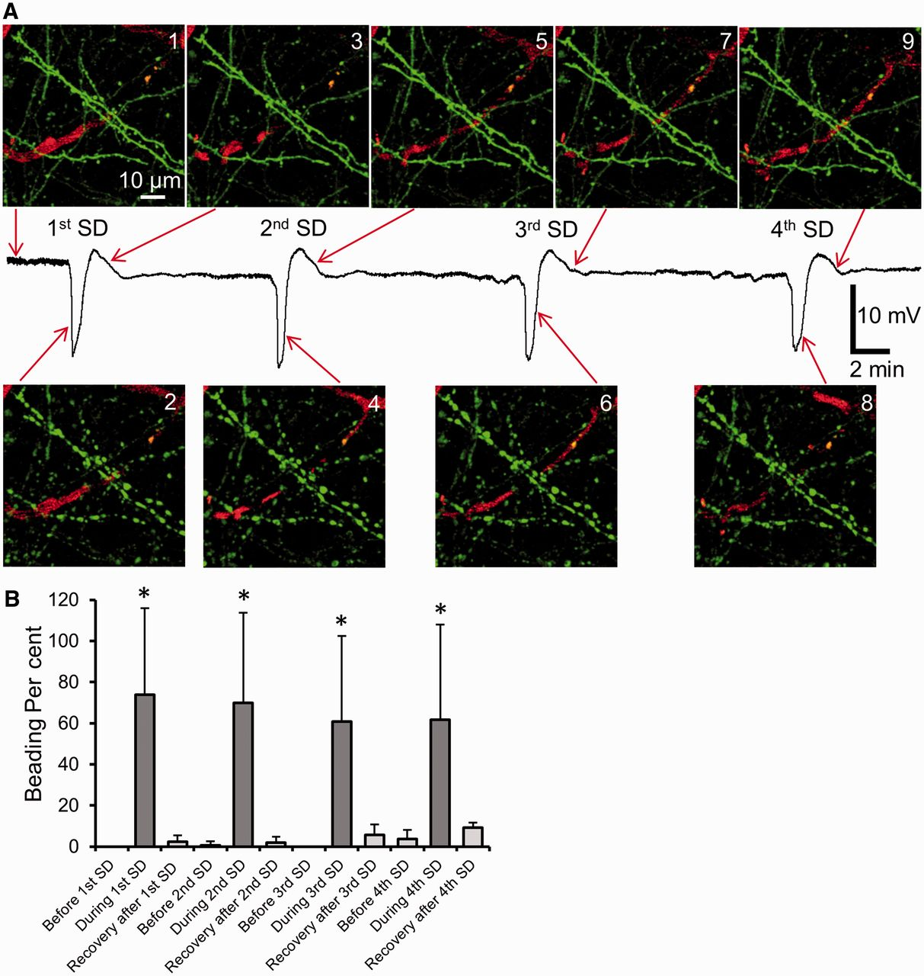
Figure 6 Several rounds of spreading depolarizations do not cause terminal dendritic injury in normoxic healthy ...
Notes:
Figure 6 Several rounds of spreading depolarizations do not cause terminal dendritic injury in normoxic healthy neocortex. (A) Maximum intensity projection image sequence shows dendrites (green) undergoing a rapid beading (Images 2, 4, 6 and 8) during the passage of four subsequent KCl-induced spreading depolarizations (SD) with complete recovery during repolarization (Images 3, 5, 7 and 9). Each numbered image corresponds with a time point indicated on the respective direct current potential recording from a glass microelectrode placed next to imaged dendrites. (B) Summary from 20 spreading depolarizations in five mice showing that dendrites in normal healthy neocortex are capable of full recovery from several rounds of spreading depolarizations. Asterisks at each bar during spreading depolarization indicate significant difference from the time point before spreading depolarization, one-way repeated measures ANOVA.
Unless provided in the caption above, the following copyright applies to the content of this slide: © The Author (2013). Published by Oxford University Press on behalf of the Guarantors of Brain. All rights reserved. For Permissions, please email: journals.permissions@oup.com

Slide 7
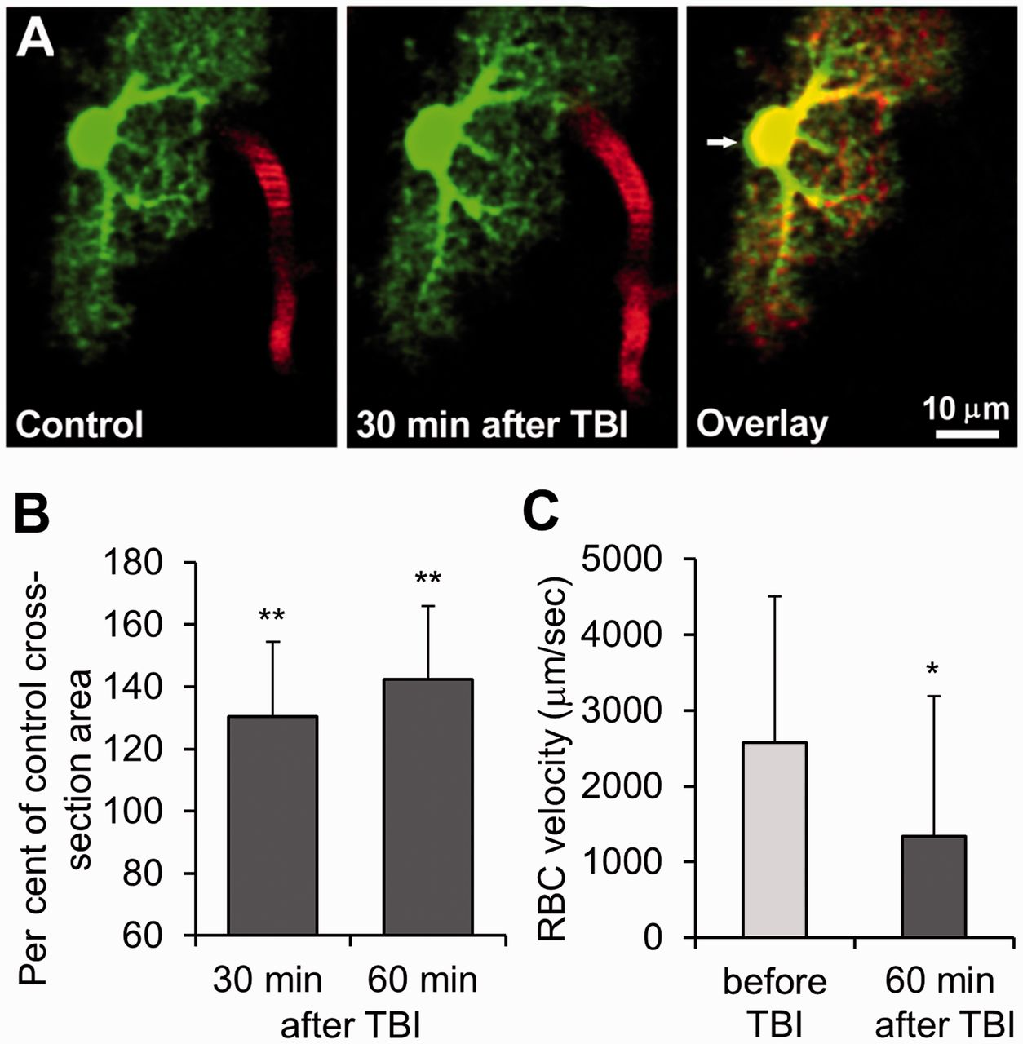
Figure 7 TBI causes astroglial swelling in the peri-contusional cortex reflecting oedema. (A) Paired single section ...
Notes:
Figure 7 TBI causes astroglial swelling in the peri-contusional cortex reflecting oedema. (A) Paired single section 2PLSM images showing an astrocyte (green) along with nearby blood vessel (red) in layer I of the peri-contusional cortex before (control) and 30 min after TBI. Streaking within blood vessel is a sign of blood flow. Blood flows but astroglial soma and processes swell at 30 min after TBI. Control and 30 min after TBI images are overlaid (right) with arrow pointing to green area illustrating swelling beyond control morphology. (B) Summary from seven astrocytes in five animals showing the increase in astroglial soma size at 30 and 60 min after TBI. **P < 0.01, relative to control, one-way repeated measures ANOVA. (C) Red blood cell velocity calculated from line scans along seven blood vessels demonstrating ∼50% loss of blood flow nearby seven imaged astrocytes measured in B at 60 min after TBI. *P < 0.05, paired t-test.
Unless provided in the caption above, the following copyright applies to the content of this slide: © The Author (2013). Published by Oxford University Press on behalf of the Guarantors of Brain. All rights reserved. For Permissions, please email: journals.permissions@oup.com

Slide 8
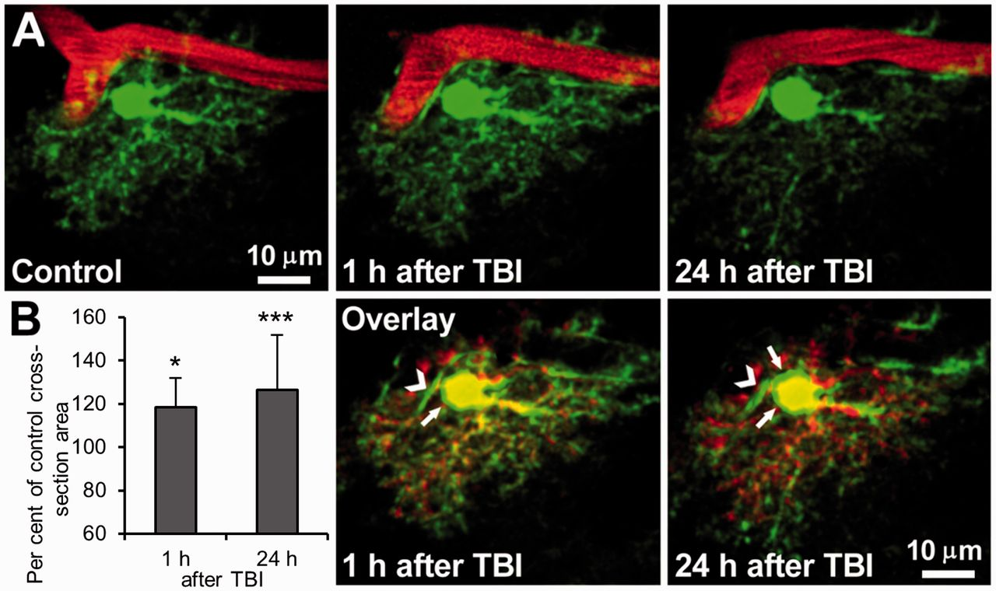
Figure 8 Persistent astroglial swelling at 24 h after TBI. (A) Maximum intensity projection image sequence showing ...
Notes:
Figure 8 Persistent astroglial swelling at 24 h after TBI. (A) Maximum intensity projection image sequence showing astrocyte and nearby blood vessel in control, 1 h and 24 h after TBI. Astrocyte was swollen at 1 h after TBI and remained swollen at 24 h as blood continued to flow, as indicated by striped image of the vessel. Bottom, middle and left: Overlays showing merged control and 1 h and 24 h after TBI images of astrocytes, respectively. Green areas (arrows) represent swelling beyond the control size. Chevron points to a swollen astroglial endfoot. (B) Summary from 10 astrocytes in three animals showing significant increase in astroglial cross-section soma area at 1 h after TBI that lasts for 24 h. *P < 0.02,***P < 0.002, relative to control, one-way repeated measures ANOVA.
Unless provided in the caption above, the following copyright applies to the content of this slide: © The Author (2013). Published by Oxford University Press on behalf of the Guarantors of Brain. All rights reserved. For Permissions, please email: journals.permissions@oup.com

