Slide 1
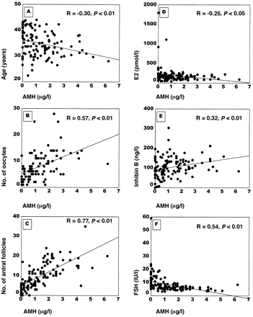
Figure 1. Correlation of age (A), number of oocytes after ovum retrieval (B), cycle day 3 number of antral follicles ...
Notes:
Figure 1. Correlation of age (A), number of oocytes after ovum retrieval (B), cycle day 3 number of antral follicles (C), cycle day 3 E2 (D), cycle day 3 inhibin B (E) and cycle day 3 FSH (F) with AMH in IVF patients. R is Spearman’s correlation coefficient followed by theP-value.
Unless provided in the caption above, the following copyright applies to the content of this slide: © European Society of Human Reproduction and Embryology

