Slide 1
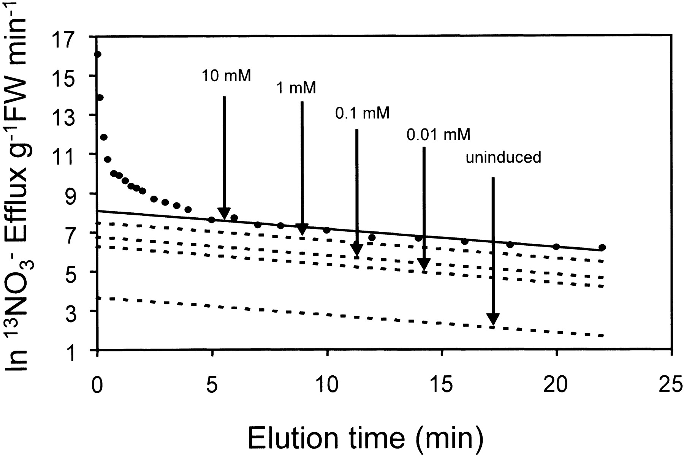
Fig. 1. ¹³\batchmode \documentclass[fleqn,10pt,legalpaper]{article} \usepackage{amssymb} ...
Notes:
Fig. 1. 13\batchmode \documentclass[fleqn,10pt,legalpaper]{article} \usepackage{amssymb} \usepackage{amsfonts} \usepackage{amsmath} \pagestyle{empty} \begin{document} \({\mathrm{NO}_{3}^{{-}}}\) \end{document} efflux from roots of barley plants grown with different concentrations of \batchmode \documentclass[fleqn,10pt,legalpaper]{article} \usepackage{amssymb} \usepackage{amsfonts} \usepackage{amsmath} \pagestyle{empty} \begin{document} \({\mathrm{NO}_{3}^{{-}}}.\) \end{document} Plants were grown for 7 d under steady-state conditions with respect to nitrate provision. Roots were then loaded with 13\batchmode \documentclass[fleqn,10pt,legalpaper]{article} \usepackage{amssymb} \usepackage{amsfonts} \usepackage{amsmath} \pagestyle{empty} \begin{document} \({\mathrm{NO}_{3}^{{-}}}\) \end{document} for >5 cytoplasmic half-lives, and subsequently transferred to the same concentration of 14\batchmode \documentclass[fleqn,10pt,legalpaper]{article} \usepackage{amssymb} \usepackage{amsfonts} \usepackage{amsmath} \pagestyle{empty} \begin{document} \({\mathrm{NO}_{3}^{{-}}}\) \end{document} for measurement of 13\batchmode \documentclass[fleqn,10pt,legalpaper]{article} \usepackage{amssymb} \usepackage{amsfonts} \usepackage{amsmath} \pagestyle{empty} \begin{document} \({\mathrm{NO}_{3}^{{-}}}\) \end{document} efflux. Rate constants for the lines were 0.041 min−1 (10 mM), 0.040 min−1 (1 mM), 0.042 min−1 (0.1 mM), 0.042 min−1 (0.01 mM), and 0.039 min−1 (uninduced plants), respectively (from Britto and Kronzucker, 2001).
Unless provided in the caption above, the following copyright applies to the content of this slide: © Society for Experimental Biology

Slide 2
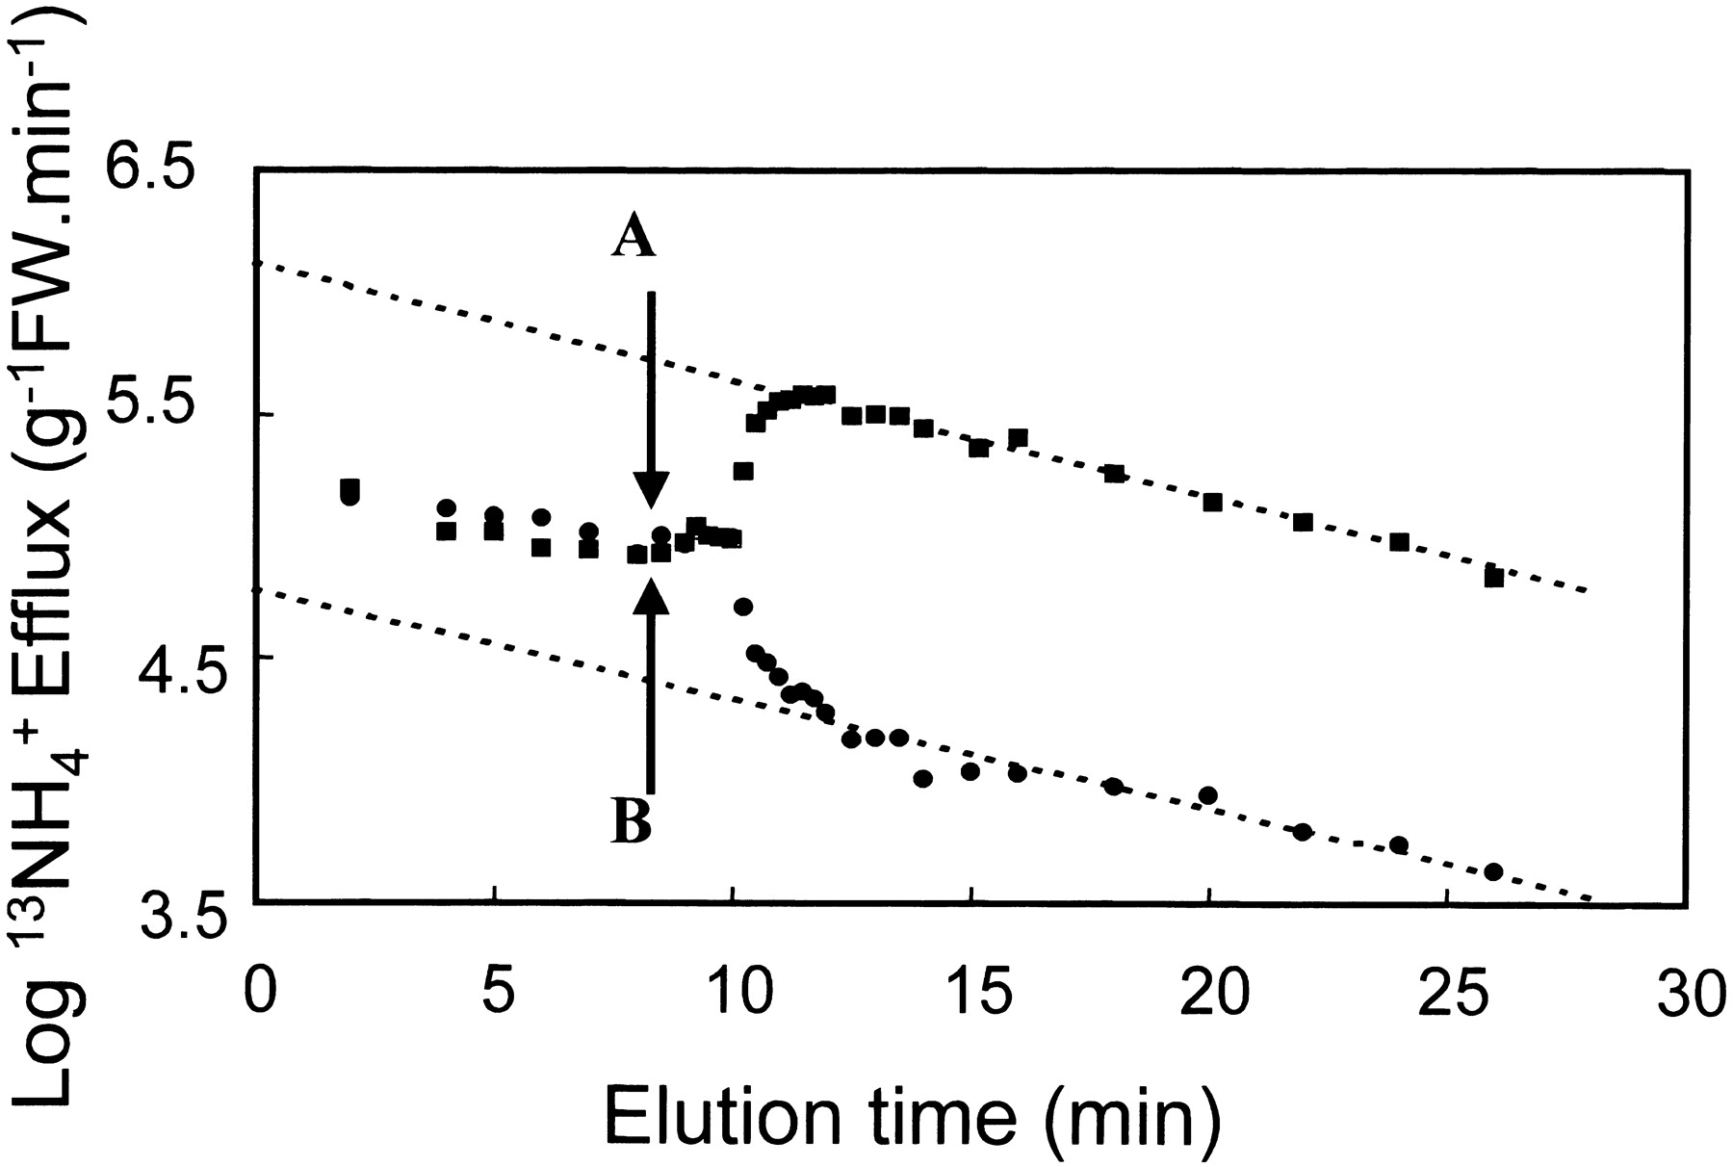
Fig. 2. Efflux of ¹³\batchmode \documentclass[fleqn,10pt,legalpaper]{article} \usepackage{amssymb} ...
Notes:
Fig. 2. Efflux of 13\batchmode \documentclass[fleqn,10pt,legalpaper]{article} \usepackage{amssymb} \usepackage{amsfonts} \usepackage{amsmath} \pagestyle{empty} \begin{document} \({\mathrm{NH}_{4}^{{+}}}\) \end{document} efflux from roots of barley plants previously grown on 0.1 mM \batchmode \documentclass[fleqn,10pt,legalpaper]{article} \usepackage{amssymb} \usepackage{amsfonts} \usepackage{amsmath} \pagestyle{empty} \begin{document} \({\mathrm{NH}_{4}^{{+}}}\) \end{document} and loaded with 13\batchmode \documentclass[fleqn,10pt,legalpaper]{article} \usepackage{amssymb} \usepackage{amsfonts} \usepackage{amsmath} \pagestyle{empty} \begin{document} \({\mathrm{NH}_{4}^{{+}}}\) \end{document} for 1 h, prior to eluting roots with 0.1 mM 14\batchmode \documentclass[fleqn,10pt,legalpaper]{article} \usepackage{amssymb} \usepackage{amsfonts} \usepackage{amsmath} \pagestyle{empty} \begin{document} \({\mathrm{NH}_{4}^{{+}}}\) \end{document}for the first 10 min shown. At this time plant roots were subjected to concentration shifts: (A) from 0.1 to 10 mM \batchmode \documentclass[fleqn,10pt,legalpaper]{article} \usepackage{amssymb} \usepackage{amsfonts} \usepackage{amsmath} \pagestyle{empty} \begin{document} \({\mathrm{NH}_{4}^{{+}}}\) \end{document} and (B) from 0.1 to 0.01 mM \batchmode \documentclass[fleqn,10pt,legalpaper]{article} \usepackage{amssymb} \usepackage{amsfonts} \usepackage{amsmath} \pagestyle{empty} \begin{document} \({\mathrm{NH}_{4}^{{+}}},\) \end{document} during elution (from Britto and Kronzucker, 2001).
Unless provided in the caption above, the following copyright applies to the content of this slide: © Society for Experimental Biology

Slide 3
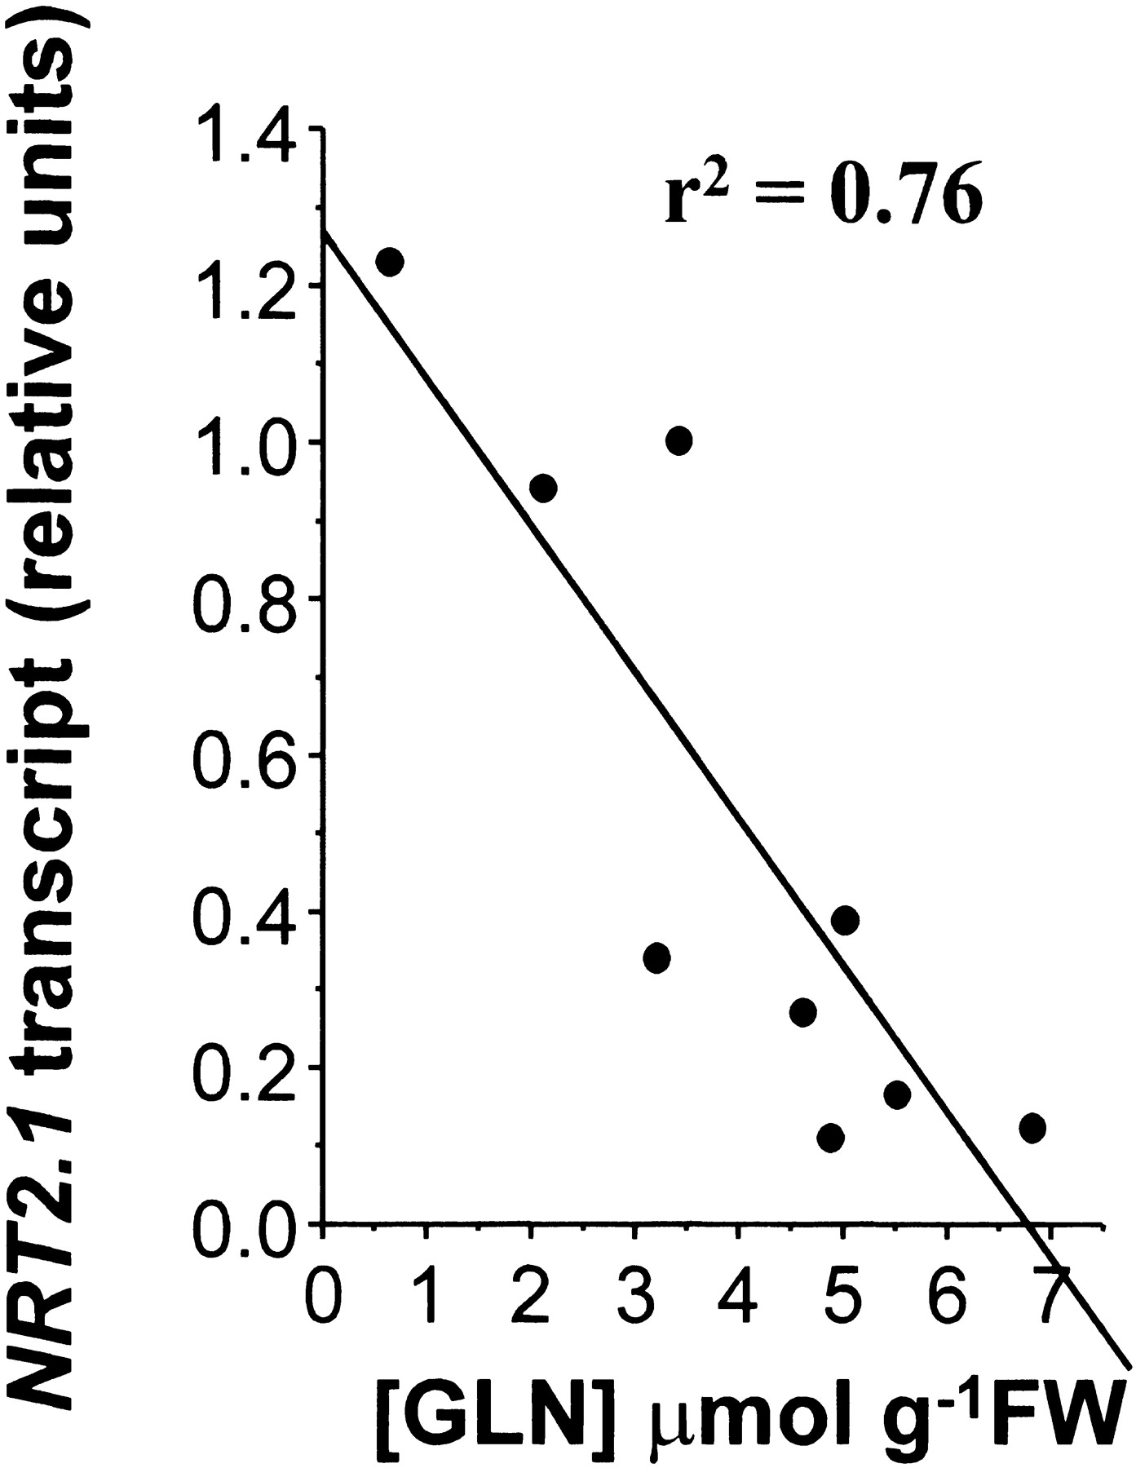
Fig. 3. Correlation between transcript abundance of the barley HvNrt2 gene and root glutamine concentrations after ...
Notes:
Fig. 3. Correlation between transcript abundance of the barley HvNrt2 gene and root glutamine concentrations after exogenous application of different amino acids and various inhibitors of nitrate assimilation (from Vidmar et al., 2000)
Unless provided in the caption above, the following copyright applies to the content of this slide: © Society for Experimental Biology

Slide 4
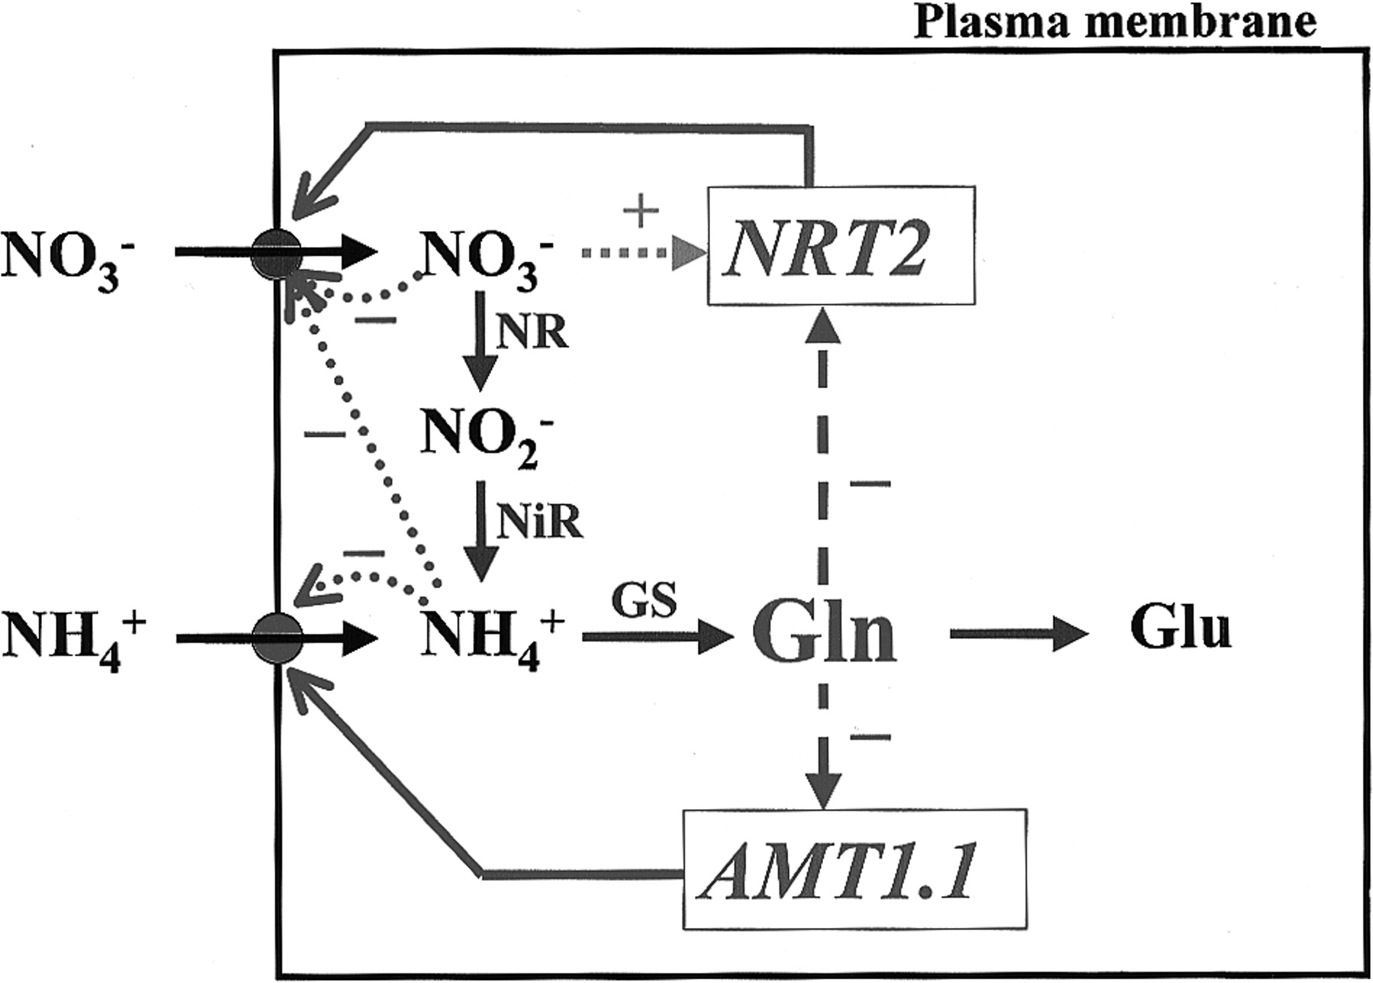
Fig. 4. A model representing proposed feedback processes involved in regulating the abundances of root Nrt2 and Amt1 ...
Notes:
Fig. 4. A model representing proposed feedback processes involved in regulating the abundances of root Nrt2 and Amt1 transcripts by root glutamine (- - -), and in direct effects upon the transporters by root cytosolic \batchmode \documentclass[fleqn,10pt,legalpaper]{article} \usepackage{amssymb} \usepackage{amsfonts} \usepackage{amsmath} \pagestyle{empty} \begin{document} \({\mathrm{NO}_{3}^{{-}}}\) \end{document} and \batchmode \documentclass[fleqn,10pt,legalpaper]{article} \usepackage{amssymb} \usepackage{amsfonts} \usepackage{amsmath} \pagestyle{empty} \begin{document} \({\mathrm{NH}_{4}^{{+}}}\) \end{document} concentrations (……). Induction of NRT2 expression by \batchmode \documentclass[fleqn,10pt,legalpaper]{article} \usepackage{amssymb} \usepackage{amsfonts} \usepackage{amsmath} \pagestyle{empty} \begin{document} \({\mathrm{NO}_{3}^{{-}}}\) \end{document} is also indicated. Solid lines from NRT2 and Amt1.1 indicate the pathways of transcription and translation leading to high-affinity nitrate and ammonium transporters (circles) in the plasma membrane (outer rectangle). For purposes of simplicity, the diagram makes no attempt to distinguish between plastidic and cytosolic nitrogen pools (from Glass et al., 2001).
Unless provided in the caption above, the following copyright applies to the content of this slide: © Society for Experimental Biology

