Slide 1
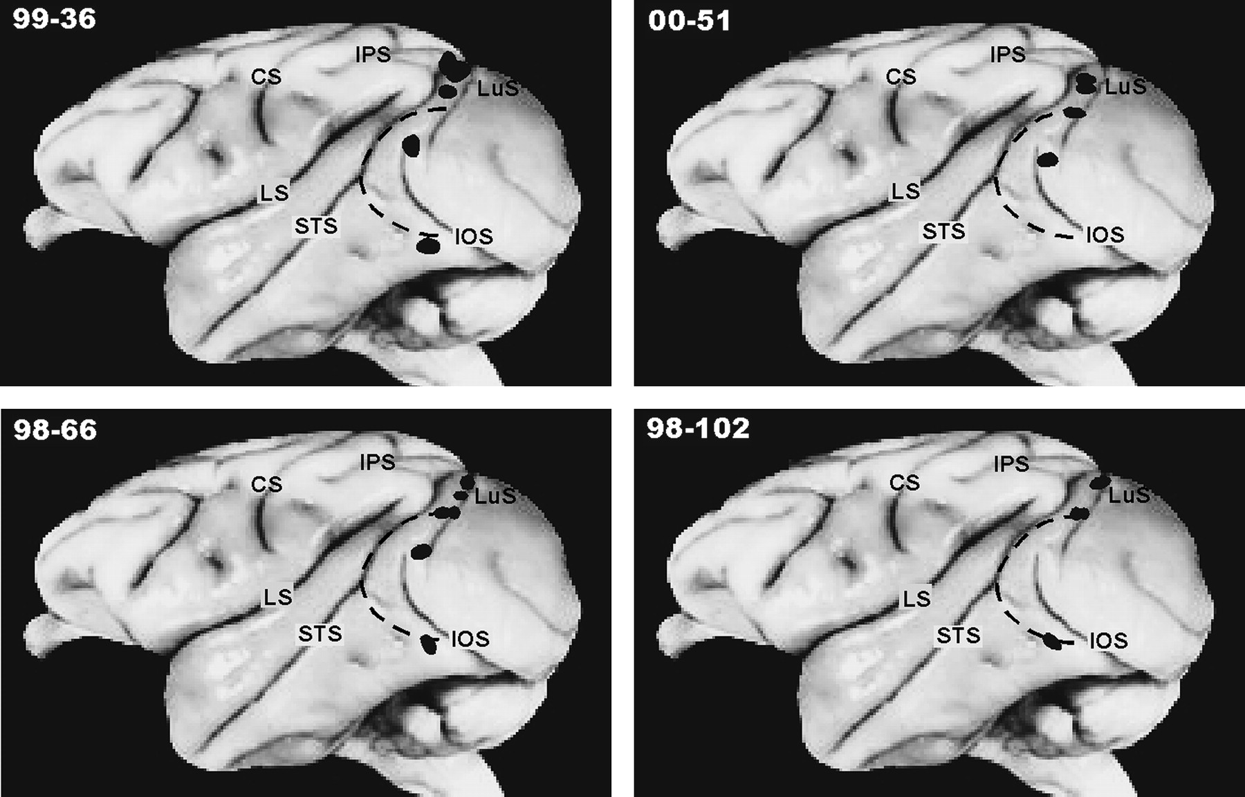
Figure 1. The locations of injection sites on lateral views of the left hemishere of a macaque brain for four studied ...
Notes:
Figure 1. The locations of injection sites on lateral views of the left hemishere of a macaque brain for four studied cases. Injections were placed in central DL in cases 99-36, 98-66 and 00-51, dorsally in the VPP or DP areas in all cases and ventrally in the inferotemporal cortex in cases 99-36, 98-66 and 98-102. Other injections were made at the PP–DL border region in cases 98-66, 00-51 and 98-102. Dashed line marks approximate border of area DL. CS, central sulcus; IPS, intraparietal sulcus; IOS, inferior occipital sulcus; LS, lateral sulcus; LuS, lunate sulcus; STS, superior temporal sulcus.
Unless provided in the caption above, the following copyright applies to the content of this slide: Cerebral Cortex V 15 N 6 © Oxford University Press 2004; all rights reserved

Slide 2
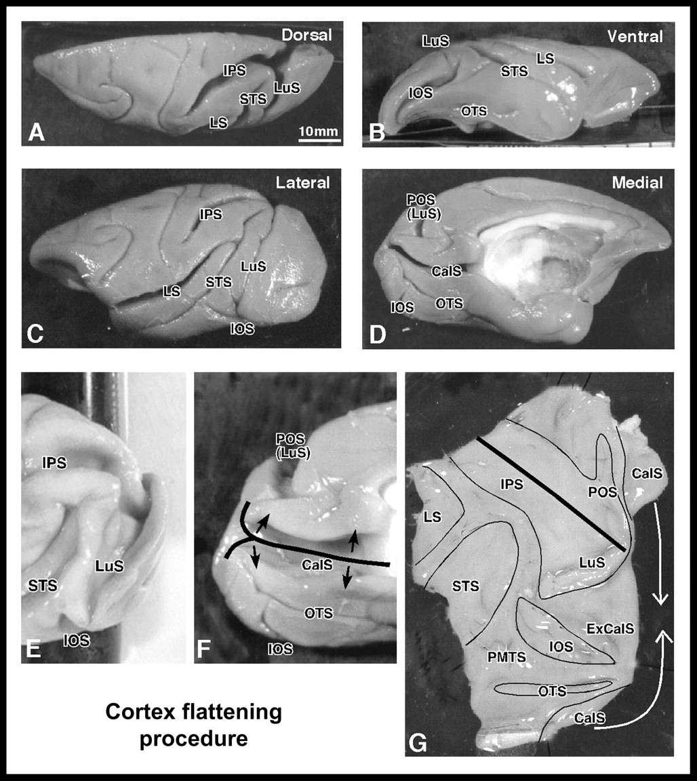
Figure 2. Cortex flattening procedure. (A–D) Dorsal, ventral, lateral and medial views of the left hemisphere with ...
Notes:
Figure 2. Cortex flattening procedure. (A–D) Dorsal, ventral, lateral and medial views of the left hemisphere with marked sulci. (E–G) The procedure used to flatten the visual cortex of the caudal part of the hemisphere. In (F) and (G), thick black lines mark cuts made along the calcarine sulcus on the medial wall and the intraparietal sulcus on the dorsal aspect of the hemisphere. In (G), thin black lines mark contours of opened sulci. CalS, calcarine sulcus; OTS, occipitotemporal sulcus; POS, parietooccipital sulcus; ExCalS, external calcarine sulcus; PMTS, posteromedial temporal sulcus. Other abbreviations are as in Figure 1.
Unless provided in the caption above, the following copyright applies to the content of this slide: Cerebral Cortex V 15 N 6 © Oxford University Press 2004; all rights reserved

Slide 3
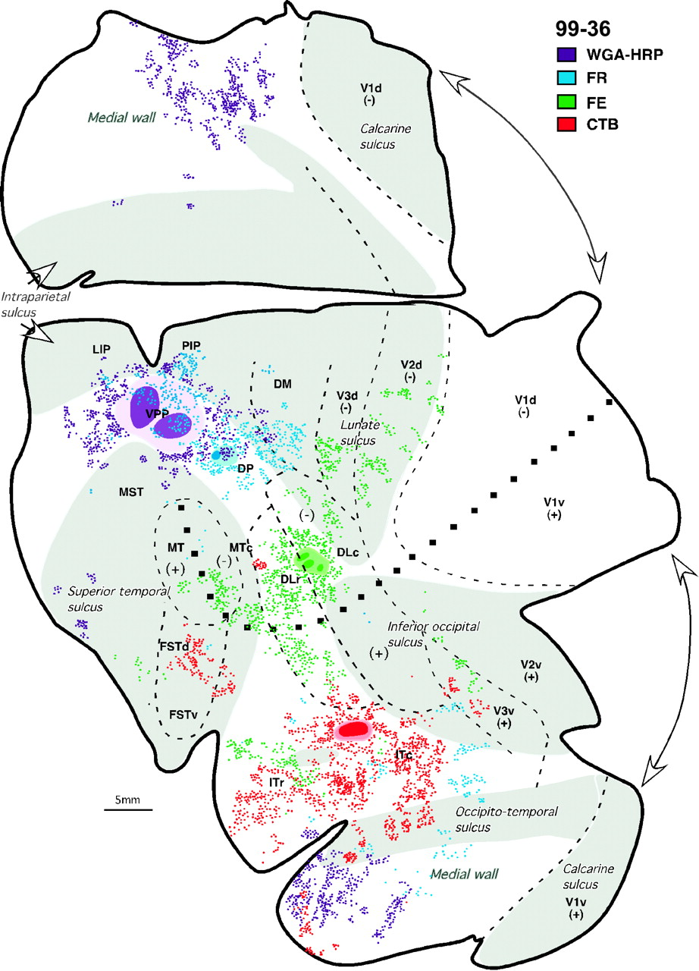
Figure 3. Distribution of labeled neurons after injections of different tracers in area DL and outside area DL (VPP, DP ...
Notes:
Figure 3. Distribution of labeled neurons after injections of different tracers in area DL and outside area DL (VPP, DP and ITc) in case 99-36. For each injection site the core is in a dark color and the diffusion zone is in a lighter shade of the same color. Correlated with injection sites colored dots demarcate the location of labeled cells, and their proportional number (one dot represents ∼5 cells). Opened sulci are shaded. Dashed lines mark the boundaries of proposed visual areas determined architectonically (see text) or estimated by reference to known areas. The small black squares mark approximate horizontal meridian. Thick lines outline the section or indicate brakes in the section due to the sulci. DLc and DLr, dorsolateral visual area, caudal and rostral; DM, dorsomedial visual area; DP, dorsal prelunate area; FSTd and FSTv, fundal superior temporal area, dorsal and ventral; ITc and ITr, inferotemporal cortex, caudal and rostral; LIP, lateral intraparietal area; MST, medial superior temporal area; MT, middle temporal area; MTc, middle temporal area crescent; PIP, posterior intraparietal area; VPP, ventral posterior parietal area; V1, primary visual area; V2, second visual area; V3, third visual area.
Unless provided in the caption above, the following copyright applies to the content of this slide: Cerebral Cortex V 15 N 6 © Oxford University Press 2004; all rights reserved

Slide 4
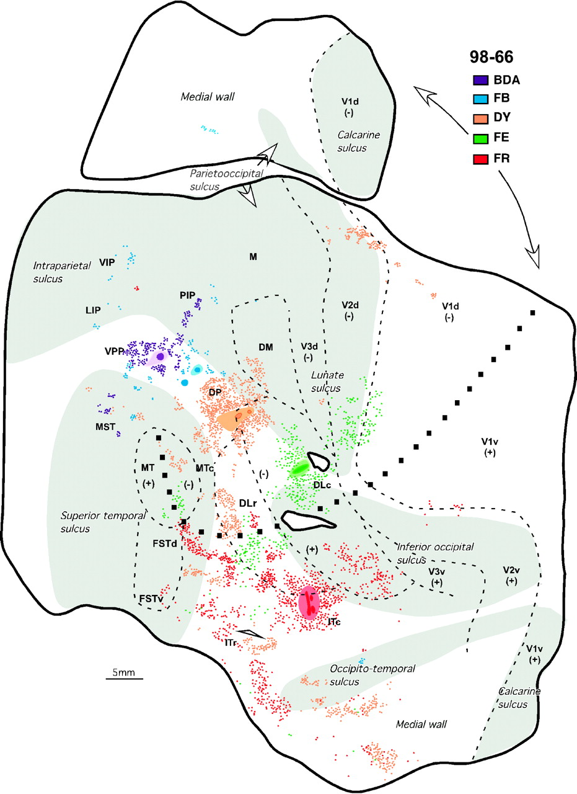
Figure 4. Distribution of labeled neurons after injections of five different tracers in DL and regions dorsal (VPP, DP, ...
Notes:
Figure 4. Distribution of labeled neurons after injections of five different tracers in DL and regions dorsal (VPP, DP, DP/DL) and ventral (ITc) to DL shown in flattened cortex in case 98-66. M, medial visual area; VIP; ventral intraparietal area. Other conventions are as in Figure 3.
Unless provided in the caption above, the following copyright applies to the content of this slide: Cerebral Cortex V 15 N 6 © Oxford University Press 2004; all rights reserved

Slide 5
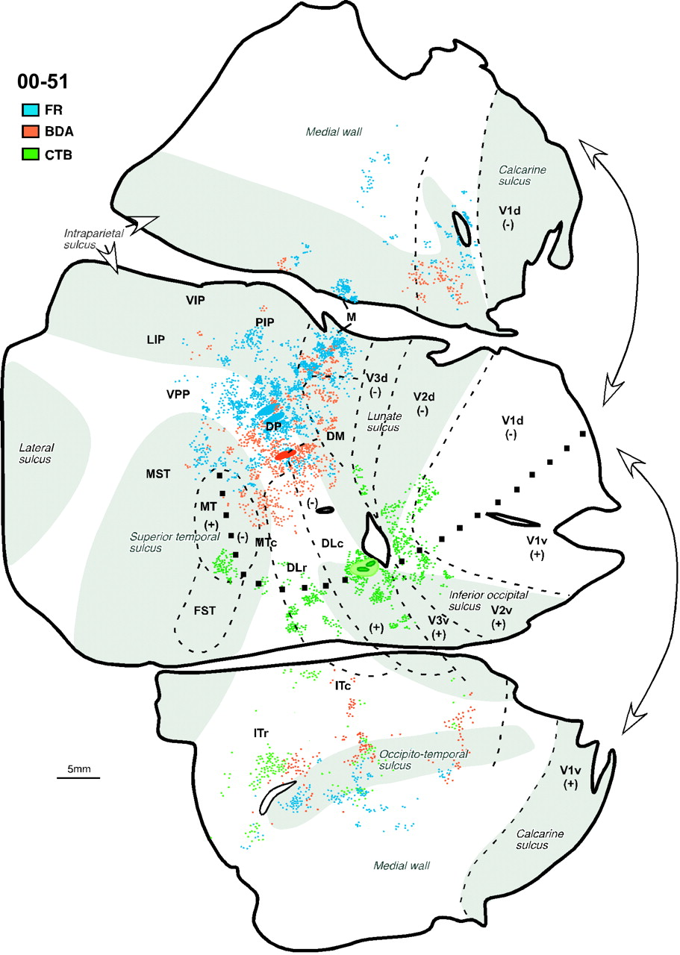
Figure 5. Distribution of labeled neurons after injections of three different tracers in DL, and dorsal to DL (DP and ...
Notes:
Figure 5. Distribution of labeled neurons after injections of three different tracers in DL, and dorsal to DL (DP and DP/DL) regions in case 00-51. Other conventions are as in Figure 4.
Unless provided in the caption above, the following copyright applies to the content of this slide: Cerebral Cortex V 15 N 6 © Oxford University Press 2004; all rights reserved

Slide 6
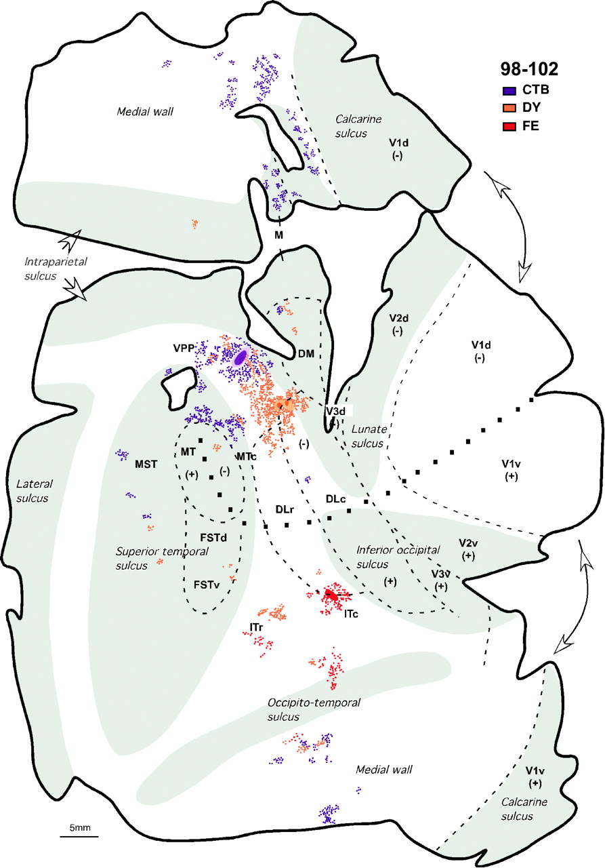
Figure 6. Distribution of labeled neurons after three different tracer injections made dorsal (VPP and DP) and ventral ...
Notes:
Figure 6. Distribution of labeled neurons after three different tracer injections made dorsal (VPP and DP) and ventral (ITc) to area DL in case 98-102. Other conventions are as in Figure 4.
Unless provided in the caption above, the following copyright applies to the content of this slide: Cerebral Cortex V 15 N 6 © Oxford University Press 2004; all rights reserved

Slide 7
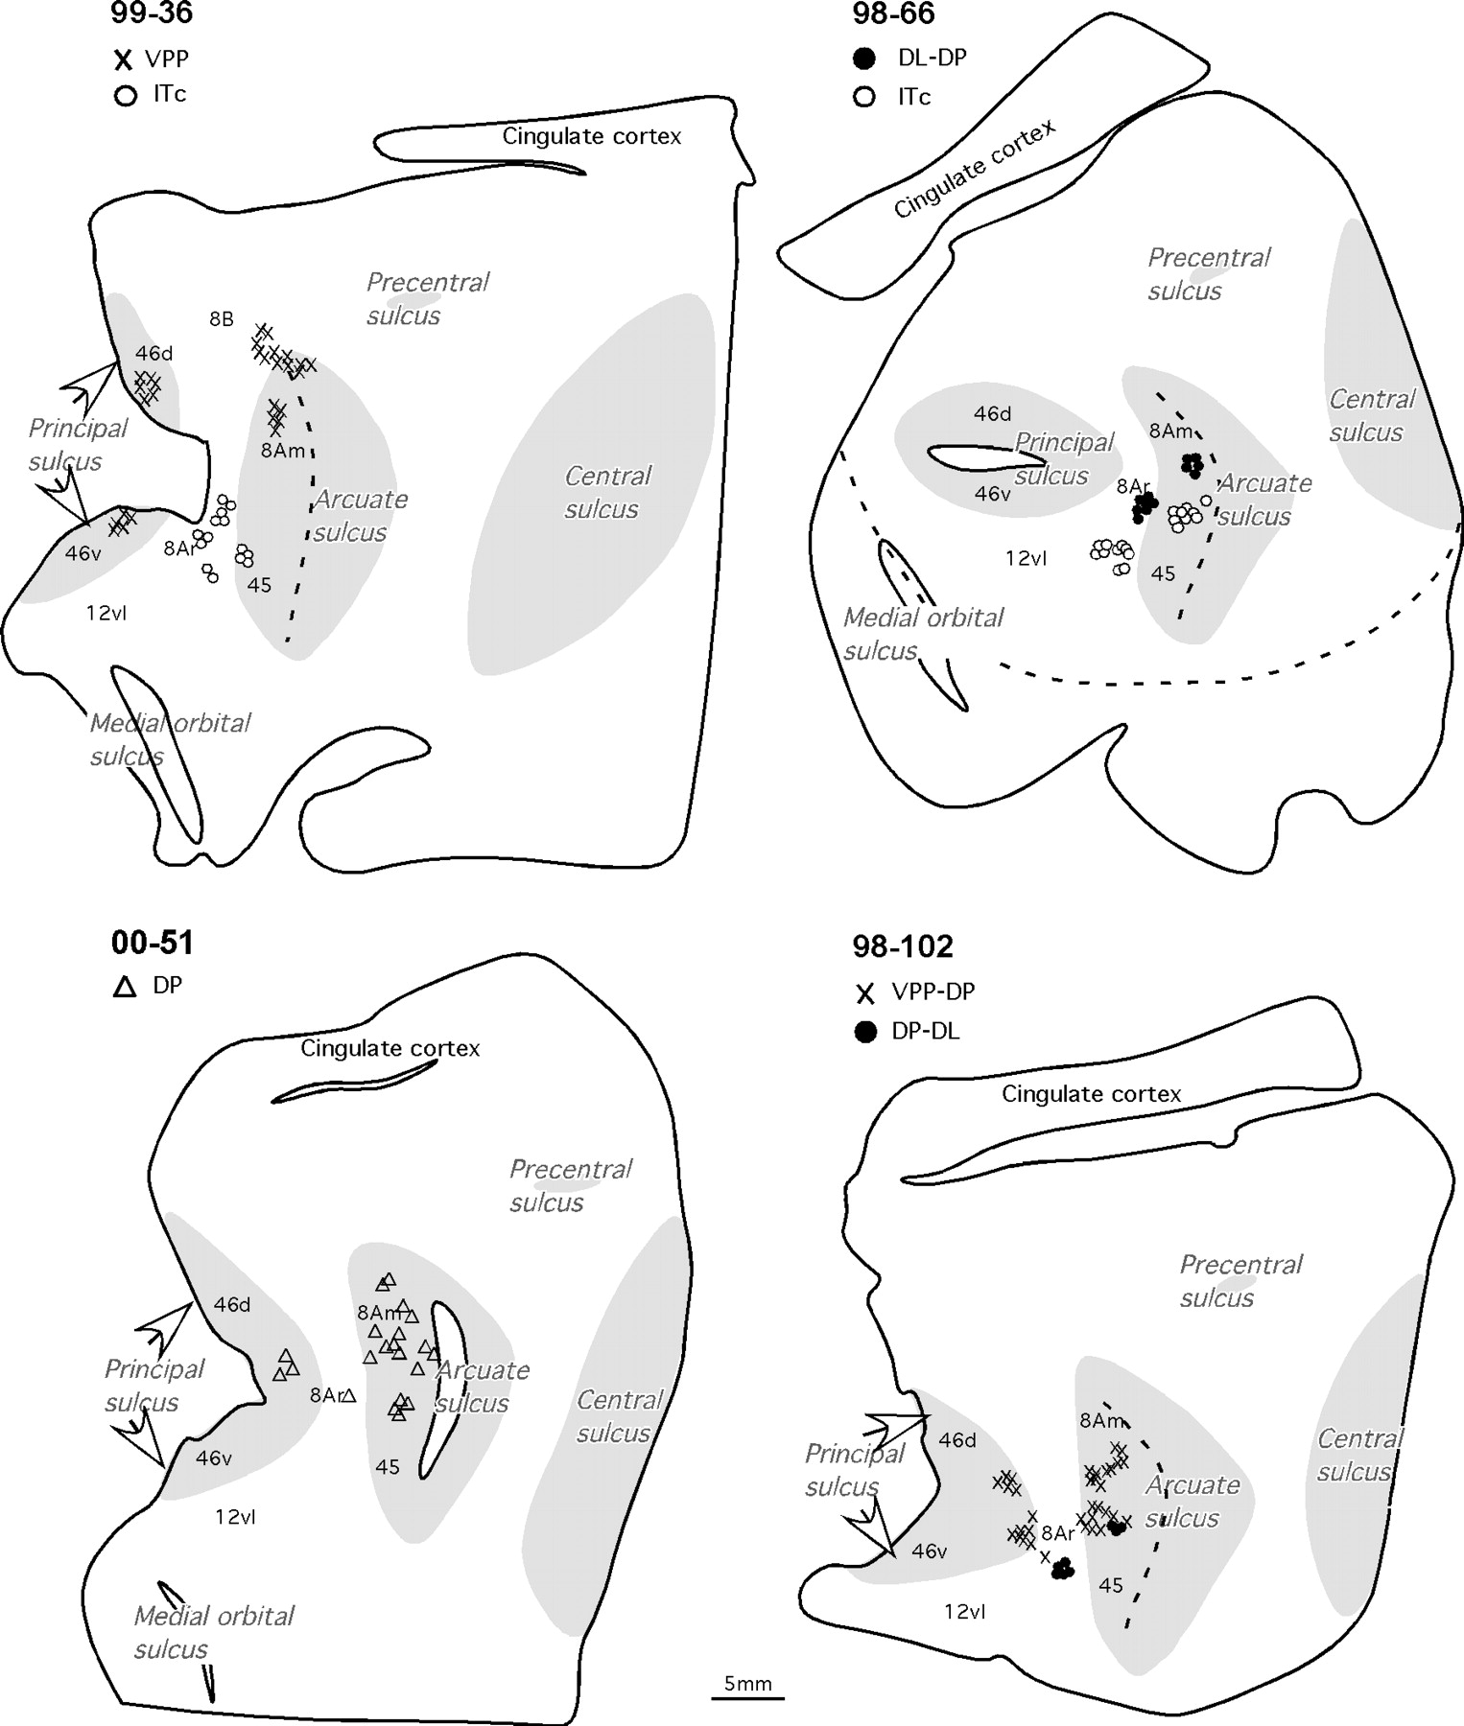
Figure 7. Reconstruction of flattened cortical section of the left frontal cortex showing the location of labeled ...
Notes:
Figure 7. Reconstruction of flattened cortical section of the left frontal cortex showing the location of labeled neurons after multiple tracer injections within and outside area DL in four cases. Symbols mark the locations where retrogradely labeled cells were found. Opened sulci are shaded.
Unless provided in the caption above, the following copyright applies to the content of this slide: Cerebral Cortex V 15 N 6 © Oxford University Press 2004; all rights reserved

Slide 8
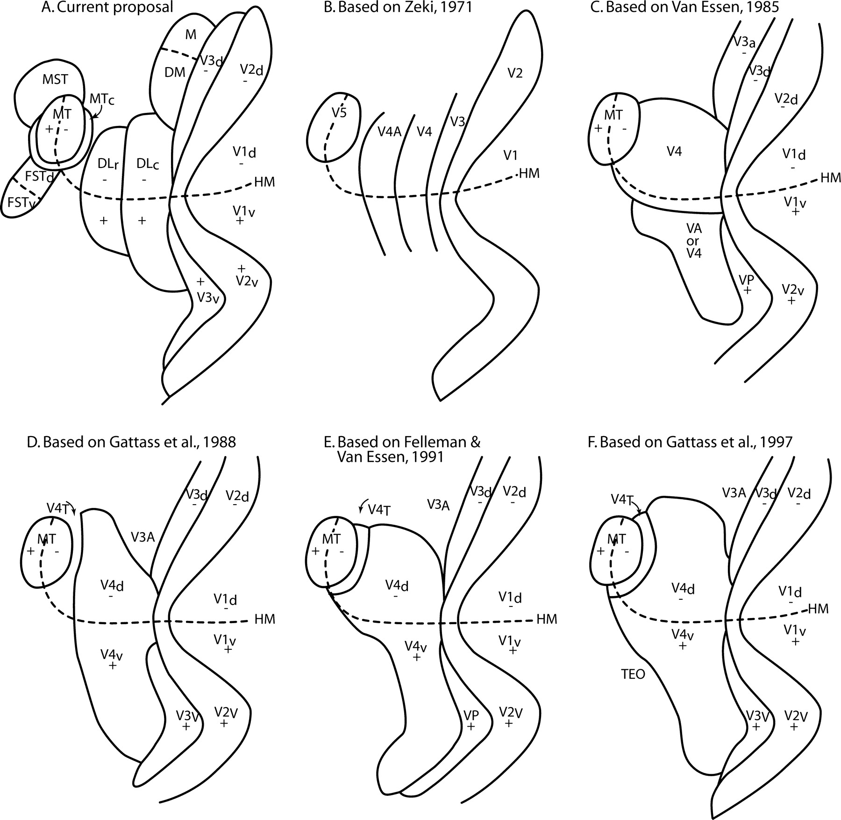
Figure 8. Different proposals of the organization of extrastriate visual cortex in the macaque monkey. Each diagram is ...
Notes:
Figure 8. Different proposals of the organization of extrastriate visual cortex in the macaque monkey. Each diagram is drawn as a flat reconstruction of the left hemisphere. The summary diagrams of other reports have been redrawn to conform to the prototype in (A) for ease of comparison, but the original diagrams in different formats may more accurately reflect the intentions of the authors. HM, horizontal meridian. Other conventions are as in Figure 4.
Unless provided in the caption above, the following copyright applies to the content of this slide: Cerebral Cortex V 15 N 6 © Oxford University Press 2004; all rights reserved

Slide 9
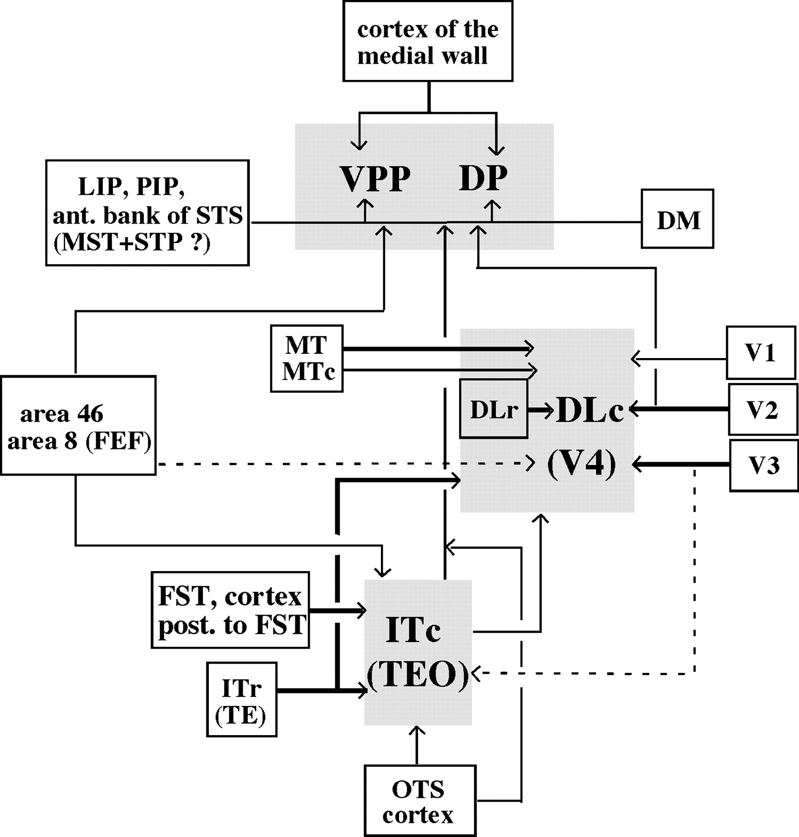
Figure 9. Summary of areas projecting to DL/V4, VPP, DP and ITc (TEO). The thickness of the arrows approximates the ...
Notes:
Figure 9. Summary of areas projecting to DL/V4, VPP, DP and ITc (TEO). The thickness of the arrows approximates the density of the connections. Dashed lines mark the possible connections. DL/V4 receives the strongest connections from V2, V3, MT and IT cortex. VPP and DP share most connections from the cortex of the medial wall as well as the areas in the intraparietal (LIP, PIP) and lunate (DM) sulci, although some of the areas project stronger to VPP (e.g. areas of the medial wall) and some to DP (e.g. DM, areas in OTS). ITc (TEO) is strongly connected to ITr (TE), areas in the OTS and in the posterior bank of STS (FST). VPP, DP and ITc (TEO), but not DL/V4, are also connected to FEF.
Unless provided in the caption above, the following copyright applies to the content of this slide: Cerebral Cortex V 15 N 6 © Oxford University Press 2004; all rights reserved

