Slide 1
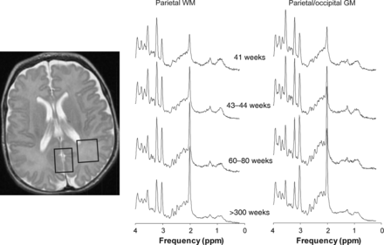
Figure 1. (Left) T₂-weighted MRI indicating the parietal WM and parietal/occipital GM ROI. (Right) ...
Notes:
Figure 1. (Left) T2-weighted MRI indicating the parietal WM and parietal/occipital GM ROI. (Right) Representative spectra of parietal WM and parietal/occipital GM in subjects with normal MRI at different stages of brain development.
Unless provided in the caption above, the following copyright applies to the content of this slide: © The Author 2012. Published by Oxford University Press. All rights reserved. For Permissions, please e-mail: journals.permissions@oup.com

Slide 2
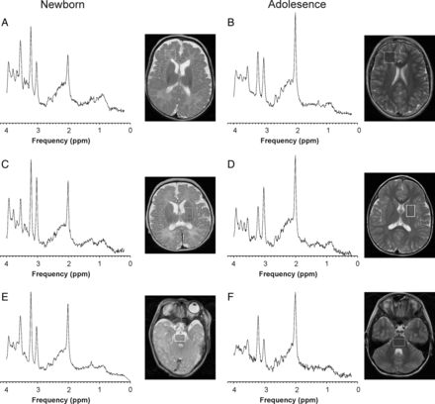
Figure 2. Representative spectra of fWM, DGN, and brain stem of the newborn brain and at early adolescence.
Notes:
Figure 2. Representative spectra of fWM, DGN, and brain stem of the newborn brain and at early adolescence.
Unless provided in the caption above, the following copyright applies to the content of this slide: © The Author 2012. Published by Oxford University Press. All rights reserved. For Permissions, please e-mail: journals.permissions@oup.com

Slide 3
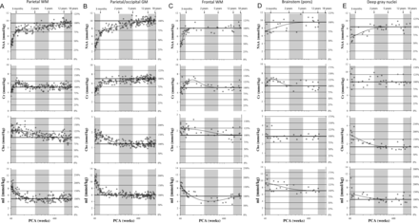
Figure 3. Measured concentrations and fitted curves for NAA, creatine (Cr), total choline (Cho), and mI for the various ...
Notes:
Figure 3. Measured concentrations and fitted curves for NAA, creatine (Cr), total choline (Cho), and mI for the various brain regions studied versus age. A logarithmic scale was used for the time-axis (x-axis) to allow a more detailed inspection of age-dependent changes immediately after birth. PCA = postconceptional age.
Unless provided in the caption above, the following copyright applies to the content of this slide: © The Author 2012. Published by Oxford University Press. All rights reserved. For Permissions, please e-mail: journals.permissions@oup.com

Slide 4
Figure 4. Measured concentrations and time courses for glutamate (Glu) and taurine (Tau) for the various brain regions ...
Notes:
Figure 4. Measured concentrations and time courses for glutamate (Glu) and taurine (Tau) for the various brain regions studied versus age. PCA = postconceptional age.
Unless provided in the caption above, the following copyright applies to the content of this slide: © The Author 2012. Published by Oxford University Press. All rights reserved. For Permissions, please e-mail: journals.permissions@oup.com

