Slide 1
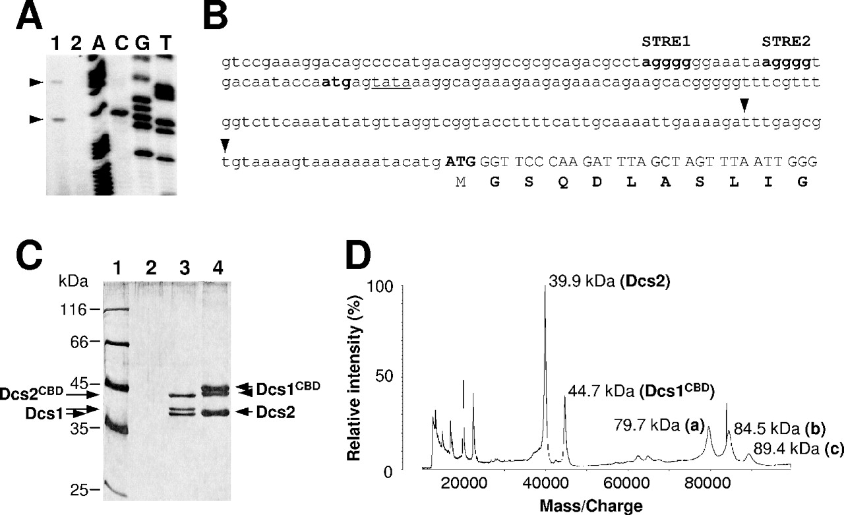
Figure 1. Characterization of DCS2 mRNA 5′ ends and Dcs1/Dcs2 dimeric complexes. ( A ) Primer extension analysis was ...
Notes:
Figure 1. Characterization of DCS2 mRNA 5′ ends and Dcs1/Dcs2 dimeric complexes. ( A ) Primer extension analysis was performed on DCS2 mRNA using total RNA isolated from S.cerevisiae BY4741 cells at mid-log phase (lane 1). In the control, total RNA was treated with RNase A before the primer extension reaction (lane 2). Each sequencing lane is labelled with the dideoxynucleotide used in the sequencing reaction. ( B ) Sequence of the upstream region of the DCS2 gene. The correct initiation codon leads off the N-terminal sequence confirmed by amino acid sequencing. The ATG upstream of this, which was originally thought to be the start codon of DCS2 , is also shown in bold type. Potential STRE elements are in bold, while a typical promoter TATA motif is underlined. Arrowheads indicate the 5′ ends detected by the primer extension analysis. ( C ) A silver-stained, 10% SDS–PAGE gel shows the proteins found in the complexes purified using Dcs1–TAP and Dcs2–TAP. Lane 1, molecular mass markers (kDa); lane 2, TAP purification from strain BY4741, as negative control; lane 3, TAP purification from strain PTC197 (Dcs2–TAP); lane 4, TAP purification from strain PTC196 (Dcs1–TAP). The identities (confirmed by MALDI) of the respective proteins running in lanes 3 and 4 are indicated by labelling on the sides of the gel. Two forms of both Dcs1 and Dcs1 CBD are evident (compare Figure 5A and B ). CBD (calmodulin binding domain) indicates proteins that still carry part of the TAP tag. ( D ) Positive ion MALDI mass spectrum of the sample that was analysed in lane 4 of ( C ) The spectrum reveals the presence of Dcs1 CBD and Dcs2 monomers, of homodimers of Dcs2 (a) and Dcs1 CBD (c), as well as of the Dcs2–Dcs1 CBD heterodimer (b). Mr values are indicated next to the corresponding peaks.
Unless provided in the caption above, the following copyright applies to the content of this slide: Nucleic Acids Research, Vol. 32 No. 12 © Oxford University Press 2004; all rights reserved

Slide 2
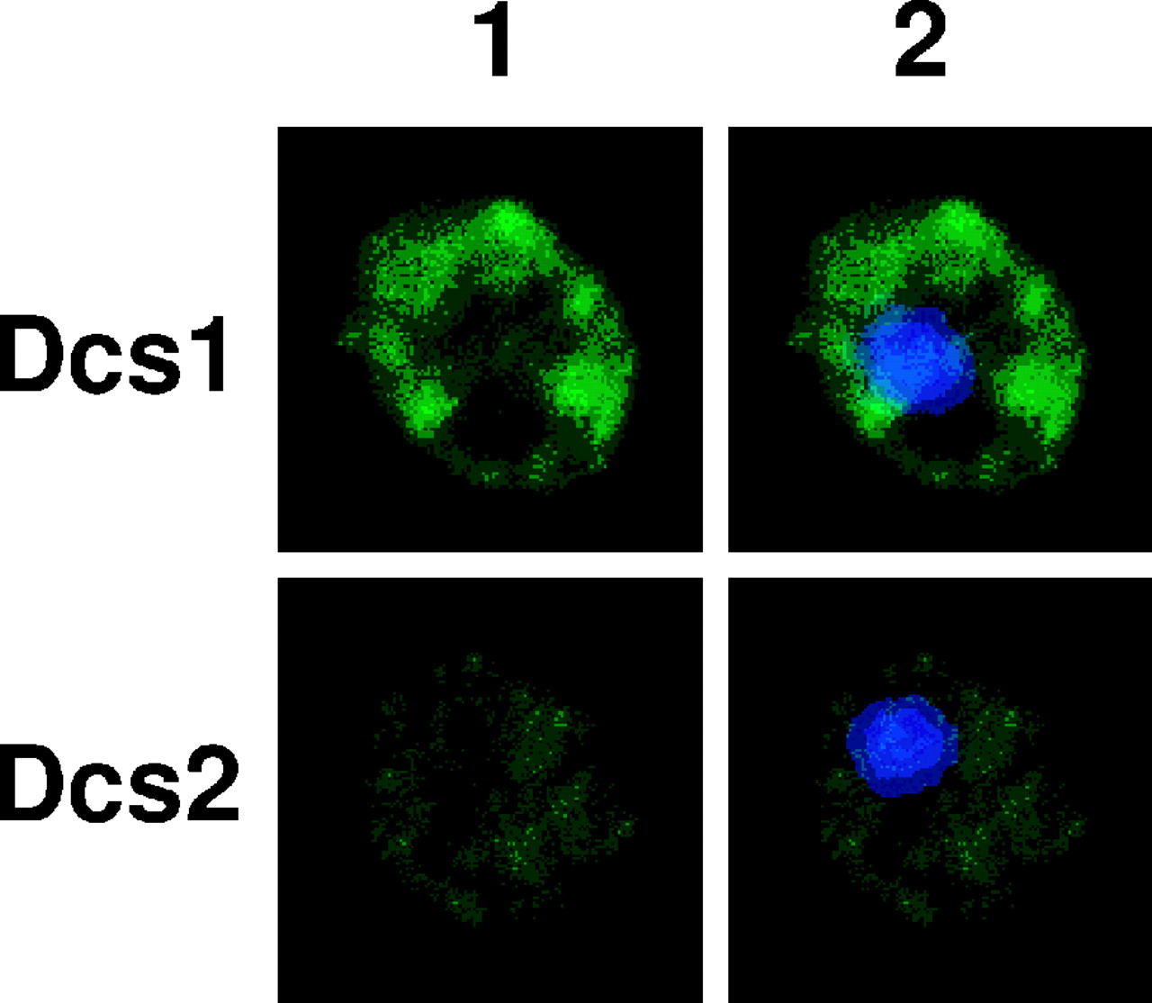
Figure 2. Subcellular localization of Dcs1 and Dcs2 proteins in S.cerevisiae cells. Strains expressing Dcs1–TAP and ...
Notes:
Figure 2. Subcellular localization of Dcs1 and Dcs2 proteins in S.cerevisiae cells. Strains expressing Dcs1–TAP and Dcs2–TAP were examined by indirect immunofluorescence microscopy using the antiserum directed against protein A and FITC-conjugated anti-rabbit secondary antibodies (column 1). Nuclear DNA was stained with DAPI in the overlay images (column 2).
Unless provided in the caption above, the following copyright applies to the content of this slide: Nucleic Acids Research, Vol. 32 No. 12 © Oxford University Press 2004; all rights reserved

Slide 3
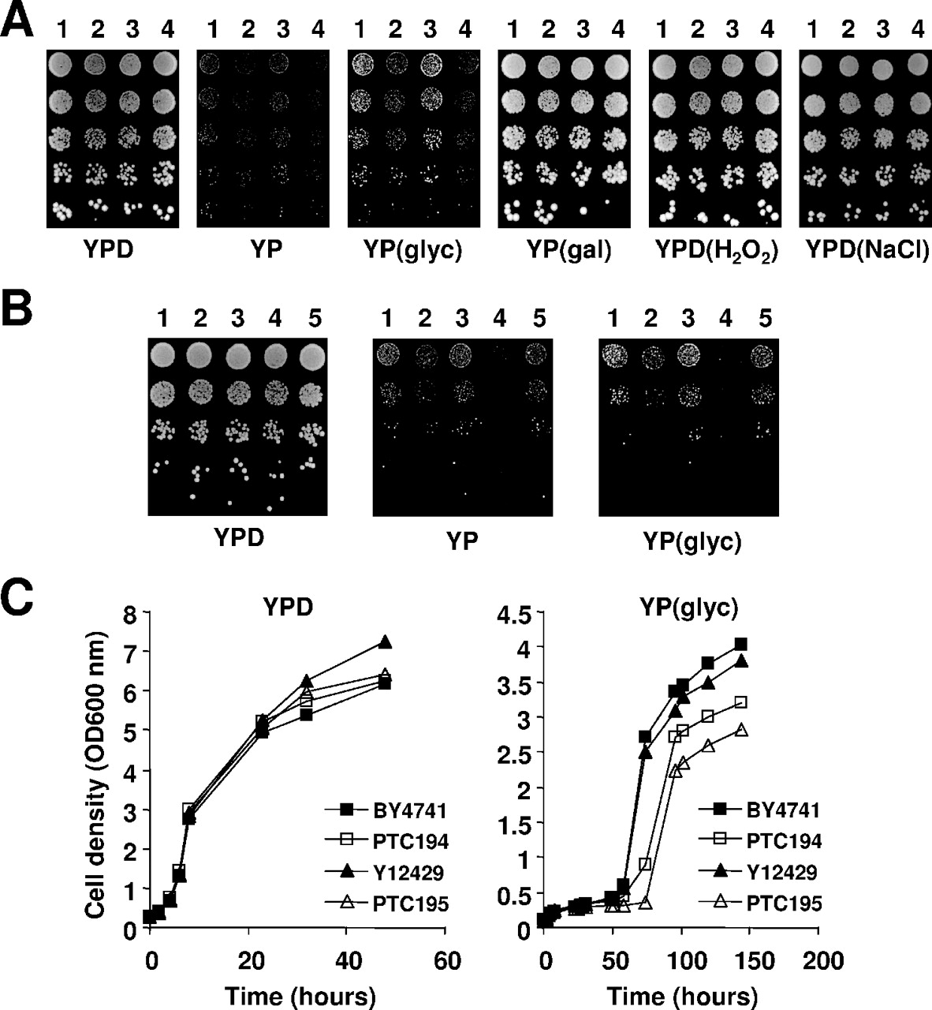
Figure 3. Growth phenotypes of the dcs deletion strains on different media. ( A ) The following strains were allowed ...
Notes:
Figure 3. Growth phenotypes of the dcs deletion strains on different media. ( A ) The following strains were allowed to reach exponential phase growth in liquid YPD medium, were serially diluted, and then spotted on YPD, YP(gal), YPD(H 2 O 2 ) and YPD(NaCl) agar plates (2 days incubation at 30°C), or YP and YP(glyc) agar plates (6 days incubation at 30°C): BY4741 (lane 1), PTC194 (lane 2), Y12429 (lane 3) and PTC195 (lane 4). ( B ) Cells were grown to mid log phase on minimal YNB medium, serially diluted, and spotted onto YPD agar plates (2 days incubation at 30°C), or onto YP and YP(glyc) agar plates (6 days incubation at 30°C): BY4741 (lane 1), PTC194 (lane 2), PTC194 transformed with pRS313- DCS1 (lane 3), PTC195 (lane 4), and PTC195 transformed with pRS313- DCS1 and pRS315- DCS2 (lane 5). ( C ) Cells of BY4741 (filled squares), PTC194 (open squares), Y12429 (filled triangles) and PTC195 (open triangles) growing exponentially in YPD were washed and transferred to YPD medium and YP(glyc) medium, respectively, and the OD was measured at the indicated time points.
Unless provided in the caption above, the following copyright applies to the content of this slide: Nucleic Acids Research, Vol. 32 No. 12 © Oxford University Press 2004; all rights reserved

Slide 4
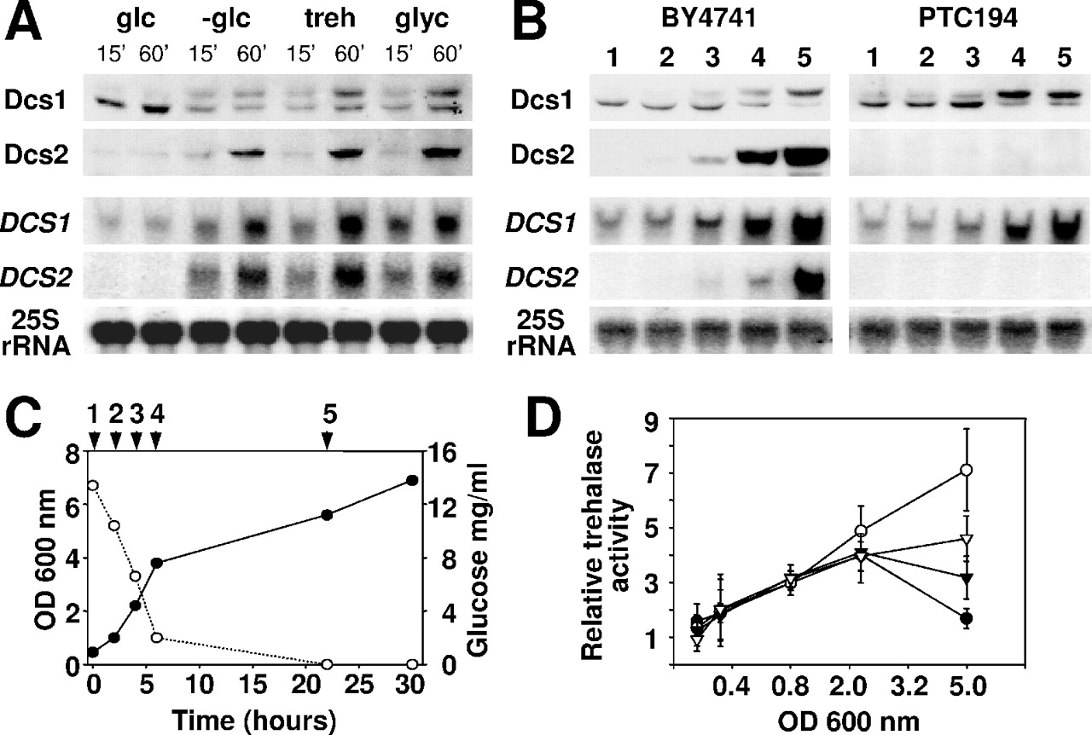
Figure 4. DCS1 and DCS2 mRNAs and proteins during diauxic shift and under carbon-source stress conditions. ( A ) Top ...
Notes:
Figure 4. DCS1 and DCS2 mRNAs and proteins during diauxic shift and under carbon-source stress conditions. ( A ) Top two rows: western blots using antibodies against Dcs1 and Dcs2, respectively. Dcs2 was detected in the form of Dcs2–TAP using PAP antibodies (Sigma). Bottom two rows: northern blotting was performed using probes against DCS1 mRNA, DCS2 mRNA and 25S rRNA, respectively. The cell extracts used in the above were prepared from the wild-type strain BY4741 under the following conditions: glucose depletion, glucose replacement by trehalose and glucose replacement by glycerol. Samples were taken 15 and 60 min, respectively, after the change in carbon source (as indicated). ( B ) Western blotting and northern blotting were performed on cell extracts prepared from the wild-type strain BY4741 and the dcs2Δ mutant Y12429 strain. The signals obtained using a probe against 25S rRNA serve as references for the amount of total RNA in each sample. The numbers at the top of each column correspond to the time points indicated in (C). ( C ) The samples used in (B) were taken from this culture of BY4741 at the points indicated. Cell density (filled circles) and glucose concentration (open circles) were measured on all samples. Growth was at 30°C in YPD medium. ( D ) Trehalase activity was measured using the glucose oxidase/peroxidase method ( 26 ) in extracts from the wild-type strain (BY4741, filled circles), the dcs1Δ strain (PTC194, open circles), the dcs2Δ strain (Y12429, closed triangles) and the dcs1Δdcs2Δ strain (PTC195, open triangles) at different stages of growth. The increase in trehalase activity is expressed as a ratio to the activity of control cells (OD 600 = 0.4), normalized to 1. The presented data represent averages of three independent experiments.
Unless provided in the caption above, the following copyright applies to the content of this slide: Nucleic Acids Research, Vol. 32 No. 12 © Oxford University Press 2004; all rights reserved

Slide 5
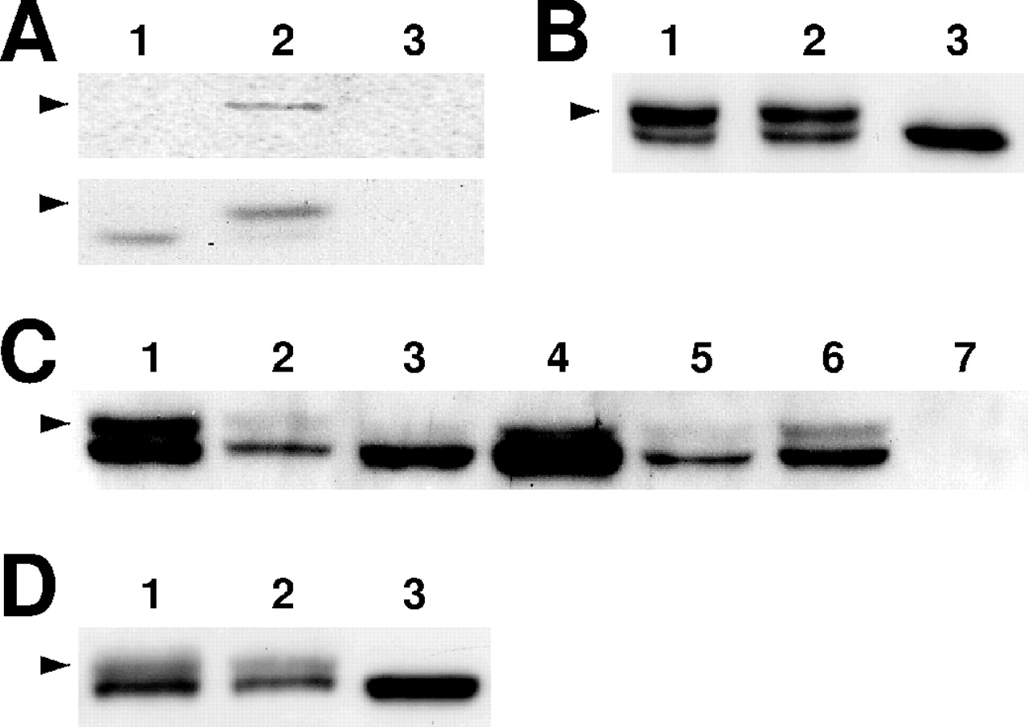
Figure 5. Dcs1 is phosphorylated in response to glucose depletion. ( A ) A [ ³² P]orthophosphate metabolic ...
Notes:
Figure 5. Dcs1 is phosphorylated in response to glucose depletion. ( A ) A [ 32 P]orthophosphate metabolic labelling experiment using the wild-type strain BY4741 (lanes 1 and 2) and the dcs1Δ strain PTC194 (lane 3). [ 32 P]orthophosphate was added to yeast previously grown for 45 min in phosphate-free medium in the presence (lane 1) or absence (lane 2) of glucose. The lower panel shows western blot analysis of immunoprecipitated Dcs1 proteins. The upper panel shows an autoradiograph of the same gel. ( B ) Dcs1 protein treatment with λ PPase. Lane1, Dcs1 purified from yeast cells at stationary phase and used in lanes 2 and 3. Lane 2, Dcs1 after incubation with λ PPase and phosphatase inhibitor. Lane 3, Dcs1 after incubation with only λ PPase. ( C ) Western blot using anti-Dcs1 antibodies. Late log phase extracts from mutant strains were analysed in the following order: lane 1, MY1 (wild-type strain); lane 2, MY2872 ( rim15Δ strain); lane 3, MY3297 ( rim15Δ yak1Δ strain); lane 4, MY3273 ( rim15Δ yak1Δ tpk1-3Δ strain); lane 5, MY2677 ( msn2Δ msn4Δ strain); lane 6, BY4741 (wild-type strain); lane 7, PTC195 ( dcs1Δ dcs2Δ strain). ( D ) Western blot using anti-Dcs1 antibodies. Late log phase extracts were prepared from PTC194 cells transformed with pRS313-DCS1 (lane 1), pRS313-DCS1-178 (lane 2) and pRS313-DCS1-196 (lane 3). Arrowheads indicate the positions of the phosphorylated form of Dcs1 protein in (A–D).
Unless provided in the caption above, the following copyright applies to the content of this slide: Nucleic Acids Research, Vol. 32 No. 12 © Oxford University Press 2004; all rights reserved

Slide 6
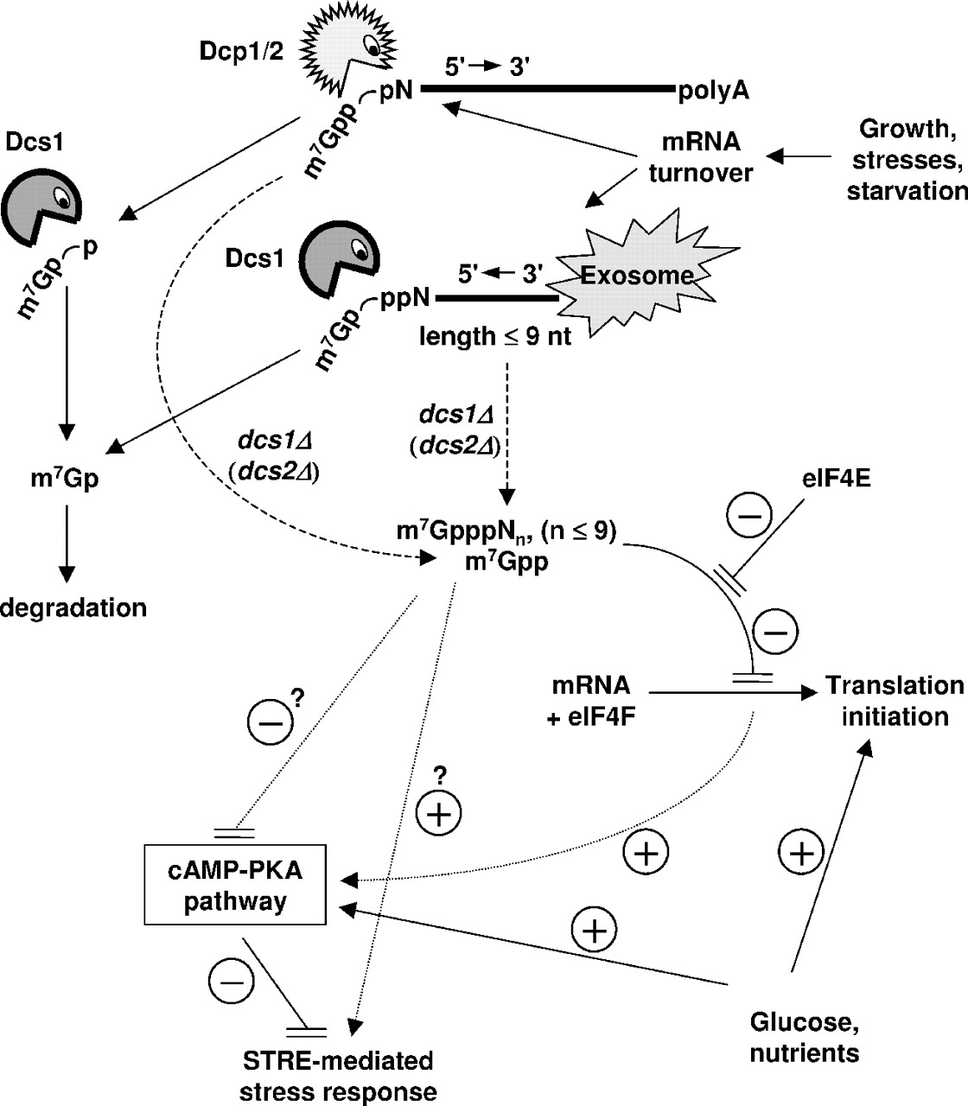
Figure 8. A testable model for the modulating role of Dcs1 in the yeast stress response. Increases in yeast growth ...
Notes:
Figure 8. A testable model for the modulating role of Dcs1 in the yeast stress response. Increases in yeast growth rate, or stress conditions, can accelerate mRNA turnover, thus increasing the rate of generation of mRNA turnover products, including m 7 G-oligoribonucleotides, m 7 GDP and other m 7 G-derivatives. In the 5′→3′ pathway, decapping of deadenylated but capped mRNA yields m 7 GDP, which is a substrate of Dcs1. In the 3′→5′ pathway, m 7 G-oligoribonucleotides are the final products of exosome-catalysed degradation. Where there is a reduction in the activity of Dcs1 (and more markedly where Dcs2 activity is also reduced), m 7 G-oligoribonucleotides and m 7 GDP levels increase and compete with capped mRNA for eIF4F and thereby inhibit translation initiation. In our experiments, we studied the extreme case where DCS1 and/or DCS2 were disrupted. Due to this inhibition, or possibly via an alternative stimulatory route, cAMP-PKA-mediated activation of STRE-promoters occurs, inducing a stressed state. Dashed arrows represent pathways that generate strong inhibitors of translation. Dotted arrows indicate potential stimulatory routes for STRE-dependent transcriptional activation, with the cAMP-PKA pathway providing one such route. In the latter case, inhibition of cAMP-PKA activity has to be repressed in order for transcription to be stimulated.
Unless provided in the caption above, the following copyright applies to the content of this slide: Nucleic Acids Research, Vol. 32 No. 12 © Oxford University Press 2004; all rights reserved

Slide 7
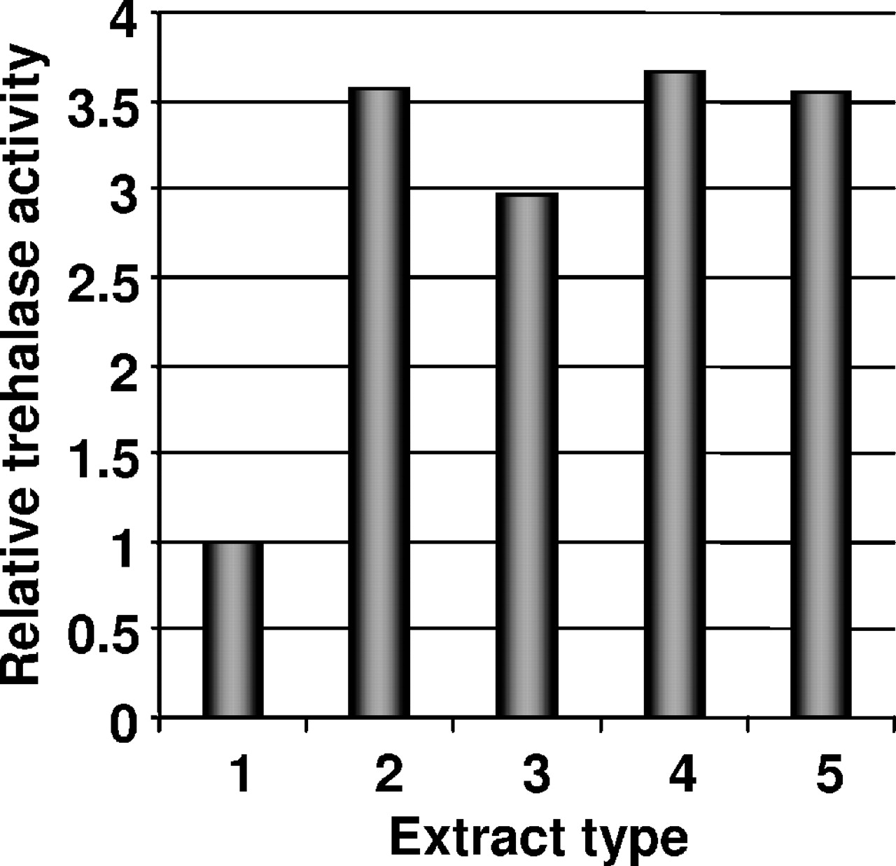
Figure 6. Effect of Dcs1 protein on Nth1 activity in cell extracts. Cell extracts were pre-incubated at 30°C for 30 ...
Notes:
Figure 6. Effect of Dcs1 protein on Nth1 activity in cell extracts. Cell extracts were pre-incubated at 30°C for 30 min with or without additional proteins, and trehalase activity was estimated. Lanes were loaded as follows: lane 1, BY4741 (wild-type strain); lane 2, PTC194 ( dcs1Δ strain); lane 3, mixture of PTC194 and PTC195 ( dcs1Δ dcs1Δ strain); lane 4, PTC194 with 1 μM of Dcs1 protein purified from the E.coli ; lane 5, PTC194 with 1 μM of phosphorylated/unphosphorylated form of Dcs1 CBD protein and 1 μM of Dcs2 protein purified from the S.cerevisiae . The increase in trehalase activity is expressed as a ratio to the activity of BY4741 cells (set at 1).
Unless provided in the caption above, the following copyright applies to the content of this slide: Nucleic Acids Research, Vol. 32 No. 12 © Oxford University Press 2004; all rights reserved

Slide 8
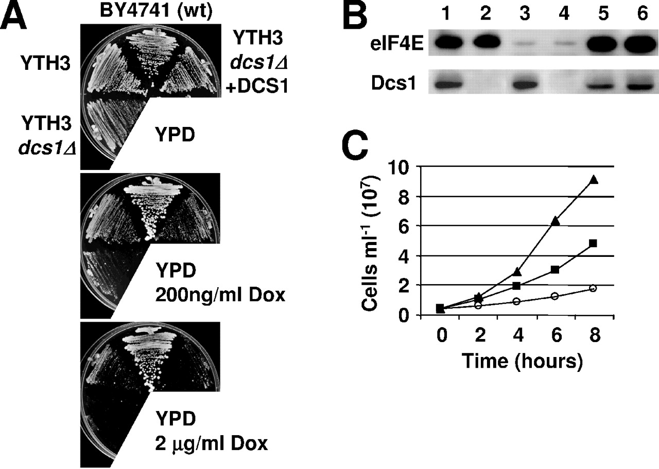
Figure 7. Suppressed CDC33 expression is synthetic lethal with dcs1Δ . ( A ) BY4741 (wt), YTH3 (tetO7 ...
Notes:
Figure 7. Suppressed CDC33 expression is synthetic lethal with dcs1Δ . ( A ) BY4741 (wt), YTH3 (tetO7 promoter-controlled CDC33 strain), YTH3 dcs1Δ (YTH3 with dcs1Δ mutation) and YTH3 dcs1Δ +DCS1 (YTH3 dcs1Δ transformed with pRS313-DCS1 plasmid) strains were streaked out on YPD medium without (top plate), or with 200 ng (middle plate) or 2 mg (bottom plate) doxycycline per millilitre of medium. Plates were incubated at 30°C for 3 days. ( B ) Western blot using antibodies against eIF4E and Dcs1 proteins. The extracts were prepared from the cells at mid log phase. YTH3 (lanes 1 and 3) and YTH3 dcs1Δ (lanes 2 and 4) were grown in the absence (lanes 1 and 2) or presence (lanes 3 and 4) of 200 ng/ml of doxycycline. Corresponding controls of extracts prepared from the wild-type strain BY4741 are shown in lanes 5 and 6. ( C ) Cell number as a function of time in yeast cultures incubated in YPD medium at 30°C in the presence of 200 ng/ml of doxycycline. The strains were BY4741 (triangles), YTH3 (squares) and YTH3 dcs1Δ (circles). Each data point represents the mean of three independent experiments.
Unless provided in the caption above, the following copyright applies to the content of this slide: Nucleic Acids Research, Vol. 32 No. 12 © Oxford University Press 2004; all rights reserved

