Slide 1
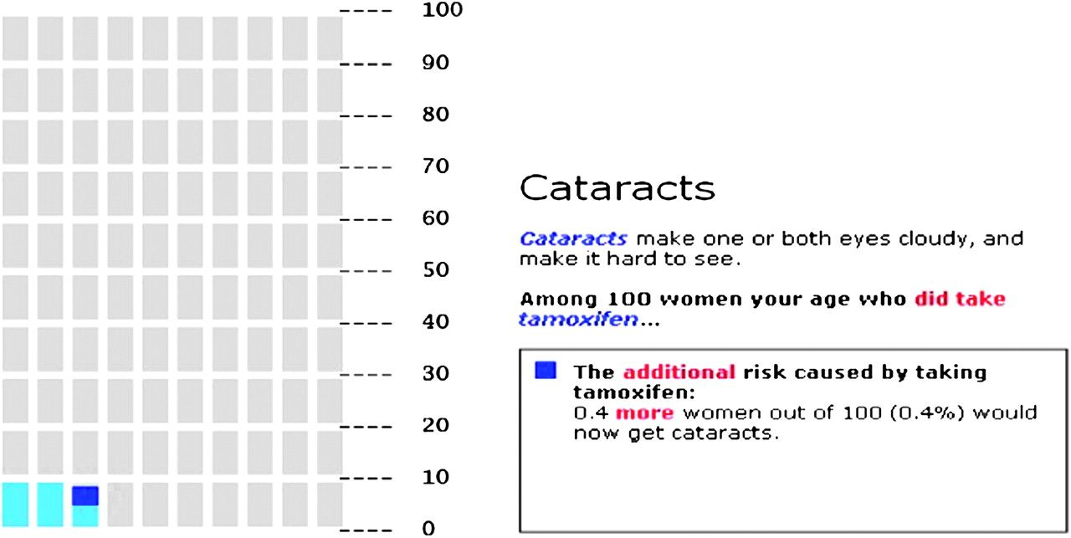
Figure 1 Pictograph format to communicate risk information. Pictograph used in the “Guide to Decide” web-based ...
Notes:
Figure 1 Pictograph format to communicate risk information. Pictograph used in the “Guide to Decide” web-based decision aid [see ( 26 ) and ( 27 ) for details] to highlight the additional risk of cataracts (one of the several side effects of tamoxifen) faced by women taking tamoxifen ( dark blue ) as compared with the baseline risk for women of the same age ( light blue ). Each rectangle represents 1 out of 100 individuals.
Unless provided in the caption above, the following copyright applies to the content of this slide: Published by Oxford University Press 2011.

Slide 2
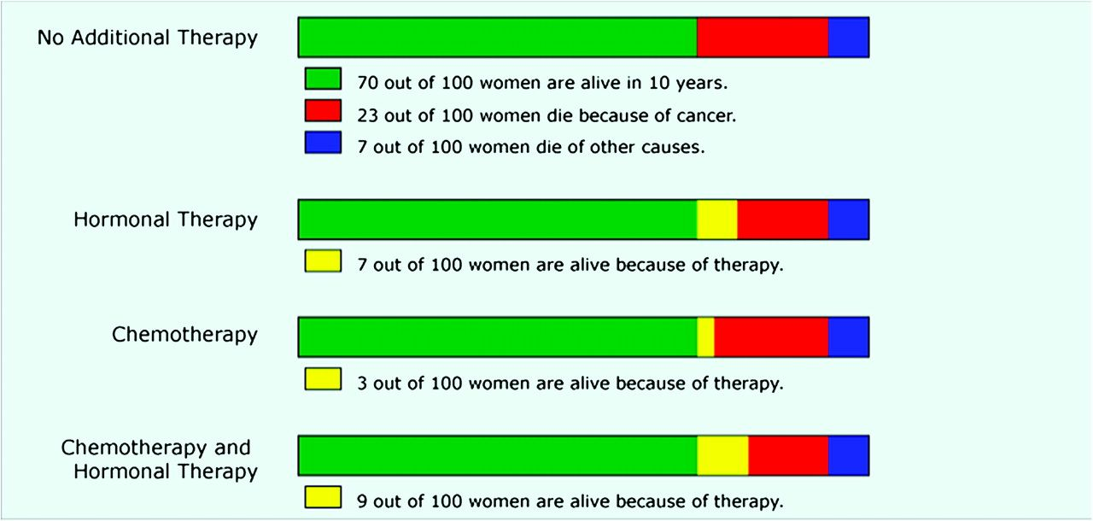
Figure 2 Bar graph format to communicate risk information. Bar graph format based on the decision support tool ...
Notes:
Figure 2 Bar graph format to communicate risk information. Bar graph format based on the decision support tool Adjuvant! Online to display estimated survival and mortality risks for breast cancer patients who are deciding between different adjuvant therapy options. Reproduced from Zikmund-Fisher et al. ( 51 ) with permission from John Wiley & Sons Inc.
Unless provided in the caption above, the following copyright applies to the content of this slide: Published by Oxford University Press 2011.

Slide 3
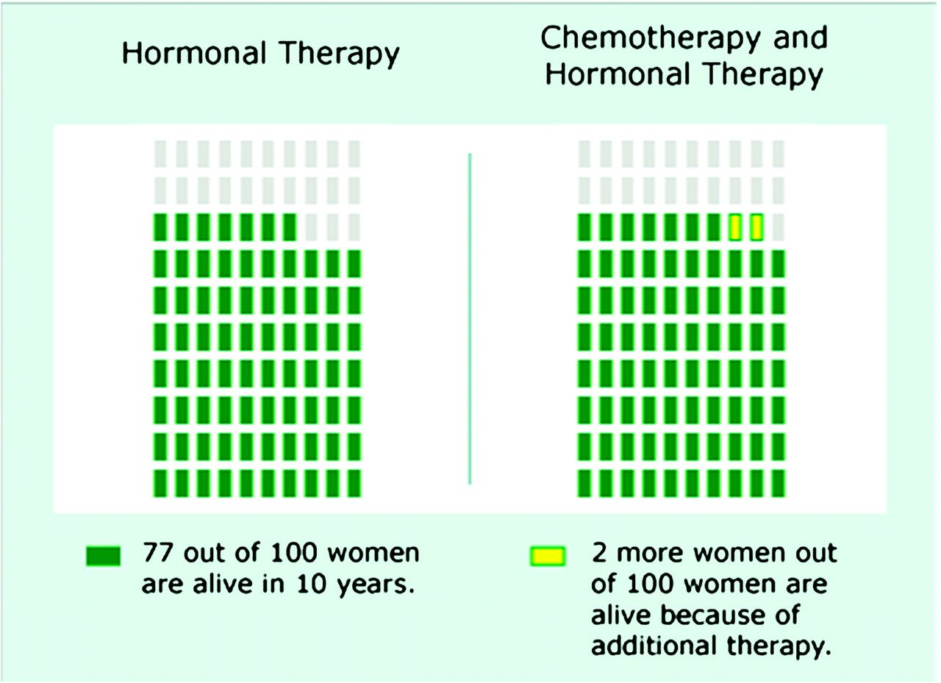
Figure 3 Binary choice pictograph format to communicate risk information. Binary format showing the incremental ...
Notes:
Figure 3 Binary choice pictograph format to communicate risk information. Binary format showing the incremental survival benefit to a breast cancer patient of adding chemotherapy to hormonal therapy. Each rectangle represents 1 out of 100 individuals. Reproduced from Zikmund-Fisher et al. ( 49 ) with permission from the authors.
Unless provided in the caption above, the following copyright applies to the content of this slide: Published by Oxford University Press 2011.

