Slide 1
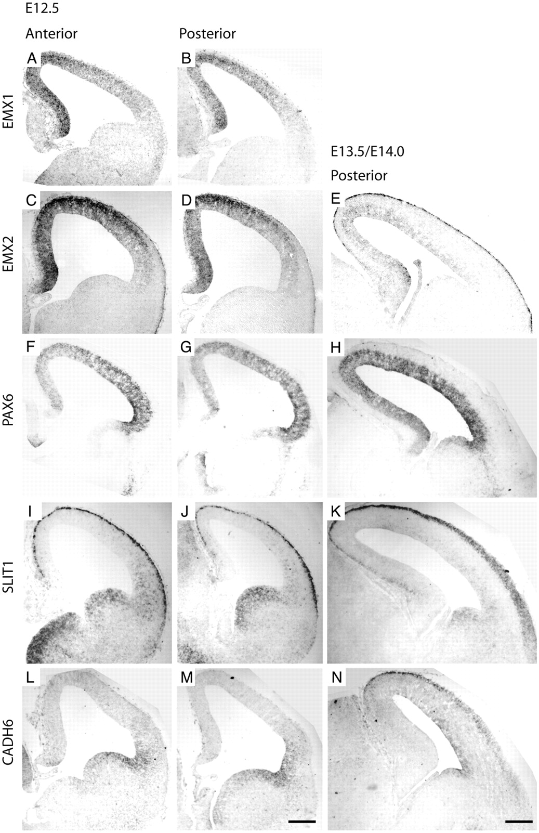
Figure 1. Expression of Emx1, Emx2, Pax6, Slit1 and Cadherin6 in the cortex at embryonic stages E12.5 (A–D,F,G,I,J,L,M) ...
Notes:
Figure 1. Expression of Emx1, Emx2, Pax6, Slit1 and Cadherin6 in the cortex at embryonic stages E12.5 (A–D,F,G,I,J,L,M) and E13.5 (E,H,K,N). In situ hybridization was performed on 14 μm thick frontal cryostat sections. Two rostro-caudal levels are illustrated at E12.5: anterior sections corresponding to the beginning of the thalamus and posterior sections to the level of the caudal GE. E12.5 sections show a decreasing dorso-lateral gradient of Emx1 expression (A,B). At E12.5, Emx2 (C,D) and Pax6 (F,G) show opposite latero-dorsal gradients of expression. At E13.5, the gradient of Emx2 expression is strongly attenuated (E), whereas the Pax6 gradient is no longer detectable (H). At E12.5, expression of Slit1 (I,J) and Cadherin6 (L,M) in the ventricular zone (VZ) is restricted to a latero-ventral sector of the cortex. In E13.5 embryos, the VZ expression of Slit1 is fainter but reaches the dorsal cortex. In comparison, the dorsal expansion of the VZ expression of Cadherin6 is moderate and leaves the most dorsal part of the cortex unlabeled. Scale bars = 200 μm.
Unless provided in the caption above, the following copyright applies to the content of this slide: © Oxford University Press

Slide 2
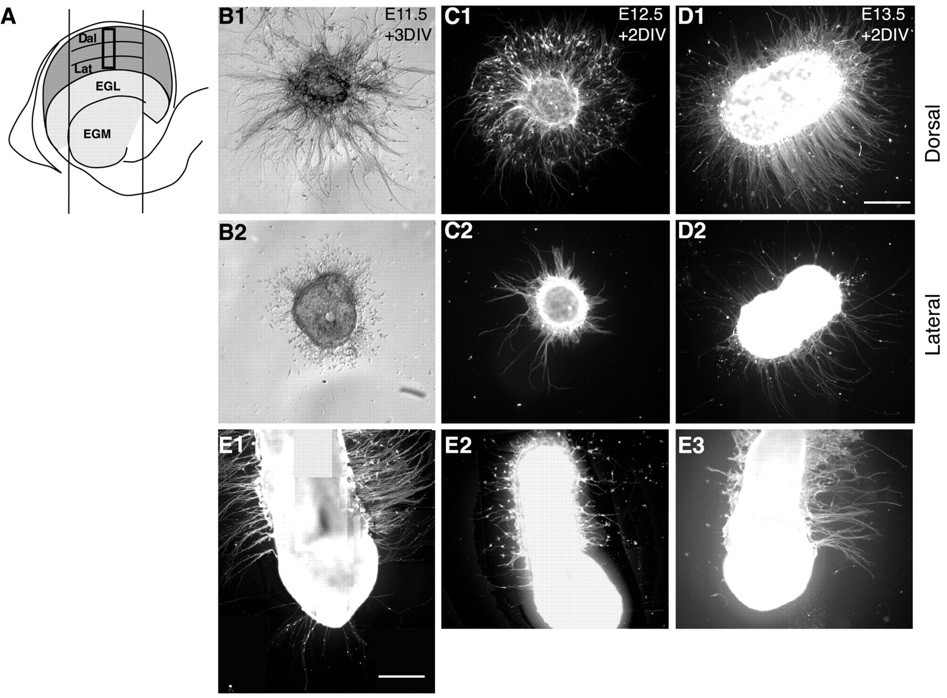
Figure 2. Axonal outgrowth and cell migration around explants of lateral and dorsal cortex. The diagram in (A) shows ...
Notes:
Figure 2. Axonal outgrowth and cell migration around explants of lateral and dorsal cortex. The diagram in (A) shows the cortical regions that were used to prepare dorsal and lateral explants at E12.5. The thick open rectangle represents the region used to prepare latero-dorsally oriented explants. Explants prepared from the dorsal or lateral cortex at E11.5 (B), E12.5 (C), or E13.5 (D,E) were cultured for several days on a laminin substrate and reacted with TUJ1 antibodies. After 2 or 3 days in vitro, they show striking differences in their density of axonal processes and in the number of long-distance-migratory neurons. Latero-dorsal bands of E13.5 parietal cortex cultured for 2 days (E1,E3) show long and dense axons only around their dorsal part. Similarly, cells were seen to migrate out of the dorsal part of the E13.5 explants that were cultured for 1 day (E2). Scale bars = 200 μm.
Unless provided in the caption above, the following copyright applies to the content of this slide: © Oxford University Press

Slide 3
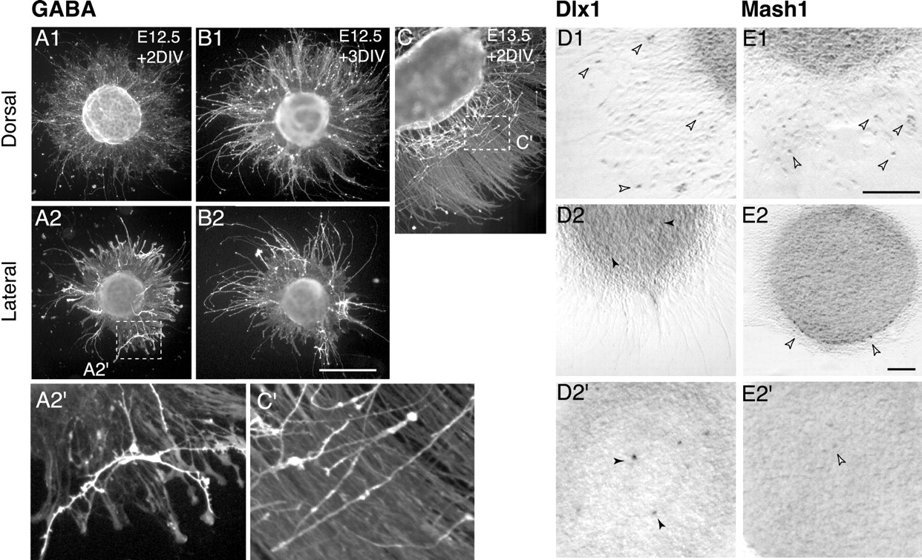
Figure 3. GABAergic phenotype and expression of Dlx1 and Mash1 in cells migrating around dorsal (A1,B1,C,D1,E1) and ...
Notes:
Figure 3. GABAergic phenotype and expression of Dlx1 and Mash1 in cells migrating around dorsal (A1,B1,C,D1,E1) and lateral (A2,B2,D2,E2) cortical explants cultured for 2 (A,C,D,E) or 3 (B) days. The long-distance-migratory neurons observed around dorsal explants of E12.5 (B1) and E13.5 (C,C′) cortex were GABA-immunopositive after 2 or 3 days in vitro (cf. A1 and B1). Strongly GABA-immunoreactive cells with small expansions on their neurites were observed in E12.5 lateral explants (A2, A2′, B2) from the beginning of the culture (not shown). (C′) and (A2′) are high-magnification views of GABAergic cells in (C) and (A2), respectively. A large proportion of cells that migrated around dorsal cortex explants expressed Dlx1 (D1) and Mash1 (E1) weakly (open arrowheads point to one labeled cell in each case). Expression of Dlx1 and Mash1 around lateral explants (D2,E2) and within the thickness of the same explants (D2′,E2′) show that a few cells scattered within explants strongly express Dlx1 (D2′, black arrowheads) and a few cells around or within explants weakly express Mash1 (E2,E2′, open arrowheads). Scale bars = 50 μm.
Unless provided in the caption above, the following copyright applies to the content of this slide: © Oxford University Press

Slide 4
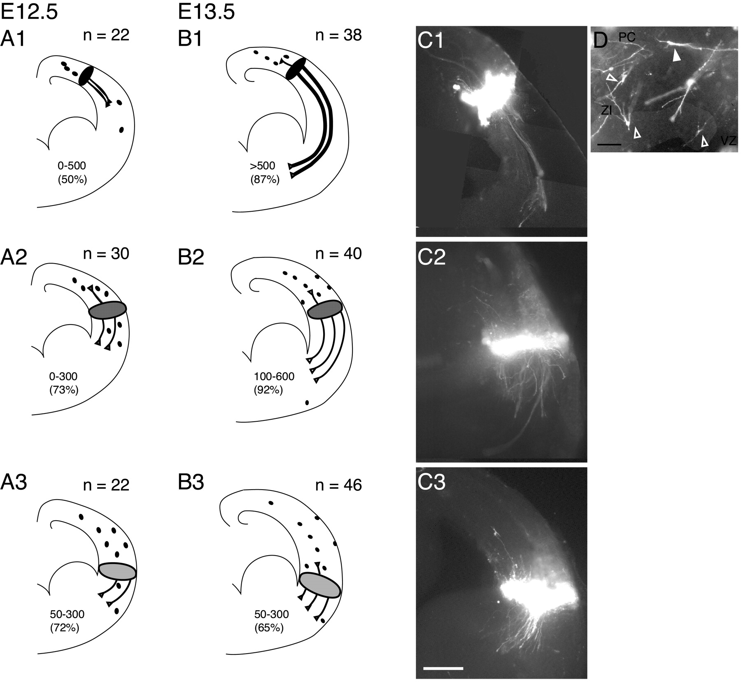
Figure 4. Axonal outgrowth in cultured forebrain slices. DiI crystals were placed at dorsal, intervening and lateral ...
Notes:
Figure 4. Axonal outgrowth in cultured forebrain slices. DiI crystals were placed at dorsal, intervening and lateral sites in the cortex of telencephalic slices before culturing them for 2 days. The characteristic patterns of labeling observed in E12.5 (A) and E13.5 (B) frontal slices according to injection site [dorsal (A1,B1), lateral (A3,B3), intervening (A2,B2)] are schematized on the left. N is the number of slices injected at each level. The range of axon lengths (mm) and the percentage of slices with labeled axons (in brackets) are indicated in each case. Labeled axons are shown in photomicrographs of E13.5 slices: axons labeled from dorsal sites (C1) form long fascicles growing ventrally, whereas ventrally oriented axons labeled from lateral sites (C3) are shorter and unfasciculated. DiI labeled cells (D) are observed both dorsally and ventrally to the injection site. Their labeling appears either punctuate (open arrowhead) or ‘Golgi-like’ (white arrowhead). Scale bars = 100 μm (C1–C3) and 50 μm (D).
Unless provided in the caption above, the following copyright applies to the content of this slide: © Oxford University Press

Slide 5
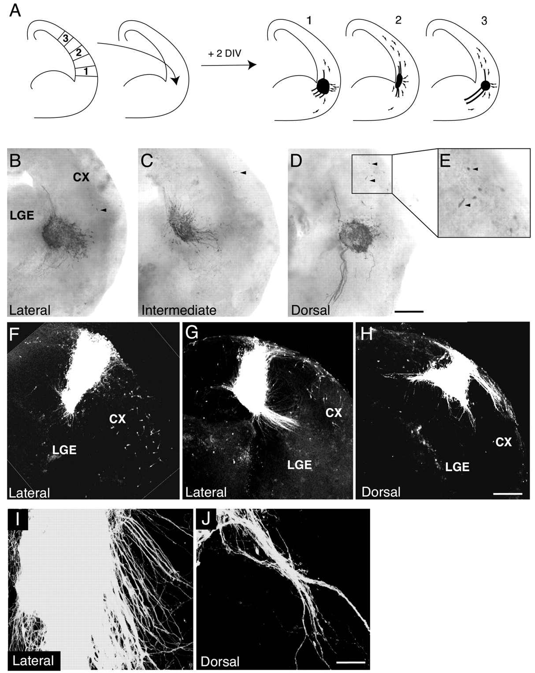
Figure 5. Axonal outgrowth and cell migration in grafted slices. Small explants of E12.5 lateral (1), dorsal (3) or ...
Notes:
Figure 5. Axonal outgrowth and cell migration in grafted slices. Small explants of E12.5 lateral (1), dorsal (3) or intervening (2) GFP-expressing cortex were placed at the cortico-striatal frontier (A–E) or within the dorsal cortex (F–J) in E13.5 telencephalic slices. After 2 days in culture, GFP-expressing cells were visualized by immunostaining. Lateral explants grafted at the cortico-striatal frontier grew short and unfasciculated ventrally oriented axons (B), whereas dorsal explants grew long and fasciculated ventrally oriented axons (D). Axons leaving explants of the intervening zone (C, intermediate) resemble those leaving lateral explants. GFP-positive cells were found in the host slice at long distances from the graft (E, black arrowheads). In all cases, short axons are oriented dorsally and few cells migrated ventrally. Lateral cortical explants grafted in the dorsal cortex extend either short (F) or longer (G) axons that only formed fascicles if their density was high (I). Explants of dorsal cortex grew long axons on the pial surface of slices (H) that formed fascicles even at low density (J). CX, cortex; LGE, lateral ganglionic eminence. Scale bars = 200 μm (B–D), 150 μm (F–H) and 40 μm (I,J).
Unless provided in the caption above, the following copyright applies to the content of this slide: © Oxford University Press

Slide 6
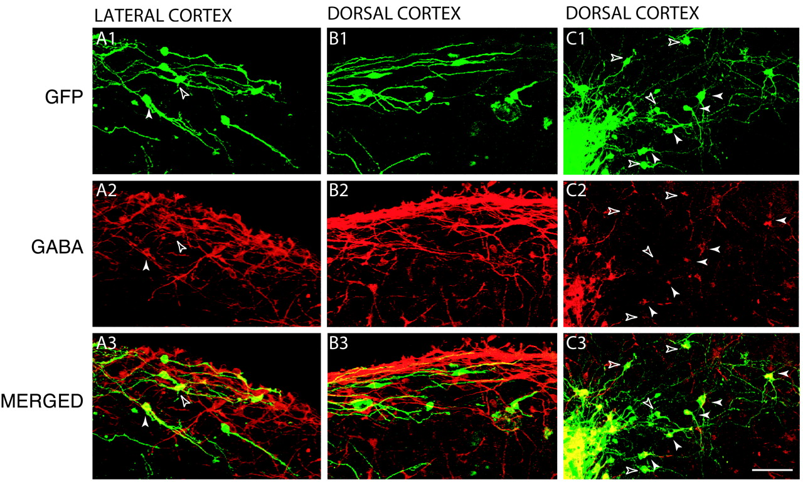
Figure 6. GABA expression in cells migrating tangentially from cortical explants into host slices. Slices grafted with ...
Notes:
Figure 6. GABA expression in cells migrating tangentially from cortical explants into host slices. Slices grafted with GFP-expressing lateral (A1–A3) or dorsal (B1–B3,C1–C3) cortical explants were immunostained with GABA antibodies (A2,B2,C2) after 2 days in culture. A few GFP-positive cells migrating tangentially into host slices from lateral cortical explants were immunopositive for GABA (white arrowhead in A2,A3). GABA-immunopositive cells migrating at the pial surface of slices grafted with dorsal cortical explants were rarely observed after 2 days in vitro (B1–B3), whereas they were much more numerous close to grafted explants (white arrowheads in C2,C3). Open arrowheads indicate cells whose double labeling was difficult to evaluate. Scale bar = 40 μm.
Unless provided in the caption above, the following copyright applies to the content of this slide: © Oxford University Press

