Slide 1
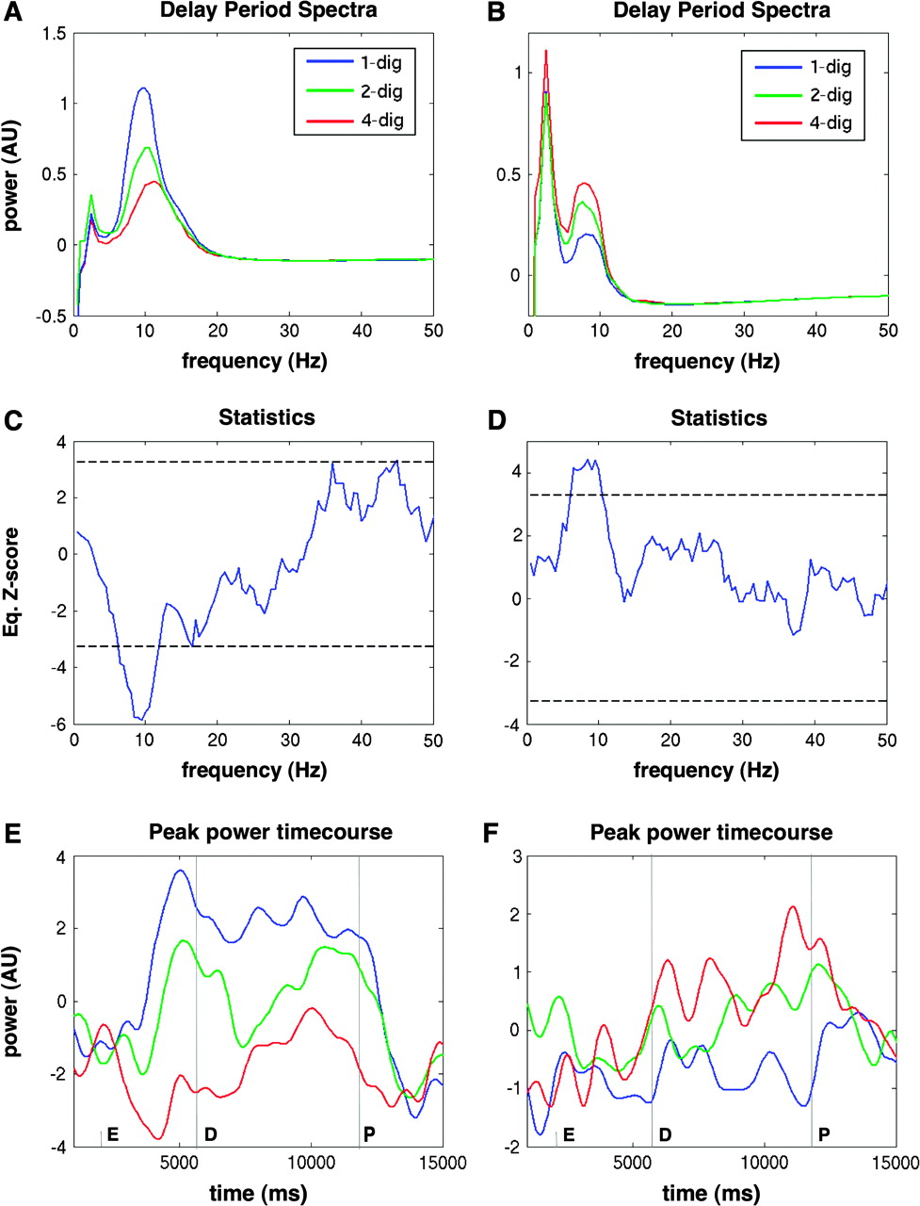
Figure 2. Examples of electrodes showing opposite effects of memory load in the theta/alpha range. (A) Whitened power ...
Notes:
Figure 2. Examples of electrodes showing opposite effects of memory load in the theta/alpha range. (A) Whitened power spectra (see Methods) of an electrode in right occipital cortex, with alpha power decreasing with memory load. (B) Power spectra of an electrode in left temporal cortex, with a peak overlapping theta and alpha bands increasing with memory load. (C) Equivalent z-value at each frequency for the same electrode shown in (A) (see Methods), showing significant alpha decrease as well as gamma increase. (D) Equivalent z-values for the electrode in (B). (E) Time course of power at the alpha peak frequency for the first electrode, demonstrating that power diverges during the delay period (indicated by vertical lines). The letters E, D, and P mark the onset of the encoding period (presentation of the digit array), delay period (offset of the digits), and probe period (onset of the single probe digit). (F) Time course of peak power for the second electrode.
Unless provided in the caption above, the following copyright applies to the content of this slide: © 2007 The AuthorsThis is an Open Access article distributed under the terms of the Creative Commons Attribution Non-Commercial License (http://creativecommons.org/licenses/by-nc/2.0/uk/) which permits unrestricted non-commercial use, distribution, and reproduction in any medium, provided the original work is properly cited.

Slide 2
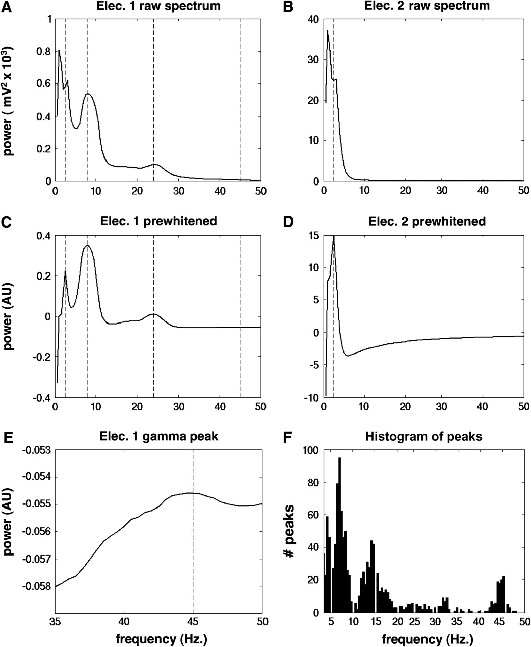
Figure 1. (A) Raw power spectrum of a single representative electrode exhibiting multiple oscillatory peaks. Vertical ...
Notes:
Figure 1. (A) Raw power spectrum of a single representative electrode exhibiting multiple oscillatory peaks. Vertical lines indicate peaks detected by an automatic algorithm. (B) Raw power spectrum of a second electrode from the same subject, exhibiting no oscillatory peaks except at very low frequencies. (C) The power spectrum from the first electrode after application of the “whitening” algorithm (see text). (D) The whitened power spectrum of the second electrode. (E) Close-up view of the gamma peak from the first prewhitened spectrum. (F) Histogram of oscillatory peaks across the frequency spectrum, detected in all 1453 electrodes in the study.
Unless provided in the caption above, the following copyright applies to the content of this slide: © 2007 The AuthorsThis is an Open Access article distributed under the terms of the Creative Commons Attribution Non-Commercial License (http://creativecommons.org/licenses/by-nc/2.0/uk/) which permits unrestricted non-commercial use, distribution, and reproduction in any medium, provided the original work is properly cited.

Slide 3
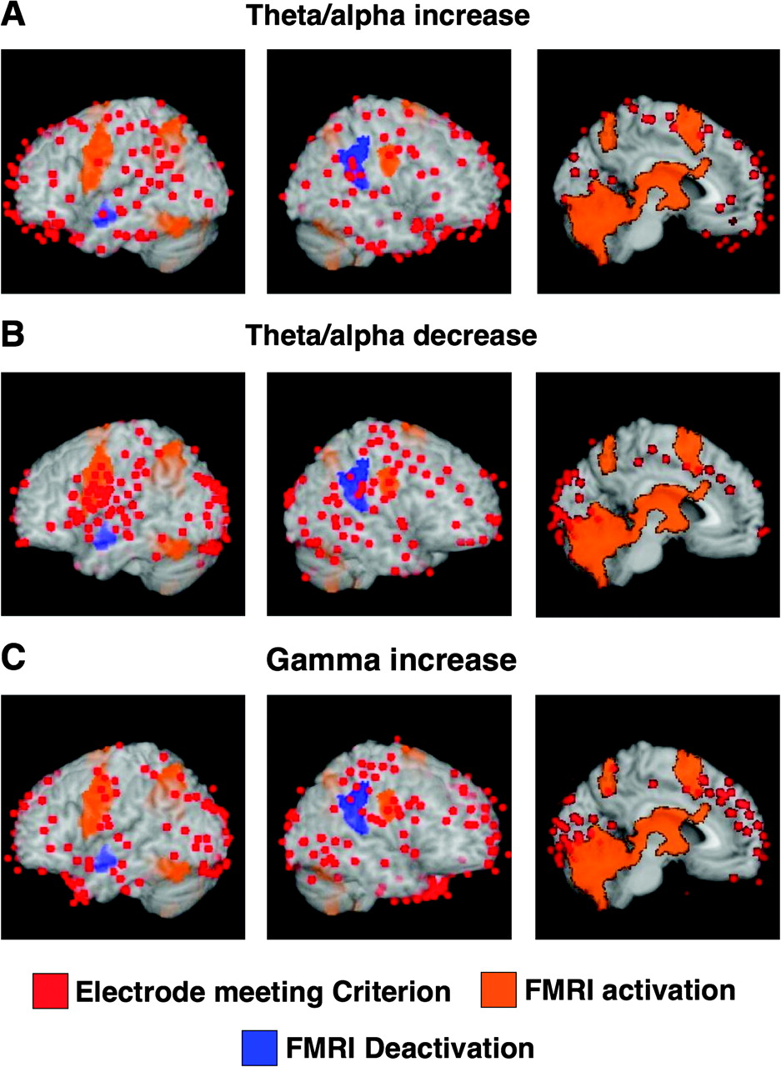
Figure 5. Maps of electrodes exhibiting each category of spectral power change, overlain on an anatomical atlas brain ...
Notes:
Figure 5. Maps of electrodes exhibiting each category of spectral power change, overlain on an anatomical atlas brain and an fMRI map of delay-period memory load–induced BOLD signal changes obtained from a previous study. (A) Electrodes exhibiting an increase in power with memory load in the theta/alpha range (5–13 Hz). (B) Electrodes exhibiting a decrease in power with memory load in the theta/alpha range. (C) Electrodes exhibiting an increase in power with memory load in the gamma range (30–50 Hz).
Unless provided in the caption above, the following copyright applies to the content of this slide: © 2007 The AuthorsThis is an Open Access article distributed under the terms of the Creative Commons Attribution Non-Commercial License (http://creativecommons.org/licenses/by-nc/2.0/uk/) which permits unrestricted non-commercial use, distribution, and reproduction in any medium, provided the original work is properly cited.

Slide 4
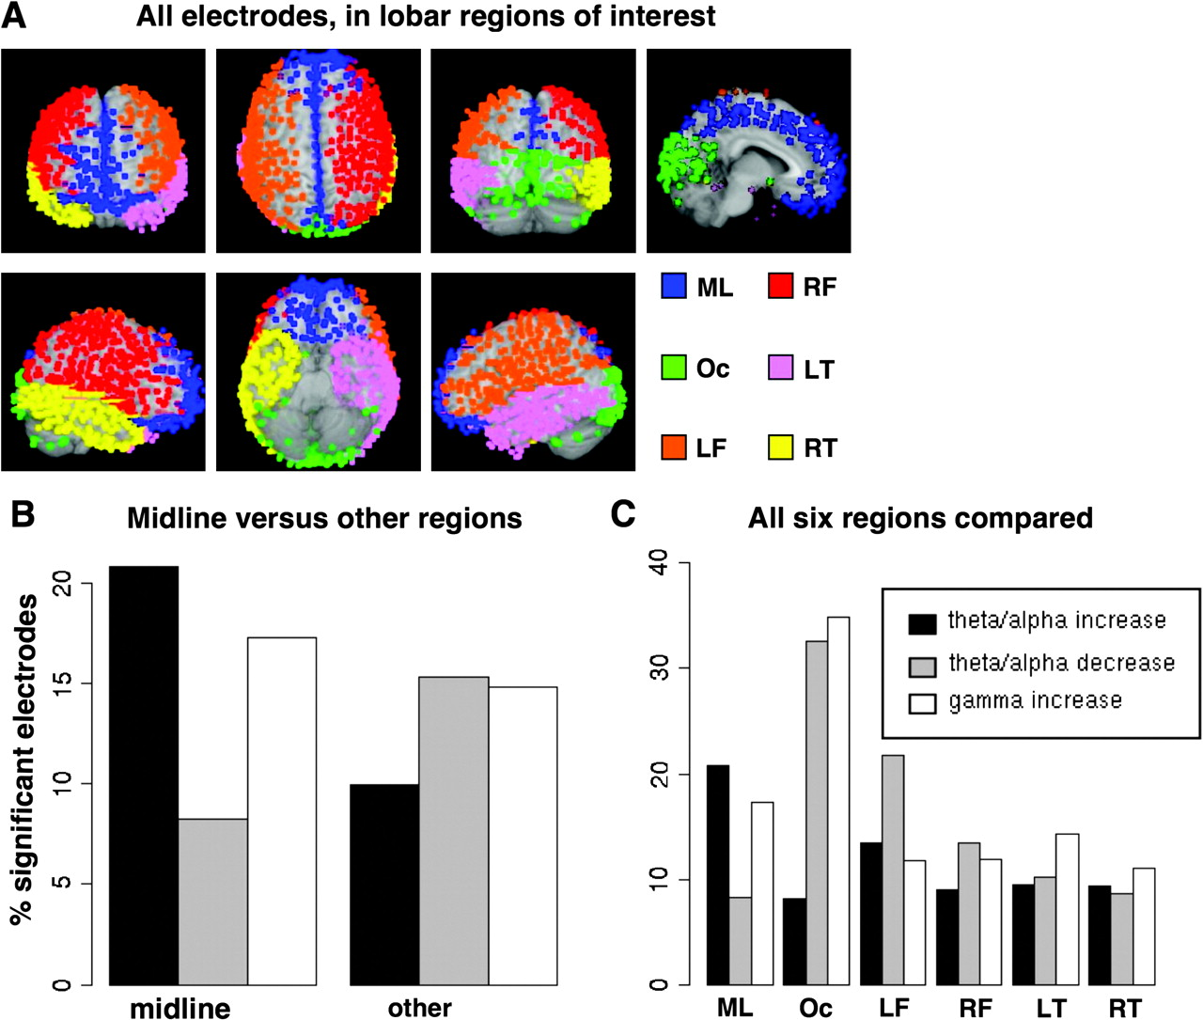
Figure 4. (A) All electrodes across 14 subjects that were included in the statistical analyses, with the 6 anatomical ...
Notes:
Figure 4. (A) All electrodes across 14 subjects that were included in the statistical analyses, with the 6 anatomical ROIs indicated by a color code (see text). (B) Proportion of electrodes in the midline frontal/parietal region expressing each category of spectral power change, compared with all other regions. (C) Comparison of power changes in all 6 regions. These proportions are combined across different subjects with different electrode placements; see text for details of statistical inference.
Unless provided in the caption above, the following copyright applies to the content of this slide: © 2007 The AuthorsThis is an Open Access article distributed under the terms of the Creative Commons Attribution Non-Commercial License (http://creativecommons.org/licenses/by-nc/2.0/uk/) which permits unrestricted non-commercial use, distribution, and reproduction in any medium, provided the original work is properly cited.

Slide 5
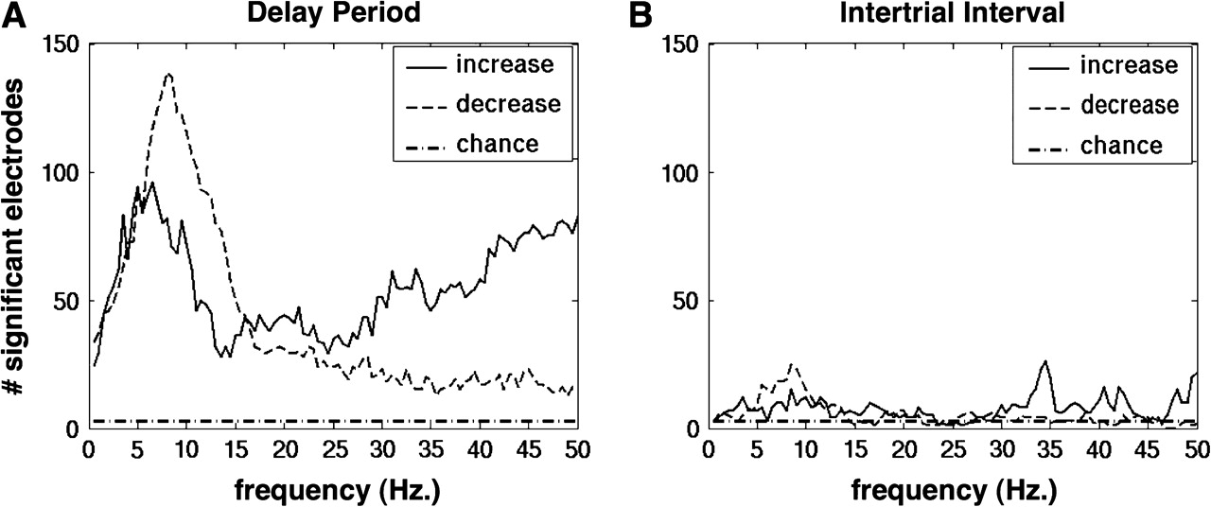
Figure 3. (A) Histogram of the total number of electrodes in all subjects showing a significant effect of memory load ...
Notes:
Figure 3. (A) Histogram of the total number of electrodes in all subjects showing a significant effect of memory load on oscillatory power at each frequency during the delay period of the Sternberg task. The horizontal line represents the number to be expected by chance alone at the chosen significance level (P < 0.001), based on a permutation distribution computed from 1000 random resamplings of the trials in each subject. (B) Identical analysis performed on data extracted from the intertrial interval. This serves as a control to confirm that the observed changes are mainly specific to the delay period of the task, rather than being driven by sustained changes in attention or effort over the length of task blocks.
Unless provided in the caption above, the following copyright applies to the content of this slide: © 2007 The AuthorsThis is an Open Access article distributed under the terms of the Creative Commons Attribution Non-Commercial License (http://creativecommons.org/licenses/by-nc/2.0/uk/) which permits unrestricted non-commercial use, distribution, and reproduction in any medium, provided the original work is properly cited.

