Slide 1
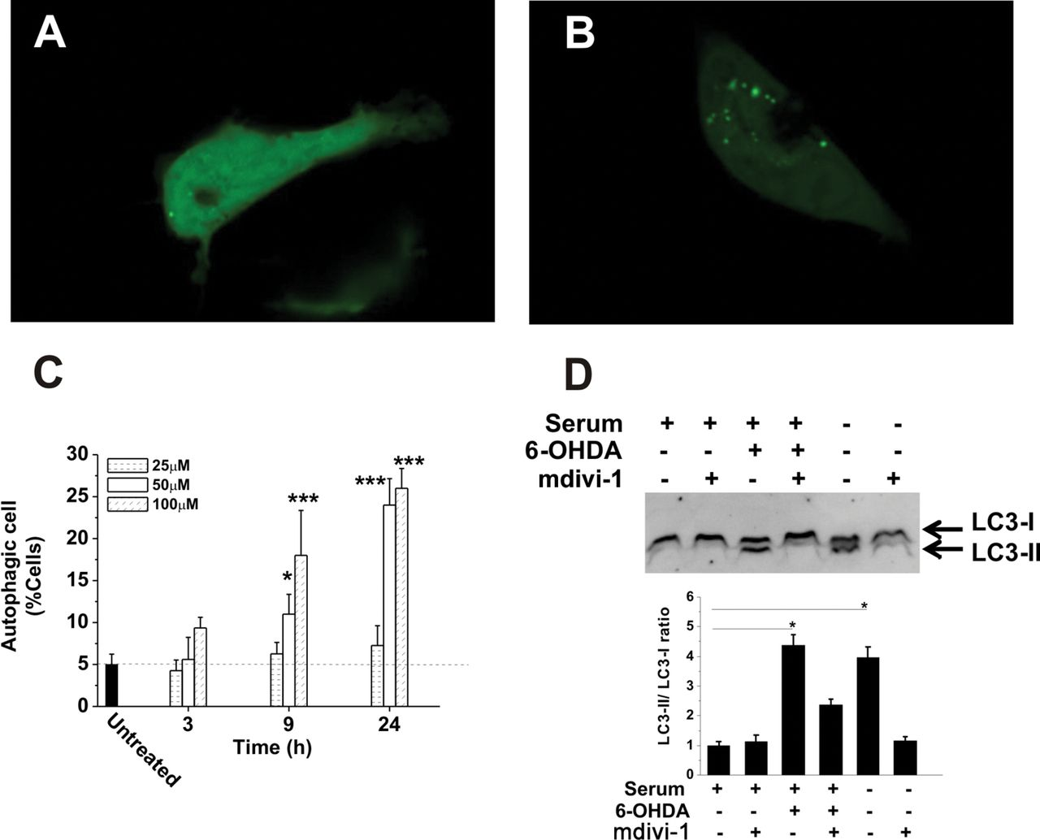
FIG. 1. 6-OHDA induces autophagy in SH-SY5Y cells. (A) Proportions of autophagic SH-SY5Y cells in cell cultures that ...
Notes:
FIG. 1. 6-OHDA induces autophagy in SH-SY5Y cells. (A) Proportions of autophagic SH-SY5Y cells in cell cultures that were challenged with 0 (untreated), 25, 50, and 100µM 6-OHDA for different periods of time. Data represent mean ± SEM of four independent experiments. Significant differences between 6-OHDA–treated and untreated cells are indicated (*p < 0.05; ***p < 0.001; t-test). (B and C) Induction of autophagosome formation by 6-OHDA. Representative confocal fluorescent microscopy images of SH-SY5Y cells transfected with GFP-LC3 cDNA and challenged (C) or not (B) with 50µM 6-OHDA for 12h. The punctuated distribution of green fluorescence indicates the formation of autophagosomes. (D) LC3b-II is induced by 6-OHDA. SH-SY5Y cell cultures were pretreated (or not) with 10µM mdivi-1 for 30min before adding 50µM 6-OHDA. Serum withdrawal was used as positive control for accumulation of LC3b-II levels. Twelve hours after 50µM 6-OHDA addition, total cellular extracts were collected. Equal amounts of protein (30 μg/lane) were loaded on the gels. The immunoblot shown is representative of three independent experiments. Histograms: Quantitative analysis of the ratio of LC3-II to LC3-I (n = 3) (*p < 0.05; t-test).
Unless provided in the caption above, the following copyright applies to the content of this slide: © The Author 2012. Published by Oxford University Press on behalf of the Society of Toxicology. All rights reserved. For permissions, please email: journals.permissions@oup.com

Slide 2
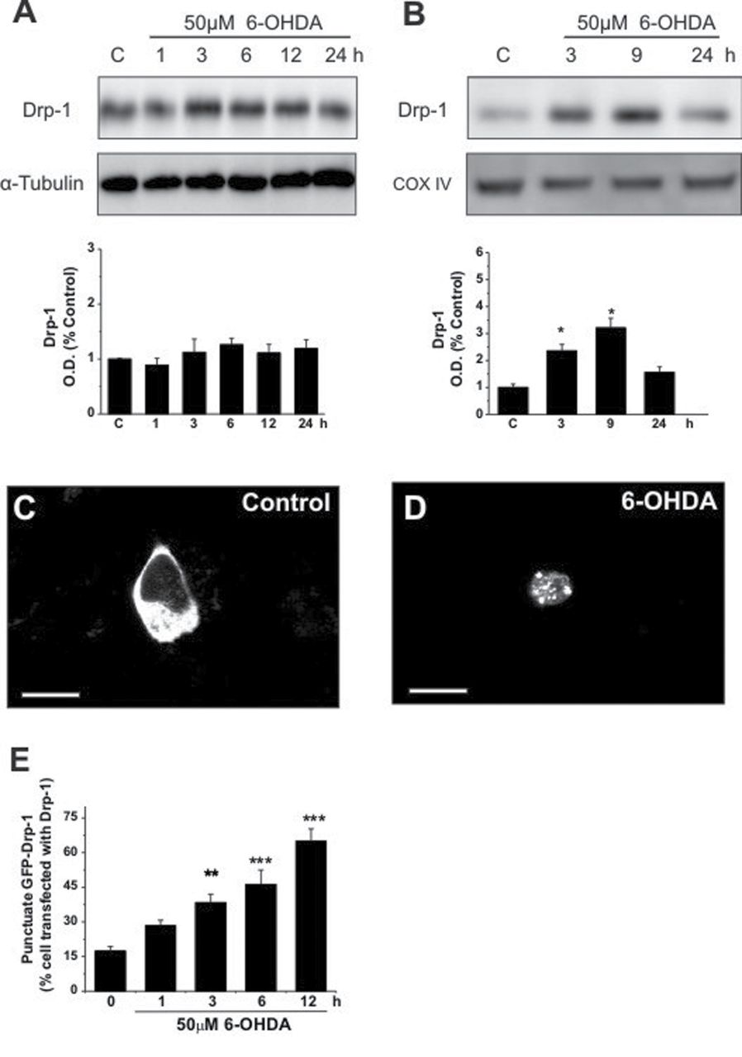
FIG. 2. Drp1 participates in 6-OHDA–induced mitochondrial fragmentation. (A and B) Immunoblot analysis showing Drp1 ...
Notes:
FIG. 2. Drp1 participates in 6-OHDA–induced mitochondrial fragmentation. (A and B) Immunoblot analysis showing Drp1 levels in total cellular extracts (A) and mitochondrial fractions (B) of SH-SY5Y cells that were challenged with 50µM 6-OHDA for the indicated periods of time. Equal amounts of protein (30 μg/lane) were loaded on the gels. α-Tubulin levels were used as an index of total cell load, COX-IV was used as an index of mitochondrial load. The immunoblots shown are representative of three independent experiments. Histograms: Variation of Drp1 levels normalized to α-Tubulin or COX is shown. Results are expressed as mean ± SEM (n = 3). (C and D) Confocal imaging of SH-SY5Y cells that were transfected with Drp1-GFP and treated (D) or not (C) with 50µM 6-OHDA for 3h. Images shown are representative of four independent experiments. In each case, several cells were examined. Scale bars: 10 µm. (E) Percentages of cells with punctuate Drp1 distribution. Results shown are the mean ± SEM of at least three experiments, each performed in triplicate. Significant differences between 6-OHDA–treated cells and controls are indicated (**p < 0.01).
Unless provided in the caption above, the following copyright applies to the content of this slide: © The Author 2012. Published by Oxford University Press on behalf of the Society of Toxicology. All rights reserved. For permissions, please email: journals.permissions@oup.com

Slide 3
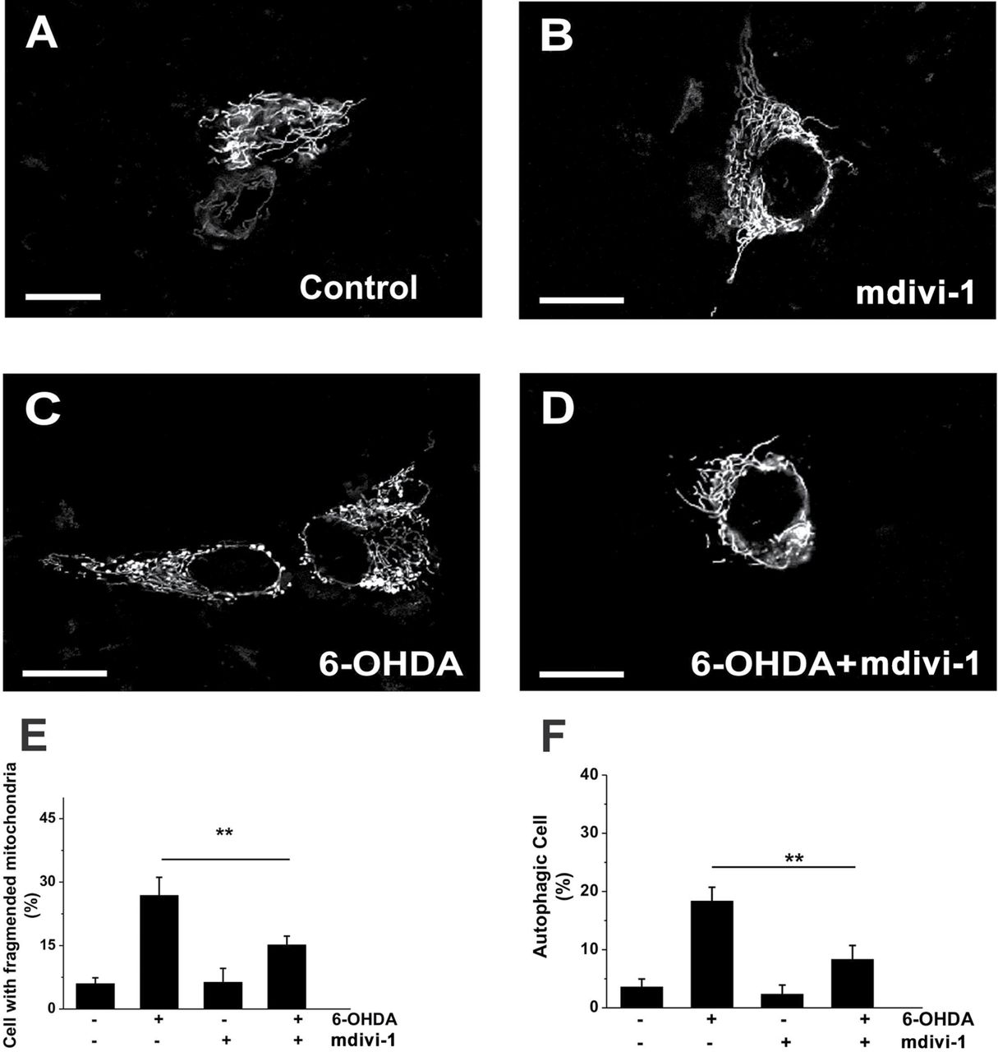
FIG. 3. Drp1 inhibition blocks 6-OHDA–induced mitochondrial morphology alteration and autophagy. (A–D) Representative ...
Notes:
FIG. 3. Drp1 inhibition blocks 6-OHDA–induced mitochondrial morphology alteration and autophagy. (A–D) Representative confocal images of SH-SY5Y cells that were transfected with the pDsRed2-mito vector. Cells were pretreated (B and D) or not (A and C) with 10µM mdivi-1 prior to a 3h treatment with 50µM 6-OHDA (C and D). Scale bars: 10 µm. (E) Proportions of cells with fragmented mitochondrial patterns were determined after a 3h treatment with 6-OHDA. (F) Proportions of autophagic cells in parallel cell cultures after 12h of 6-OHDA treatment. Data in histograms are the mean ± SEM of four independent experiments (**p < 0.01; one way ANOVA post hoc Tukey).
Unless provided in the caption above, the following copyright applies to the content of this slide: © The Author 2012. Published by Oxford University Press on behalf of the Society of Toxicology. All rights reserved. For permissions, please email: journals.permissions@oup.com

Slide 4
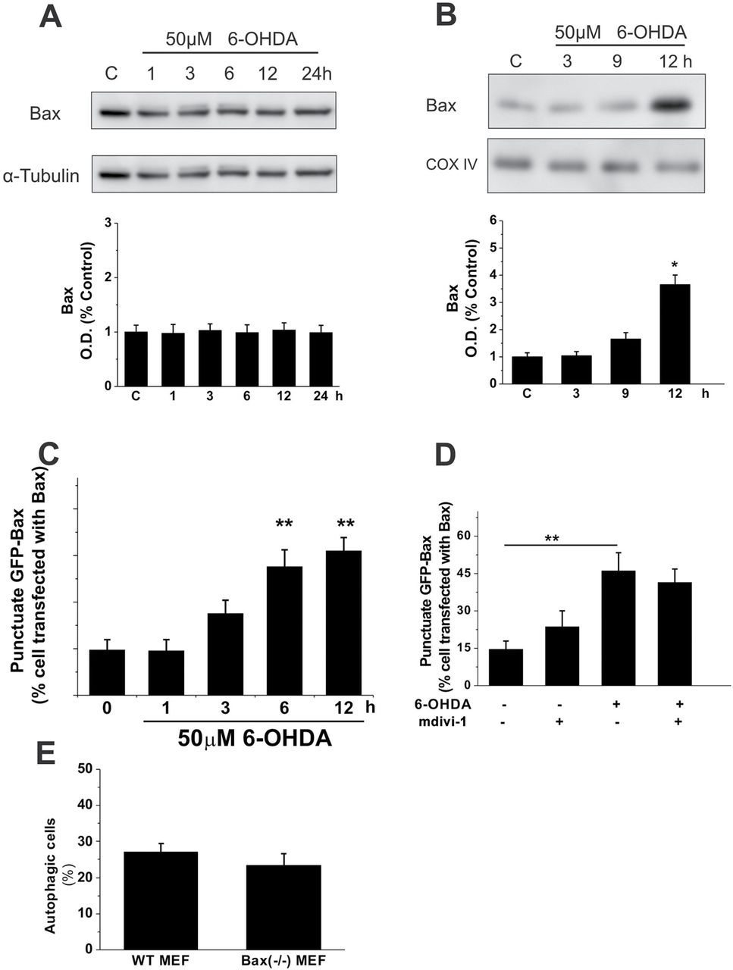
FIG. 4. 6-OHDA induces autophagy in a Bax-independent manner. (A and B) Immunoblot analysis of Bax protein levels in ...
Notes:
FIG. 4. 6-OHDA induces autophagy in a Bax-independent manner. (A and B) Immunoblot analysis of Bax protein levels in total cellular extracts (A) and mitochondrial fractions (B) of SH-SY5Y cells that were challenged with 50µM 6-OHDA for the periods of time indicated. Equal amounts of protein (30 μg per lane) were loaded on the gels. The immunoblots shown are representative of three independent experiments. Histograms: Variation of Bax levels normalized to COX or α-Tubulin is shown. Results are expressed as mean ± SEM (n = 3). (C) Percentages of cells with punctuate Bax distribution upon a 12h treatment with 50µM 6-OHDA. (D) Drp1 inhibition failed to block Bax translocation. Cell cultures overexpressing Bax-GFP were pretreated (or not) with mdivi-1 for 30min prior to the addition of 50µM 6-OHDA. After 12h of 6-OHDA treatment, the percentages of cells with punctuate Bax-GFP distribution were determined. (E) Lack of Bax protein expression does not affect the autophagosome formation that is triggered by 6-OHDA. Percentages of autophagic cells, determined as the proportions of MEF cells expressing LC3-GFP, upon a 12h treatment with 50µM 6-OHDA. Cells with more than 5 LC3-GFP dots were considered positive. In C–E, data are the mean ± SEM of at least three independent experiments, each performed in triplicate. Significant differences between treated cells and controls are indicated (**p < 0.01).
Unless provided in the caption above, the following copyright applies to the content of this slide: © The Author 2012. Published by Oxford University Press on behalf of the Society of Toxicology. All rights reserved. For permissions, please email: journals.permissions@oup.com

Slide 5
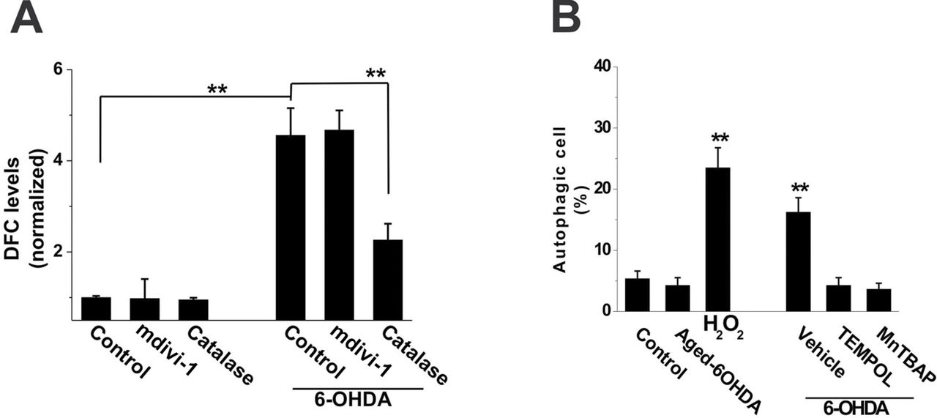
FIG. 5. ROS function as second messengers in 6-OHDA–induced mitochondrial fragmentation and autophagy. (A) Effect of ...
Notes:
FIG. 5. ROS function as second messengers in 6-OHDA–induced mitochondrial fragmentation and autophagy. (A) Effect of 6-OHDA on the MitoP/MitoB ratio in SH-SY5Y cells. Cells that had been incubated with MitoB were incubated under 50µM 6-OHDA for 3h, and then the MitoP/MitoB ratio was determined. Data are means ± SEM of three replicates. (B) Proportions of autophagic cells were determined in at least six different cultures under basal conditions (control) and after 12h of treatments. Cell cultures overexpressing GFP-LC3 protein were challenged either with 50µM aged 6-OHDA or with 100µM H2O2. Parallel cultures were preincubated with 0.2µM TEMPOL or 10nM MnTBAP for 30min prior to treatment with 6-OHDA. Given values are the mean ± SEM of five independent experiments that were performed in quadruplicate. (*p < 0.05; **p 0.05).
Unless provided in the caption above, the following copyright applies to the content of this slide: © The Author 2012. Published by Oxford University Press on behalf of the Society of Toxicology. All rights reserved. For permissions, please email: journals.permissions@oup.com

