Slide 1
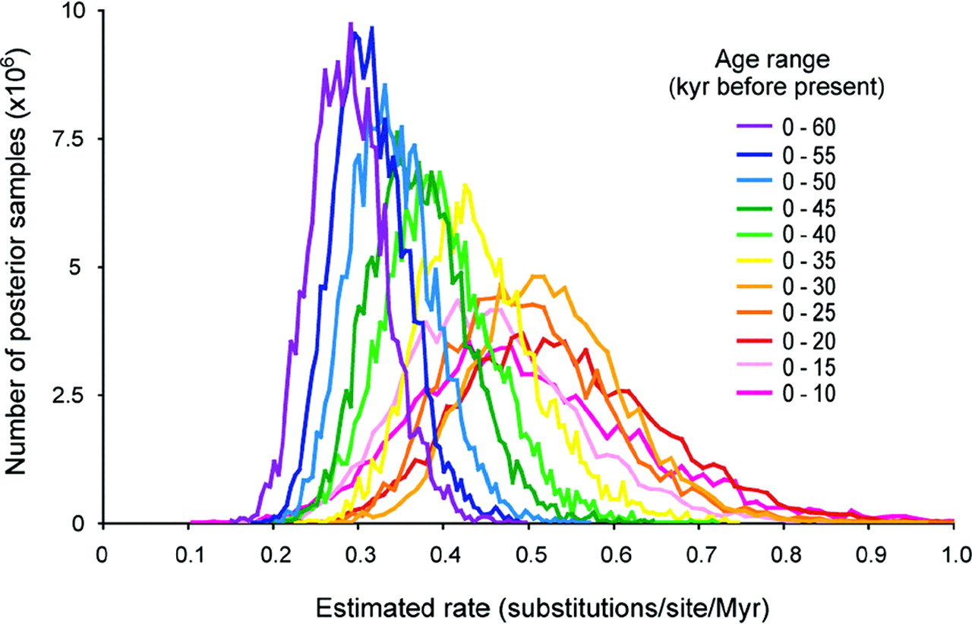
Figure 1 Posterior distributions of substitution rates for 11 data sets of mitochondrial control region sequences from ...
Notes:
Figure 1 Posterior distributions of substitution rates for 11 data sets of mitochondrial control region sequences from Beringian bison. Each data set is a subset of a published alignment of 184 taxa (Shapiro et al., 2004), with sequences ranging in age from 0 to approximately 60 kyr. The 11 data sets used in this analysis were produced by the progressive removal of older sequences from the complete data set in increments of 5 kyr, with an associated decrease in both the number of sequences and in total tree length. The resulting data sets ranged from 184 sequences spanning 60 kyr to 66 sequences spanning only 10 kyr. Each data set was analyzed using the Bayesian phylogenetic software BEAST, with 30,000,000 MCMC steps. The first 10% of the MCMC was discarded as burn-in and parameters were sampled every 3000 steps thereafter. Further details are given in the main text.
Unless provided in the caption above, the following copyright applies to the content of this slide: © 2007 Society of Systematic BiologistsThis article is published and distributed under the terms of the Oxford University Press, Standard Journals Publication Model (https://academic.oup.com/journals/pages/open_access/funder_policies/chorus/standard_publication_model)

