Slide 1
Fig. 1. Donatello, David, ca. 1440, bronze, 158 cm. Museo Nazionale del Bargello, Florence. (Photo: Conway Library, ...
Notes:
Fig. 1. Donatello, David, ca. 1440, bronze, 158 cm. Museo Nazionale del Bargello, Florence. (Photo: Conway Library, The Courtauld Institute of Art.)
Unless provided in the caption above, the following copyright applies to the content of this slide: © The Author 2010. Published by Oxford University Press; all rights reserved

Slide 2
Fig. 2. Agostino Veneziano, after Michelangelo, Soldier Fastening his Trousers, ca. 1517, engraving, 16.4 × 12.1 cm. ...
Notes:
Fig. 2. Agostino Veneziano, after Michelangelo, Soldier Fastening his Trousers, ca. 1517, engraving, 16.4 × 12.1 cm. Department of Prints and Drawings, British Museum, London, H, 3.71. (Photo: The Trustees of the British Museum.)
Unless provided in the caption above, the following copyright applies to the content of this slide: © The Author 2010. Published by Oxford University Press; all rights reserved

Slide 3
Fig. 3. Sandro Botticelli, illustration to Dante, Divina Commedia, Inferno, Canto 21, 1490s, pen and brown ink over ...
Notes:
Fig. 3. Sandro Botticelli, illustration to Dante, Divina Commedia, Inferno, Canto 21, 1490s, pen and brown ink over black chalk underdrawing on parchment, ca. 32.5 × 47.5 cm. Kupferstichkabinett, Berlin, cod. Hamilton 201. (Photo: bpk, Kupferstichkabinett, SMB, Philipp Allard.)
Unless provided in the caption above, the following copyright applies to the content of this slide: © The Author 2010. Published by Oxford University Press; all rights reserved

Slide 4
Fig. 4. Giotto, The Raising of Lazarus, ca. 1306, mural. Scrovegni chapel, Padua. (Photo: Gabinetto Fotografico, ...
Notes:
Fig. 4. Giotto, The Raising of Lazarus, ca. 1306, mural. Scrovegni chapel, Padua. (Photo: Gabinetto Fotografico, Museo Civico, Padua, su gentile concessione del Comune di Padova, Assessorato ai Musei, Politiche Culturali e Spettacoli.)
Unless provided in the caption above, the following copyright applies to the content of this slide: © The Author 2010. Published by Oxford University Press; all rights reserved

Slide 5
Fig. 5. Masaccio, The Beheading of the Baptist, 1426, tempera on panel, 20.8 × 60.1 cm. 20.8 × ca. 30 cm, ...
Notes:
Fig. 5. Masaccio, The Beheading of the Baptist, 1426, tempera on panel, 20.8 × 60.1 cm. 20.8 × ca. 30 cm, Gemäldegalerie, Berlin. (Photo: bpk, Gemäldegalerie, SMB, Jörg P. Anders.)
Unless provided in the caption above, the following copyright applies to the content of this slide: © The Author 2010. Published by Oxford University Press; all rights reserved

Slide 6
Fig. 6. Master of the Osservanza, Flagellation, ca. 1435, tempera on panel, 36.5 × 45.7 cm. Musei Vaticani, Città del ...
Notes:
Fig. 6. Master of the Osservanza, Flagellation, ca. 1435, tempera on panel, 36.5 × 45.7 cm. Musei Vaticani, Città del Vaticano. (Photo: Alinari Archives, Florence.)
Unless provided in the caption above, the following copyright applies to the content of this slide: © The Author 2010. Published by Oxford University Press; all rights reserved

Slide 7
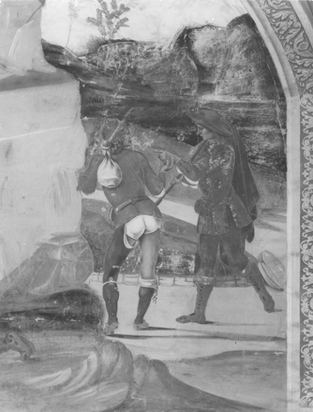
Fig. 7. Luca Signorelli, detail from How Saint Benedict Reproved Fra Valerian's Brother for Breaking his Fast, ...
Notes:
Fig. 7. Luca Signorelli, detail from How Saint Benedict Reproved Fra Valerian's Brother for Breaking his Fast, 1498–99, mural. Monteoliveto Maggiore. (Photo: Tom Henry)
Unless provided in the caption above, the following copyright applies to the content of this slide: © The Author 2010. Published by Oxford University Press; all rights reserved

Slide 8
Fig. 8. Bottega del 1473, San Bernardino Revives a Young Man Wounded by a Ball, 1473, panel. Galleria Nazionale ...
Notes:
Fig. 8. Bottega del 1473, San Bernardino Revives a Young Man Wounded by a Ball, 1473, panel. Galleria Nazionale dell'Umbria, Perugia. (Photo: Galleria Nazionale dell'Umbria.)
Unless provided in the caption above, the following copyright applies to the content of this slide: © The Author 2010. Published by Oxford University Press; all rights reserved

Slide 9
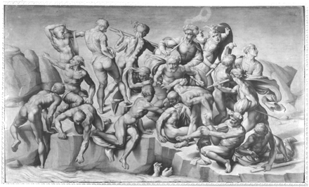
Fig. 9. Aristotile da Sangallo, after Michelangelo, Bathers, 1542, oil on panel, 76.4 × 130.2 cm. Holkham Hall, ...
Notes:
Fig. 9. Aristotile da Sangallo, after Michelangelo, Bathers, 1542, oil on panel, 76.4 × 130.2 cm. Holkham Hall, Norfolk (Photo: Photographic Survey, The Courtauld Institute of Art, reproduced by kind permission of Viscount Coke and the Trustees of the Holkham Estate.)
Unless provided in the caption above, the following copyright applies to the content of this slide: © The Author 2010. Published by Oxford University Press; all rights reserved

Slide 10
Fig. 10. Michelangelo, Compositional Study for the Battle of Cascina, 1504, black chalk over stylus, 23.5 × 35.6 cm. ...
Notes:
Fig. 10. Michelangelo, Compositional Study for the Battle of Cascina, 1504, black chalk over stylus, 23.5 × 35.6 cm. Gabinetto Disegni e Stampe, Uffizi, Florence, 613E. (Photo: Gabinetto Fotografico, Soprintendenza, Florence.)
Unless provided in the caption above, the following copyright applies to the content of this slide: © The Author 2010. Published by Oxford University Press; all rights reserved

Slide 11
Fig. 11. Luca Signorelli, Nude Man, ca. 1498–99, black chalk, 27 × 13.6 cm. Department of Prints and Drawings, British ...
Notes:
Fig. 11. Luca Signorelli, Nude Man, ca. 1498–99, black chalk, 27 × 13.6 cm. Department of Prints and Drawings, British Museum, London, 1946.7.13.11. (Photo: The Trustees of the British Museum.)
Unless provided in the caption above, the following copyright applies to the content of this slide: © The Author 2010. Published by Oxford University Press; all rights reserved

Slide 12
Fig. 12. Michelangelo, Nude from Behind and Other Studies, 1504, black chalk and pen and brown ink, 31.5 × 27.8 cm. ...
Notes:
Fig. 12. Michelangelo, Nude from Behind and Other Studies, 1504, black chalk and pen and brown ink, 31.5 × 27.8 cm. Department of Prints and Drawings, British Museum, London, 1859,0625.564 recto. (Photo: The Trustees of the British Museum.)
Unless provided in the caption above, the following copyright applies to the content of this slide: © The Author 2010. Published by Oxford University Press; all rights reserved

Slide 13
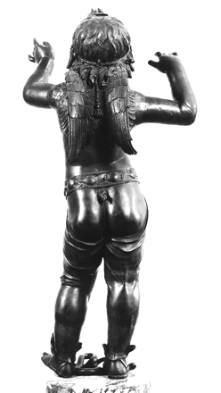
Fig. 13. Donatello, Boy Faun Treading on a Snake (‘Atys /Amorino’), ca. 1440, bronze, height 104 cm. Museo Nazionale ...
Notes:
Fig. 13. Donatello, Boy Faun Treading on a Snake (‘Atys /Amorino’), ca. 1440, bronze, height 104 cm. Museo Nazionale del Bargello, Florence. (Photo: Conway Library, The Courtauld Institute, London.)
Unless provided in the caption above, the following copyright applies to the content of this slide: © The Author 2010. Published by Oxford University Press; all rights reserved

Slide 14
Fig. 14. Raphael, after Michelangelo, David, 1507–8, pen and brown ink over traces of black chalk, 39.6 × 21.9 cm. ...
Notes:
Fig. 14. Raphael, after Michelangelo, David, 1507–8, pen and brown ink over traces of black chalk, 39.6 × 21.9 cm. Department of Prints and Drawings, British Museum, London, Pp. 1.65. (Photo: The Trustees of the British Museum.)
Unless provided in the caption above, the following copyright applies to the content of this slide: © The Author 2010. Published by Oxford University Press; all rights reserved

Slide 15
Fig. 15. Bronzino, detail from the The Gathering of Manna, 1540–45, mural, Chapel of Eleonora of Toledo, Palazzo ...
Notes:
Fig. 15. Bronzino, detail from the The Gathering of Manna, 1540–45, mural, Chapel of Eleonora of Toledo, Palazzo Vecchio, Florence. (Photo: Antonio Quattrone, Florence.)
Unless provided in the caption above, the following copyright applies to the content of this slide: © The Author 2010. Published by Oxford University Press; all rights reserved

