Slide 1
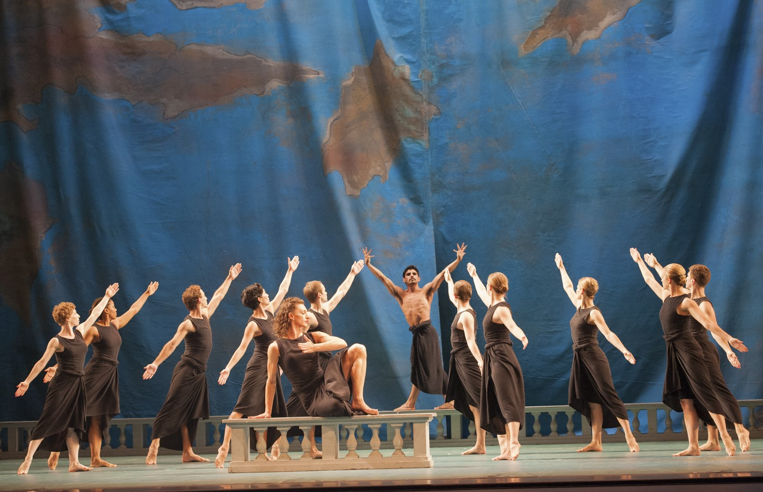
Figure 1 Mark Morris, Dido and Aeneas, Act 1. Set design by Robert Bordo. After Morris's retirement from the role of ...
Notes:
Figure 1 Mark Morris, Dido and Aeneas, Act 1. Set design by Robert Bordo. After Morris's retirement from the role of Dido in 2000, he was succeeded by others. This photograph shows Amber Star Merkens, on bench in foreground, as Dido, and Domingo Estrada, Jr., bare-chested, on balustrade at rear, as Aeneas, with the company. Photograph by Susana Millman ©, courtesy of the Mark Morris Dance Group.
Unless provided in the caption above, the following copyright applies to the content of this slide: © The Author 2015. Published by Oxford University Press. All rights reserved.For permissions, please e-mail: journals.permissions@oup.com

