Slide 1
Figure 1. Flowchart schema of the microarray experiment. The schematic represents the steps for an experiment. Dorsal ...
Notes:
Figure 1. Flowchart schema of the microarray experiment. The schematic represents the steps for an experiment. Dorsal dissections of A, M, and P from each litter were combined to obtain pooled RNA samples, which were consequently used to for comparative hybridizations of A versus M and A versus P on cDNA microarrays. Each comparison was run in duplicate with a dye flip, resulting in a total of 4 slides per litter. The microarray experiment presented used 4 litters for a total of 16 slides.
Unless provided in the caption above, the following copyright applies to the content of this slide: © The Author 2006. Published by Oxford University Press. All rights reserved. For permissions, please e-mail: journals.permissions@oxfordjournals.org

Slide 2
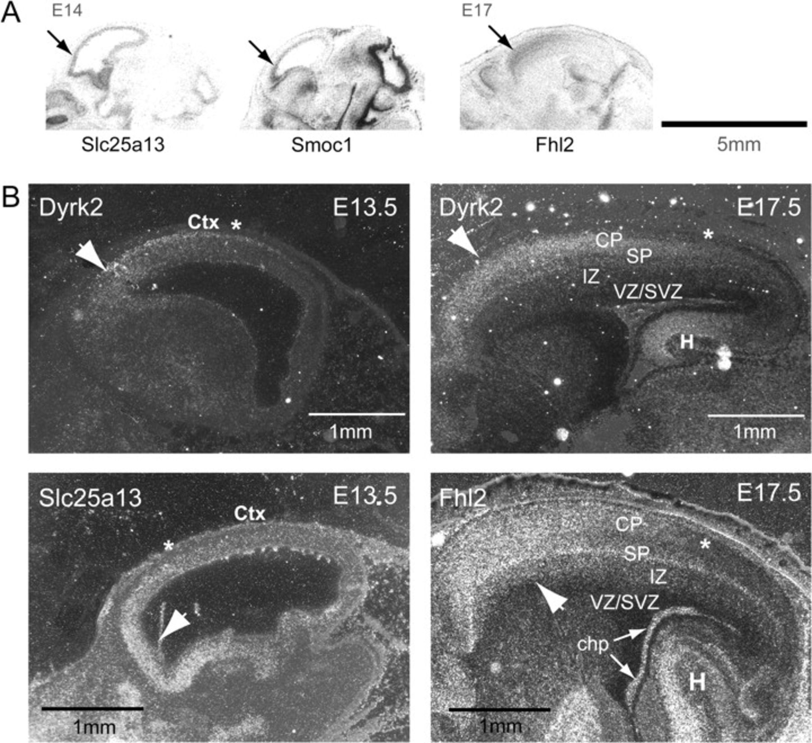
Figure 2. Genes with enriched anterior expression. (A) Autoradiographic images of in situ hybridization with probes ...
Notes:
Figure 2. Genes with enriched anterior expression. (A) Autoradiographic images of in situ hybridization with probes representing anterior-enriched genes showing a clear gradient along the A-P axis of the developing telencephalon. (B) Images from emulsion dipped slides representing mRNA expression (silver grains) of anterior-enriched genes. Slc25a13 is expressed strongly in the anterior telencephalon at E13.5. Fhl2 is expressed anteriorly most prominently at E17.5. Note that the expression is strong in all the cortical layers but is low in the ventricular zone, suggesting that Fhl2 is expressed by postmitotic neural cells. It is also expressed at high levels in the choroid plexus, the differentiating hippocampus, and the thalamus. Dyrk2 is expressed strongly in the cortical plate and the hippocampus but expressed weakly in the VZ/SVZ. chp: choroid plexus, CP: cortical plate, Ctx: cortex, H: hippocampus, IZ: intermediate zone, SP: subplate. Arrows point to the regions of enriched expression. Asterisks indicate expression boundaries. Anterior is to the left.
Unless provided in the caption above, the following copyright applies to the content of this slide: © The Author 2006. Published by Oxford University Press. All rights reserved. For permissions, please e-mail: journals.permissions@oxfordjournals.org

Slide 3
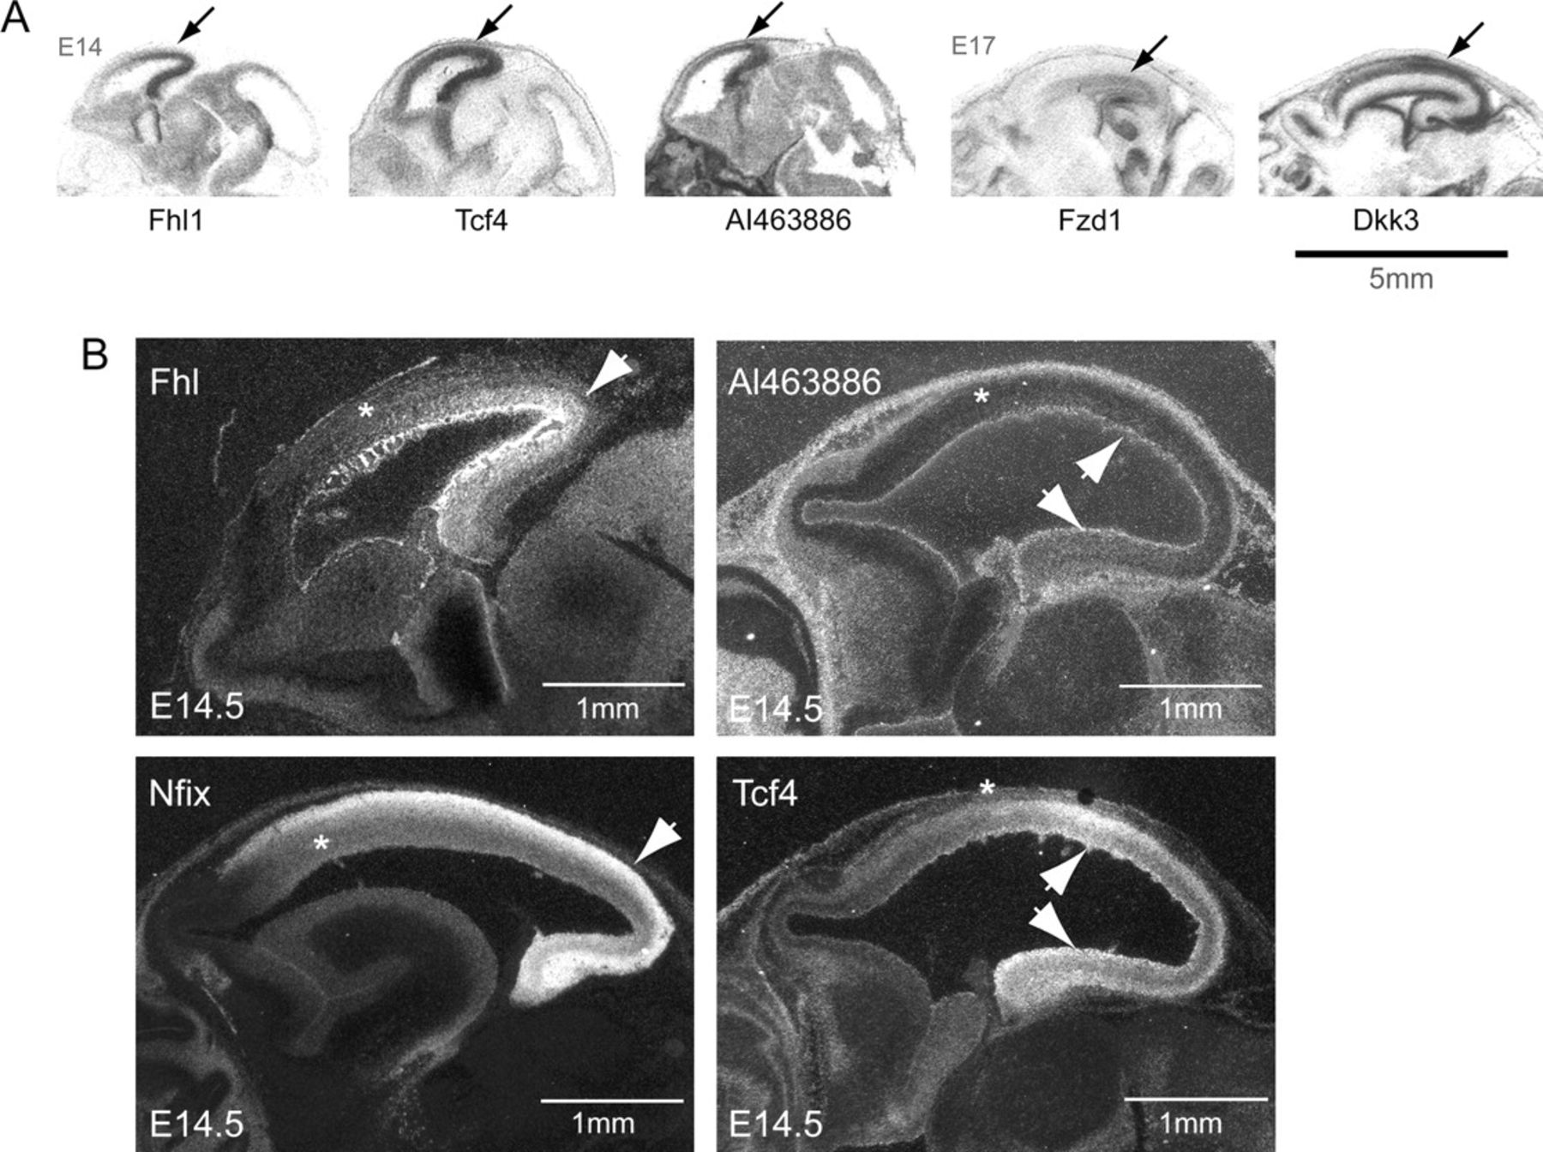
Figure 3. Posterior-enriched genes. (A) Autoradiographic film images of posterior-enriched genes showing a clear ...
Notes:
Figure 3. Posterior-enriched genes. (A) Autoradiographic film images of posterior-enriched genes showing a clear gradient along the A-P axis of the developing telencephalon. (B) Dark field images representing mRNA expression of posterior-enriched genes after developing slides dipped in photographic emulsion. Fhl1 and AI463886 show a strong A-P gradient at E14.5 (see Methods). Anterior is to the left. Arrows point to the regions of enriched expression. Asterisks indicate relative expression boundaries, which in most cases were gradual.
Unless provided in the caption above, the following copyright applies to the content of this slide: © The Author 2006. Published by Oxford University Press. All rights reserved. For permissions, please e-mail: journals.permissions@oxfordjournals.org

Slide 4
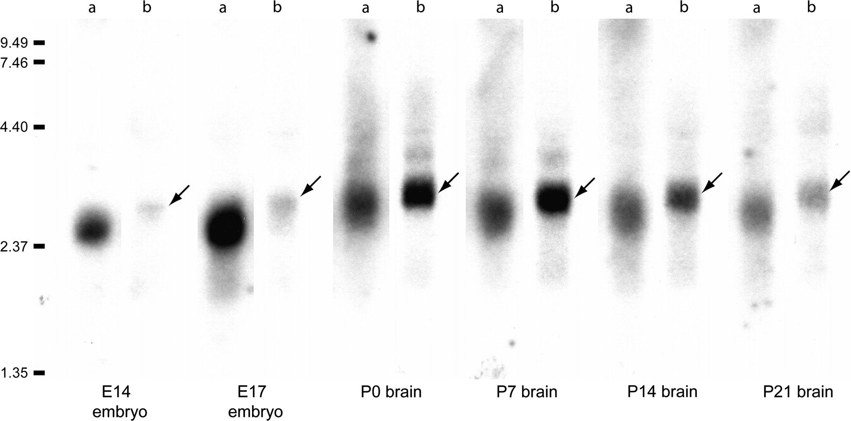
Figure 4. Northern blot analysis of Fhl1 and Fhl1Bm expression in total RNA. Fhl1 (lanes a) was expressed at high ...
Notes:
Figure 4. Northern blot analysis of Fhl1 and Fhl1Bm expression in total RNA. Fhl1 (lanes a) was expressed at high levels in the embryonic tissue and decreased postnatally. Note that the bands are narrower for the Fhl1Bm (lanes b) hybridization, indicating the specificity of the probe to this particular isoform. Most difference is seen at E14 and E17, showing that Fhl1Bm is not high during embryogenesis, and does not seem to be the predominant isoform of Fhl1 in embryonic or fetal brain. Arrows point to the bands for Fhl1Bm that is larger than that for the wider bands seen with Fhl1 probe.
Unless provided in the caption above, the following copyright applies to the content of this slide: © The Author 2006. Published by Oxford University Press. All rights reserved. For permissions, please e-mail: journals.permissions@oxfordjournals.org

Slide 5
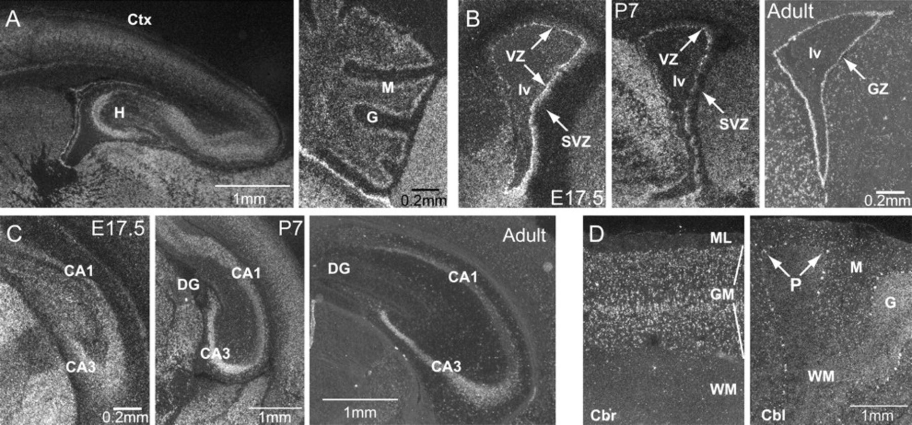
Figure 5. Fhl1 expression patterns in the telencephalon. (A) P0 sagittal section showed strong expression of Fhl1 in ...
Notes:
Figure 5. Fhl1 expression patterns in the telencephalon. (A) P0 sagittal section showed strong expression of Fhl1 in most areas of the cerebral cortex and other telencephalic structures, as well as the cerebellum. (B) Coronal sections of the germinal layer (medial to the left) showed Fhl1 expression through adulthood. (C) Fhl1 was expressed in the hippocampus throughout development, and in the adult the expression became more limited to the CA1 and CA3 regions, with much less robust expression in the dentate gyrus. (D) In situ hybridization of Fhl1 on adult human brain shows that Fhl1 signal is strong in pyramidal neurons in the gray matter in all cortical layers. The expression of Fhl1 appears to be expressed by different cell types in the cerebellum but most prominently in the Purkinje cells. CA1 and CA3: cornu ammonis 1 and 3, Cbl: cerebellum, Cbr: cerebral cortex; Ctx: cortex, DG: dentate gyrus, G: granular layer, GM: gray matter; GZ: germinal zone, lv: lateral ventricle, M: molecular layer of the cerebellum, ML: molecular layer, P: Purkinje cell layer, WM: white matter.
Unless provided in the caption above, the following copyright applies to the content of this slide: © The Author 2006. Published by Oxford University Press. All rights reserved. For permissions, please e-mail: journals.permissions@oxfordjournals.org

Slide 6
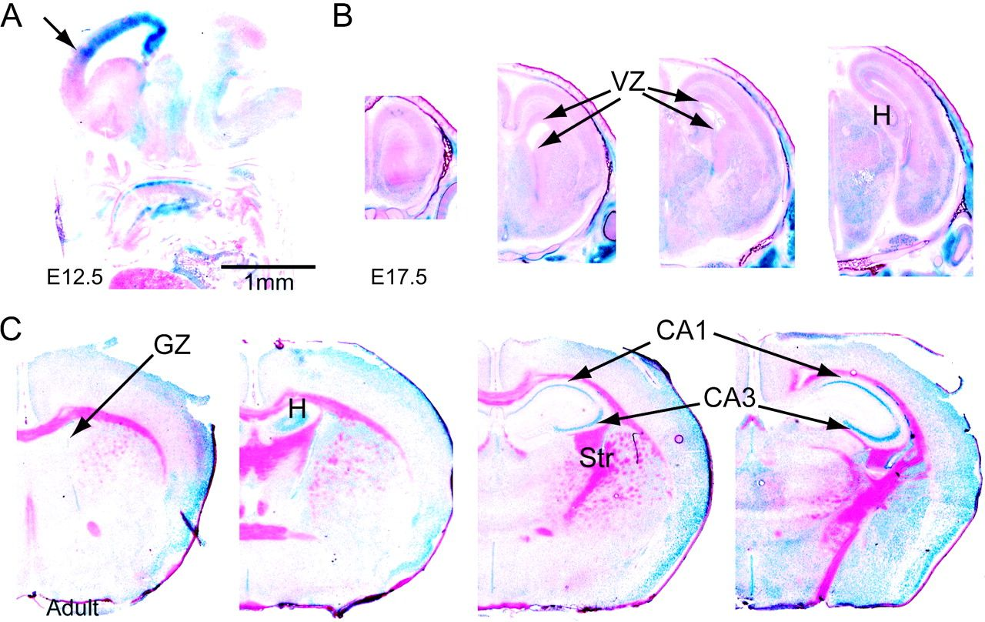
Figure 6. LacZ staining on Fhl1 +/− adult brain. (A) Sagittal section of an E14 Fhl1 +/− mouse facing left. (B and C) ...
Notes:
Figure 6. LacZ staining on Fhl1 +/− adult brain. (A) Sagittal section of an E14 Fhl1 +/− mouse facing left. (B and C) Coronal sections (rostral to caudal in left to right) of brains from an E17 Fhl1 +/− mouse and an adult Fhl1 −/y mouse, respectively. The staining pattern shows highest levels in the ventral-most regions of the VZ at E17.5 and pyramidal neurons of the adult hippocampus, identical to that of Fhl1 expression in the wild-type brains. CA1 and CA3: cornu ammonis 1 and 3, GZ: germinal zone, H: hippocampus, Str: striatum.
Unless provided in the caption above, the following copyright applies to the content of this slide: © The Author 2006. Published by Oxford University Press. All rights reserved. For permissions, please e-mail: journals.permissions@oxfordjournals.org

Slide 7
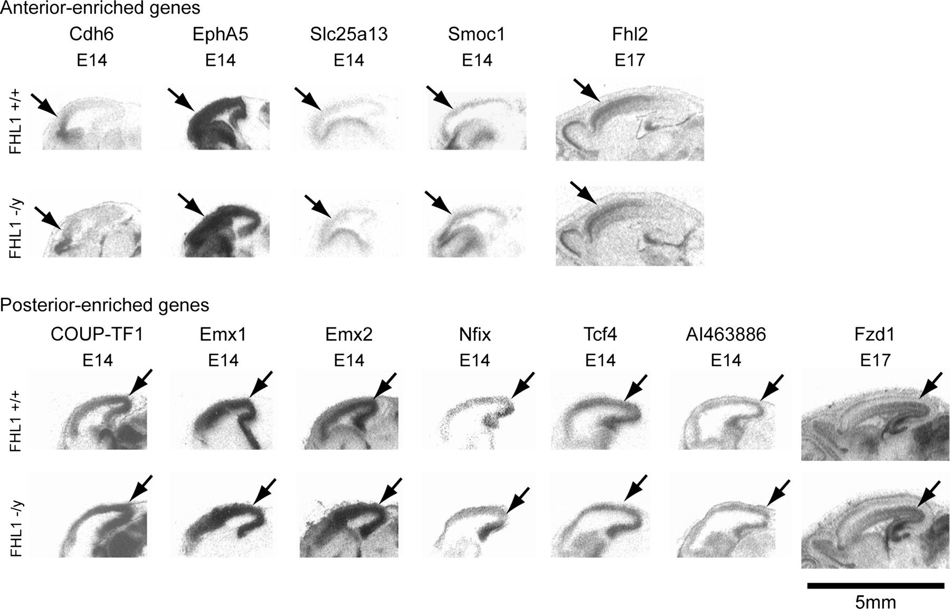
Figure 7. Expression of A-P gradient genes in Fhl1 knockout mice. The images are low-power autoradiographs of sagittal ...
Notes:
Figure 7. Expression of A-P gradient genes in Fhl1 knockout mice. The images are low-power autoradiographs of sagittal sections. The expression patterns of both known and newly identified genes regionalized along the A-P axis show comparable gradients in the Fhl1 knockout animals compared with their wild-type littermates. Arrows point to the regions of enriched expression in the cortex.
Unless provided in the caption above, the following copyright applies to the content of this slide: © The Author 2006. Published by Oxford University Press. All rights reserved. For permissions, please e-mail: journals.permissions@oxfordjournals.org

Slide 8
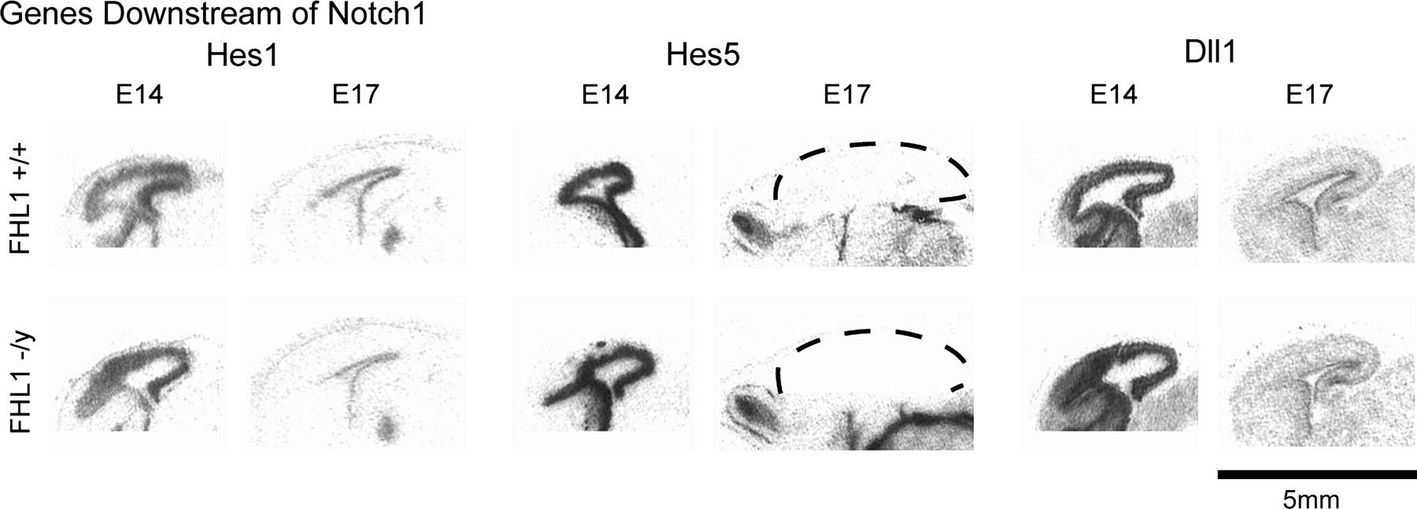
Figure 8. Expression of genes downstream of Notch1 in Fhl1 knockout mice. Low-power autoradiographs of sagittal ...
Notes:
Figure 8. Expression of genes downstream of Notch1 in Fhl1 knockout mice. Low-power autoradiographs of sagittal sections show that the expression patterns and levels of Hes1, Hes5, and Dll1 appear unaltered in the E14 and E17 mice that are deficient in Fhl1. Dashed lines outline the cerebral cortex.
Unless provided in the caption above, the following copyright applies to the content of this slide: © The Author 2006. Published by Oxford University Press. All rights reserved. For permissions, please e-mail: journals.permissions@oxfordjournals.org

