Slide 1
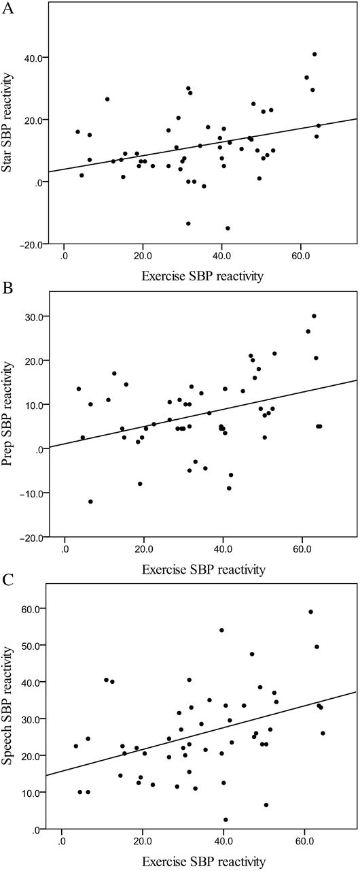
Figure 1. Unadjusted associations between systolic blood pressure (SBP) reactivity during exercise (5 metabolic ...
Notes:
Figure 1. Unadjusted associations between systolic blood pressure (SBP) reactivity during exercise (5 metabolic equivalents) and (a) SBP reactivity during star tracing (β = 0.34, P = 0.01), (b) SBP reactivity during speech preparation (β = 0.37, P = 0.007), and (c) SBP reactivity during speech (β = 0.41, P = 0.003).
Unless provided in the caption above, the following copyright applies to the content of this slide: © American Journal of Hypertension, Ltd 2013. All rights reserved. For Permissions, please email: journals.permissions@oup.com

