Slide 1
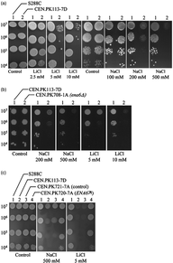
1 (a) Na⁺ and Li⁺ sensitivity of Saccharomyces cerevisiae S288C and CEN.PK113-7D, (b) ...
Notes:
1 (a) Na+ and Li+ sensitivity of Saccharomyces cerevisiae S288C and CEN.PK113-7D, (b) Na+ and Li+ tolerance of S. cerevisiae parental strain and ena6Δ deletion mutant CEN.PK708-1A (c) Na+ and Li+ tolerance of S. cerevisiae S288C, CEN.PK113-7D, CEN.PK721-7A (control strain carrying an empty vector) and CEN.PK720-7A overexpressing ENA6 on a multicopy plasmid behind its own promoter. Saccharomyces cerevisiae strains were grown overnight at 30°C in shake-flask cultures containing YPD medium (Sherman, 1991), and were then washed once with water and resuspended in an equal amount of water. After counting, cell suspensions were diluted and spotted on agar plates containing defined minimal medium (Verduyn, 1992) supplemented with the specified concentration of salt and adjusted to pH 6 with potassium hydroxide. Two percent glucose was used as the carbon source. The strains and primer sets used in this work are described in Tables S2 and S3.
Unless provided in the caption above, the following copyright applies to the content of this slide: © 2009 Federation of European Microbiological Societies. Published by Blackwell Publishing Ltd. All rights reserved

