Slide 1
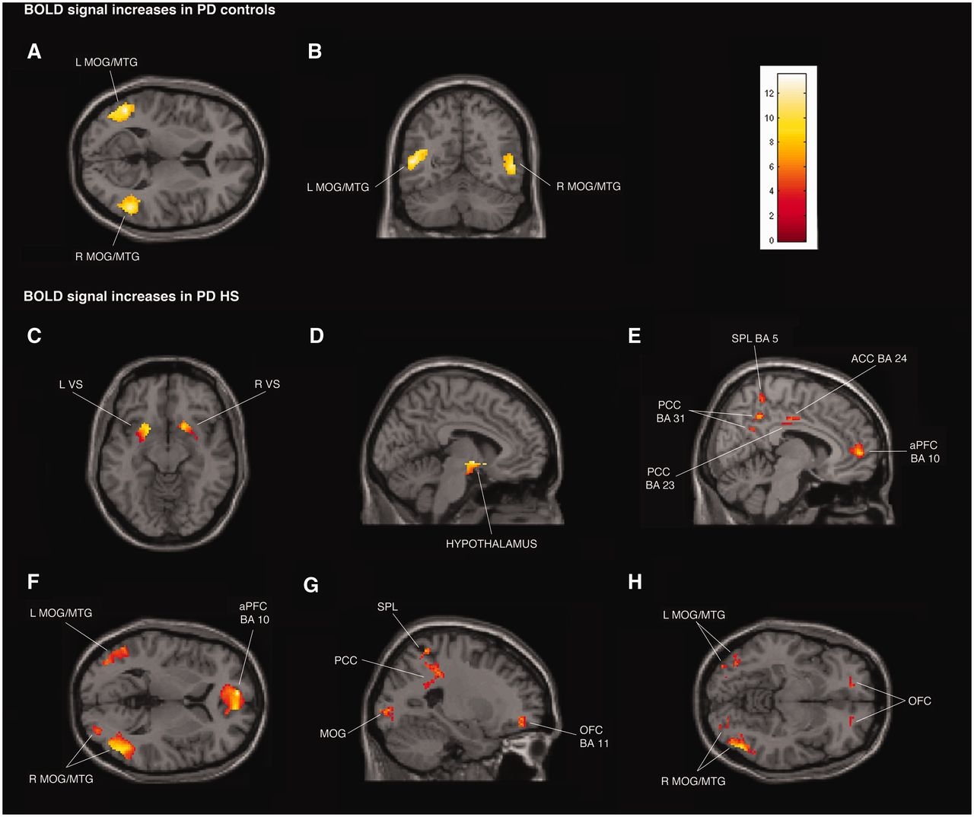
Figure 1 Transverse, coronal and sagittal sections of statistical parametric maps showing significant BOLD signal ...
Notes:
Figure 1 Transverse, coronal and sagittal sections of statistical parametric maps showing significant BOLD signal increases (yellow–red areas) associated with exposure to common sexual imagery in 12 Parkinson’s disease (PD) control patients (A and B) and in 12 patients with Parkinson’s disease with hypersexuality (PD HS) (C–H) during ON and OFF medication states. BOLD signal increases are illustrated in (A and B) left and right middle temporal gyrus (MTG) and middle occipital gyrus (MOG) (x = −48, y = −59, z = 9), (C) ventral striatum (VS) (x = 18, y = 15, z = − 11), (D) hypothalamus (x = −5, y = −4, z = −9), (E) anterior prefrontal cortex (aPFC), anterior cingulate cortex (ACC), superior parietal lobule (SPL) and posterior cingulate cortex (PCC) (x = 8, y = −16, z = 33), (F) left and right middle temporal gyrus and middle occipital gyrus and anterior prefrontal cortex (x = −8, y = 56, z = 4), and (G and H) orbitofrontal cortex (OFC), superior parietal lobule, posterior cingulate cortex, and left and right middle temporal gyrus and middle occipital gyrus (x = −24, y = 48, z = −8). The colour bar indicates z-values.
Unless provided in the caption above, the following copyright applies to the content of this slide: © The Author (2013). Published by Oxford University Press on behalf of the Guarantors of Brain. All rights reserved. For Permissions, please email: journals.permissions@oup.com

