Slide 1
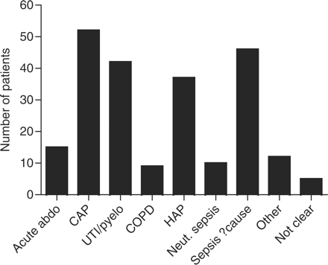
Figure 1. Frequency chart of indication for gentamicin use. Acute abdo: acute abdomen; CAP: community-acquired ...
Notes:
Figure 1. Frequency chart of indication for gentamicin use. Acute abdo: acute abdomen; CAP: community-acquired pneumonia; UTI/pyelo: complicated urinary tract infection/pyelonephritis; COPD: infective exacerbation of chronic obstructive pulmonary disease; HAP: hospital acquired pneumonia, neut sepsis: neutropaenic sepsis, other: an indication outside microbiology guidelines, not clear: indication unclear from hospital case notes review.
Unless provided in the caption above, the following copyright applies to the content of this slide: © The Author 2009. Published by Oxford University Press on behalf of the Association of Physicians. All rights reserved. For Permissions, please email: journals.permissions@oxfordjournals.org

Slide 2
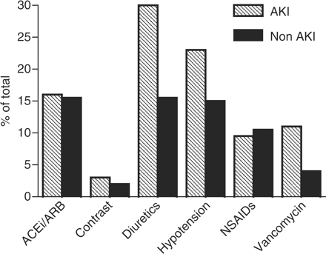
Figure 2. Frequency of additional factors that may potentially contribute to the development of AKI. NSAIDs = ...
Notes:
Figure 2. Frequency of additional factors that may potentially contribute to the development of AKI. NSAIDs = non-steroidal anti-inflammatory agents; ACEi/ARB = angiotensin converting inhibitors or angiotensin receptor blockers.
Unless provided in the caption above, the following copyright applies to the content of this slide: © The Author 2009. Published by Oxford University Press on behalf of the Association of Physicians. All rights reserved. For Permissions, please email: journals.permissions@oxfordjournals.org

Slide 3
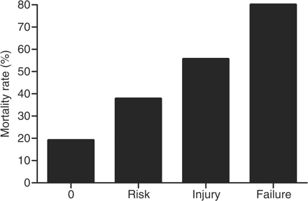
Figure 3. Proportion of in-patient mortality stratified by RIFLE criteria. The chi-squared test for trend highly ...
Notes:
Figure 3. Proportion of in-patient mortality stratified by RIFLE criteria. The chi-squared test for trend highly significant (P < 0.0001) and logistic regression analysis calculated an odds ratio of 2.62 for each increase in RIFLE score (95% CI 1.59–4.31).
Unless provided in the caption above, the following copyright applies to the content of this slide: © The Author 2009. Published by Oxford University Press on behalf of the Association of Physicians. All rights reserved. For Permissions, please email: journals.permissions@oxfordjournals.org

