Slide 1
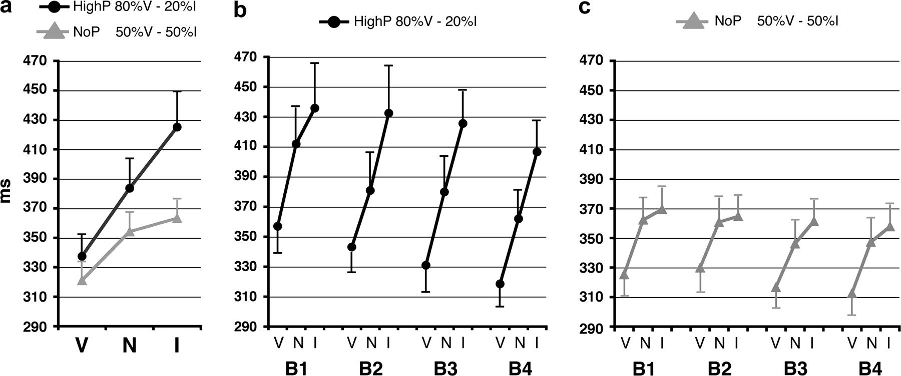
Figure 2. (A) Task performance during fMRI. Group-averaged RTs to Valid, Neutral, and Invalid targets in the High ...
Notes:
Figure 2. (A) Task performance during fMRI. Group-averaged RTs to Valid, Neutral, and Invalid targets in the High Cue-Predictiveness (HighP—80%Valid/20% Invalid trials) and No Cue-Predictiveness (NoP—50%Valid/50% Invalid trials) experimental groups. (B) Averaged RTs to Valid (V), Neutral (N), and Invalid (I) targets of the HighP group in the 4 consecutive blocks (B) of trials. (C) Averaged RTs to Valid, Neutral, and Invalid targets of the NoP group in the 4 consecutive blocks of trials. The NoP group shows selective abatement of attentional costs (RT difference between Invalid and Neutral trials). The performance of both groups was stable across consecutive blocks of trials.
Unless provided in the caption above, the following copyright applies to the content of this slide: © The Author 2009. Published by Oxford University Press. All rights reserved. For permissions, please e-mail: journals.permissions@oxfordjournals.org

Slide 2
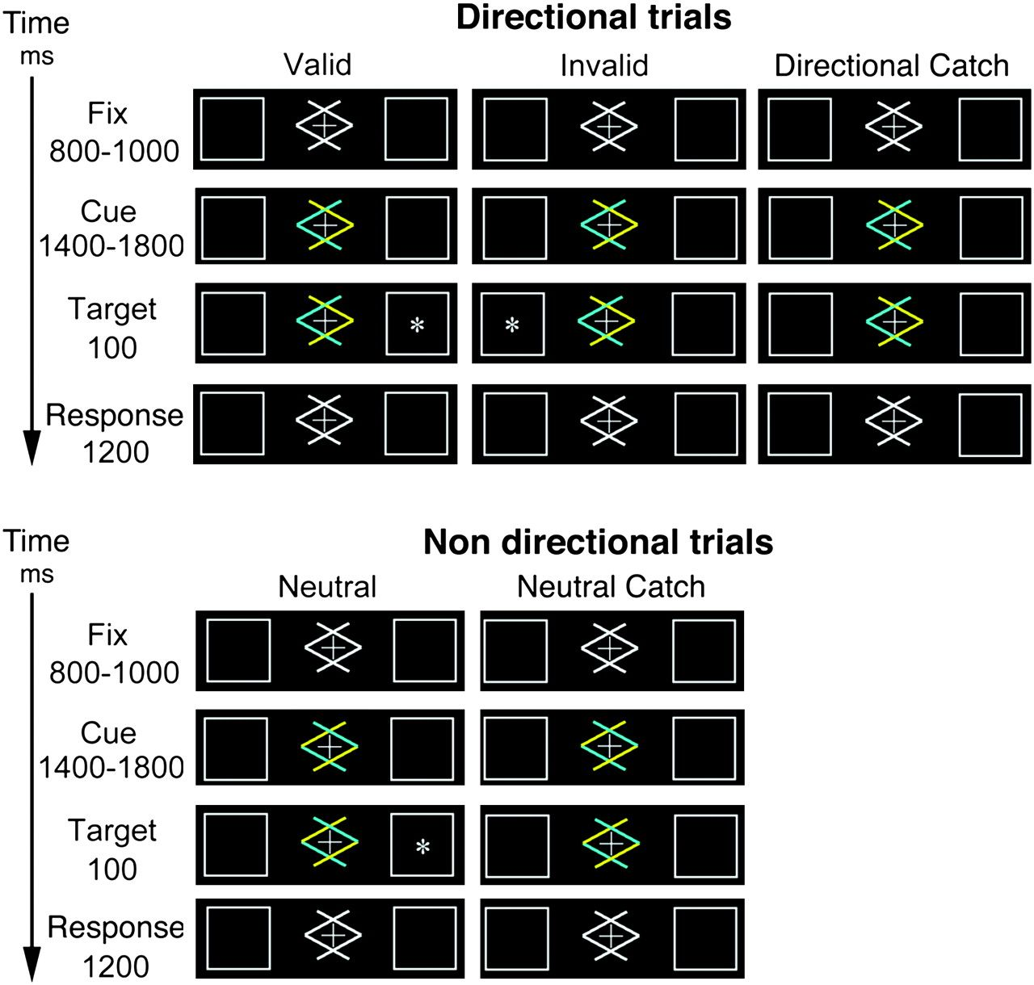
Figure 1. Time course of events during experimental trials (see Materials and Methods section for details). On ...
Notes:
Figure 1. Time course of events during experimental trials (see Materials and Methods section for details). On Directional trials, each one of the colored arrows cues one of the lateral boxes: Half of the participants were instructed to pay attention to the box pointed by the blue arrow and the other half to the box pointed by the yellow arrow. On nondirectional trials, mixed-color arrows did not allow orienting of attention to either boxes. No target was presented on Directional Catch and Neutral Catch trials.
Unless provided in the caption above, the following copyright applies to the content of this slide: © The Author 2009. Published by Oxford University Press. All rights reserved. For permissions, please e-mail: journals.permissions@oxfordjournals.org

Slide 3
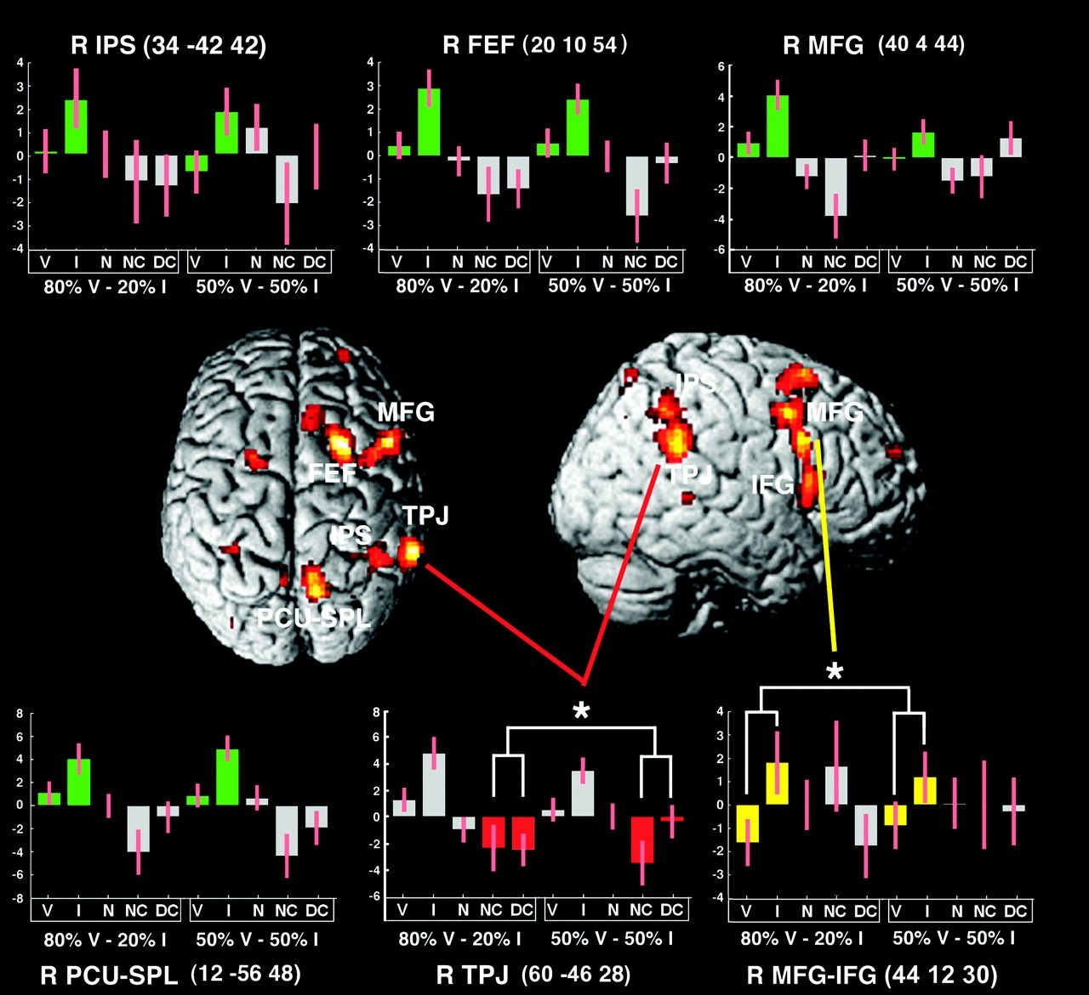
Figure 3. Areas showing greater BOLD response to Invalid than Valid trials (P <0.05 “corrected at cluster level”). The ...
Notes:
Figure 3. Areas showing greater BOLD response to Invalid than Valid trials (P <0.05 “corrected at cluster level”). The plots show the z-score of each local maxima (±90% of confidence interval) as a function of trial-type and cue-predictiveness conditions (HighP, NoP). V: valid trials, I: invalid trials, N: neutral trials, NC: neutral catch trials, and DC: directional catch trials. In each plot, the first 5 bars on the left side of the abscissa refer to the HighP condition (80% Valid/20% Invalid trials) and the 5 bars on the right side of the abscissa to the NoP condition (50% Valid/50% Invalid trials). The right TPJ showed a significant interaction of cue predictiveness (red bars with asterisk): It was more inhibited during the cue period in the HighP as compared with the NoP condition. The right mid-inferior frontal gyrus (MFG–IFG) showed a significant interaction of cue predictiveness (yellow bars with asterisk): It was more activated in response to infrequent Invalid targets in the HighP as compared with the NoP condition. The other local maxima did not show interactions as a function of cue predictiveness (green bars). TPJ: temporal–parietal junction, MFG: mid frontal gyrus, IFG: inferior frontal gyrus, MFG–IFG: mid-inferior frontal gyrus, FEF: frontal eye fields, PCU: precuneus, SPL: superior parietal lobule, and IPS: intraparietal sulcus.
Unless provided in the caption above, the following copyright applies to the content of this slide: © The Author 2009. Published by Oxford University Press. All rights reserved. For permissions, please e-mail: journals.permissions@oxfordjournals.org

Slide 4
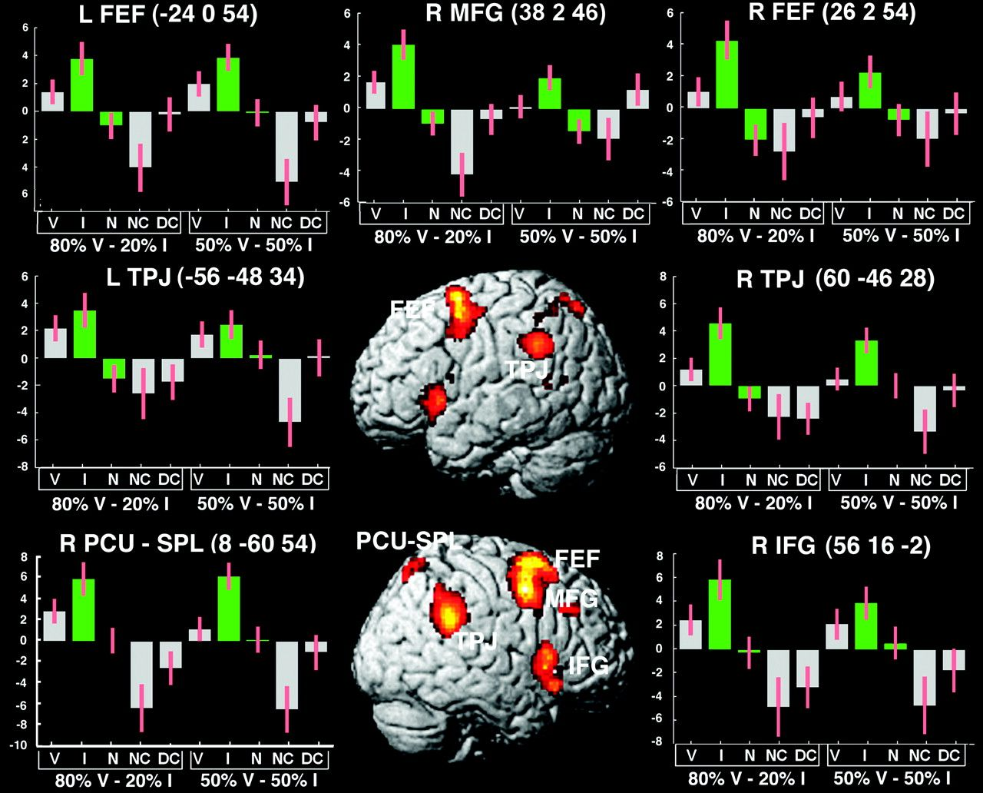
Figure 4. Areas showing greater BOLD responses to Invalid than Neutral trials (P <0.05 corrected at cluster level). No ...
Notes:
Figure 4. Areas showing greater BOLD responses to Invalid than Neutral trials (P <0.05 corrected at cluster level). No area showed a significant interaction as a function of cue predictiveness.
Unless provided in the caption above, the following copyright applies to the content of this slide: © The Author 2009. Published by Oxford University Press. All rights reserved. For permissions, please e-mail: journals.permissions@oxfordjournals.org

Slide 5
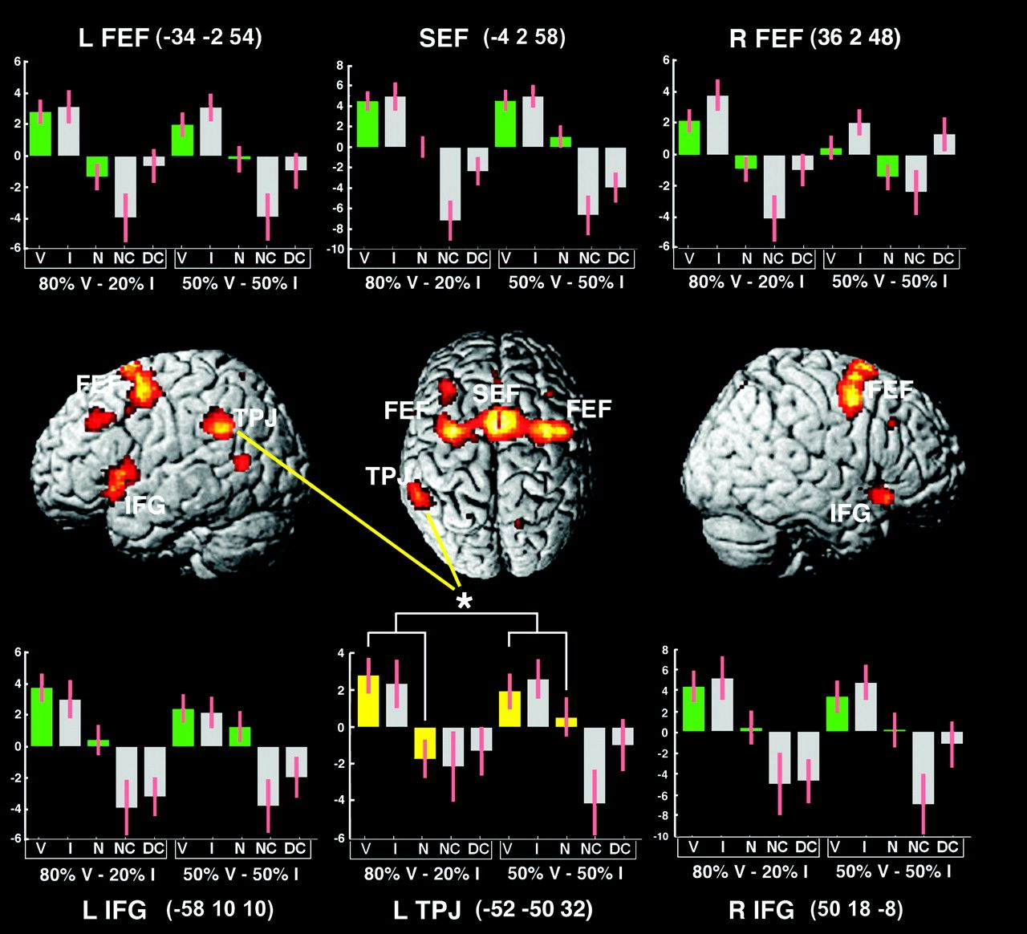
Figure 5. Areas showing greater BOLD responses to Valid than Neutral trials (P< 0.05 corrected at cluster level). The ...
Notes:
Figure 5. Areas showing greater BOLD responses to Valid than Neutral trials (P< 0.05 corrected at cluster level). The left TPJ was more activated by targets in the HighP as compared with the NoP condition (yellow bars with asterisk). The left IFG showed a similar interaction that was significant at P uncorrected level (P = 0.01). No equivalent interaction was found in all other areas. SEF: supplementary eye fields.
Unless provided in the caption above, the following copyright applies to the content of this slide: © The Author 2009. Published by Oxford University Press. All rights reserved. For permissions, please e-mail: journals.permissions@oxfordjournals.org

Slide 6
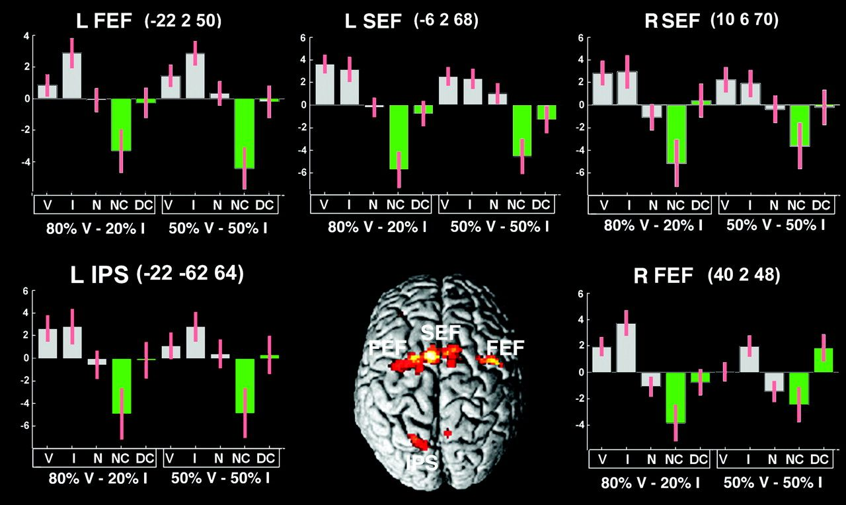
Figure 6. Areas showing greater BOLD responses during endogenous attentional orienting, as resulting from the ...
Notes:
Figure 6. Areas showing greater BOLD responses during endogenous attentional orienting, as resulting from the comparison between Directional Catch and Neutral Catch trials (P <0.05 corrected at cluster level). Clusters in the left IPS and the right FEF were significant at P uncorrected at cluster level (P = 0.02 and P = 0.01, respectively). None of these areas showed an interaction with cue predictiveness.
Unless provided in the caption above, the following copyright applies to the content of this slide: © The Author 2009. Published by Oxford University Press. All rights reserved. For permissions, please e-mail: journals.permissions@oxfordjournals.org

