Slide 1
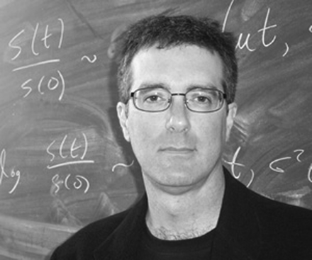
H. Allen Orr is the Shirley Cox Kearns Professor of Biology at the University of Rochester. He received his ...
Notes:
H. Allen Orr is the Shirley Cox Kearns Professor of Biology at the University of Rochester. He received his Ph.D. from The University of Chicago and performed postdoctoral research at the University of California, Davis. His research focuses on experimental and theoretical studies of speciation and the genetics of adaptation. He recently published the book Speciation (with Jerry A. Coyne), a scholarly review of research on the origin of species. In addition to his scientific work, Orr is a frequent contributor of book reviews and critical essays to such publications as The New Yorker and The New York Review of Books. He has been the recipient of a Guggenheim Fellowship, a David and Lucile Packard Fellowship in Science and Engineering, an Alfred P. Sloan Foundation Postdoctoral Fellowship, and a Rockefeller Foundation Scholar in Residence Fellowship (Bellagio Study Center). This Wilhelmine E. Key Lecture as delivered on July 24, 2006 at the “Genetics of Speciation” meeting in Vancouver, CA.
Unless provided in the caption above, the following copyright applies to the content of this slide: © The American Genetic Association. 2006. All rights reserved. For permissions, please email: journals.permissions@oxfordjournals.org.

Slide 2
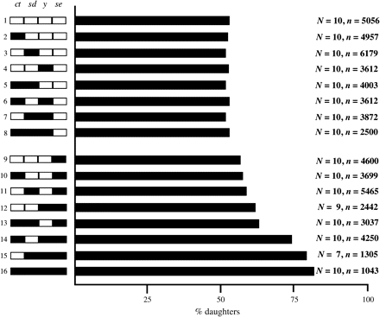
Figure 1 Mapping of chromosomal regions causing segregation distortion in hybrids between the Bogota and USA ...
Notes:
Figure 1 Mapping of chromosomal regions causing segregation distortion in hybrids between the Bogota and USA subspecies of Drosophila pseudoobscura. Recombinant X chromosomes among backcross males are shown on the y axis (region in black are from Bogota, whereas regions in white are from USA; ct, sd, y, and se correspond to mapped visible markers on the X chromosome); progeny sex ratio from these backcross males is shown on the x axis. Strong segregation distortion occurs only when hybrid males carry all relevant regions from the Bogota subspecies.
Unless provided in the caption above, the following copyright applies to the content of this slide: © The American Genetic Association. 2006. All rights reserved. For permissions, please email: journals.permissions@oxfordjournals.org.

Slide 3
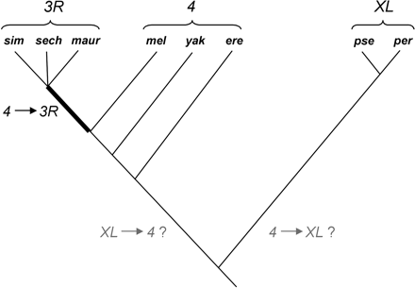
Figure 2 JYAlpha location in the subgenus Sophophora of the genus Drosophila. The branch on which JYAlpha's ...
Notes:
Figure 2 JYAlpha location in the subgenus Sophophora of the genus Drosophila. The branch on which JYAlpha's transposition from chromosome 4 to chromosome 3 occurred is shown in bold. Another JYAlpha transposition event occurred between D. pseudoobscura–D. persimilis and the melanogaster group species, although its directionality is presently unclear. Chromosome arm XL of D. pseudoobscura and D. persimilis is not homologous to an autosomal arm of D. melanogaster or its sister species. Abbreviations: sim = D. simulans; sech = D. sechellia; maur = D. mauritiana; mel = D. melanogaster; yak = D. yakuba; ere = D. erecta; pse = D. pseudoobscura; per = D. persimilis.
Unless provided in the caption above, the following copyright applies to the content of this slide: © The American Genetic Association. 2006. All rights reserved. For permissions, please email: journals.permissions@oxfordjournals.org.

