Slide 1
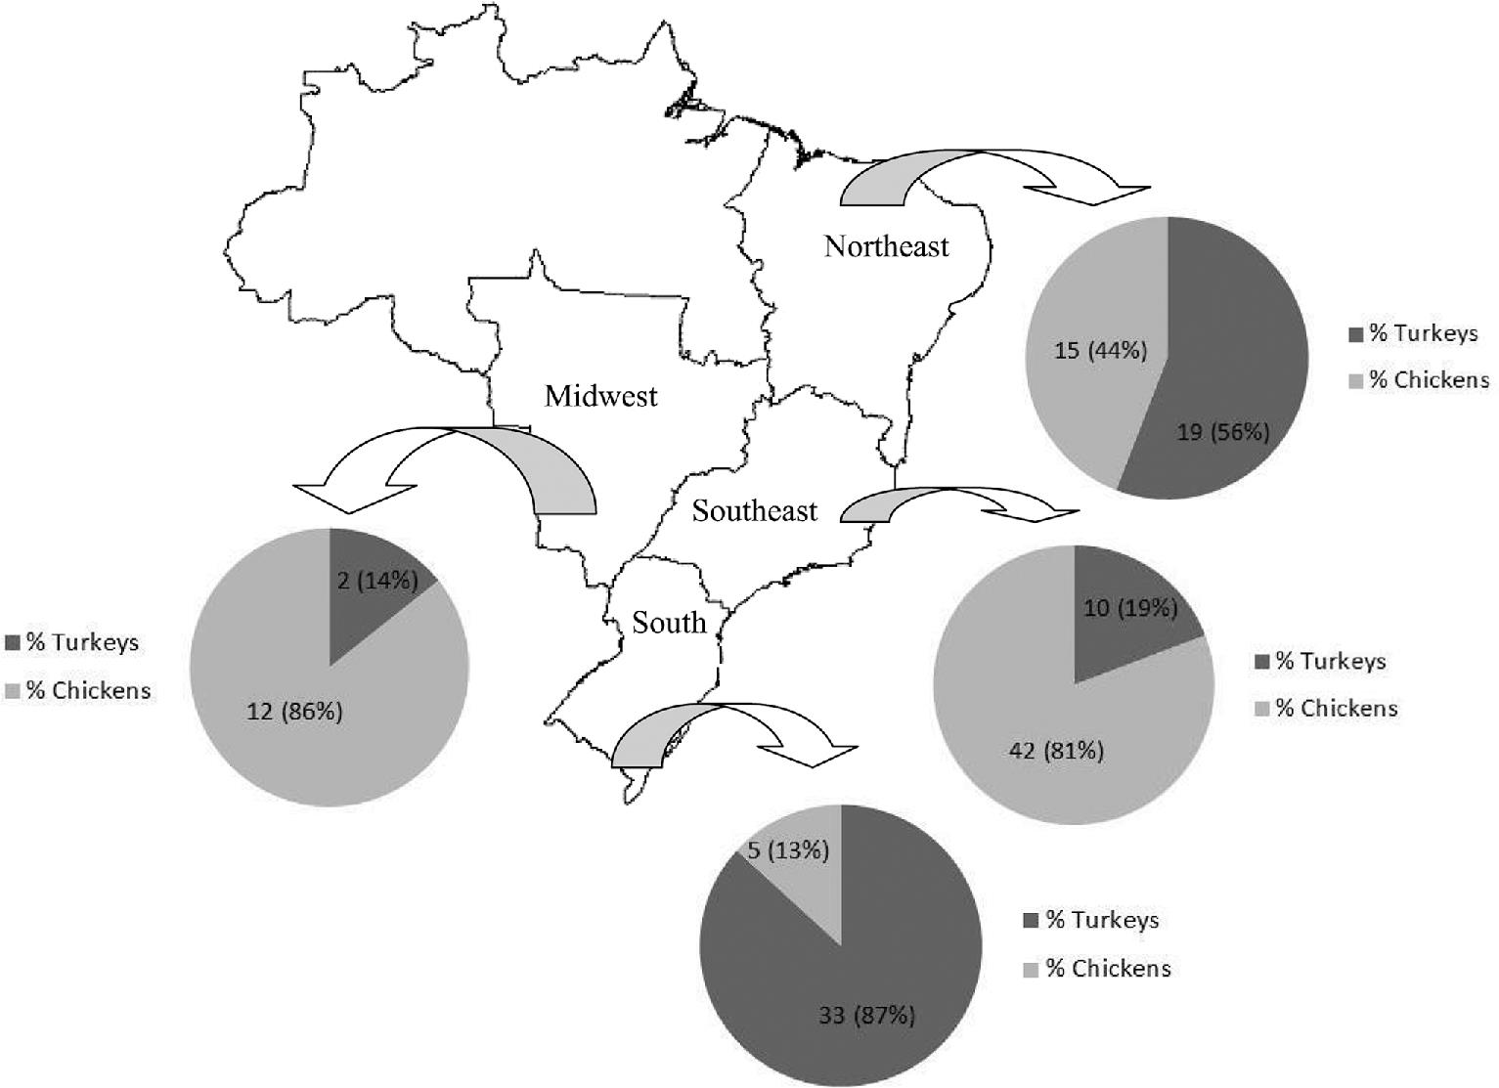
Figure 1. Geographical origin and host species (chicken or turkey) of the 138 Escherichia coli isolates.
Notes:
Figure 1. Geographical origin and host species (chicken or turkey) of the 138 Escherichia coli isolates.
Unless provided in the caption above, the following copyright applies to the content of this slide: © 2015 Poultry Science Association Inc.

