Slide 1
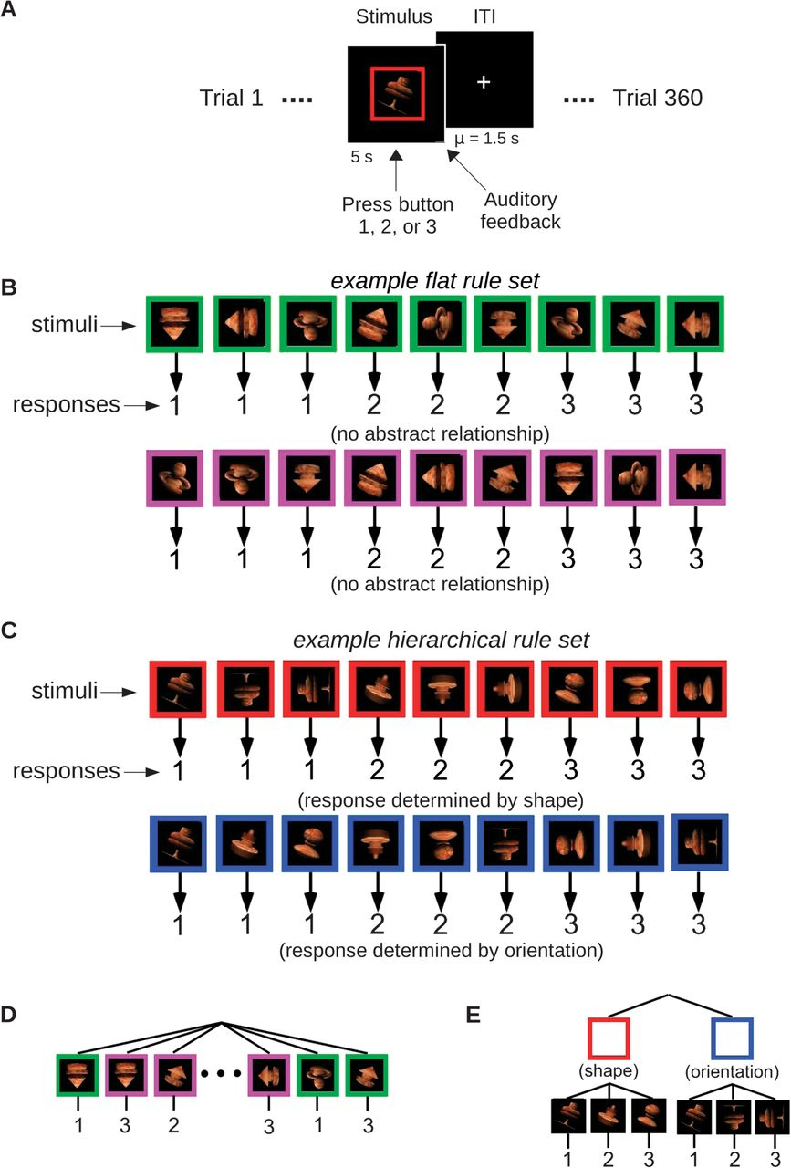
Figure 1. Schematic depiction of trial events, example stimulus-to-response mappings, and policy for Hierarchical and ...
Notes:
Figure 1. Schematic depiction of trial events, example stimulus-to-response mappings, and policy for Hierarchical and Flat rule sets. (A) Trials began with presentation of the stimulus for 5 s, during which subjects could respond with a button press at any point. Immediately after stimulus presentation, participants received auditory feedback indicating whether the response they had chosen was correct given the presented stimulus. Trials were separated by a variable intertrial interval with a mean of 1.5 s. (B) Example stimulus-to-response mappings for the Flat set. The arrangement of mappings for the Flat set was such that no higher order relationship was present; thus, each rule had to be learned individually. (C) Example stimulus-to-response mappings for the Hierarchical set. Response mappings are grouped such that in the presence of a red square, only shape determines the response, while in the presence of a blue square only orientation determines the response. (D) The Flat set of many first-order rules can be represented as a large flat policy structure with only 1 level and 18 alternatives. (E) The Hierarchical set can be represented as a 2-level policy structure with a second-order rule selecting between the shape or orientation mapping sets and a set of first-order rules linking specific shapes or orientations to responses.
Unless provided in the caption above, the following copyright applies to the content of this slide: © The Author 2012. Published by Oxford University Press. All rights reserved. For permissions, please e-mail: journals.permissions@oup.com

Slide 2
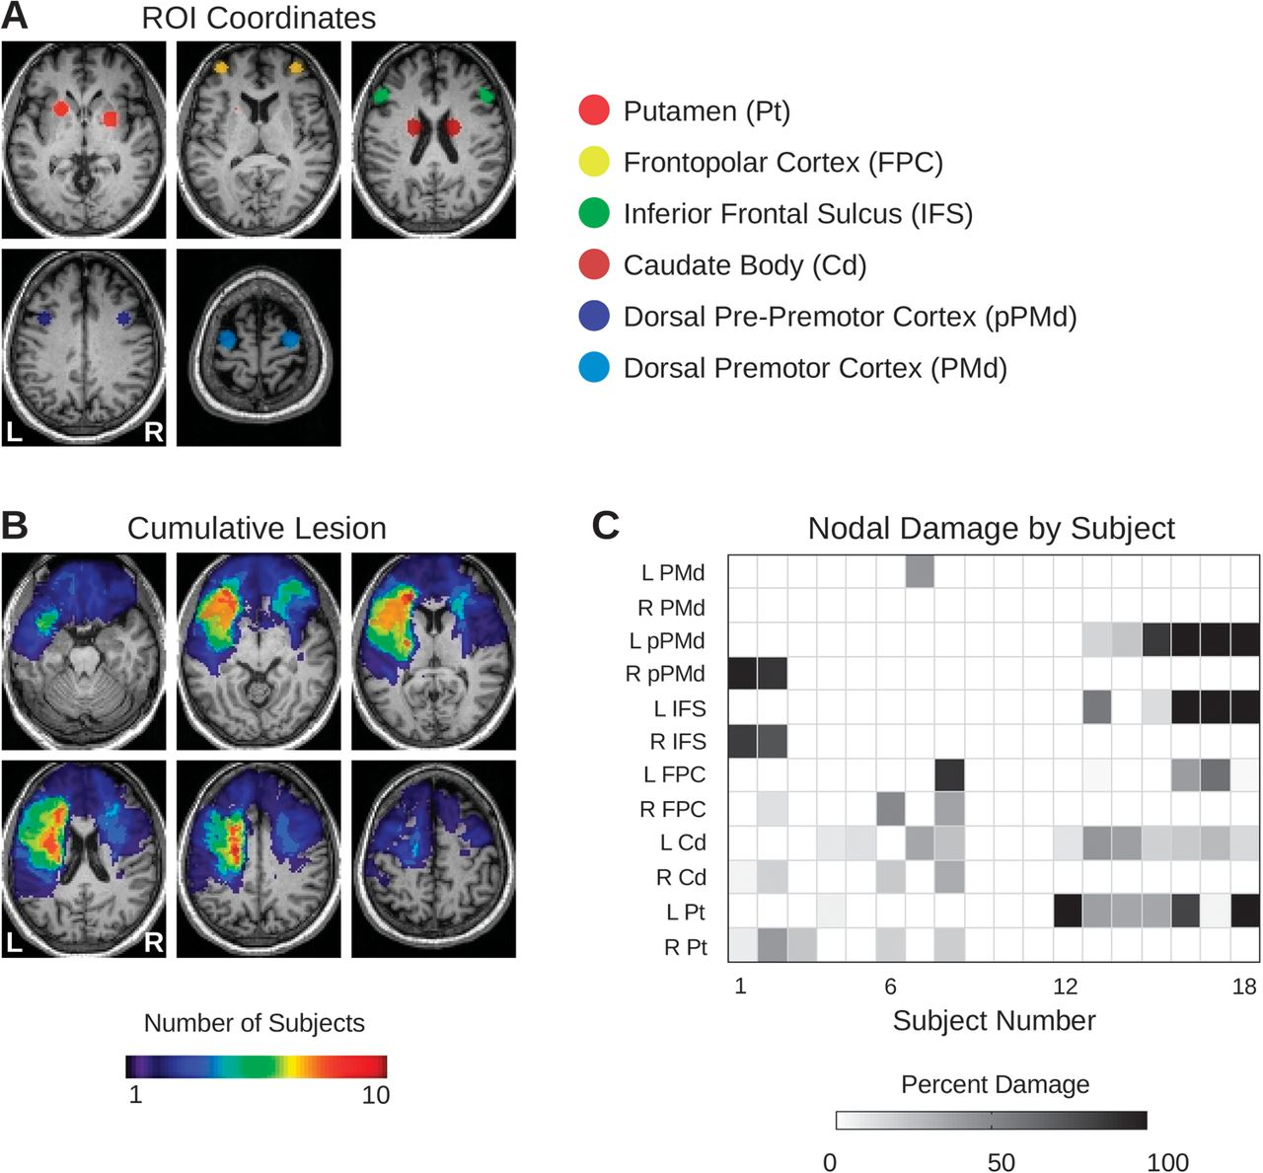
Figure 2. (A) Locations of ROIs. (B) The cumulative lesion burden across all 18 subjects. The number of subjects with ...
Notes:
Figure 2. (A) Locations of ROIs. (B) The cumulative lesion burden across all 18 subjects. The number of subjects with overlapping lesion locations is indicated by the color bar at bottom. (C) The percentage of voxels in each ROI affected by the single lesions in each of the 18 subjects. Note that the lesions in subjects 9–11 did not involve any of the prespecified ROIs. (Please see Supplementary Figure S1 for individual subject lesions.)
Unless provided in the caption above, the following copyright applies to the content of this slide: © The Author 2012. Published by Oxford University Press. All rights reserved. For permissions, please e-mail: journals.permissions@oup.com

Slide 3
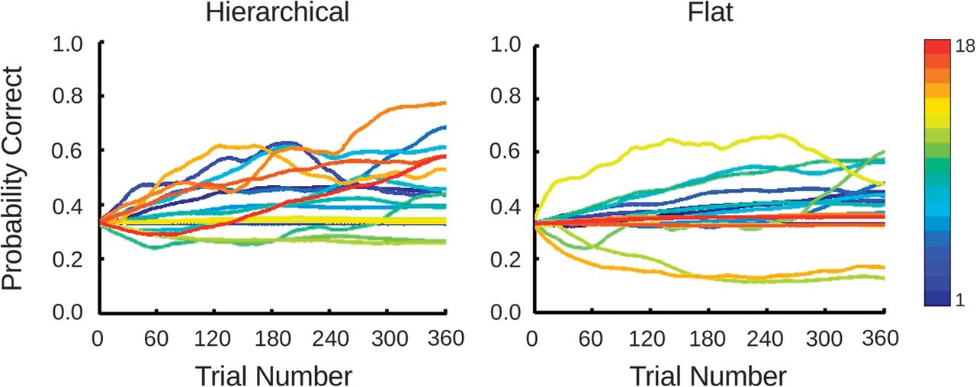
Figure 3. Learning curves for each of the (color coded) 18 subjects across the 360 trials for the Hierarchical (left) ...
Notes:
Figure 3. Learning curves for each of the (color coded) 18 subjects across the 360 trials for the Hierarchical (left) and Flat (right) rule sets. A probability correct of 0.33 represents chance performance. The probability correct after the last trial is defined as the terminal accuracy.
Unless provided in the caption above, the following copyright applies to the content of this slide: © The Author 2012. Published by Oxford University Press. All rights reserved. For permissions, please e-mail: journals.permissions@oup.com

Slide 4
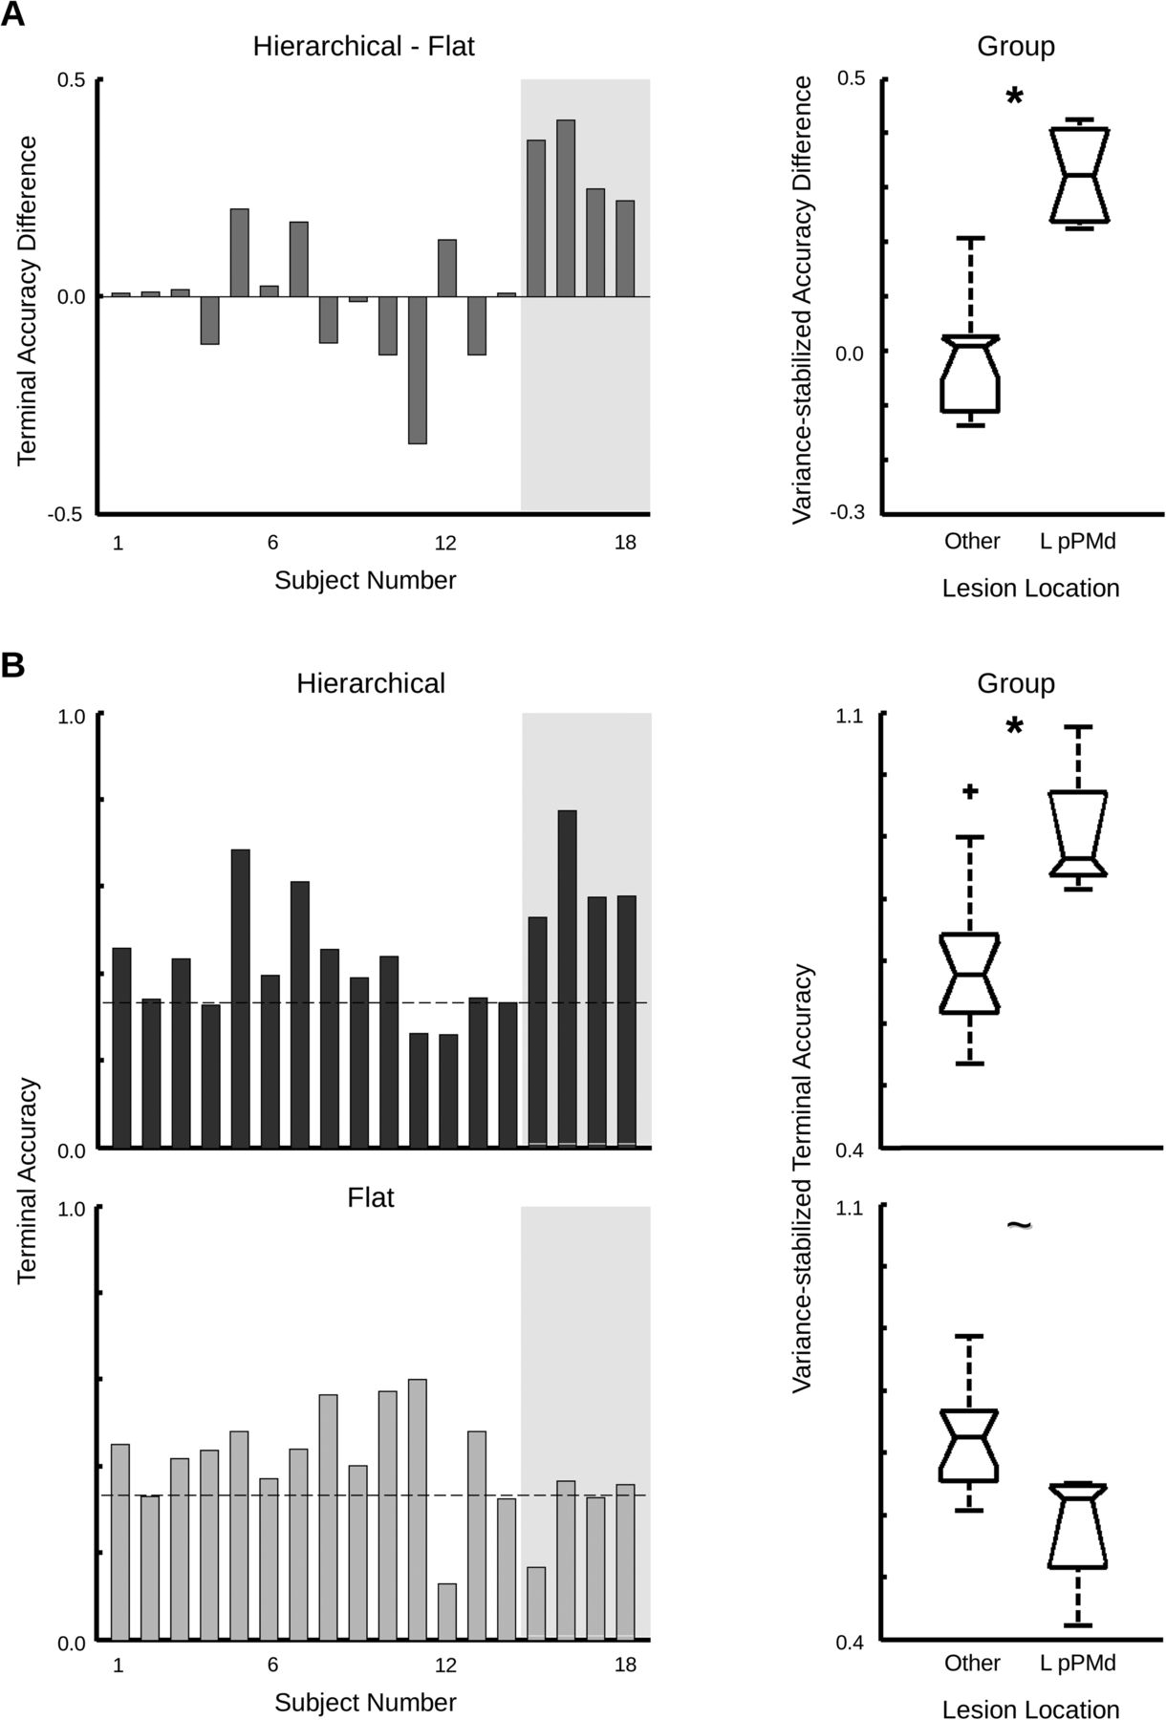
Figure 4. (A) The difference between the terminal accuracies in the Hierarchical and Flat conditions for each of the 18 ...
Notes:
Figure 4. (A) The difference between the terminal accuracies in the Hierarchical and Flat conditions for each of the 18 subjects. Those subjects with complete or near-complete lesions of left pre-PMd cortex (left pre-PMd; subjects #15–18) are highlighted by the gray shading. The box-whisker plot to the right summarizes these differences for the left pre-PMd and other-lesion groups. (B) Terminal accuracies for the subjects in the Hierarchical condition (top) and Flat condition (bottom). *indicates P ≤ 0.001; ∼ indicates 0.05 < P < 0.10.
Unless provided in the caption above, the following copyright applies to the content of this slide: © The Author 2012. Published by Oxford University Press. All rights reserved. For permissions, please e-mail: journals.permissions@oup.com

Slide 5
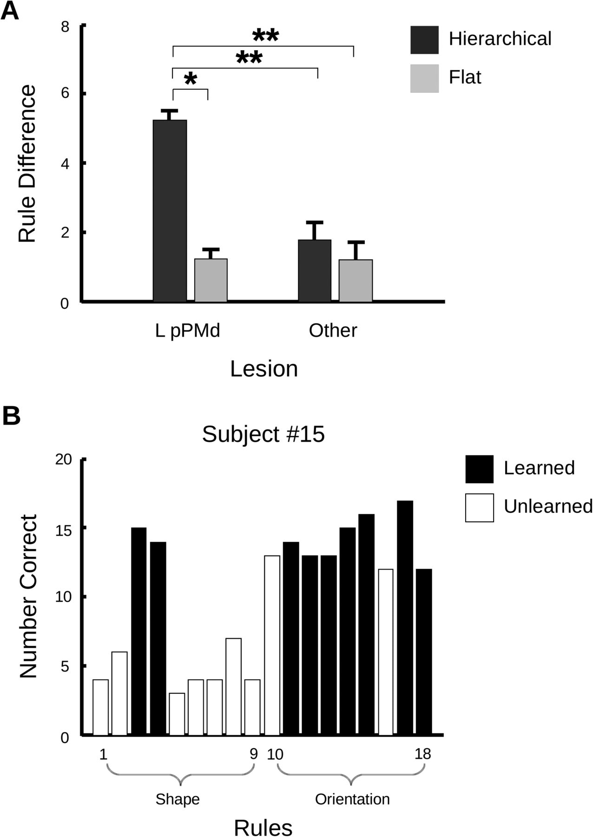
Figure 5. (A) The difference between the number of learned rules associated with one colored square versus the other ...
Notes:
Figure 5. (A) The difference between the number of learned rules associated with one colored square versus the other (in the Hierarchical condition, representing the “shape” and “orientation” rules). The left pre-PMd group shows asymmetric learning across colored squares in the Hierarchical condition only (*P < 0.01; **P < 0.0001). (B) Number of correct responses for each of the 18 stimuli during the Hierarchical condition for subject #15, who showed median terminal accuracy within the left pPMd group. Learned rules are indicated by the black shading, while unlearned rules are indicated by white shading. The first 9 stimuli are part of the “shape” rule, while the second 9 are part of the “orientation” rule.
Unless provided in the caption above, the following copyright applies to the content of this slide: © The Author 2012. Published by Oxford University Press. All rights reserved. For permissions, please e-mail: journals.permissions@oup.com

Slide 6
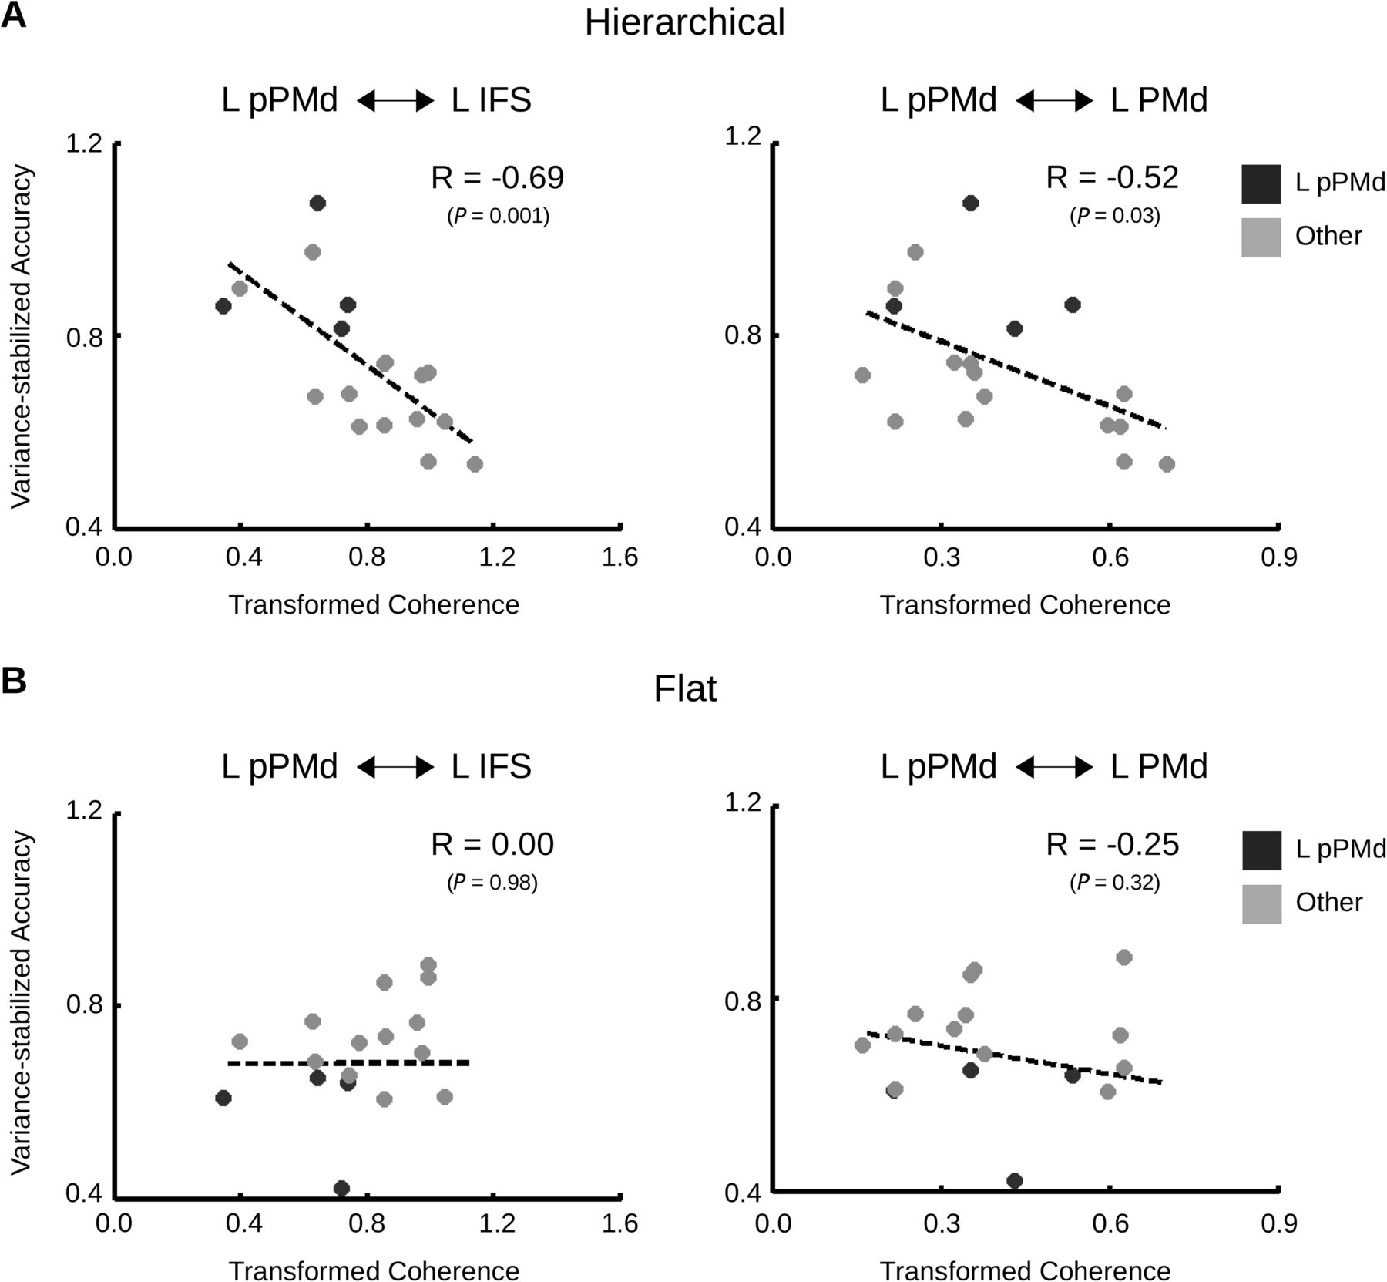
Figure 6. (A) The correlation of terminal accuracy in the Hierarchical condition with resting-state coherence between ...
Notes:
Figure 6. (A) The correlation of terminal accuracy in the Hierarchical condition with resting-state coherence between left pre-PMd and left IFS (left panel) and between left pre-PMd and left premotor cortex (PMd; right panel). Subjects in the left pre-PMd group are indicated by dark gray circles; subjects in the other-lesion group are indicated by light gray circles. Both correlations remain significant if left pre-PMd subjects are excluded. (B) The correlation of terminal accuracy in the Flat condition with resting-state coherence between these same ROIs. Neither correlation value is significant.
Unless provided in the caption above, the following copyright applies to the content of this slide: © The Author 2012. Published by Oxford University Press. All rights reserved. For permissions, please e-mail: journals.permissions@oup.com

Slide 7
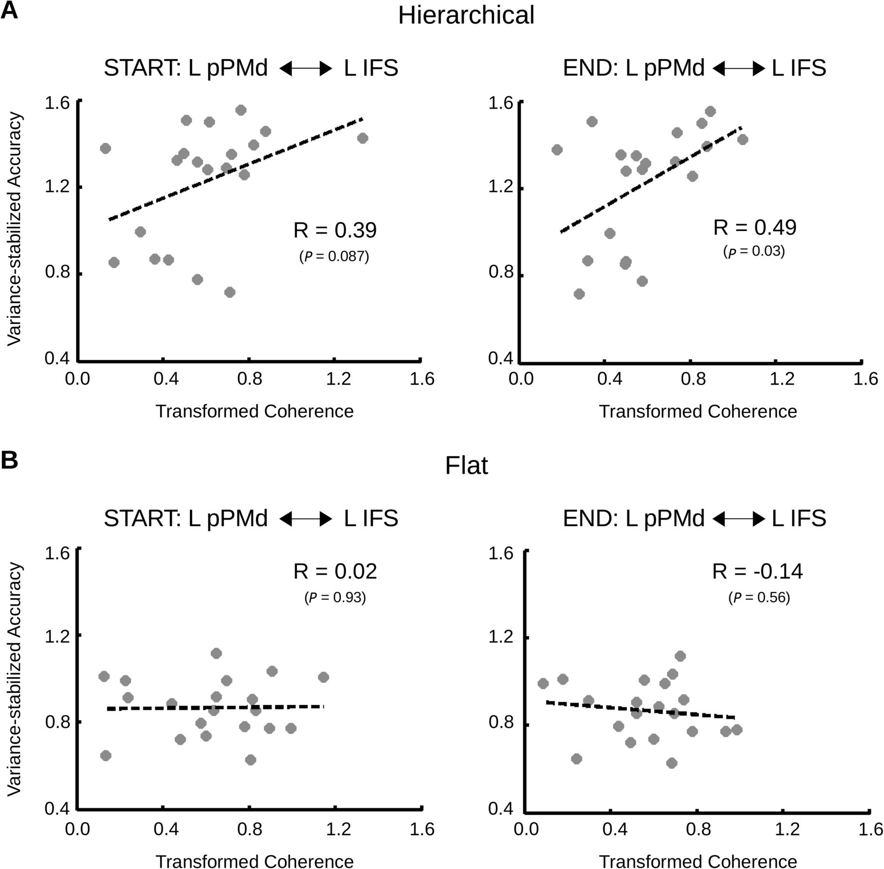
Figure 7. (A) The correlation of terminal accuracy in the Hierarchical condition with task-state coherence between left ...
Notes:
Figure 7. (A) The correlation of terminal accuracy in the Hierarchical condition with task-state coherence between left pre-PMd and left IFS during both early learning (i.e., during the first third of trials—left panel) and later learning (i.e., during the last third of trials—right panel) for healthy subjects from our previous study (Badre et al. 2010). (B) The correlation of terminal accuracy with functional connectivity between these same regions in the Flat condition. Neither correlation value is significant.
Unless provided in the caption above, the following copyright applies to the content of this slide: © The Author 2012. Published by Oxford University Press. All rights reserved. For permissions, please e-mail: journals.permissions@oup.com

