Slide 1
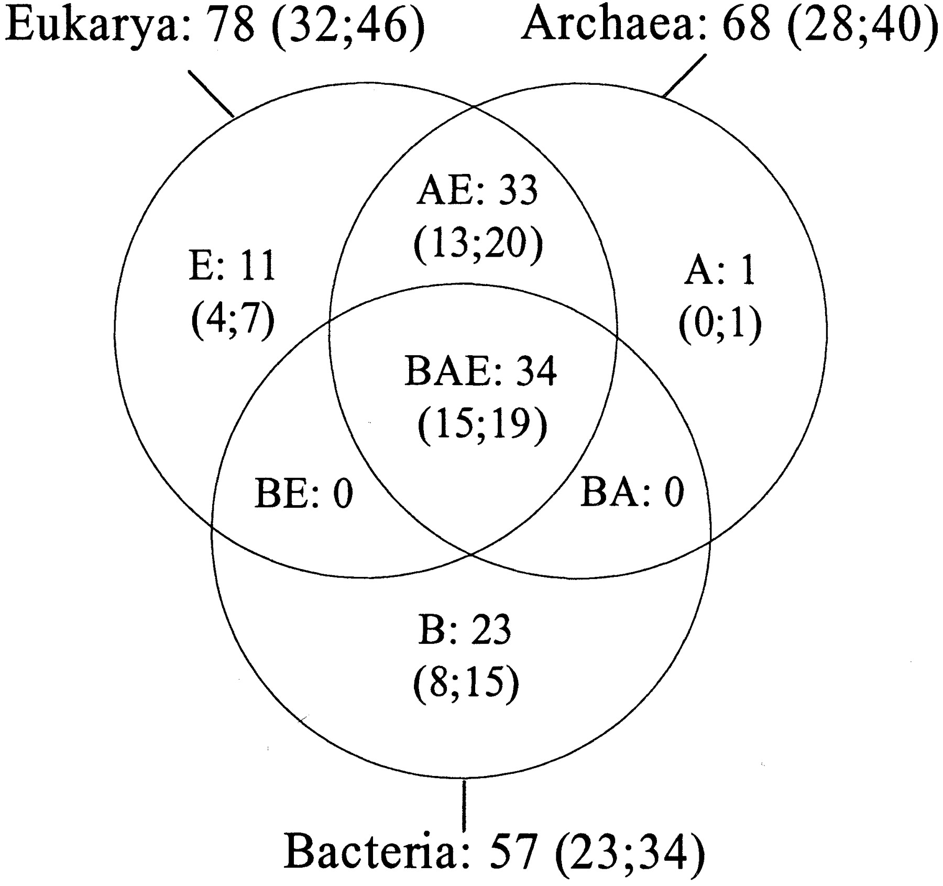
Figure 1. Venn diagram showing the general distribution of r‐protein families between the three domains: ...
Notes:
Figure 1. Venn diagram showing the general distribution of r‐protein families between the three domains: Bacteria (B), Archaea (A), Eucarya (E). The number of families is indicated for each set. The two numbers enclosed by parentheses refer to r‐protein families found in the small and large ribosome subunits respectively.
Unless provided in the caption above, the following copyright applies to the content of this slide:

Slide 2
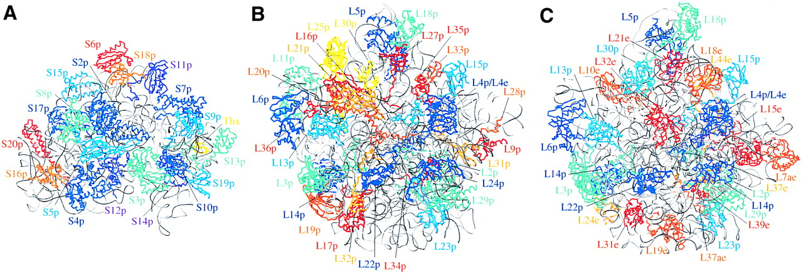
Figure 2. (A) Overview of the 30S ribosomal subunit of T.thermophilus (2) and (B) of the 50S ribosomal ...
Notes:
Figure 2. (A) Overview of the 30S ribosomal subunit of T.thermophilus (2) and (B) of the 50S ribosomal subunit of D.radiodurans (4) and (C) H.marismortui (5). The 30S subunit is presented from the back side (as defined in 2) and the large subunits are presented in the crown view rotated by 180° about a vertical axis. The rRNA molecules are shown in grey and protein backbones are colored according to their phylogenetic distribution (proteins conserved in the three domains, in different shades of blue; proteins conserved in Bacteria or in Archaea/Eucarya, in different shades of red and orange). When dispensable, the bacterial r‐proteins are coloured in yellow. Figures were generated using SETOR (79).
Unless provided in the caption above, the following copyright applies to the content of this slide:

Slide 3
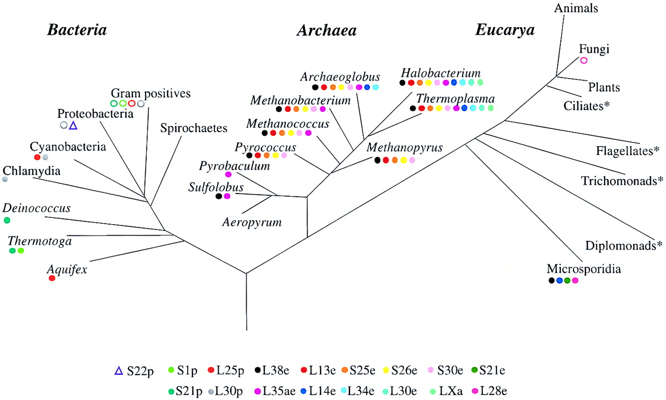
Figure 3. Schematic representation of the universal tree of life (adapted from 49). R‐proteins exhibiting a ...
Notes:
Figure 3. Schematic representation of the universal tree of life (adapted from 49). R‐proteins exhibiting a heterogeneous distribution within a primary domain are symbolized by circles or a triangle. Full circles indicate proteins absent in all complete genomes investigated in the indicated taxon. Empty circles stand for proteins absent in some complete genomes of the indicated taxon: S1p is absent in the Gram positives M.genitalium, M.pneumoniae and U. urealyticum; S21p is absent in the Gram positives M.leprae, M.tuberculosis; L25p is absent in the Gram positives C.acetobutylicum, M.genitalium, M.pneumoniae, U.urealyticum, L.lactis, S.pyogenes, S.pneumoniae; L30p is absent in the Gram positives M.genitalium, M.pneumoniae, U.urealyticum and in the Proteobacteria C.jejuni and H.pylori. The empty triangle symbolises the S22p protein exclusively found in the Proteobacteria E.coli, S.typhimurium and S.enterica. The four eukaryotic lineages marked by an asterisk are positioned in the tree for comparison purposes but have not been investigated in this study.
Unless provided in the caption above, the following copyright applies to the content of this slide:

Slide 4
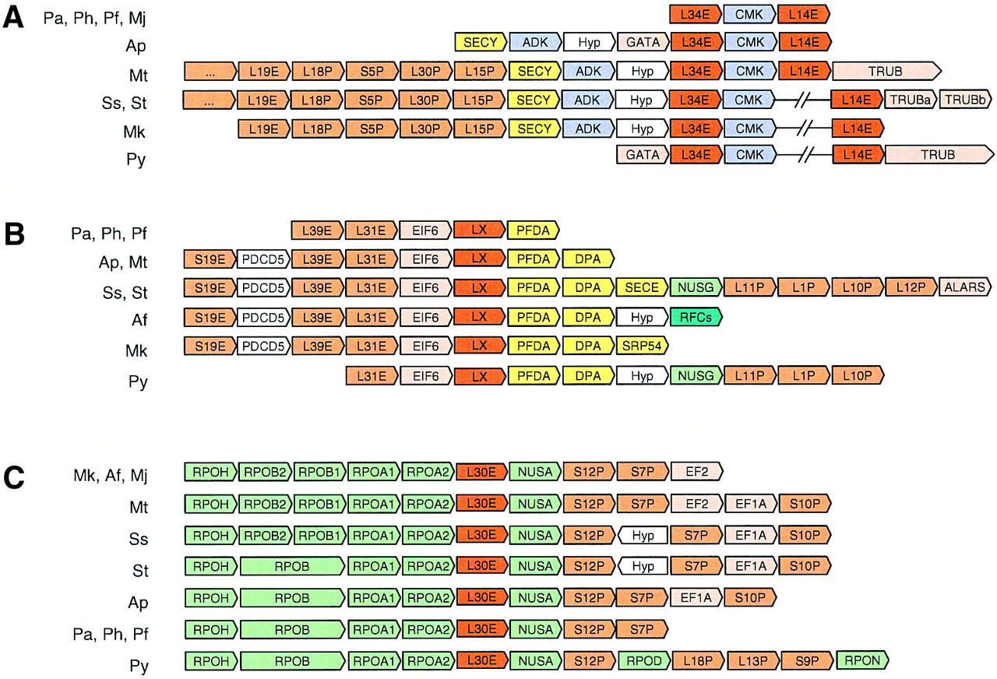
Figure 4. Genomic context of dispensable r‐protein genes in Archaea: L34e and L14e (A), LXa (B) and L30e (C). ...
Notes:
Figure 4. Genomic context of dispensable r‐protein genes in Archaea: L34e and L14e (A), LXa (B) and L30e (C). Arrows represent genes with their relative orientation in the genomes. Contiguous arrows represent adjacent genes while broken lines indicate a loss of proximity. r‐protein genes are labeled according to the r‐protein families. Conserved r‐protein genes are colored in orange and dispensable ones in dark orange while other genes are colored according to general functional categories: translation (light orange), protein processing (yellow), transcription (green), replication (dark green), nucleotide synthesis (blue) and unknown function (white). Abbreviations used for gene names: SECY (preprotein translocase secY subunit), ADK (adenylate kinase), CMK (cytidylate kinase), GATA [glutamyl‐tRNA(Gln) amidotransferase subunit A], TRUB (tRNA pseudouridine synthase B), TRUBa (tRNA pseudouridine synthase B subunit a), TRUBb (tRNA pseudouridine synthase B subunit b), Hyp (hypothetical protein), EIF6 (translation initiation factor 6), PFDA (prefoldin alpha subunit), DPA (signal recognition particle protein), SECE (preprotein translocase secE subunit), NUSG (transcription antitermination protein nusG), ALARS (alanyl‐tRNA synthetase), PDCD5 (DNA‐binding protein belonging to the PDCD5 family), RFCs (replication factor C small subunit), SRP54 (signal recognition 54 kDa protein), NUSA (nusA protein homolog), EF2 (translation elongation factor 2), EF1A (elongation factor 1‐alpha). RPOH, RPOB, RPOB2, RPOB1, RPOA1, RPOA2, RPOD, RPON correspond to subunits of the DNA‐directed RNA polymerase. Abbreviation used for organisms: Af, A.fulgidus; Ap, A.pernix; Mj, M.janaschii; Mk, M.kandleri; Mt, M.thermoautrophicum; Pa, P.abyssi; Pf, P.furiosus; Ph, P.horikoshii; Py, P.aerophilum; St, S.tokodaii; Ss, S.solfataricus. The LXa gene of Methanococcus jannaschii is not represented since the cluster organization is disrupted for this gene.
Unless provided in the caption above, the following copyright applies to the content of this slide:

