Slide 1
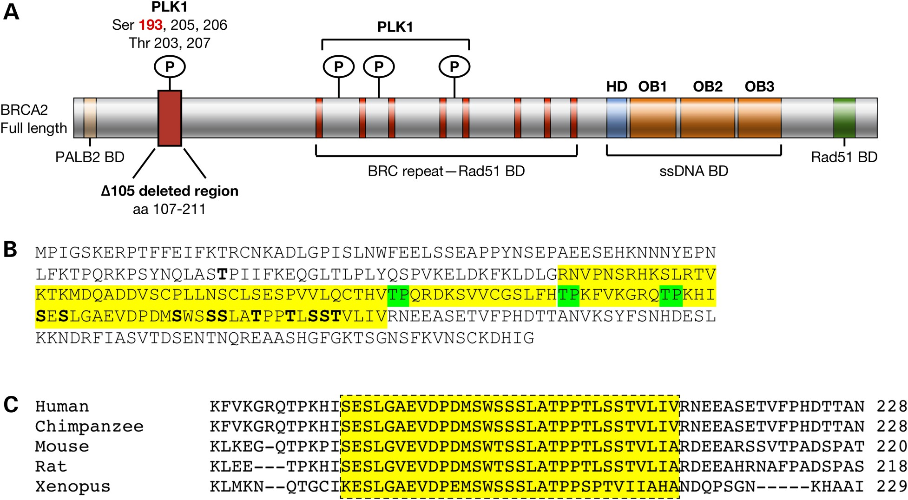
Figure 1. Human BRCA2 protein showing the distribution of PLK1 phosphorylation sites and their evolutionary ...
Notes:
Figure 1. Human BRCA2 protein showing the distribution of PLK1 phosphorylation sites and their evolutionary conservation. (A) Schematic representation of BRCA2 protein showing its functional domains and binding partners. The 105-amino acid region containing multiple PLK1 (Ser 193, a widely studied PLK1 phosphorylation site is highlighted in red) and CDK1 phosphorylation sites and region deleted in BRCA2Δ105 is marked by a red box. BD, binding domain; HD, Helicase Domain; OB1, OB2 and OB3, oligonucleotide-binding folds 1, 2 and 3. (B) A sequence of 284 N-terminal amino acids of BRCA2; residues highlighted in yellow are in BRCA2Δ105. CDK1 phosphorylation sites highlighted in green and PLK1 phosphorylation sites in bold. Residue T77, in bold, is phosphorylated by CDK1. (C) Evolutionary conservation of PLK1 phosphorylation sites.
Unless provided in the caption above, the following copyright applies to the content of this slide: Published by Oxford University Press 2016. This work is written by (a) US Government employee(s) and is in the public domain in the US.

Slide 2
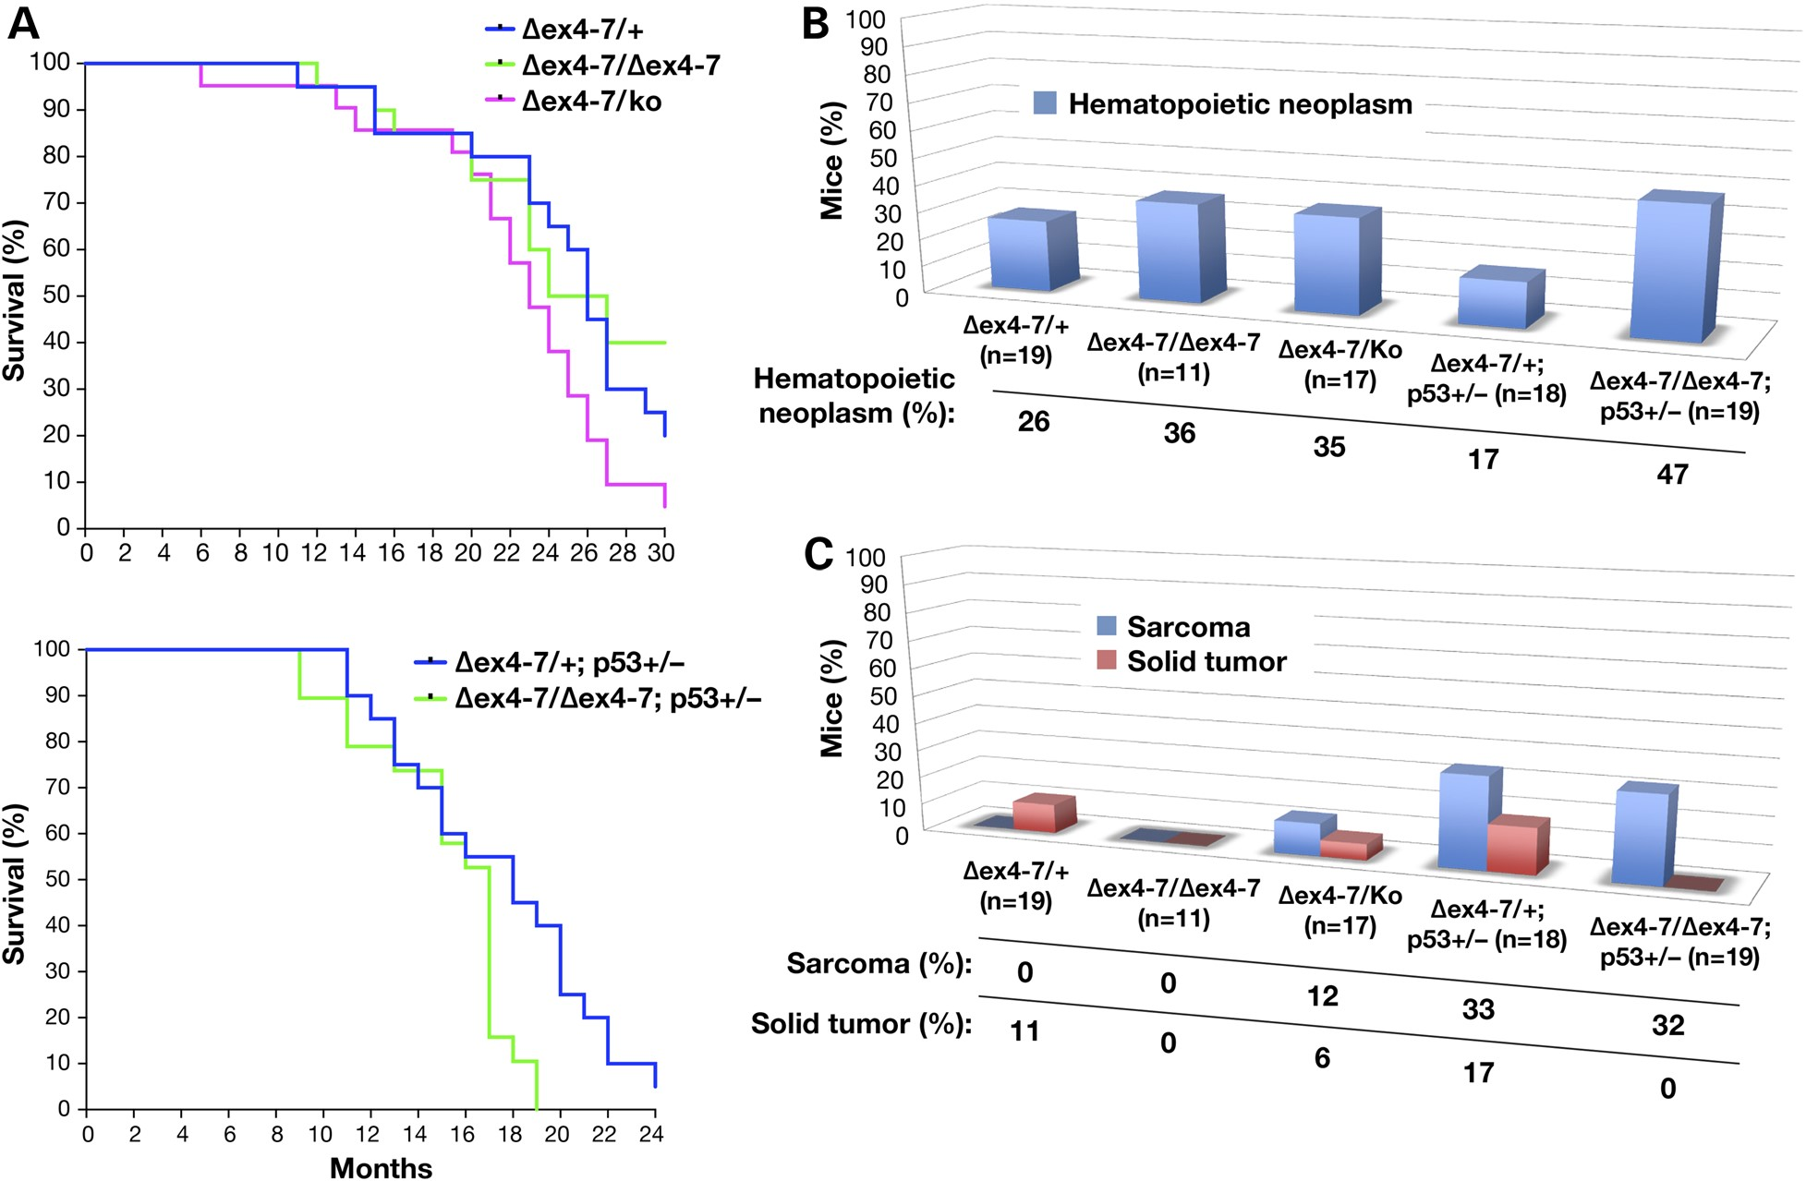
Figure 2. Brca2^{Δex4–7/Δex4–7};Trp53^{Ko/+} mice exhibit increased occurrence of lymphomas, solid ...
Notes:
Figure 2. Brca2Δex4–7/Δex4–7;Trp53Ko/+ mice exhibit increased occurrence of lymphomas, solid tumors and other hematopoietic and proliferative abnormalities. (A) The Kaplan–Meier plot showing tumor-free survival of Brca2Δex4–7/+, Brca2Δex4–7/Δex4–7 and Brca2Δex4–7/Ko mice (10 males and 10 females/genotype) on a Trp53+/+ (upper panel; Over all: χ2 = 4.226, P = 0.1209) and Brca2Δex4–7/+;Trp53Ko/+ and Brca2Δex4–7/Δex4–7;Trp53Ko/+ (lower panel; over all: χ2 = 1.730, P = 0.4210). (B) Incidence of hematopoietic neoplasm (Brca2Δex4–7/+ versus Brca2Δex4–7/Ko, P = 0.7206; Brca2Δex4–7/+;Trp53Ko/+ versus Brca2Δex4–7/Δex4–7;Trp53Ko/+, P = 0.0789), (C) Sarcoma and solid tumor (Brca2Δex4–7/+;Trp53Ko/+ versus Brca2Δex4–7/Δex4–7;Trp53Ko/+, P = 0.1050 for solid tumor). N = confirmed pathology per genotype.
Unless provided in the caption above, the following copyright applies to the content of this slide: Published by Oxford University Press 2016. This work is written by (a) US Government employee(s) and is in the public domain in the US.

Slide 3
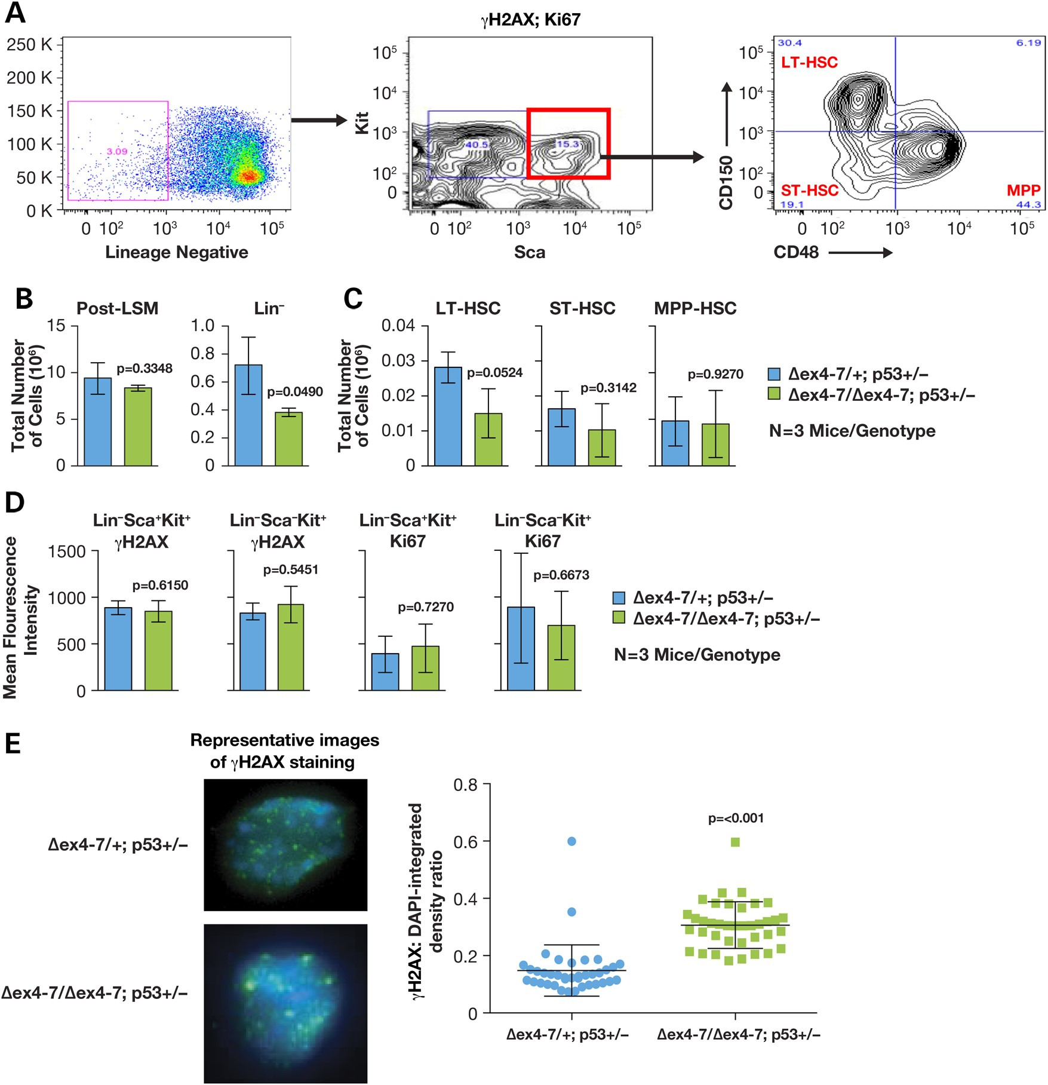
Figure 3. Brca2^{Δex4–7/Δex4–7};Trp53^{Ko/+} mice undergo HSC depletion. (A) Representative FACS ...
Notes:
Figure 3. Brca2Δex4–7/Δex4–7;Trp53Ko/+ mice undergo HSC depletion. (A) Representative FACS analysis of bone marrow mononuclear cells stained with antibodies against lineage markers [to identify lineage (Lin) negative cells, c-Kit and Sca (to identify stem and progenitor cells), γH2AX and Ki67. CD150 and CD48 were used to analyze and sort Lin− Sca+ Kit+ cells into long-term (LT), short-term (ST) and multipotent progenitors (MPP). (B) Comparison of total number of mononuclear cells harvested from bone marrow following gradient separation (post-LSM) and percentage of Lin− cells in Brca2Δex4–7/+;Trp53Ko/+ and Brca2Δex4–7/Δex4–7;Trp53Ko/+ (n = 3 mice/genotype). (C) Comparison of LT, ST and MPP cell population, extrapolated as part of total mononuclear cells harvested from whole bone marrow, between Brca2Δex4–7/+;Trp53Ko/+ and Brca2Δex4–7/Δex4–7;Trp53Ko/+ (n = 3 mice/genotype). (D) Comparison of the presence of DNA damage (γH2AX) and proliferation (Ki67) staining in stem (Lin− Sca+ Kit+) and progenitor (Lin− Sca− Kit+) cells of Brca2Δex4–7/+;Trp53Ko/+ and Brca2Δex4–7/Δex4–7;Trp53Ko/+ (n = 3 mice/genotype). (E) Representative images of Brca2Δex4–7/+;Trp53Ko/+ and Brca2Δex4–7/Δex4–7;Trp53Ko/+ FACS sorted MPP cells stained with γH2AX-Alexa488 and DAPI (left panel). Right panel shows ratio of Alexa488:DAPI as a measure of levels of DNA damage present in Brca2Δex4–7/+;Trp53Ko/+ and Brca2Δex4–7/Δex4–7;Trp53Ko/+ MPP cells (n = 2 mice/genotype).
Unless provided in the caption above, the following copyright applies to the content of this slide: Published by Oxford University Press 2016. This work is written by (a) US Government employee(s) and is in the public domain in the US.

Slide 4
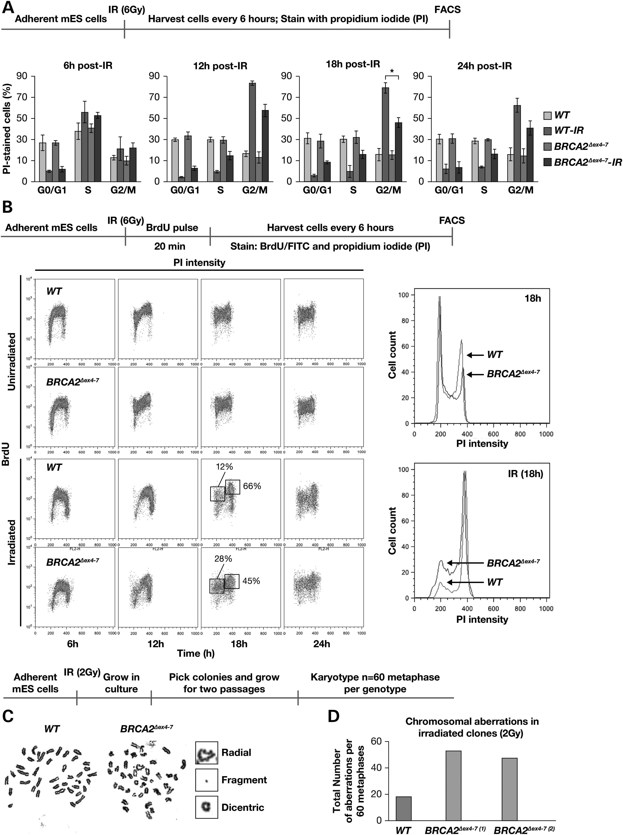
Figure 4. Defects in maintaining G2/M arrest and genomic stability in mES cells expressing BRCA2^{Δex4–7}. (A) ...
Notes:
Figure 4. Defects in maintaining G2/M arrest and genomic stability in mES cells expressing BRCA2Δex4–7. (A) FACS analysis of PI stained mES cells expressing WT and BRCA2Δex4–7. (B) Cell-cycle profile of BrdU and PI-stained unirradiated and 6 Gy irradiated mES cells expressing WT and BRCA2Δex4–7 (left panel). DNA content analysis of the G2/M fraction of BrdU and PI-stained cells. (C) Representative metaphase spread of irradiated WT and BRCA2Δex4–7 mES cells. (D) Quantification of chromosomal aberrations observed in mES cells expressing WT and BRCA2Δex4–7 (WT versus BRCA2Δex4–7, P = <0.001); N = 60 metaphase per genotype. Scheme of experimental design is shown at the top of each panel.
Unless provided in the caption above, the following copyright applies to the content of this slide: Published by Oxford University Press 2016. This work is written by (a) US Government employee(s) and is in the public domain in the US.

Slide 5
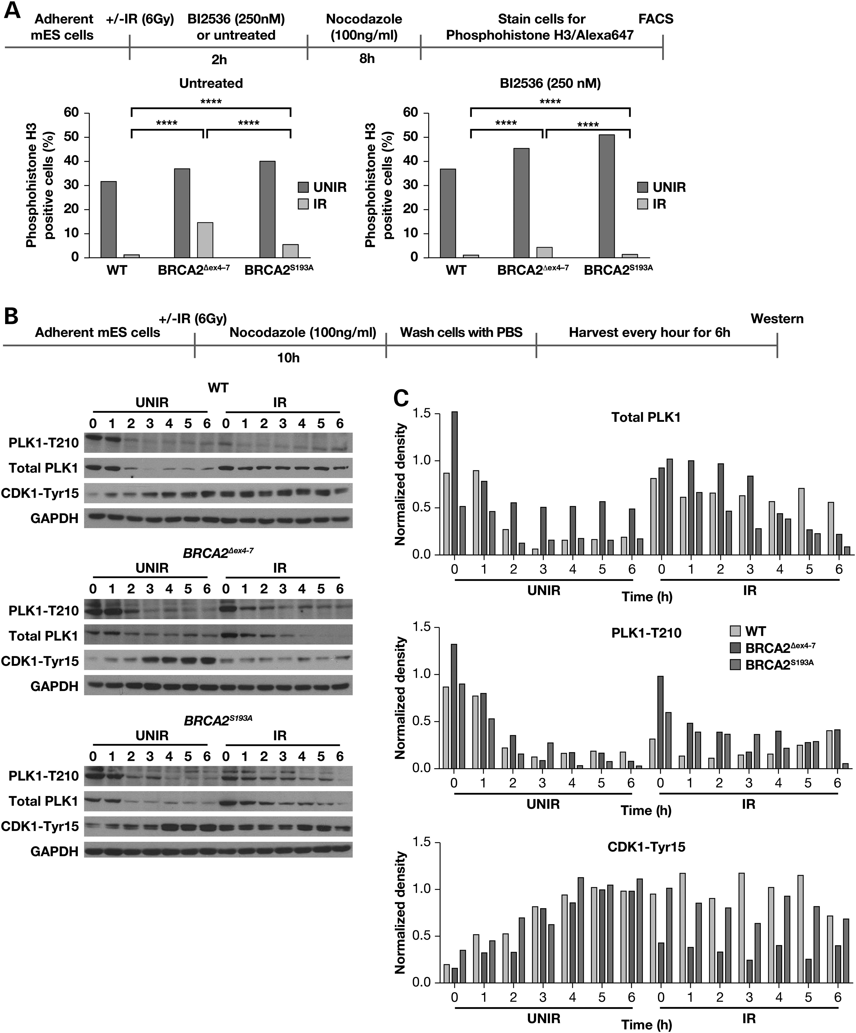
Figure 5. Aberrant activation of PLK1 following IR in BRCA2^{Δex4–7} expressing mES cells. (A) FACS analysis of ...
Notes:
Figure 5. Aberrant activation of PLK1 following IR in BRCA2Δex4–7 expressing mES cells. (A) FACS analysis of phospho-histone H3 (Ser10) stained mES cells expressing WT, BRCA2Δex4–7 and BRCA2S193A with or without PLK1 inhibitor treatment, following IR. (B) Western blot analysis of total cell lysate from mES cells expressing WT, BRCA2Δex4–7 and BRCA2S193A showing total PLK1, activated PLK1-Thr210 and CDK1-Tyr15 levels at different time following release from nocodazole. (C) Densitometric analysis of protein bands shown in (B), normalized against glyceraldehyde-3-phosphate dehydrogenase. The scheme of experimental design is shown at the top of each panel.
Unless provided in the caption above, the following copyright applies to the content of this slide: Published by Oxford University Press 2016. This work is written by (a) US Government employee(s) and is in the public domain in the US.

