Slide 1
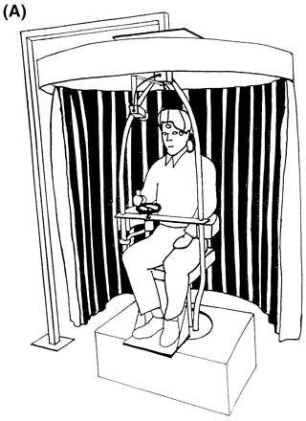
Fig. 1 (A) Diagram of the experimental setting. A subject is shown holding the handle of the tachometer wheel, which ...
Notes:
Fig. 1 (A) Diagram of the experimental setting. A subject is shown holding the handle of the tachometer wheel, which he turns to indicate subjective rotational velocity. An infra-red video camera imaging the face, EOG electrodes, rotating chair and optokinetic drum are also shown. (B) Tachometer output in a normal subject during a rotational stopping response. The fitted exponential curve and the time constant of decay of his vestibular sensation are also shown.
Unless provided in the caption above, the following copyright applies to the content of this slide: © Oxford University Press 1999

Slide 2
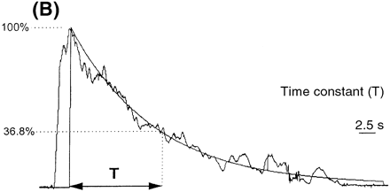
Fig. 1 (A) Diagram of the experimental setting. A subject is shown holding the handle of the tachometer wheel, which ...
Notes:
Fig. 1 (A) Diagram of the experimental setting. A subject is shown holding the handle of the tachometer wheel, which he turns to indicate subjective rotational velocity. An infra-red video camera imaging the face, EOG electrodes, rotating chair and optokinetic drum are also shown. (B) Tachometer output in a normal subject during a rotational stopping response. The fitted exponential curve and the time constant of decay of his vestibular sensation are also shown.
Unless provided in the caption above, the following copyright applies to the content of this slide: © Oxford University Press 1999

Slide 3
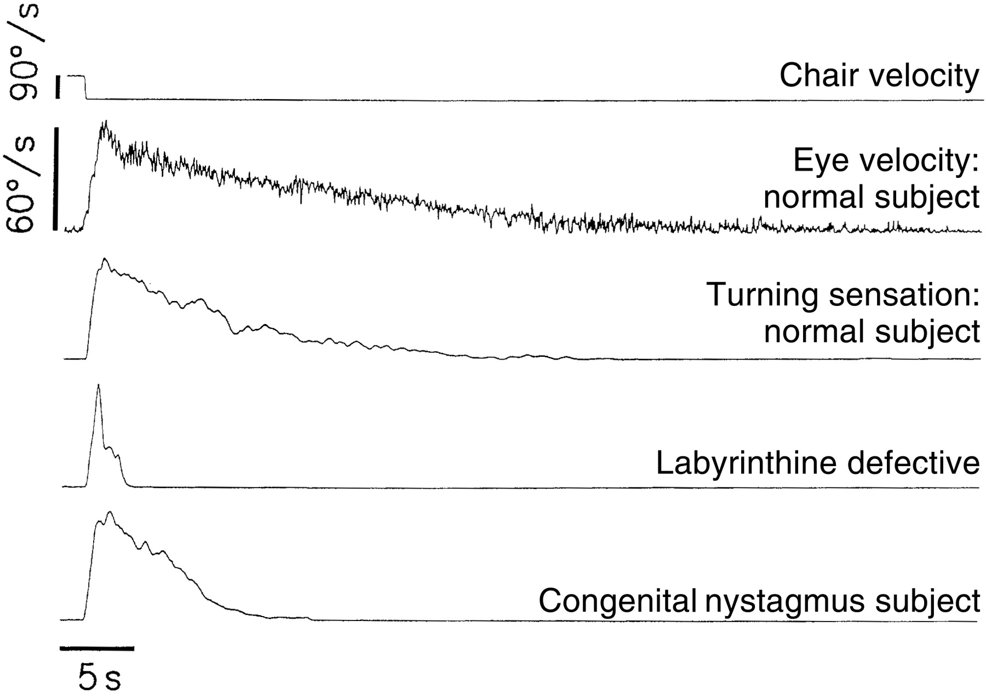
Fig. 2 Individual eye velocity and vestibular sensation data of a representative normal subject. Individual ...
Notes:
Fig. 2 Individual eye velocity and vestibular sensation data of a representative normal subject. Individual vestibular sensation data from a congenital nystagmus patient, and for comparison a labyrinthine-defective subject.
Unless provided in the caption above, the following copyright applies to the content of this slide: © Oxford University Press 1999

Slide 4
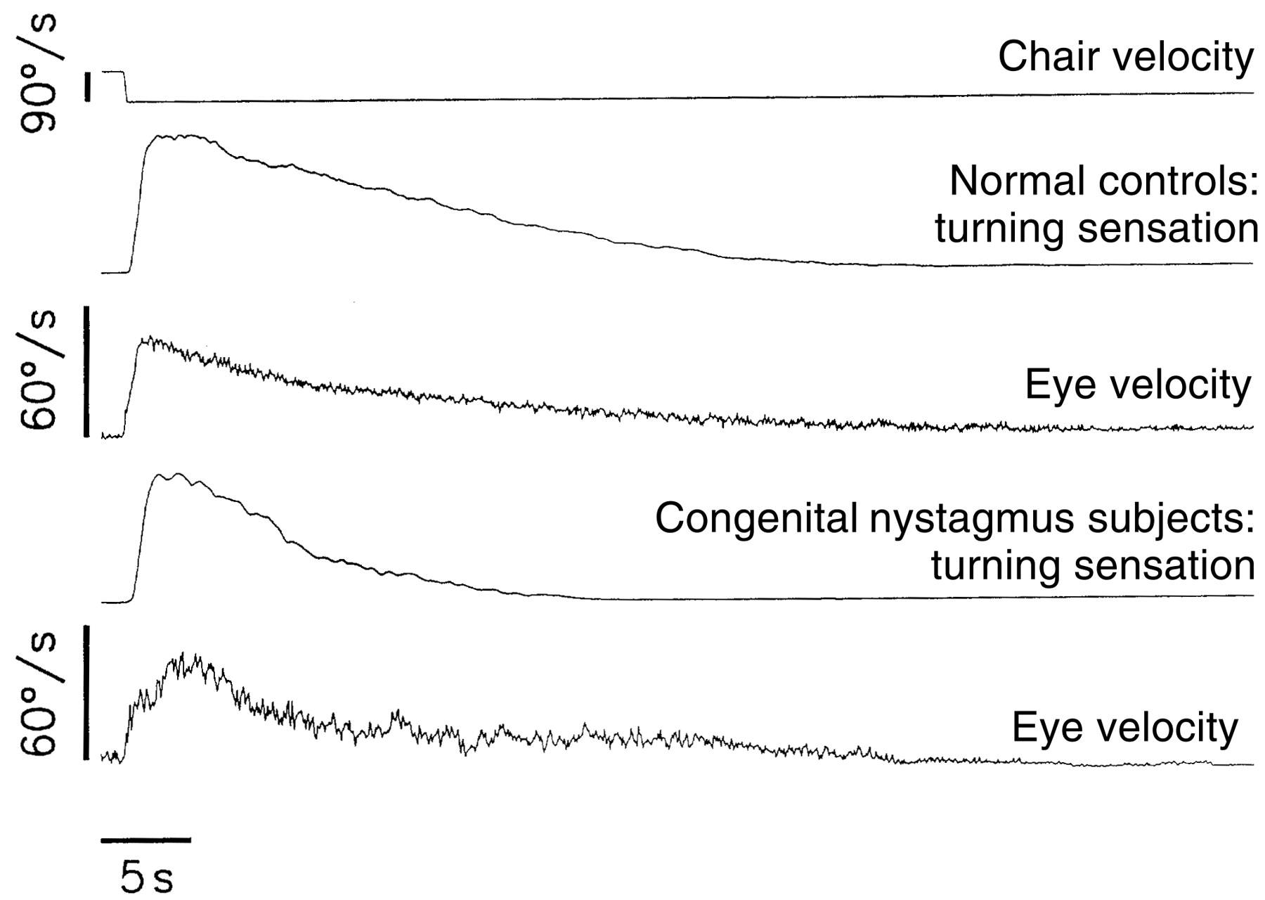
Fig. 3 Grand average eye velocity and vestibular sensation data in congenital nystagmus patients (n = 14) and normal ...
Notes:
Fig. 3 Grand average eye velocity and vestibular sensation data in congenital nystagmus patients (n = 14) and normal subjects (n = 31).
Unless provided in the caption above, the following copyright applies to the content of this slide: © Oxford University Press 1999

Slide 5
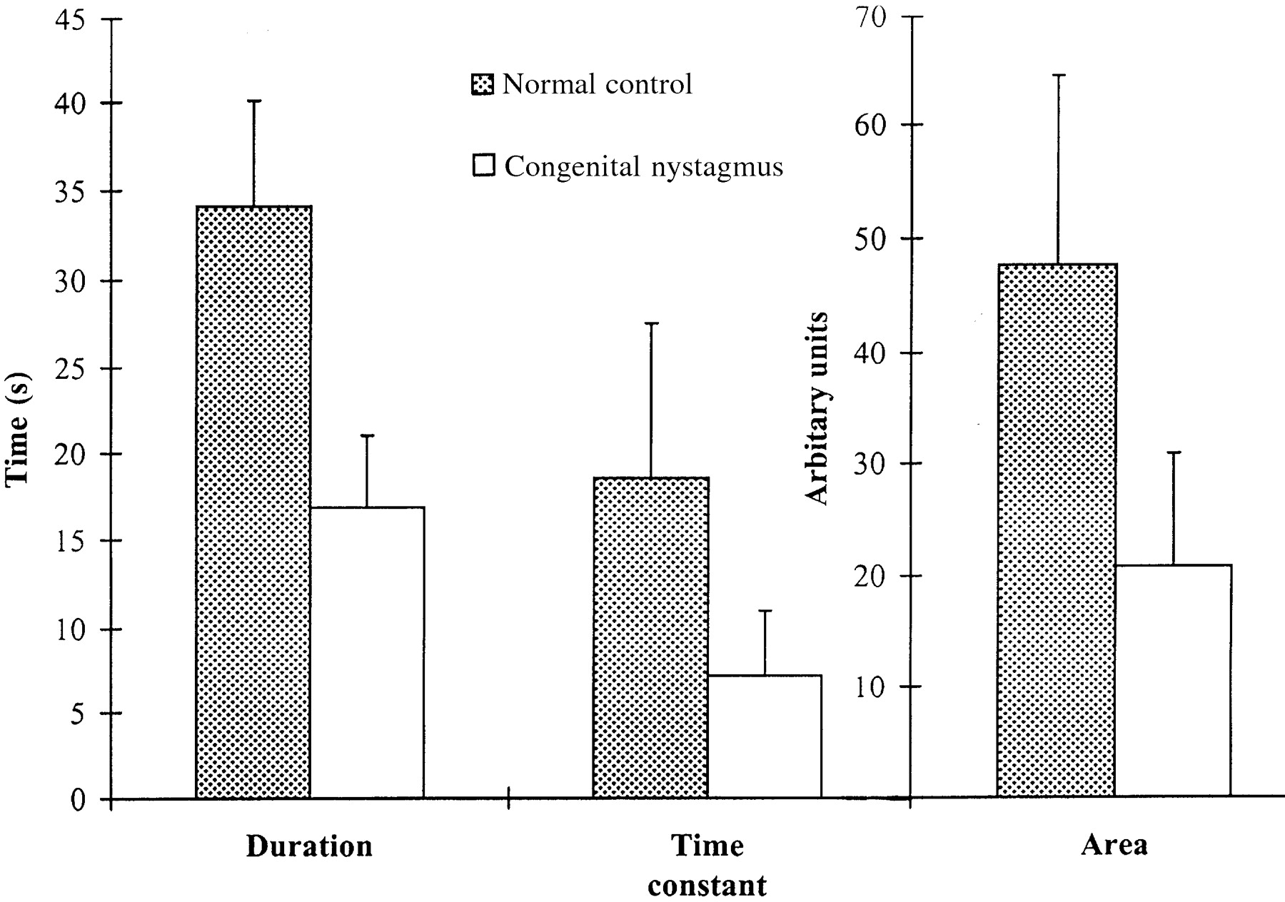
Fig. 4 Mean duration, time constant and area under the curve of turning sensation in congenital nystagmus patients ...
Notes:
Fig. 4 Mean duration, time constant and area under the curve of turning sensation in congenital nystagmus patients (n = 14) and age-matched normal controls (n = 14).
Unless provided in the caption above, the following copyright applies to the content of this slide: © Oxford University Press 1999

