Slide 1
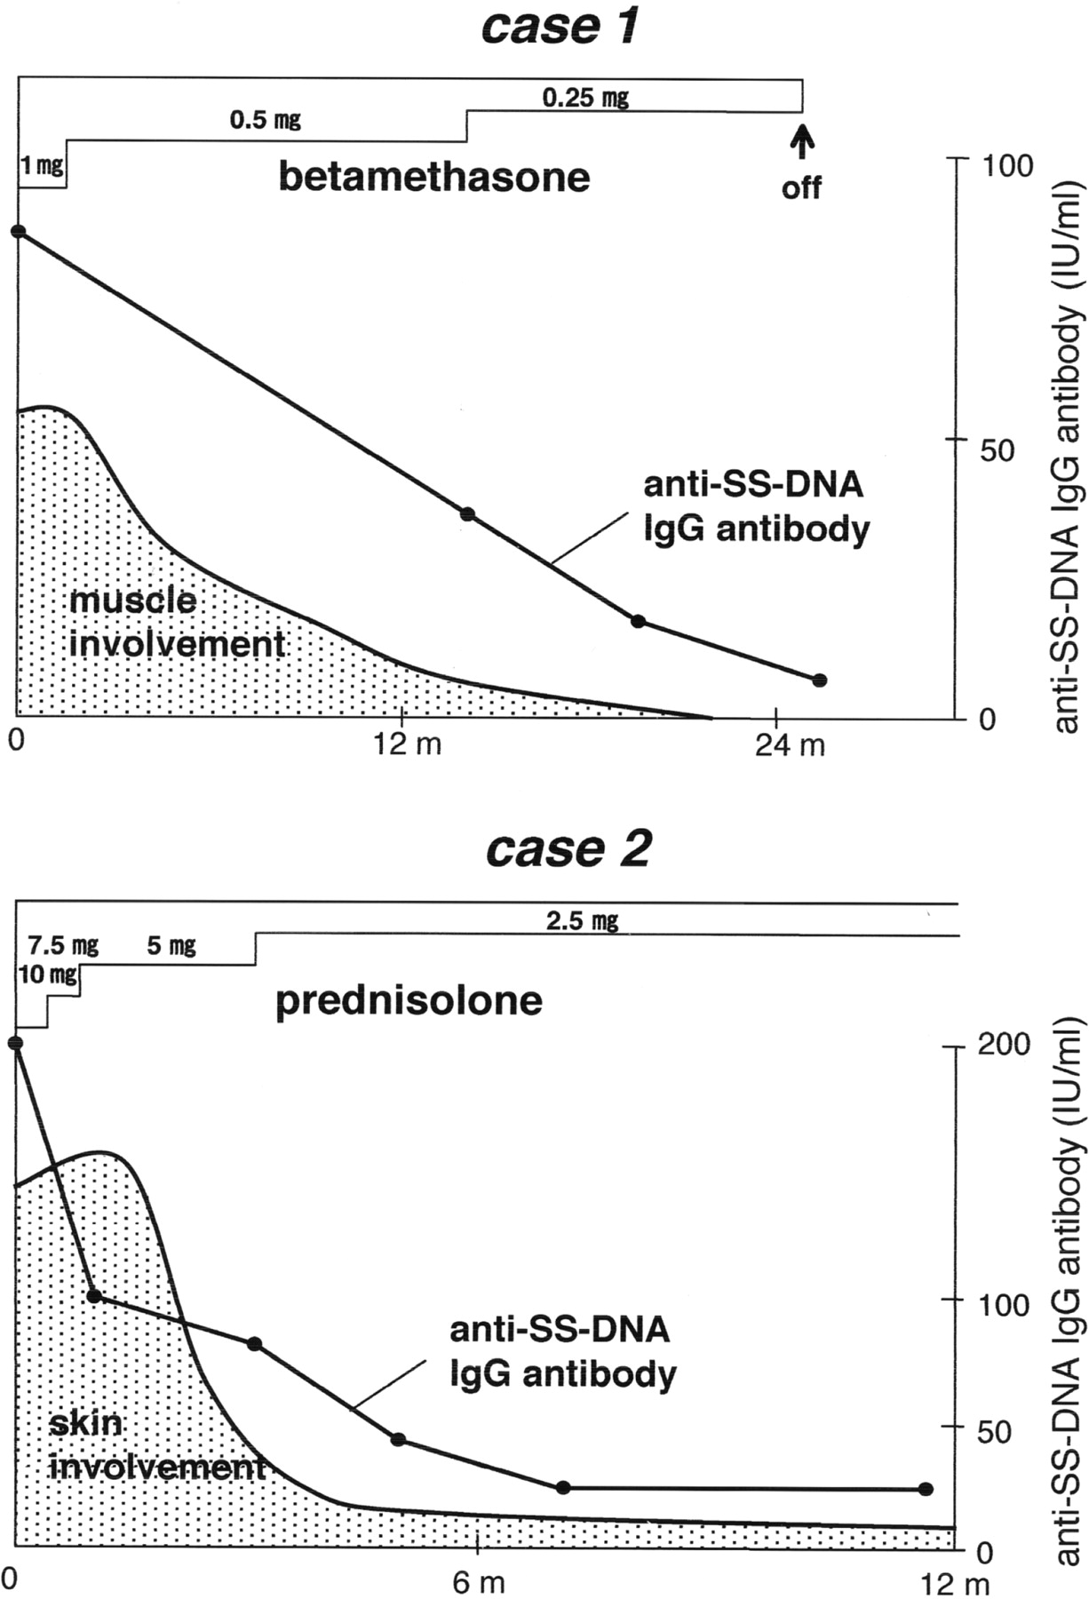
Fig. 1. Clinical course, treatment and titres of anti-ssDNA antibodies. Case 1 was a 15-yr-old female who complained ...
Notes:
Fig. 1. Clinical course, treatment and titres of anti-ssDNA antibodies. Case 1 was a 15-yr-old female who complained of disturbed movement of her left lower leg. She was treated successfully with betamethasone at 1 mg per day. Case 2 was a 9-yr-old male who complained of a rapid increase in multiple sclerotic plaques. He was treated successfully with prednisolone at 10 mg per day.
Unless provided in the caption above, the following copyright applies to the content of this slide: Rheumatology Vol. 44 No. 3 © British Society for Rheumatology 2004; all rights reserved

