Slide 1
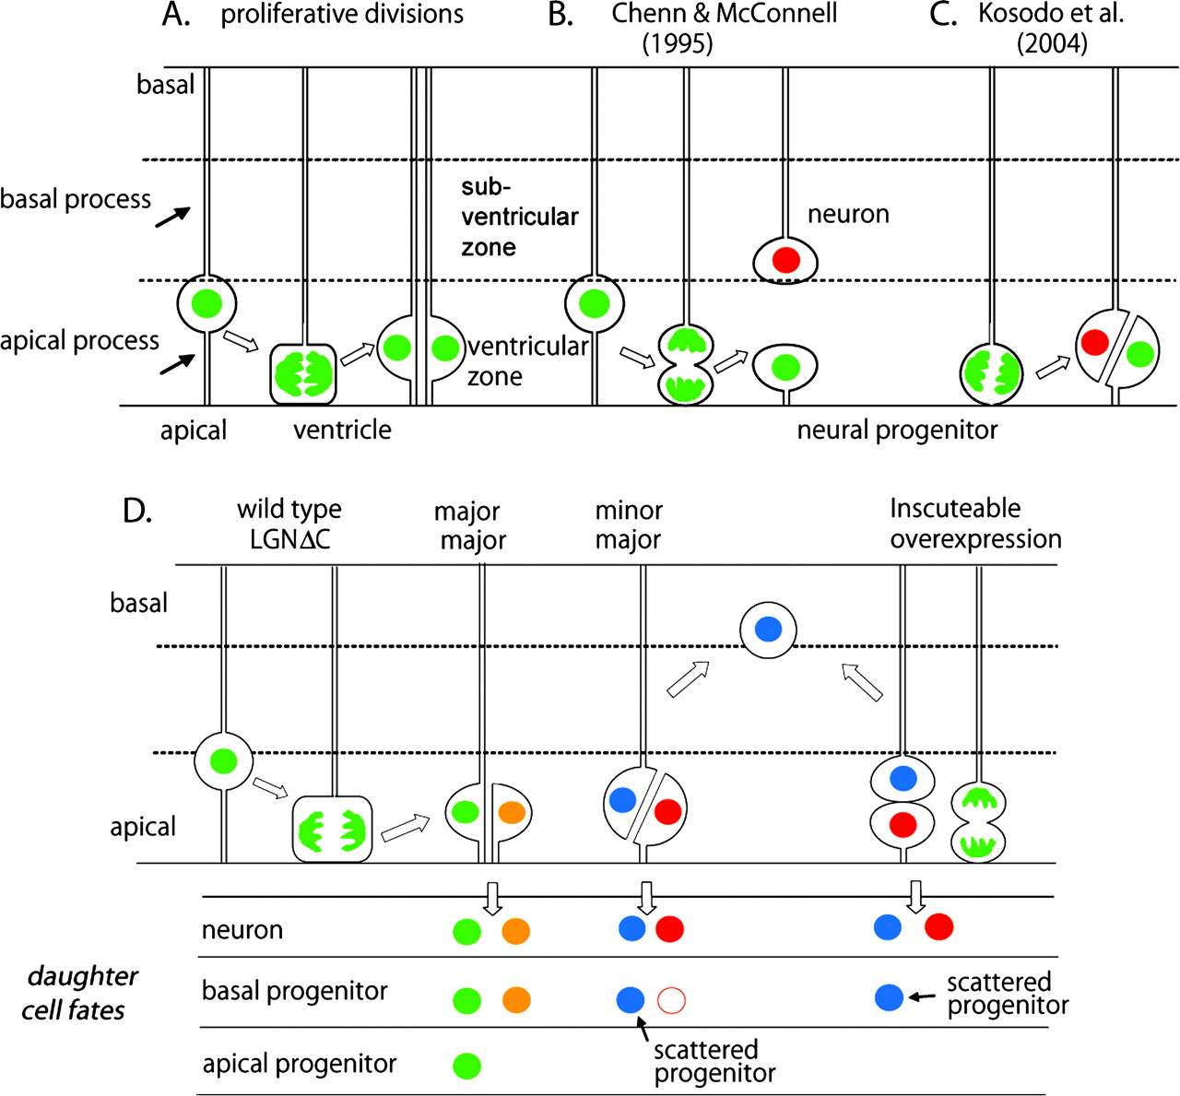
Figure 1. Schematic illustration of models for the division patterns of apical progenitors. (A) At proliferative ...
Notes:
Figure 1. Schematic illustration of models for the division patterns of apical progenitors. (A) At proliferative stages, apical divisions produce 2 equivalent daughters. (B) Chenn and McConnell (1995) proposed that neurogenic divisions have the cleavage plane perpendicular or oblique to the epithelial surface so as to give rise to a neuron as the basal daughter and a self-renewing progenitor as the apical daughter. (C) Kosodo et al. (2004) proposed that a slight tilt or displacement of mitotic spindles enables the cleavage plane to bypass the apical membrane because of the narrow apical membrane area during apical division. (D) Konno et al. (2008) proposed that one daughter inherits both the apical membrane and the basal process, whereas the other inherits only the apical membrane during normal apical divisions. The self-renewable progenitor (apical progenitor) appears to be formed only from the daughter that inherits both apical and basal processes at mid-neurogenic stages. Loss of LGN function or overexpression of Inscuteable induces asymmetric partition of the apical membrane and the basal process into different daughters and generates an apical neuron and an ectopic progenitor (or a neuron) as the basal daughter, which might self-renew and produce neurons.
Unless provided in the caption above, the following copyright applies to the content of this slide: © 2009 The AuthorsThis is an Open Access article distributed under the terms of the Creative Commons Attribution Non-Commercial License (http://creativecommons.org/licenses/by-nc/2.0/uk/) which permits unrestricted non-commercial use, distribution, and reproduction in any medium, provided the original work is properly cited.

Slide 2
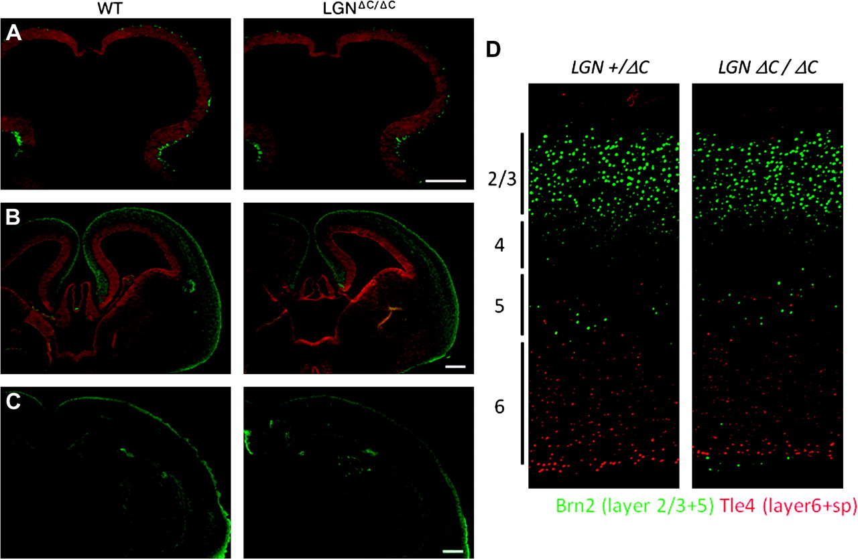
Figure 2. The overall brain morphology of LGN mutants does not differ from that of wild type. (A) E10.5 and (B) E14.5, ...
Notes:
Figure 2. The overall brain morphology of LGN mutants does not differ from that of wild type. (A) E10.5 and (B) E14.5, green; betaIII-tubulin, red; SRY-box containing gen2 (SOX2) and (C) E18.5, green; betaIII-tubulin. In the E14.5 LGN-mutant brain, SOX2-expressing cells distribute outside the ventricular zone, but it is not visible in (B) as betaIII-tubulin staining overrides the SOX2 staining. Scale bar, 200 μm. (D) Stratification of the adult cortex does not appear to be significantly affected by the absence of LGN function.
Unless provided in the caption above, the following copyright applies to the content of this slide: © 2009 The AuthorsThis is an Open Access article distributed under the terms of the Creative Commons Attribution Non-Commercial License (http://creativecommons.org/licenses/by-nc/2.0/uk/) which permits unrestricted non-commercial use, distribution, and reproduction in any medium, provided the original work is properly cited.

