Slide 1
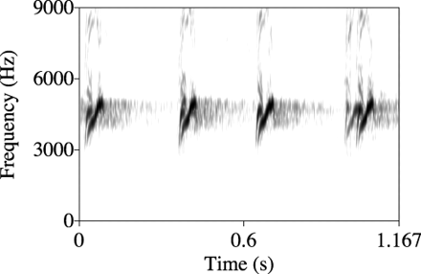
Figure 1 A representative sonogram of pik mobbing calls of pied flycatchers.
Notes:
Figure 1 A representative sonogram of pik mobbing calls of pied flycatchers.
Unless provided in the caption above, the following copyright applies to the content of this slide: Behavioral Ecology vol. 16 no. 1 © International Society for Behavioral Ecology 2005; all rights reserved.

