Slide 1
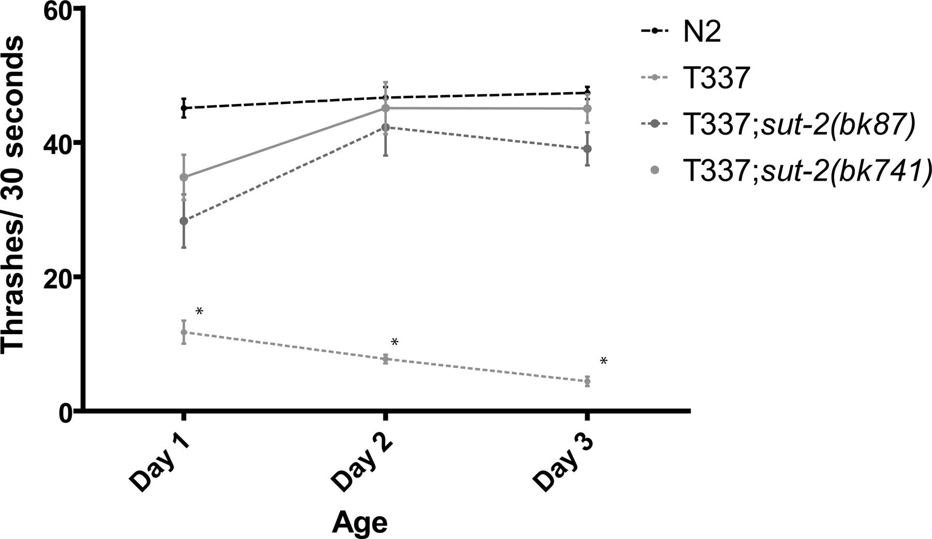
Figure 1. Loss of sut-2 suppresses tau-induced locomotion defects. Liquid thrashing assays for staged 1- to 3-day-old ...
Notes:
Figure 1. Loss of sut-2 suppresses tau-induced locomotion defects. Liquid thrashing assays for staged 1- to 3-day-old worms. N2 is wild-type. T337 is tau transgenic. T337; sut-2 ( bk87 ) and T337; sut-2 ( bk741 ) are tau suppressor strains. Each data point is the mean (±SEM) thrashing rate for 15 worms. Statistical comparison was made using one-way ANOVA (Kruskal–Wallis test) with Dunn's post hoc comparison. Asterisks denote that T337 animals are significantly different ( P < 0.0001) from N2, T337; sut-2 ( bk87 ) and T337; sut-2 ( bk741 ).
Unless provided in the caption above, the following copyright applies to the content of this slide: Published by Oxford University Press 2009

Slide 2
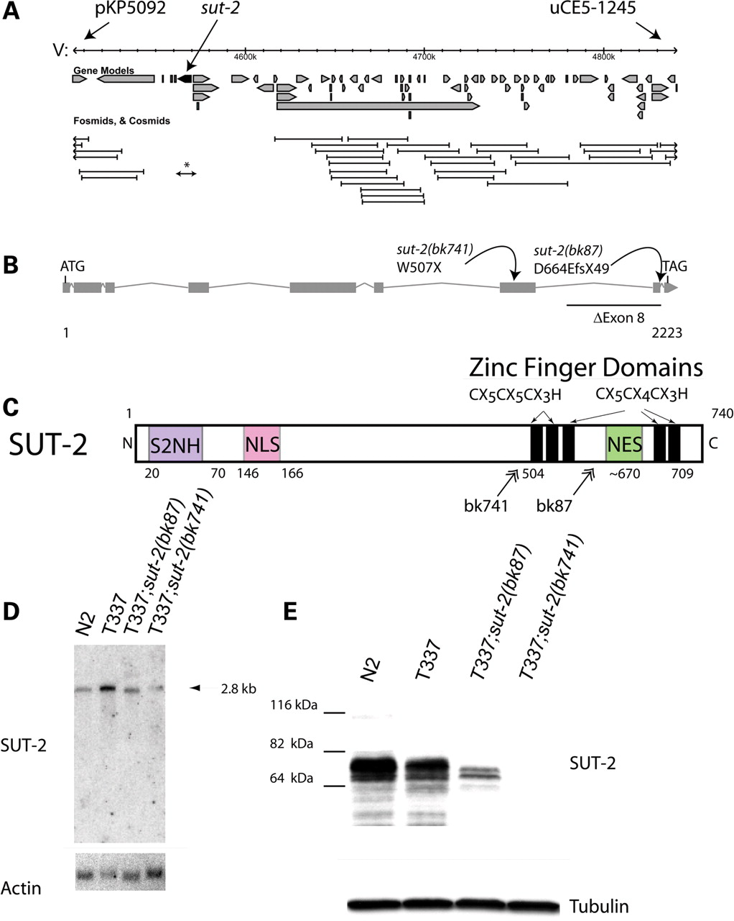
Figure 2. Structure and expression of the sut-2 gene. ( A ) The minimum sut-2 region as determined by genetic mapping ...
Notes:
Figure 2. Structure and expression of the sut-2 gene. ( A ) The minimum sut-2 region as determined by genetic mapping was between SNP markers pKP5092 and uCe5-1245, a physical interval of ∼404 kb. Predicted gene transcripts are shown as boxed arrows. Cosmid coverage is shown below the transcripts. A single 10 kb long-range PCR product containing the genomic sequence for Y61A9LA.8 is sufficient to rescue the sut-2 phenotype (asterisk). Other flanking cosmids did not rescue. ( B ) Predicted sut-2 mRNA transcript structure. Boxes depict exons, whereas forked lines show introns. The positions of bk87 and bk741 mutations are shown. ( C ) Predicted SUT-2 protein domains. SUT-2 N-terminal homology (S2NH) is a novel domain found in SUT-2 related proteins. Other domains are putative CCCH type ZF domains, a nuclear localization signal (NLS) and a nuclear export signal (NES). Double arrows represent positions of premature termination of SUT-2 as a result of mutations in strains carrying bk87 and bk741 alleles. ( D ) Northern blot of polyA selected RNA from wild-type (N2), tau transgenic (T337) and both sut-2(bk87) and sut-2(bk741) mutants. Upper panel, wild-type sut-2 mRNA is ∼2.8 kb as detected by radiolabled probe complementary to sut-2 . Lower panel, the same blot probed for actin. ( E ) Upper panel, an immunoblot of N2, T337, sut-2(bk87) and sut-2(bk741) worm total protein lysates probed with anti-SUT-2 protein antibodies. Lower panel, immunoblot of the same lysates probed for β-tubulin.
Unless provided in the caption above, the following copyright applies to the content of this slide: Published by Oxford University Press 2009

Slide 3
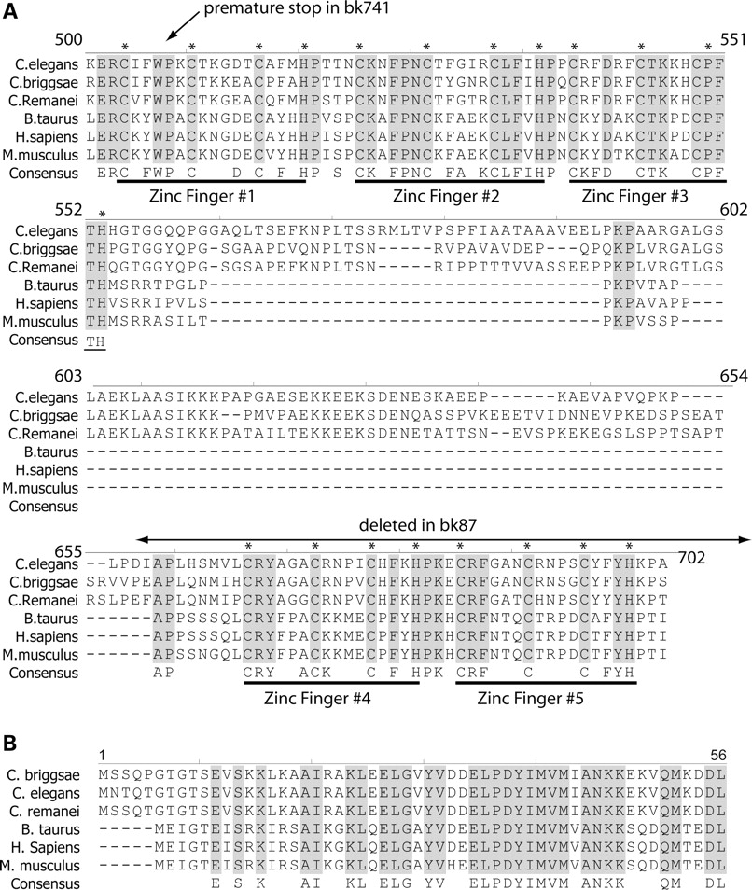
Figure 3. SUT-2 is conserved between nematodes and man. Shown is an alignment of the SUT-2 homologs from three ...
Notes:
Figure 3. SUT-2 is conserved between nematodes and man. Shown is an alignment of the SUT-2 homologs from three nematode and three mammalian species. ( A ) Alignment of CCCH domains. ( B ) Alignment of SUT-2 N-terminal homology domain. * Represents putative metal chelating residues in CCCH finger domains. Also see Supplementary Material, Fig. S1 for full length protein alignment.
Unless provided in the caption above, the following copyright applies to the content of this slide: Published by Oxford University Press 2009

Slide 4
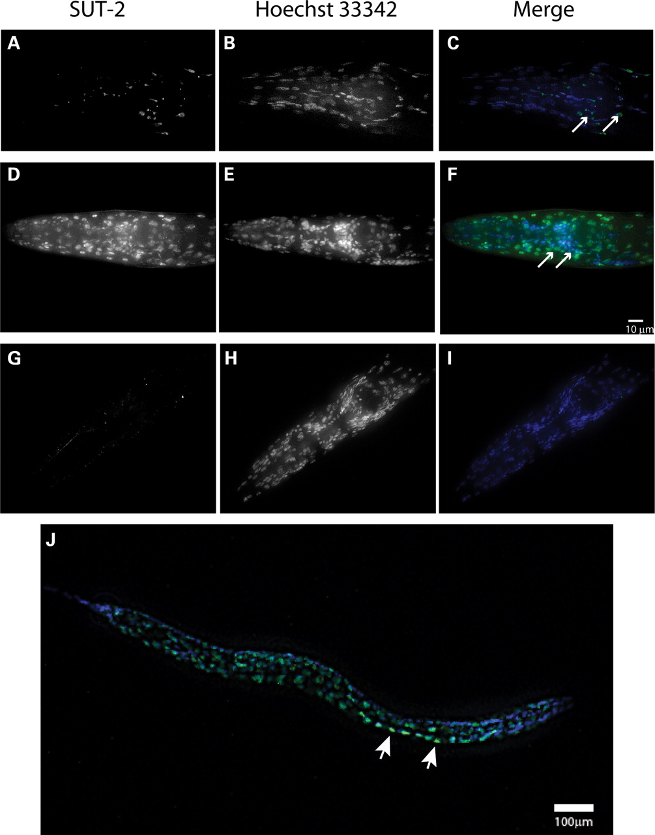
Figure 4. SUT-2 protein is expressed primarily in the nucleus of neurons and other cell types. ( A – C ) Expression of ...
Notes:
Figure 4. SUT-2 protein is expressed primarily in the nucleus of neurons and other cell types. ( A – C ) Expression of SUT-2::GFP reporter transgene in the head of an adult N2 animal. (A) SUT-2::GFP fluorescence. (B) Hoechst 33342 nuclear marker fluorescence staining. (C) Merged images of (A and B), green is GFP-fluorescence, blue is Hoechst 33342. Arrows represent nerve ring neurons. ( D – F ) Depict immunocytochemical staining of wild-type worms with anti-SUT-2 specific antibodies (D) and Hoechst 33342 nuclear marker (E) and a Merged image (F) (green = SUT-2, blue = Hoechst 33342). Arrows represent nerve ring neurons. ( G – I ) Depict immunocytochemical staining of sut-2(bk741) worms with anti-SUT-2 specific antibodies and Alexa 488 fluorescent secondary antibodies (G) and Hoechst 33342 nuclear marker (H) and a merged image (I). (B and C) Are high magnification views of the heads of adult sut-2(bk87) and sut-2(bk741) animals, respectively. (D) Shows a high magnification view of the head of an adult N2 animal. ( J ) Shows an L2 stage wild-type larvae stained with SUT-2 specific antibodies (green) and Hoechst 33342 (blue). Arrows represent nerve ring neurons. Arrowheads indicate normal ventral cord neurons with SUT-2 protein staining.
Unless provided in the caption above, the following copyright applies to the content of this slide: Published by Oxford University Press 2009

Slide 5
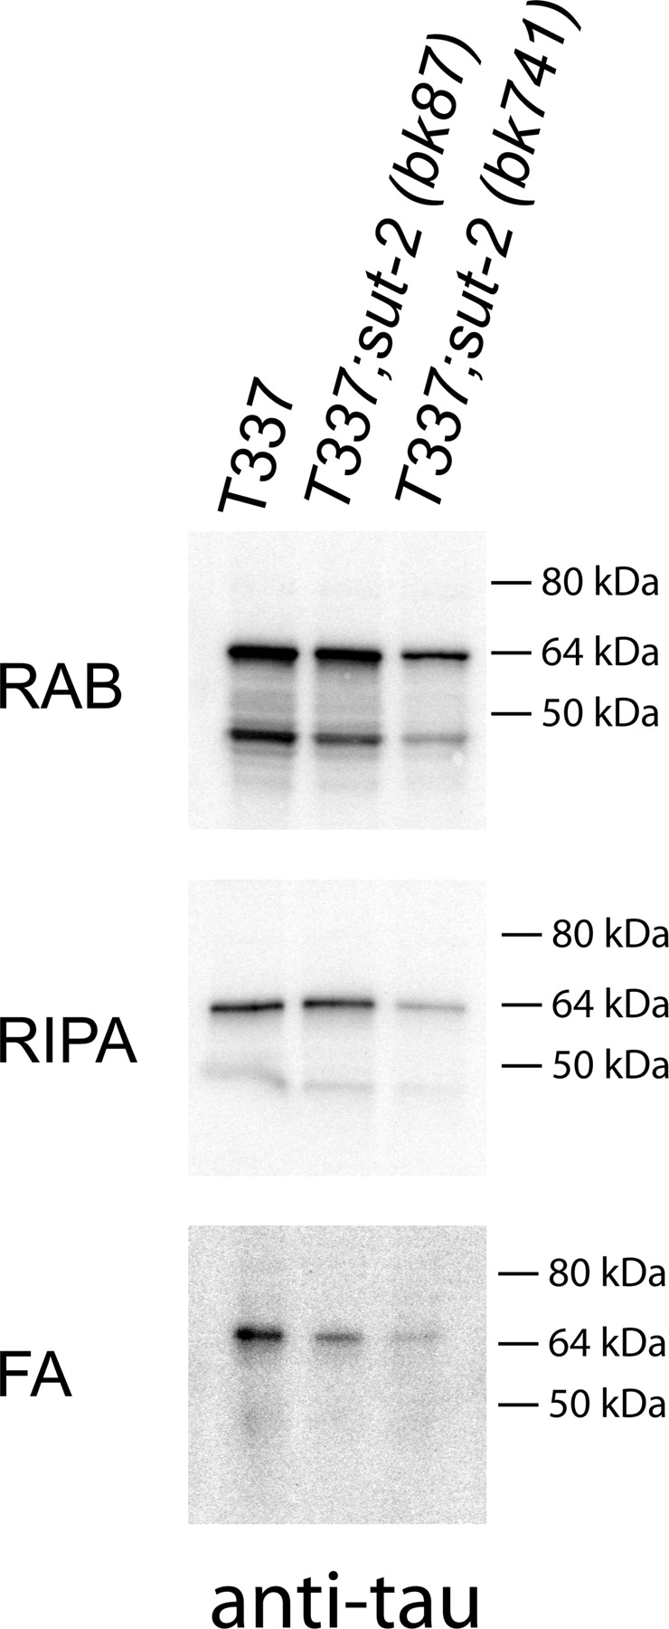
Figure 5. Loss of SUT-2 reduces accumulation of detergent insoluble tau species. Sequential extraction of insoluble ...
Notes:
Figure 5. Loss of SUT-2 reduces accumulation of detergent insoluble tau species. Sequential extraction of insoluble tau protein from T337, T337; sut-2(bk87) and T337; sut-2(bk741) worm lysates yields soluble and insoluble tau. RAB contains tau solublized by high salt soluble tau fraction; RIPA contains detergent soluble tau, whereas FA contains the detergent insoluble material formic acid (FA) solublized protein.
Unless provided in the caption above, the following copyright applies to the content of this slide: Published by Oxford University Press 2009

Slide 6
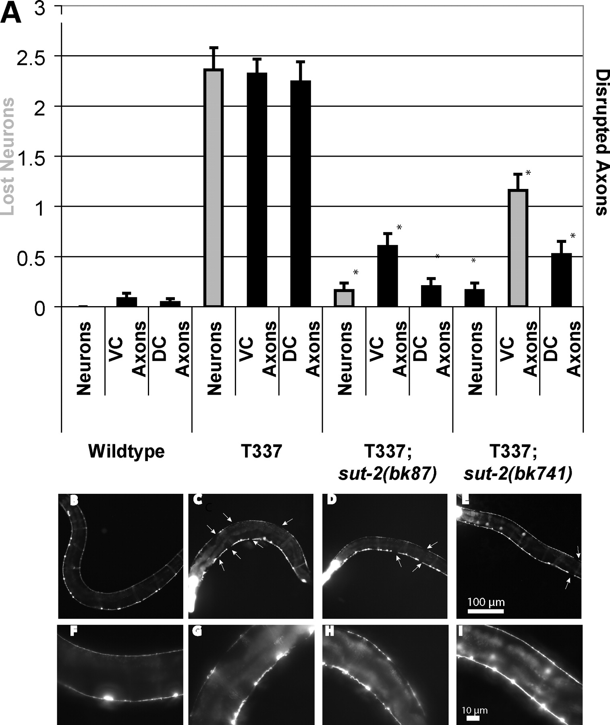
Figure 6. Loss of sut-2 reduces tau-induced neuronal damage. All strains shown contain a reporter transgene that marks ...
Notes:
Figure 6. Loss of sut-2 reduces tau-induced neuronal damage. All strains shown contain a reporter transgene that marks the 19 VD and DD class GABAergic neurons with GFP ( unc-25 ::GFP) from strain CZ1200. Left is anterior, down is ventral. ( A ) Measurement of neurodegenerative changes seen in wild-type, T337, T337; sut-2(bk87) and T337; sut-2(bk741) . Three types of neurodegenerative changes were scored: neuronal loss (neurons), interruption of ventral cord continuity (VC axons) or interruption of dorsal cord continuity (DC axons). Measurements are the average from 25 animals for each strain and error bars are SEM. Using a ANOVA (Kruskal–Wallis test), both T337; sut-2(bk87) and T337; sut-2(bk741) are significantly different from the parental T337 strain for neuronal loss, ventral cord interruptions and dorsal cord interruptions ( P < 0.0001). ( B ) Reporter strain CZ1200 in a non-transgenic wild-type background at 4 days of age. No neurodegenerative changes observed. (F) Higher magnification view of wild-type. ( C ) Four-day-old T337 animal exhibits loss of neurons, and interruptions of both dorsal and ventral nerve cords (white arrows) in all animals. ( D ) Four-day-old T337; sut-2(bk87) animal showing that loss of sut-2 ameliorates many of the defects seen in T337 alone. ( E ) Four-day-old T337; sut-2(bk741) animal showing that loss of sut-2 ameliorates many of the defects seen in T337 alone. ( F – I ) Higher magnification views of (B–E). Bright head fluorescence (in C–E) is myo-2 ::GFP, the marker transgene used to identify tau transgenic worms.
Unless provided in the caption above, the following copyright applies to the content of this slide: Published by Oxford University Press 2009

Slide 7
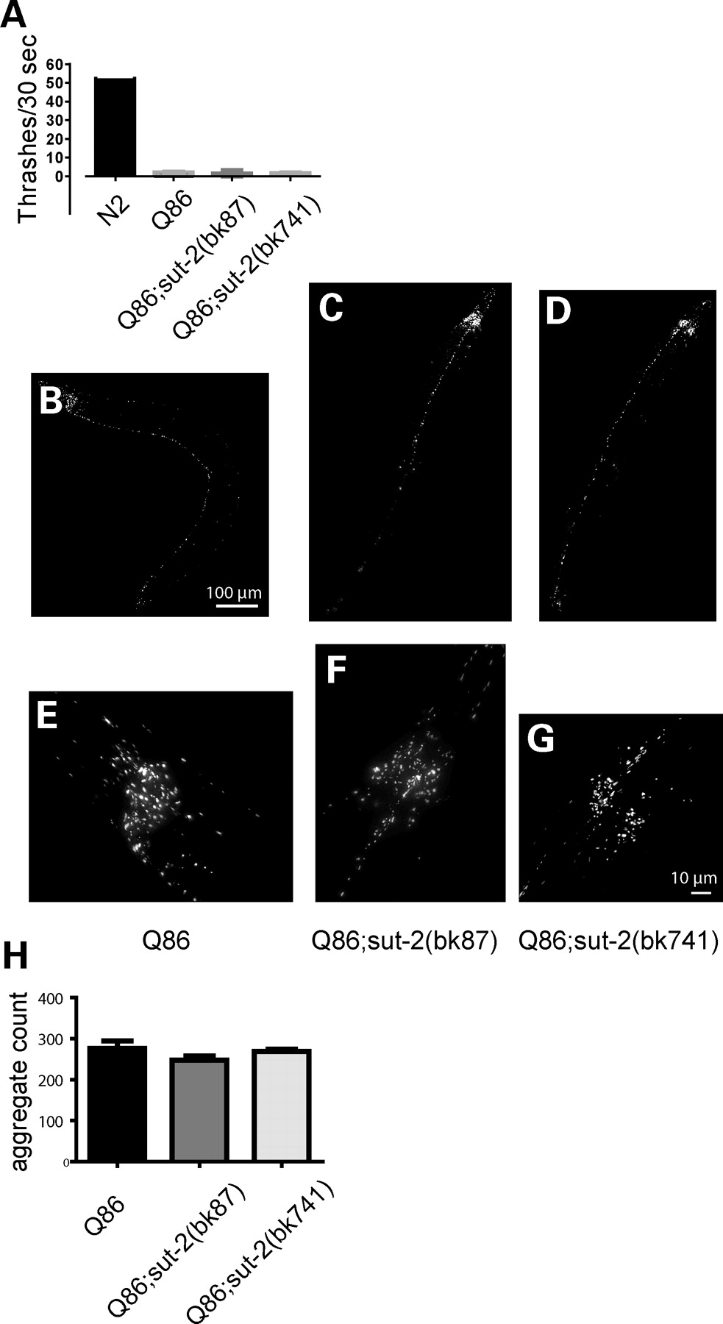
Figure 7. Loss of sut-2 does not modify polyglutamine phenotypes. ( A ) Graph of liquid thrashing assays for staged ...
Notes:
Figure 7. Loss of sut-2 does not modify polyglutamine phenotypes. ( A ) Graph of liquid thrashing assays for staged 4-day-old worms. Each column depicts the mean thrashing rate value (±SEM) for 20 worms: wild-type (N2)—52.6 ± 1.8, YFP-Q86—2.2 ± 0.4, YFP-Q86; sut-2(bk87) —1.6 ± 0.4 and YFP-Q86; sut-2(bk741) —1.9 ± 0.4; using the Kruskal–Wallis test, there are no statistically significant differences between YFP-Q86, YFP-Q86; sut-2(bk87) and YFP-Q86; sut-2(bk741) suggesting sut-2 does not modify the Q86 induced Unc phenotype. ( B – G ) Live image of polyQ aggregates of living worms. YFP-Q86 at low (B) and high magnification (E). YFP-Q86; sut-2(bk87) at low (C) and high magnification (F). YFP-Q86; sut-2(bk741) at low (D) and high magnification. ( H ) Graph of total number of YFP+ aggregates found per worm. Each data point represents the total number of YFP+ fluorescent polyQ86 deposits. The mean aggregate count (±SEM) for 10 worms scored: YFP-Q86–276 ± 19, YFP-Q86; sut-2(bk87) —247 ± 33 and YFP-Q86; sut-2(bk741) —269 ± 15. Using the Kruskal–Wallis test, there are no statistically significant differences between YFP-Q86, YFP-Q86; sut-2(bk87) , and YFP-Q86; sut-2(bk741) suggesting sut-2 does not modify Q86 aggregate count.
Unless provided in the caption above, the following copyright applies to the content of this slide: Published by Oxford University Press 2009

Slide 8
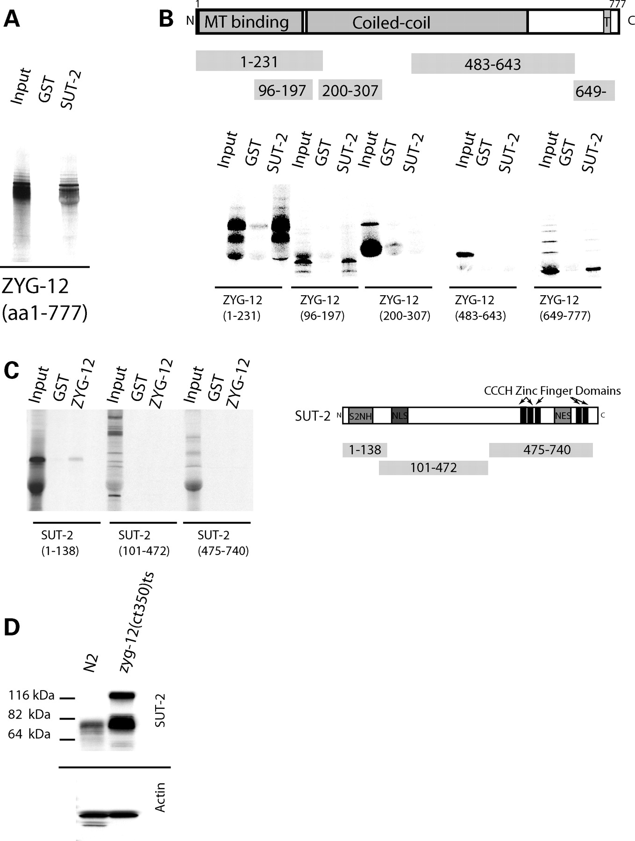
Figure 8. SUT-2 physically interacts with ZYG-12. ( A ) In vitro confirmation of the yeast two hybrid interaction ...
Notes:
Figure 8. SUT-2 physically interacts with ZYG-12. ( A ) In vitro confirmation of the yeast two hybrid interaction between SUT-2 and ZYG-12. Radiolabled ZYG-12 protein was tested against immobilized recombinant GST–SUT-2 fusion protein or recombinant GST alone using GST pull-down assays. ( B ) SUT-2 binds both N- and C-terminal domains containing fragments of ZYG-12 in GST pull-down assays. T is a single pass transmembrane domain. ( C ) A radiolabled SUT-2 protein fragment containing the S2NH domain is sufficient for binding to immobilized ZYG-12. ( D ) Loss of zyg-12 causes upregulation of SUT-2 protein. SUT-2 80 kDa band is ∼3-fold more abundant in zyg-12(bw54) than in N2.
Unless provided in the caption above, the following copyright applies to the content of this slide: Published by Oxford University Press 2009

Slide 9
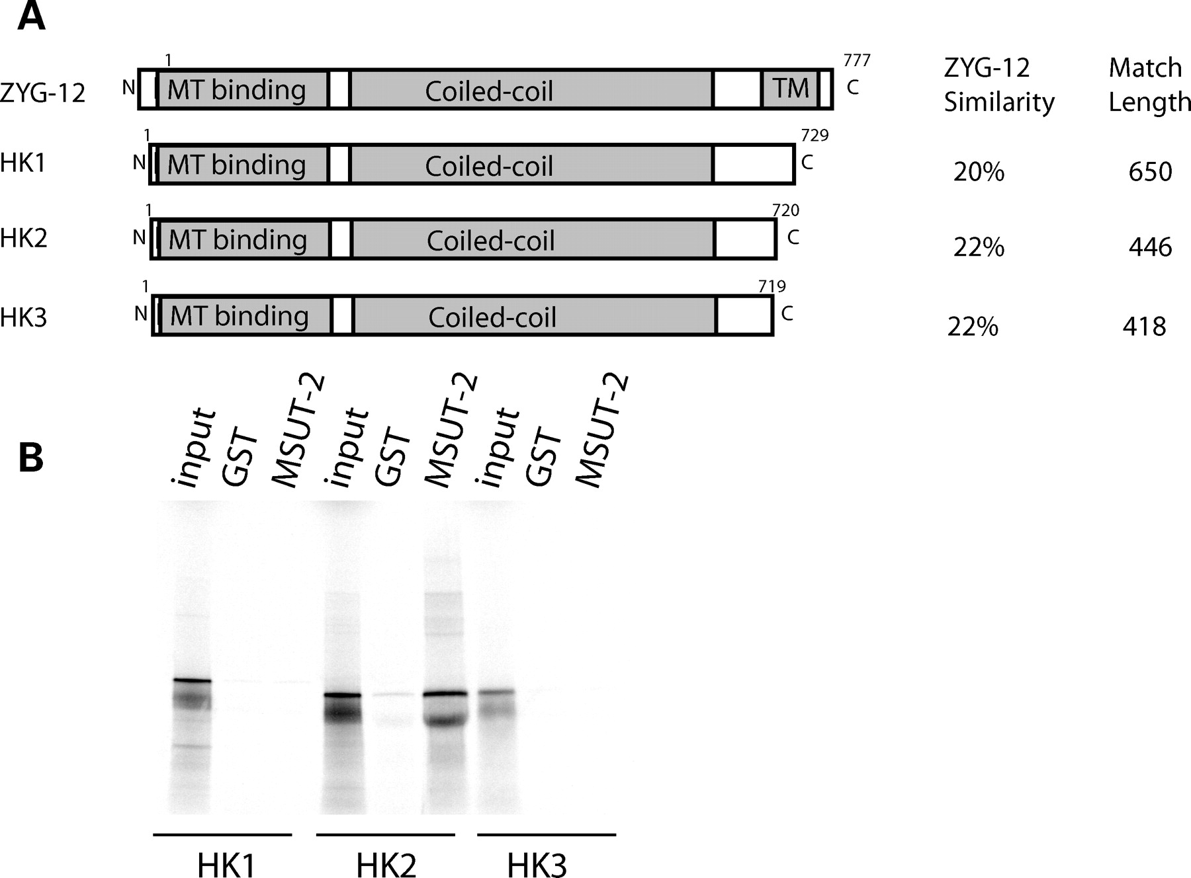
Figure 9. Human MSUT-2 binds HOOK2. ( A ) Comparison of shared domains in ZYG-12 and human HOOK1-3. See Supplementary ...
Notes:
Figure 9. Human MSUT-2 binds HOOK2. ( A ) Comparison of shared domains in ZYG-12 and human HOOK1-3. See Supplementary Material, Fig. S2 for detailed alignments. ( B ) In vitro protein binding assays between radiolabled human MSUT-2 and immobilized recombinant human HOOK1, HOOK2 and HOOK3 proteins. Immobilized recombinant GST is negative control.
Unless provided in the caption above, the following copyright applies to the content of this slide: Published by Oxford University Press 2009

