Slide 1
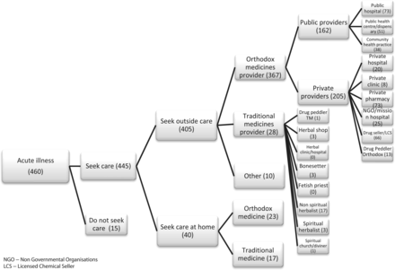
Figure 1 First recourses taken, acute illness
Notes:
Figure 1 First recourses taken, acute illness
Unless provided in the caption above, the following copyright applies to the content of this slide: Published by Oxford University Press in association with The London School of Hygiene and Tropical Medicine © The Author 2012; all rights reserved.

Slide 2
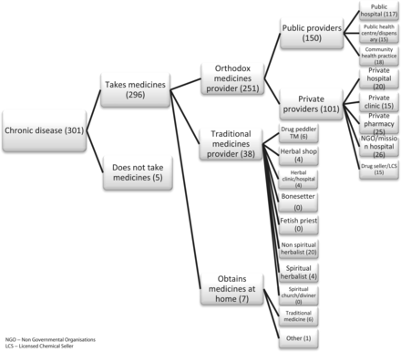
Figure 2 First recourses taken, chronic illness
Notes:
Figure 2 First recourses taken, chronic illness
Unless provided in the caption above, the following copyright applies to the content of this slide: Published by Oxford University Press in association with The London School of Hygiene and Tropical Medicine © The Author 2012; all rights reserved.

