Slide 1
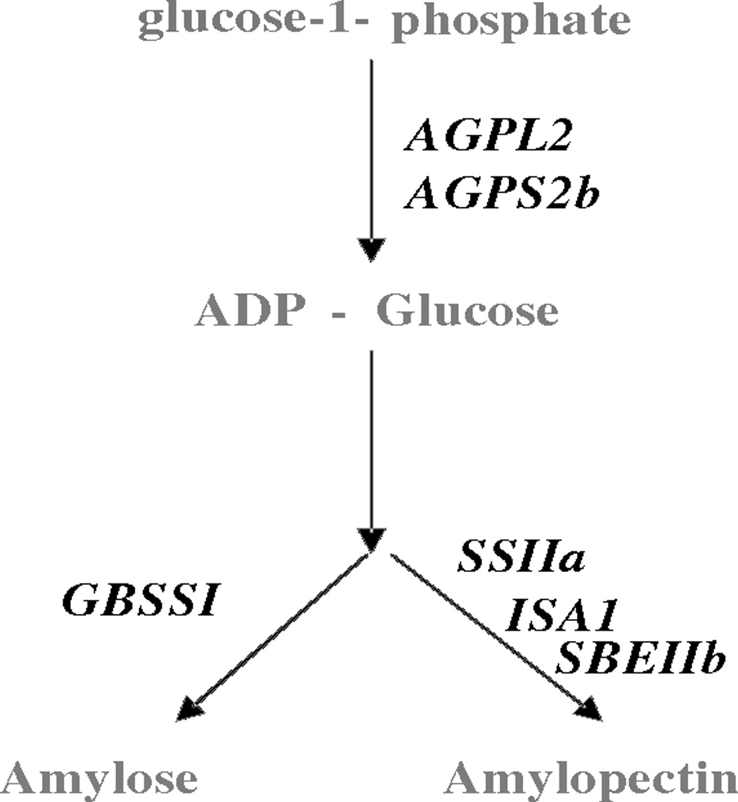
FIG. 1. Simplified starch synthesis pathway with all the studied starch genes.
Notes:
FIG. 1. Simplified starch synthesis pathway with all the studied starch genes.
Unless provided in the caption above, the following copyright applies to the content of this slide: © The Author 2010. Published by Oxford University Press on behalf of the Society for Molecular Biology and Evolution. All rights reserved. For permissions, please e-mail: journals.permissions@oup.com

Slide 2
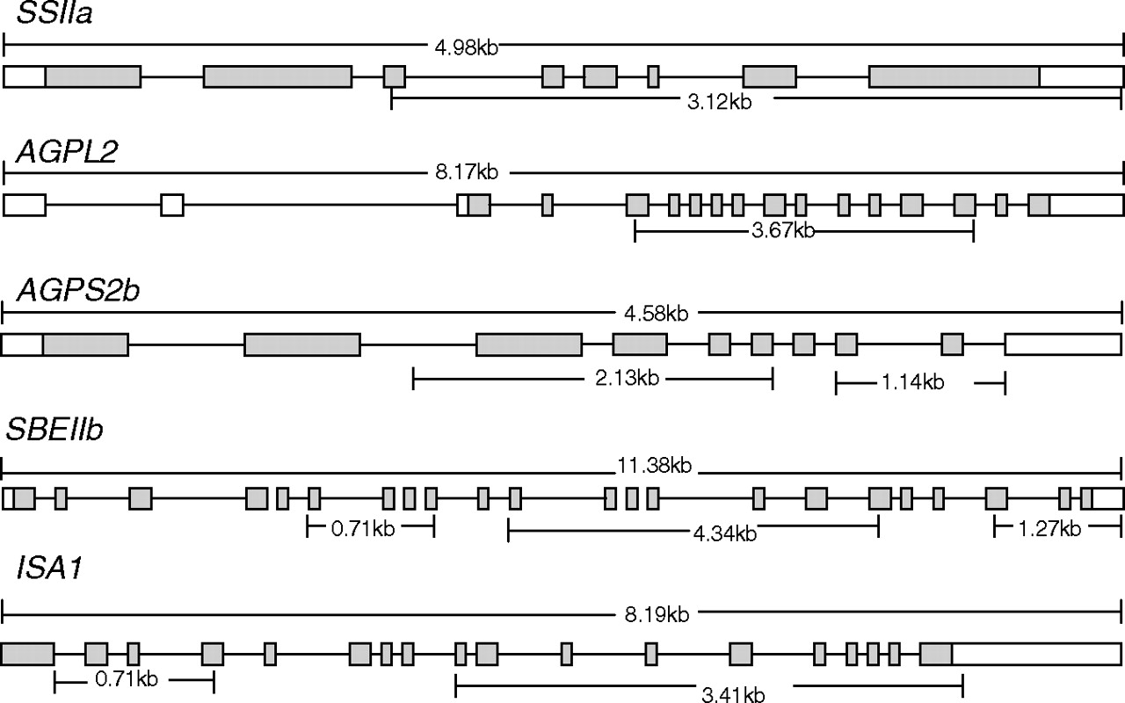
FIG. 2. Location and size of the sequenced regions; the boxes represent exons; shaded boxes correspond to translated ...
Notes:
FIG. 2. Location and size of the sequenced regions; the boxes represent exons; shaded boxes correspond to translated regions; the lines connecting the boxes are introns; the gene size is indicated above the boxes. The sequenced regions and size are shown under the boxes.
Unless provided in the caption above, the following copyright applies to the content of this slide: © The Author 2010. Published by Oxford University Press on behalf of the Society for Molecular Biology and Evolution. All rights reserved. For permissions, please e-mail: journals.permissions@oup.com

Slide 3
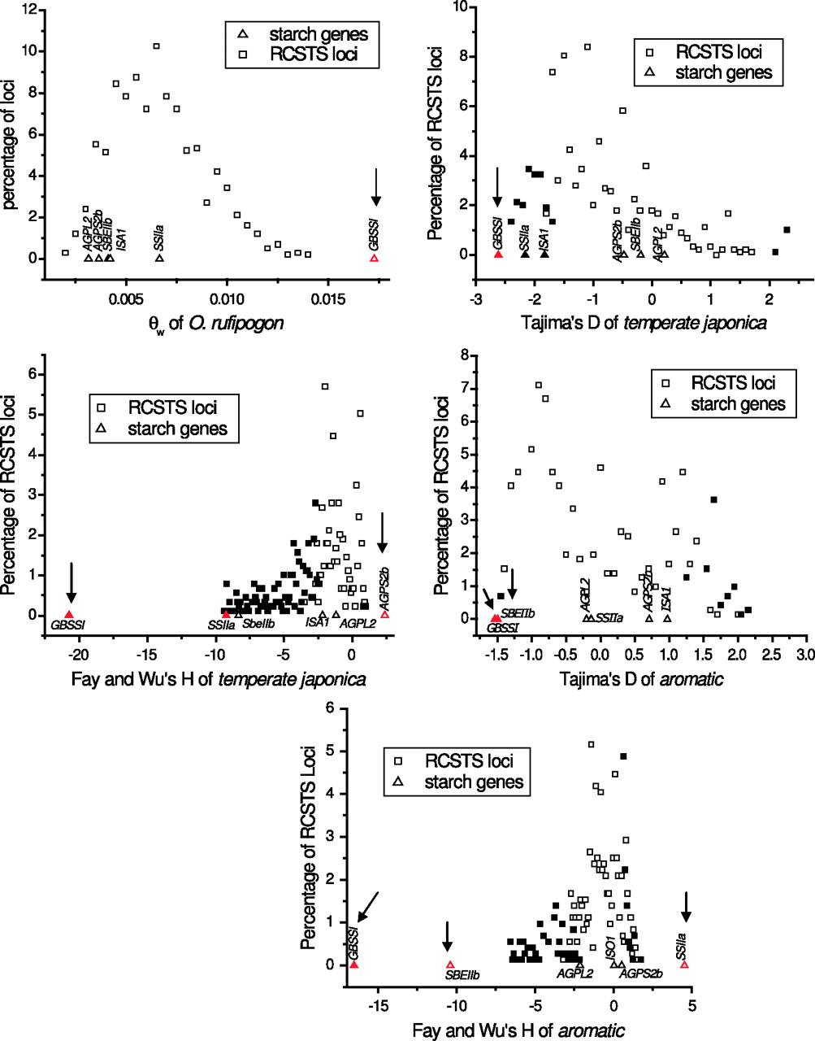
FIG. 3. The results of comparison between studied starch genes and RCSTS loci in O. rufipogon, aromatic, and ...
Notes:
FIG. 3. The results of comparison between studied starch genes and RCSTS loci in O. rufipogon, aromatic, and temperate japonica rice. Triangles represent the studied starch genes. Squares represent RCSTS loci. Filled triangles or squares represent significant deviation from the standard neutral model at a 5% significant level. A red triangle indicates that the gene significantly deviates from genome-wide RCSTS loci at the 5% significant level. A gene indicated by an arrow deviates significantly from genome-wide RCSTS loci after Bonferroni correction.
Unless provided in the caption above, the following copyright applies to the content of this slide: © The Author 2010. Published by Oxford University Press on behalf of the Society for Molecular Biology and Evolution. All rights reserved. For permissions, please e-mail: journals.permissions@oup.com

