Slide 1
Figure 1 Overview of the Bordetellapertussis chromosomal region harbouring tcfA. The deletion found in some strains is ...
Notes:
Figure 1 Overview of the Bordetellapertussis chromosomal region harbouring tcfA. The deletion found in some strains is indicated and corresponds to position 1 264 096–1 266 422 in Tohama I (Parkhill et al., 2003). The positions of the polymorphic G-track and the primers used for amplification are indicated. HP, hypothetical protein.
Unless provided in the caption above, the following copyright applies to the content of this slide: © 2007 Federation of European Microbiological Societies

Slide 2
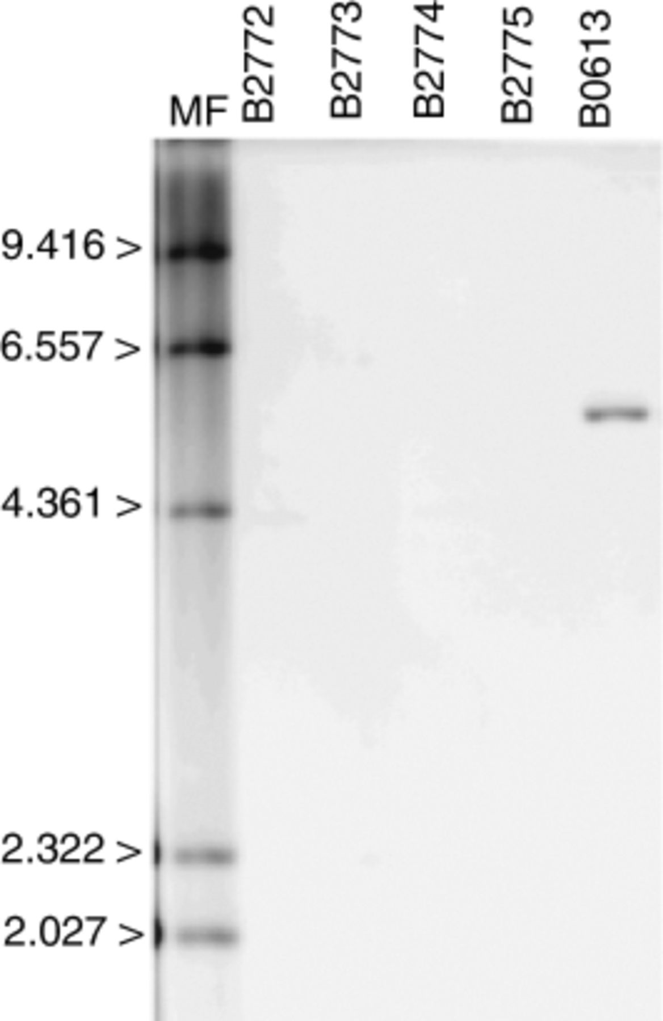
Figure 2 Detection of tcfA in Bordetellapertussis strains. Chromosomal DNA was digested with ClaI and hybridized to a ...
Notes:
Figure 2 Detection of tcfA in Bordetellapertussis strains. Chromosomal DNA was digested with ClaI and hybridized to a tcfA-specific probe. The numbers on the left refer to base pair sizes of marker DNA fragments (MF).
Unless provided in the caption above, the following copyright applies to the content of this slide: © 2007 Federation of European Microbiological Societies

Slide 3
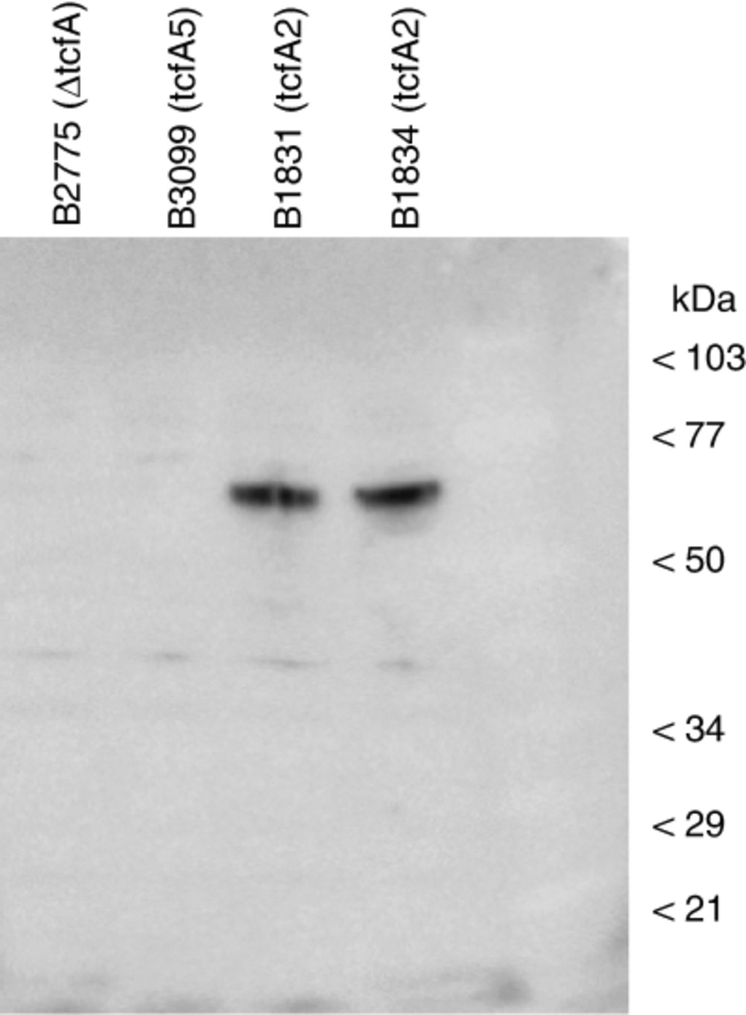
Figure 3 Detection of TcfA with specific antibodies. Western blotting was performed with polyclonal rabbit anti-TcfA ...
Notes:
Figure 3 Detection of TcfA with specific antibodies. Western blotting was performed with polyclonal rabbit anti-TcfA antibodies. B2775 and B3099 are representatives of strains missing the complete tcfA gene (ΔtcfA) or carrying a frame-shift mutation (tcfA5). The numbers on the right refer to the molecular mass of protein markers in kDa.
Unless provided in the caption above, the following copyright applies to the content of this slide: © 2007 Federation of European Microbiological Societies

Slide 4
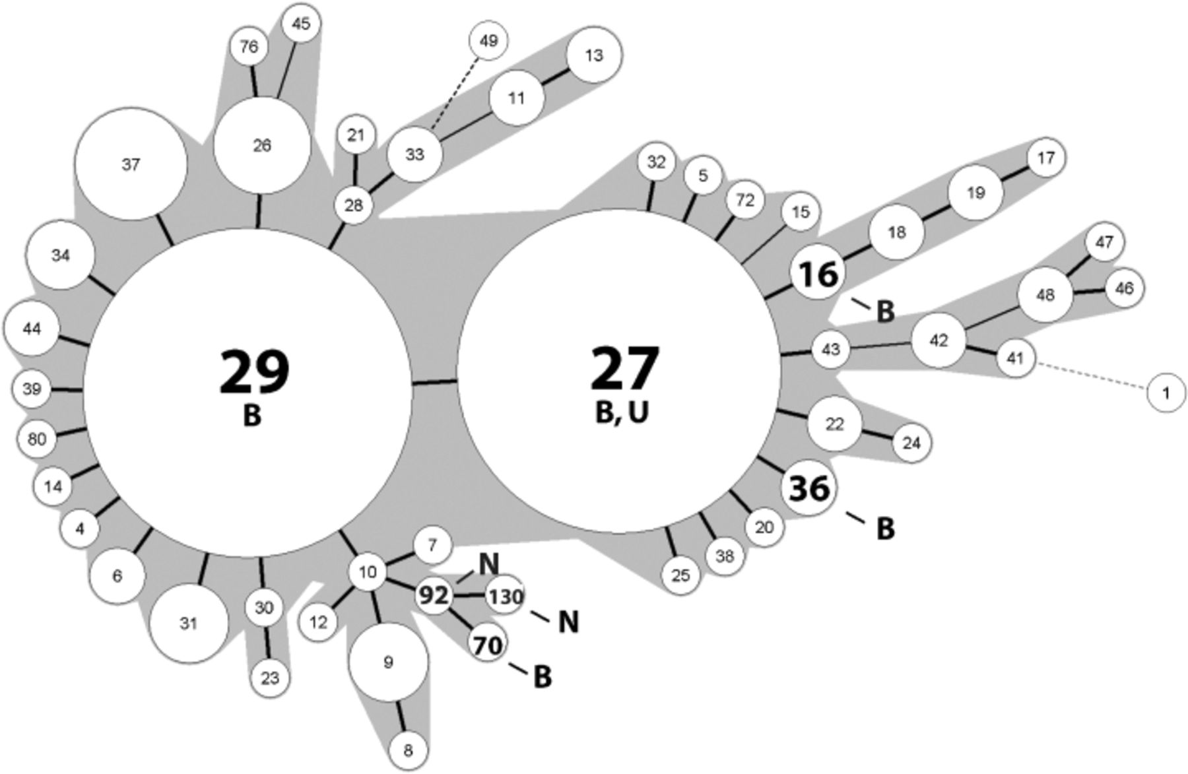
Figure 4 Minimum spanning tree based on MLVA of Bordetella pertussis isolates. MLVA types are indicated in the ...
Notes:
Figure 4 Minimum spanning tree based on MLVA of Bordetella pertussis isolates. MLVA types are indicated in the circles, the size of which is related to the number of isolates within that particular MLVA type. MLVA types harbouring tcfA mutants are indicated by thick set numbers. Thick set and stippled lines indicate differences of one and more than one locus, respectively. The country of isolation is indicated. A total of 213 Dutch isolates were included for this analysis (Schouls et al., 2004). B, Belgium; N, the Netherlands; U, USA.
Unless provided in the caption above, the following copyright applies to the content of this slide: © 2007 Federation of European Microbiological Societies

