Slide 1
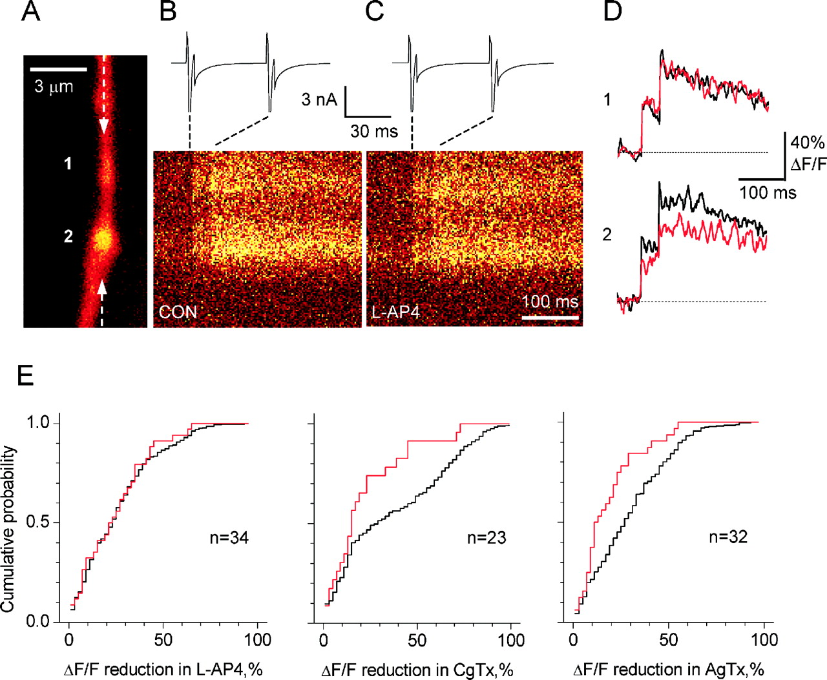
Figure 5. Functional comparison of axonal varicosities supplied by the same axon. (A–D) Example. Axonal ...
Notes:
Figure 5. Functional comparison of axonal varicosities supplied by the same axon. (A–D) Example. Axonal fragment with two varicosities (denoted 1 and 2 in A; Alexa 594 fluorescence; increased brightness in the middle of varicosity 1 implies that its size in the Z direction exceeds the axon diameter two- to threefold) showed Ca2+ transients in response to evoked action currents (B, average of 10 line scans). Application of l-AP4 reduced ΔF/F in varicosity 2 but not in varicosity 1 (C; quantitative results are shown in D with black traces, control; red trace, l-AP4). (E) Shuffled control (Monte Carlo) test for similarity between varicosities supplied by the same axon. Cumulative distributions are shown; the black line indicates the distribution of the absolute difference between two randomly selected varicosities (shuffled control, sample size = 500); the red line indicates the distribution of the absolute difference between two varicosities on the same axon (experimental sample sizes are indicated). The difference in the effect of l-AP4 on neighboring varicosities was distributed the same way as the difference between any two varicosities randomly drawn from the sample (left panel). In contrast, the effects of CgTx and AgTx among neighbors showed much greater similarity than among randomly selected pairs of varicosities (P < 0.001 and P < 0.01, respectively, Kolmogorov–Smirnov test), implying that the presynaptic axon largely determines whether N-type or P-type channels are expressed.
Unless provided in the caption above, the following copyright applies to the content of this slide:

Slide 2
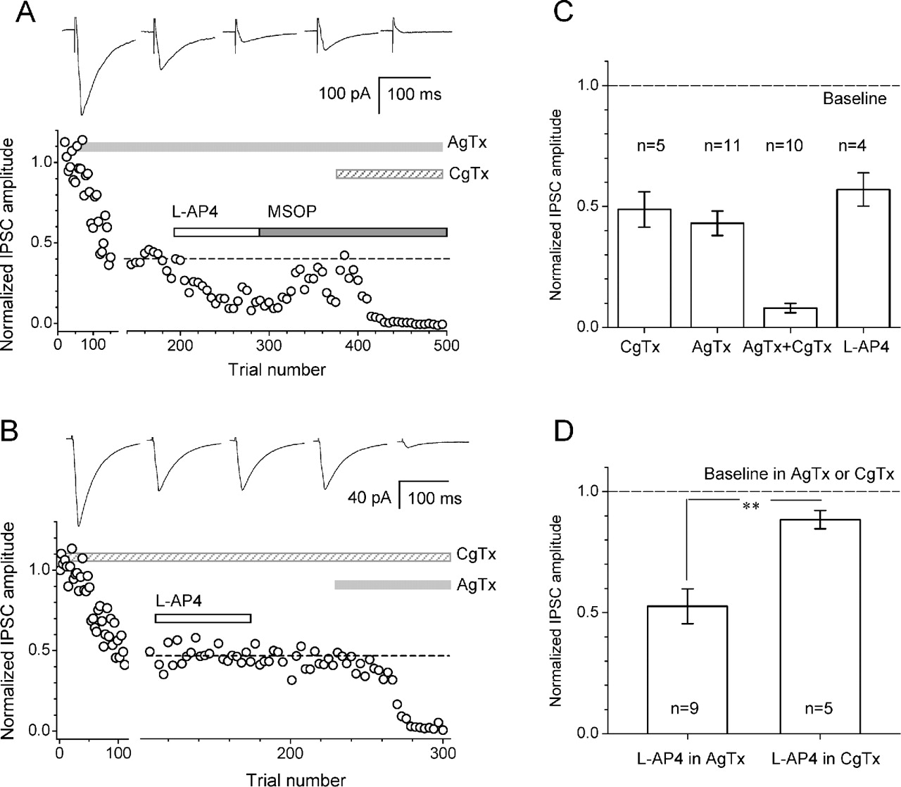
Figure 1. Blockade of N-type Ca²⁺ channels partially occludes the depression of IPSCs by group III ...
Notes:
Figure 1. Blockade of N-type Ca2+ channels partially occludes the depression of IPSCs by group III mGluRs. (A) Single cell example: the IPSC amplitude (normalized to baseline) was reduced in 0.1 µM AgTx. l-AP4 (50 µM) further reduced the IPSC from the new baseline (dotted line, estimated from the average of 20 trials prior to l-AP4 application). The traces shown above were averaged from 10 to 20 successive IPSCs in the following recording conditions (from left to right): control, AgTx, AgTx + l-AP4, AgTx + MSOP and AgTx + CgTx. (B) Single cell example: the IPSC amplitude was depressed to a new level by 0.25 µM CgTx (dotted line), but subsequent application of l-AP4 had no effect. Traces: control, CgTx, CgTx + l-AP4, CgTx + l-AP4 washout, and CgTx + AgTx; the other notations are as in B. (C) Summary of effects of Ca2+ channel blockers and l-AP4 on IPSC amplitudes. All effects were significant at P < 0.001. (D) When P-type channels were blocked by AgTx, l-AP4 still reduced IPSCs to 52 ± 7% of baseline (n = 9, P < 0.001); in contrast, when N-type channels were blocked by CgTx, the IPSC reduction in l-AP4 was fourfold smaller (88 ± 4% of baseline; n = 5, P < 0.04; the difference between the effects was significant at P < 0.005).
Unless provided in the caption above, the following copyright applies to the content of this slide:

Slide 3
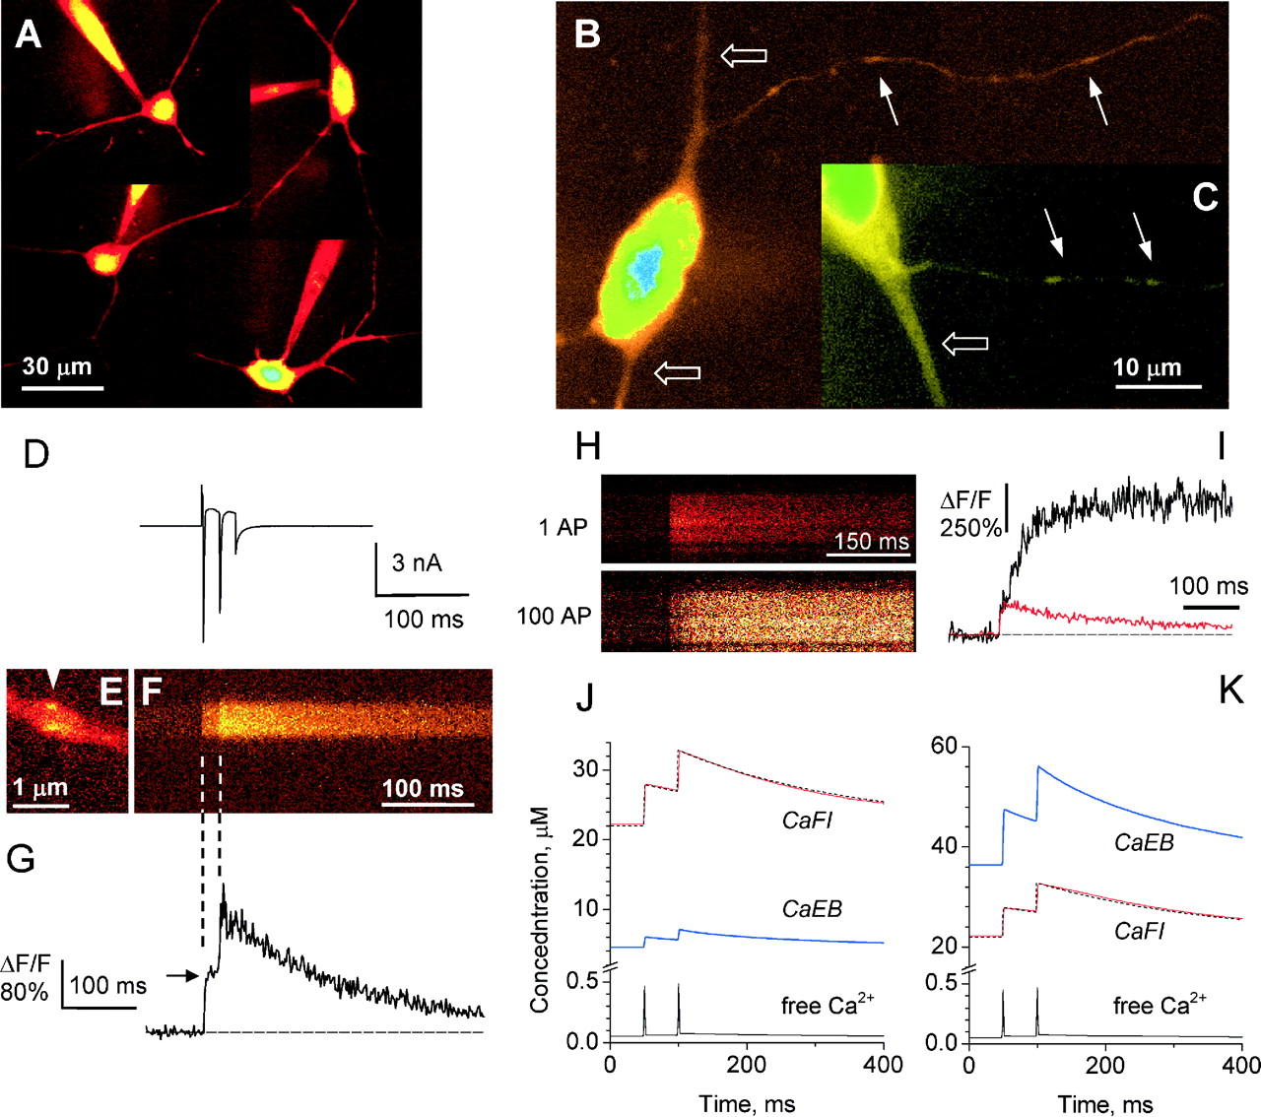
Figure 2. Properties of action potential-evoked Ca²⁺ influx in axonal varicosities of CA1 ...
Notes:
Figure 2. Properties of action potential-evoked Ca2+ influx in axonal varicosities of CA1 interneurons. (A) Examples of stratum radiatum interneurons imaged in two-photon mode (Alexa 594 fluorescence, λx = 810 nm; Kalman fusion of 20 confocal sections over 15 µm depth) whole cell pipettes are visible. (B, C) Fragments of imaged interneurons at higher resolution, showing fragments of the axons (solid arrows) and dendrites (open arrows). (D–G) A depolarizing command voltage step induced two action currents (D) which elicited in a single varicosity (E) two Fluo-4 fluorescence responses (F) with little or no occlusion (G); arrowhead in E shows the line scan position; arrow in G indicates the ΔF/F step that corresponds to the first action current. (H, I) Example of a saturation experiment: fluorescence response to a single spike (average of five sweeps, upper panel in H, red line in I) and a train of 100 spikes (a single sweep, lower panel in H, red line in I; only part of the 2.5 s long sweep is shown) in the same varicosity. See Results for details. (J, K) Numerical simulation of Ca2+ kinetics in the axonal varicosity in the two likely limiting cases of endogenous buffer (EB), 50 nM (J) and 400 nM (K); computed kinetics of free Ca2+ (black line), Ca-bound indicator (CaFI, red line) and Ca-bound buffer (CaEB, blue line) are shown; the CaEB concentration corresponding to the average experimental fluorescence signal is shown as a black dotted line. See text for further details.
Unless provided in the caption above, the following copyright applies to the content of this slide:

Slide 4
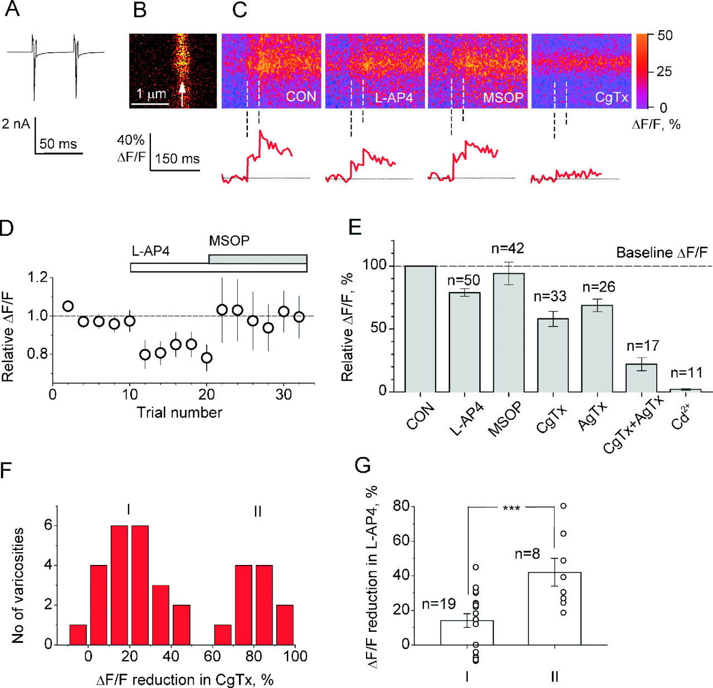
Figure 3. Contribution of N- and P-type Ca²⁺ channels to Ca²⁺ signaling at individual ...
Notes:
Figure 3. Contribution of N- and P-type Ca2+ channels to Ca2+ signaling at individual axonal varicosities and comparison of the effects of N-type Ca2+ channel blockade and activation of group III mGluRs in the same varicosities. (A–C) Typical experimental design. Two action currents evoked by brief (5 ms) depolarizing voltage steps (A), triggered in a single varicosity (B, Alexa 594 fluorescence; arrow indicates line scan position) a fluorescence transient (C, average of 10 scans, Fluo-4 fluorescence). This transient was reduced by l-AP4, recovered following blockade of group III mGluRs with MSOP, and was then suppressed by CgTx (panels and traces in C; false color table applies). Dotted lines indicate the times of the action currents. (D) Average response of ΔF/F to l-AP4 and subsequent application of MSOP (n = 42). Points were averaged for two consecutive trials; for illustration purposes, the baseline and l-AP4 data (consisting of 10–20 scans) were truncated to the 10 first trials (five points) before averaging across the population. (E) Summary of the average effects of l-AP4 and Ca2+ channel blockers on the evoked Ca2+ signal across all recorded varicosities. (F) The effects of CgTx on the ΔF/F signal fell into two groups (I and II, n = 33; experiments with or without prior application of l-AP4 followed by MSOP were included). (G) Varicosities that were more sensitive to CgTx were also more sensitive to l-AP4: group II varicosities showed a threefold larger reduction in ΔF/F than group I varicosities (42 ± 8 versus 14 ± 4%, P < 0.001). Open circles represent individual data points.
Unless provided in the caption above, the following copyright applies to the content of this slide:

Slide 5
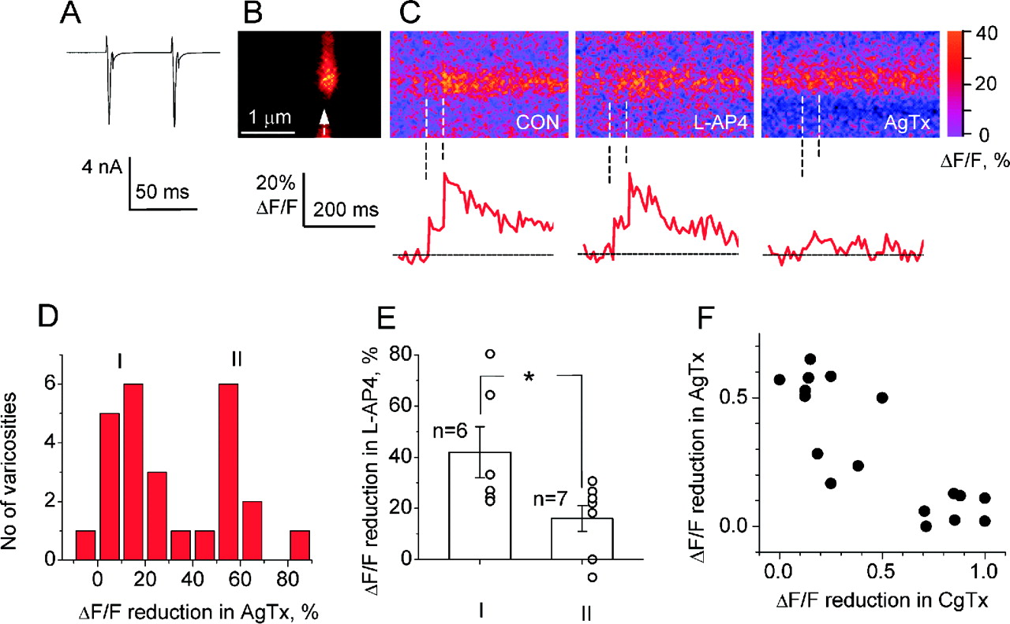
Figure 4. Comparison of the effects of P-type Ca²⁺ channel blockade and activation of group III ...
Notes:
Figure 4. Comparison of the effects of P-type Ca2+ channel blockade and activation of group III mGluRs in the same axonal varicosities. (A–C) Example: two action currents evoked by brief depolarizing voltage steps (A) elicited in a single varicosity (B, Alexa 594 fluorescence) a fluorescence transient (C, average of 10–12 scans, Fluo-4 fluorescence), which was not affected by l-AP4 but was suppressed by AgTx (panels and traces in C, false color table applies); doted lines indicate onset of two action currents. (D) The effects of AgTx on ΔF/F in individual varicosities fell into two groups (I and II, n = 26; experiments with or without prior application of l-AP4 followed by MSOP were included). (E) Varicosities that were more sensitive to AgTx were less sensitive to l-AP4: group I varicosities showed a smaller reduction in ΔF/F than group II varicosities (42 ± 10% and 16 ± 5%, respectively; P < 0.04). (F) Effects of AgTx and CgTx on Ca2+ transients in an individual varicosity were anti-correlated (r = –0.83, P < 0.001); reduction in ΔF/F is shown on the 0–1 scale.
Unless provided in the caption above, the following copyright applies to the content of this slide:

