Slide 1
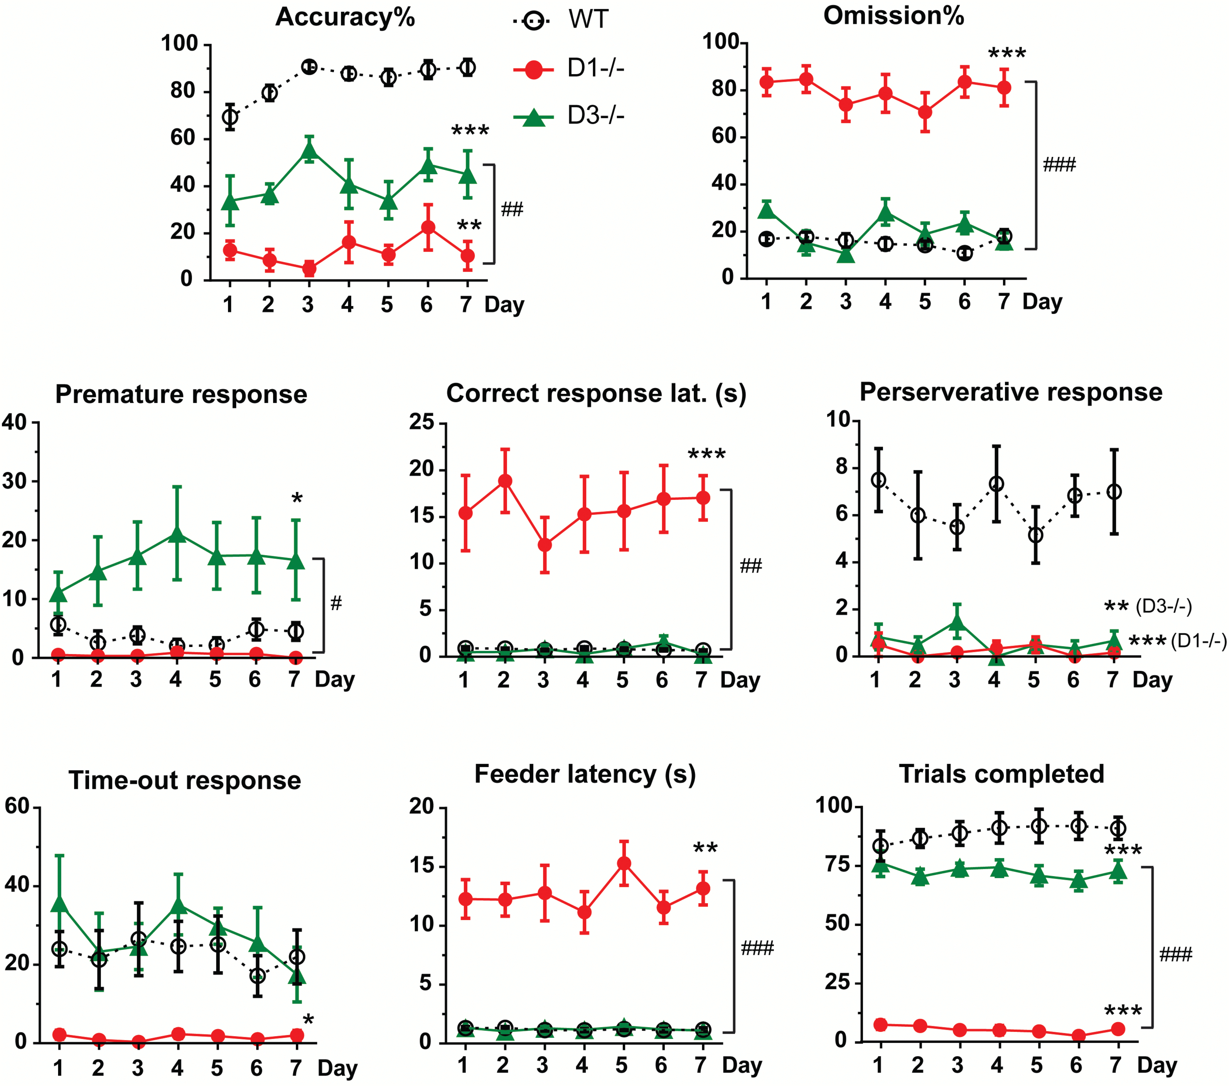
Figure 1. 5-Choice serial reaction time task (5-CSRTT) baseline performance in the D1^{-/-} and ...
Notes:
Figure 1. 5-Choice serial reaction time task (5-CSRTT) baseline performance in the D1-/- and D3-/- mice. The training sessions were performed from days 1 to 7. The values represent the mean ± SEM. The final performance on day 7 was analyzed by 1-way ANOVA. Sidak’s posthoc test was used to analyze difference between genotypes. *P<.05, **P<.01, ***P<.0001, compared with WT mice. #P < .05, ##P < .01, ###P < .0001, compared between D1-/- and D3-/- mice.
Unless provided in the caption above, the following copyright applies to the content of this slide: © The Author 2017. Published by Oxford University Press on behalf of CINP.This is an Open Access article distributed under the terms of the Creative Commons Attribution Non-Commercial License (http://creativecommons.org/licenses/by-nc/4.0/), which permits non-commercial re-use, distribution, and reproduction in any medium, provided the original work is properly cited. For commercial re-use, please contact journals.permissions@oup.com

Slide 2
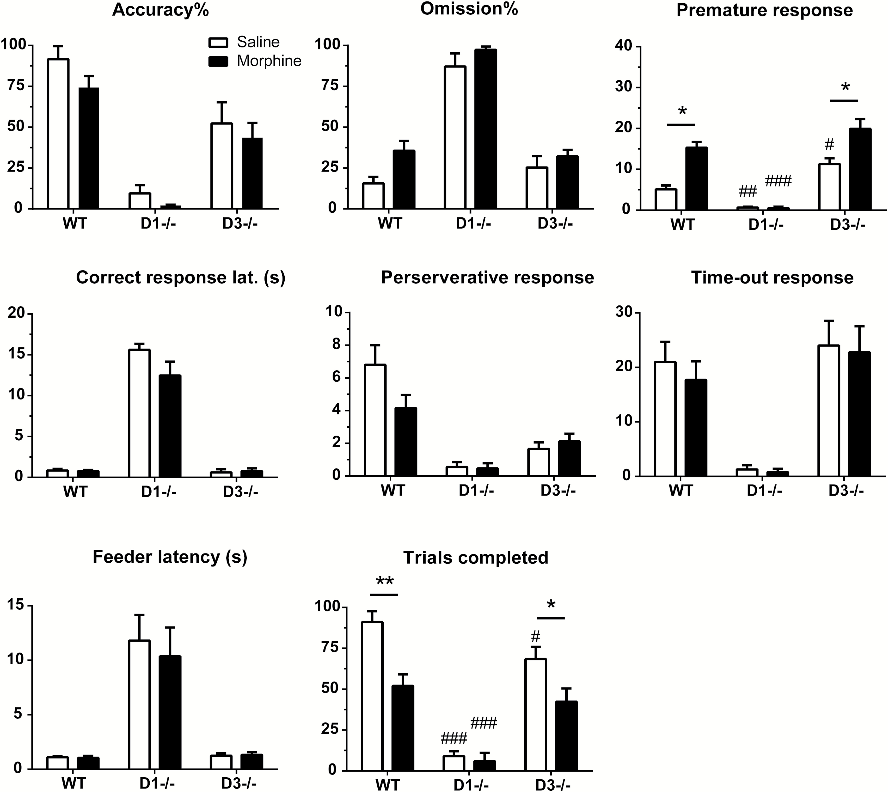
Figure 2. Effects of repeated morphine administration in D1^{-/-} or D3^{-/-} mice. Mice were ...
Notes:
Figure 2. Effects of repeated morphine administration in D1-/- or D3-/- mice. Mice were administered 10 mg/kg morphine i.p. for 7 days. The values represent the mean ± SEM. Two-way ANOVA followed by Sidak’s multiple comparisons test was used to reveal difference between groups. *P < .05, **P < .01, morphine-treated mice were compared with their saline-treated counterparts. #P < .05, ##P < .01, ###P<.0001, D1-/- and D3-/- mice were compared with WT mice with the morphine and saline treatments.
Unless provided in the caption above, the following copyright applies to the content of this slide: © The Author 2017. Published by Oxford University Press on behalf of CINP.This is an Open Access article distributed under the terms of the Creative Commons Attribution Non-Commercial License (http://creativecommons.org/licenses/by-nc/4.0/), which permits non-commercial re-use, distribution, and reproduction in any medium, provided the original work is properly cited. For commercial re-use, please contact journals.permissions@oup.com

Slide 3
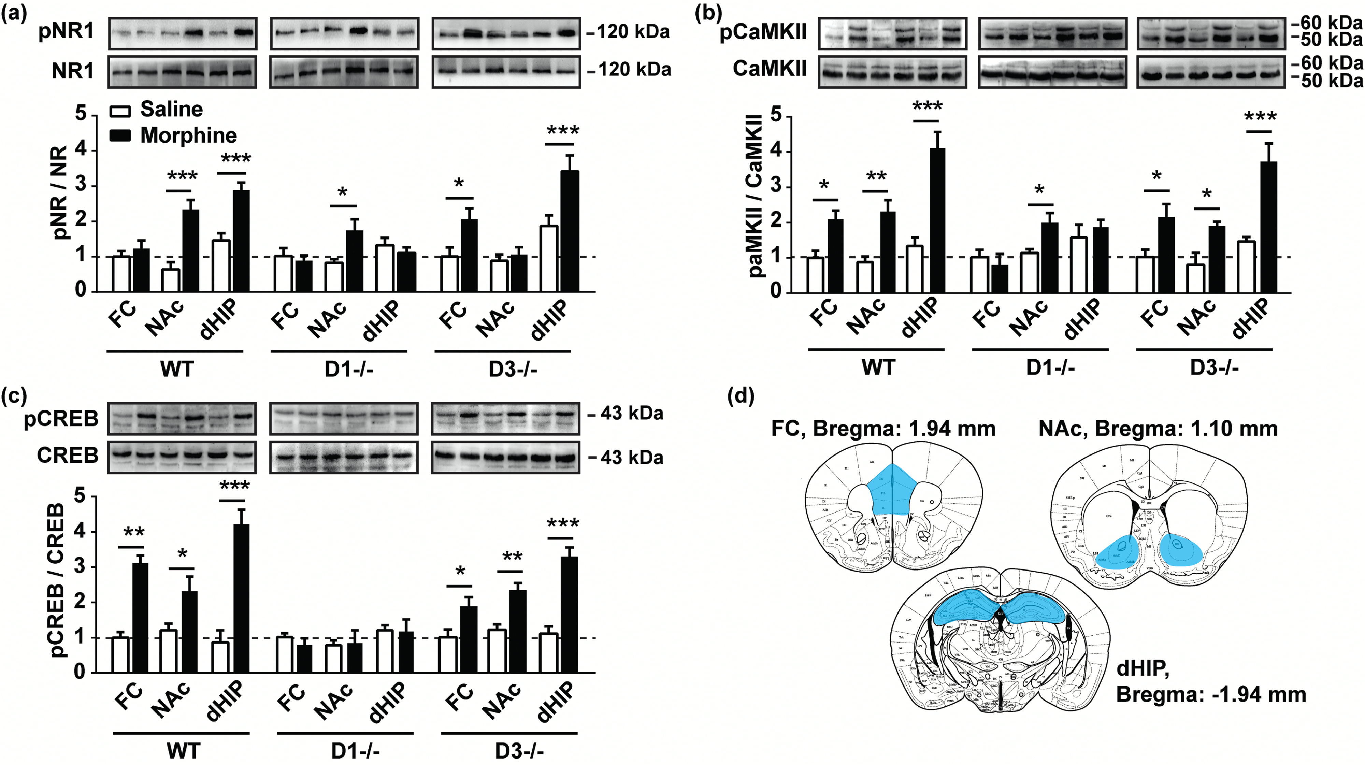
Figure 3. Effects of repeated morphine administration on NR1-Ca²⁺/calmodulin-dependent protein kinase II ...
Notes:
Figure 3. Effects of repeated morphine administration on NR1-Ca2+/calmodulin-dependent protein kinase II (CaMKII)-cAMP response element-binding protein (CREB) phosphorylation. Mice were administered 10 mg/kg morphine i.p. for 7 days. The relative fold changes in the levels of phosphorylated (a) NR1, (b) CaMKII, and (c) CREB protein were analyzed. The protein levels in the frontal cortex (FC) of the saline group were set as 1. The values represent the mean±SEM. Morphine-treated mice were compared with their saline-treated counterparts, *P<.05, **P<.01, ***P<.0001. (d) Schematic representation showing the locations of the excised brain regions (blue area). Figures were adapted from atlas of Paxinos and Watson (George Paxinos, 2001). NAc, nucleus accumbens; dHIP, dorsal hippocampus.
Unless provided in the caption above, the following copyright applies to the content of this slide: © The Author 2017. Published by Oxford University Press on behalf of CINP.This is an Open Access article distributed under the terms of the Creative Commons Attribution Non-Commercial License (http://creativecommons.org/licenses/by-nc/4.0/), which permits non-commercial re-use, distribution, and reproduction in any medium, provided the original work is properly cited. For commercial re-use, please contact journals.permissions@oup.com

Slide 4
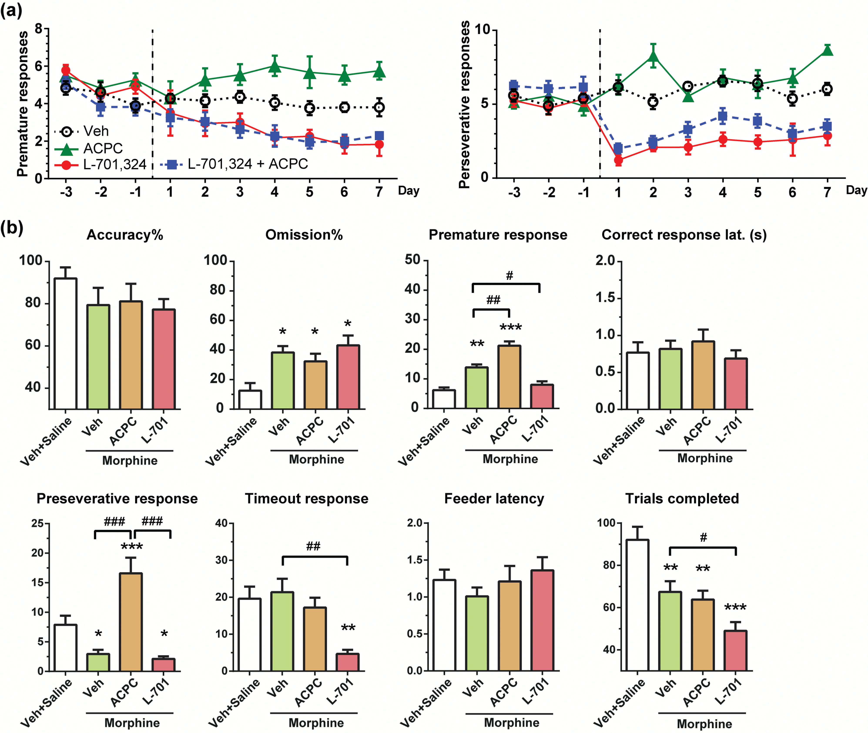
Figure 4. Effects of l-aminocyclopropanecarboxylic acid (ACPC) and ...
Notes:
Figure 4. Effects of l-aminocyclopropanecarboxylic acid (ACPC) and 7-chloro-4-hydroxy-3-(3-phenoxy)phenyl-2(1H)-quinolone (L-701,324) administration on morphine-induced cognitive and behavioral changes. (a) Mice received ACPC (200 mg/kg), L-701,324 (3 mg/kg), L-701,324+ACPC, or Veh (1% Tween-80 vehicle) i.p. once per day for 7 consecutive days. Premature responses and perseverative responses are showed. (b) Mice received ACPC, L-701,324, or vehicle 15 minutes before 10 mg/kg morphine or saline administration. 5-Choice serial reaction time task (5-CSRTT) performance was analyzed after 7 days of treatment. *P < .05, **P < .01, ***P < .0001, compared with Veh+Saline controls. #P<.05, ##P<.01, ###P<.0001, comparison between the 2 indicated groups.
Unless provided in the caption above, the following copyright applies to the content of this slide: © The Author 2017. Published by Oxford University Press on behalf of CINP.This is an Open Access article distributed under the terms of the Creative Commons Attribution Non-Commercial License (http://creativecommons.org/licenses/by-nc/4.0/), which permits non-commercial re-use, distribution, and reproduction in any medium, provided the original work is properly cited. For commercial re-use, please contact journals.permissions@oup.com

Slide 5
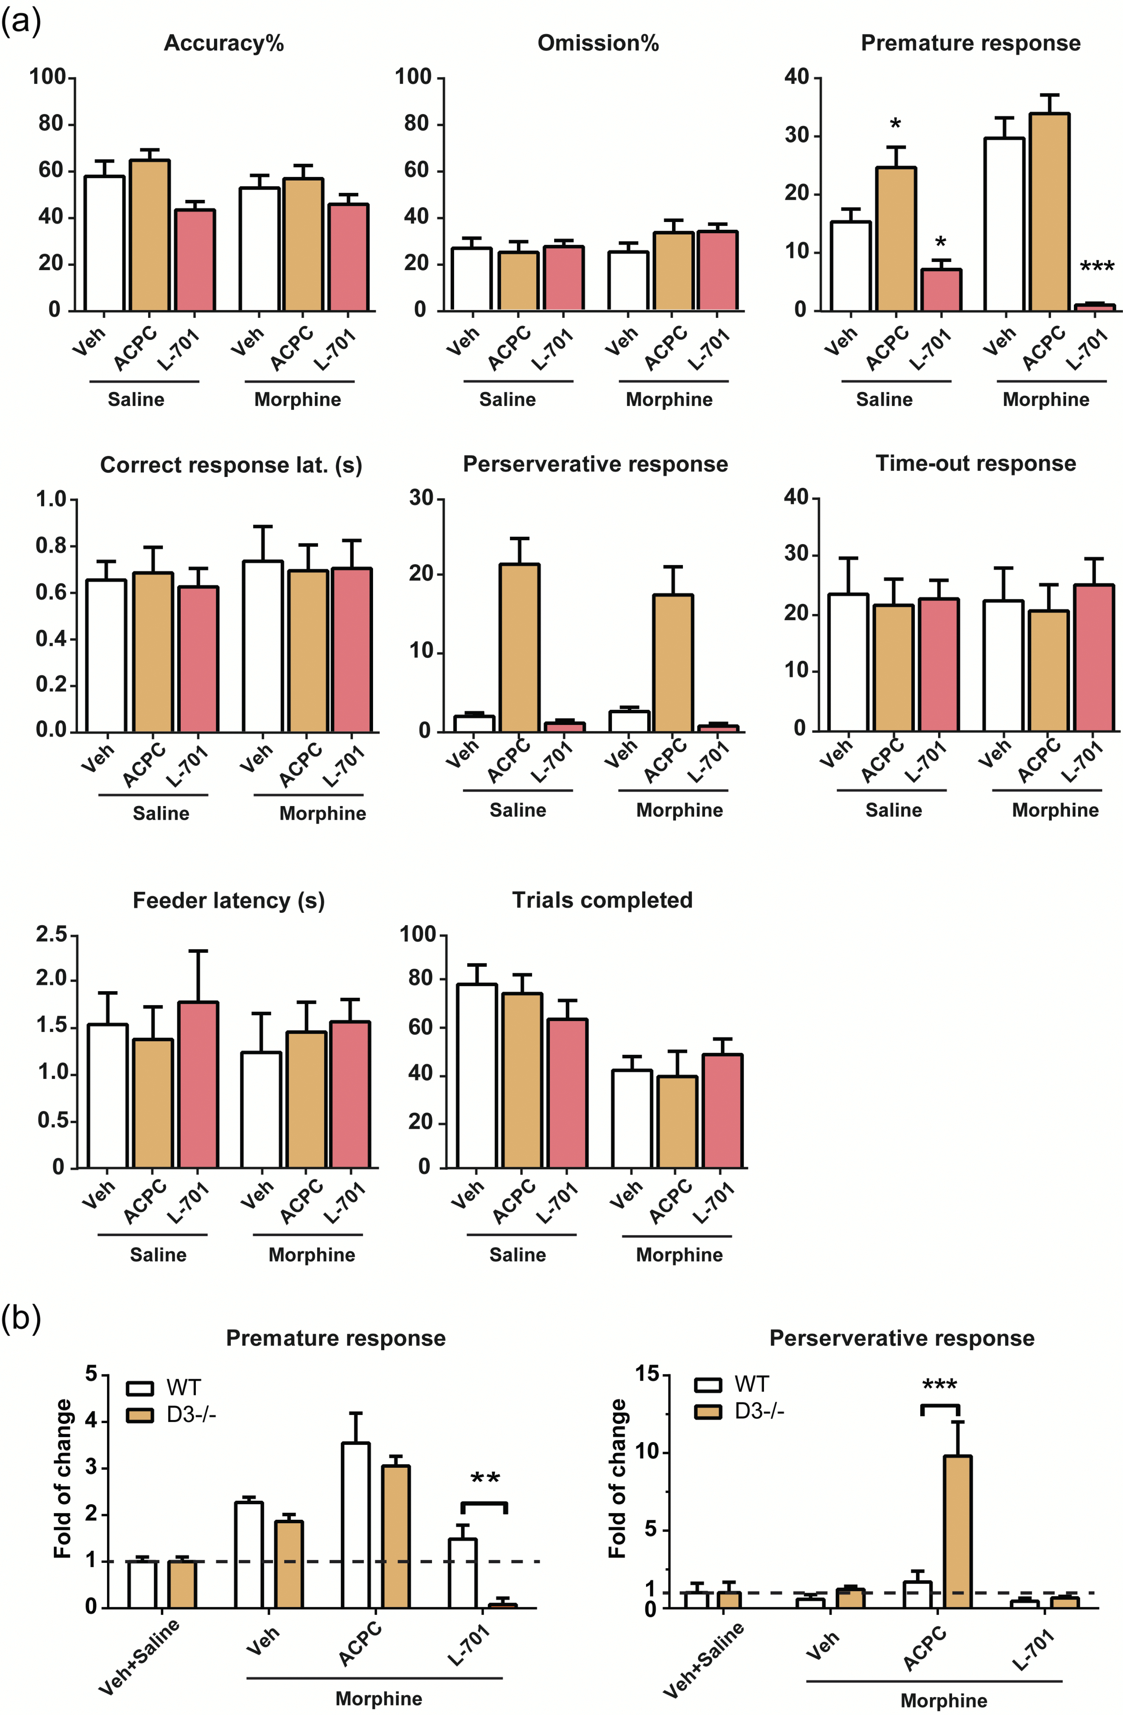
Figure 5. Effects of l-aminocyclopropanecarboxylic acid (ACPC)/7-chloro-4-hydroxy-3-(3-phenoxy)phenyl-2(1H)-quinolone ...
Notes:
Figure 5. Effects of l-aminocyclopropanecarboxylic acid (ACPC)/7-chloro-4-hydroxy-3-(3-phenoxy)phenyl-2(1H)-quinolone (L-701,324) on morphine-induced cognitive and behavioral changes in D3-/- mice. (a) D3-/- mice were administered ACPC (200 mg/kg), L-701,324 (3 mg/kg), or Veh (1% Tween-80) i.p. in combination with 10 mg/kg morphine or saline for 7 days. *P < .05, ***P < .0001, vs Veh controls within the saline- or morphine-treated groups. (b) The fold changes in the numbers of premature and perseverative responses in wild-type (WT) and D3-/- mice. In each genotype, the data from the Veh+Saline group were set as 1, and the data from the other treatment groups are expressed as the relative fold change vs the Veh+Saline group. *P < .05, ***P < .0001, comparison between the 2 indicated groups.
Unless provided in the caption above, the following copyright applies to the content of this slide: © The Author 2017. Published by Oxford University Press on behalf of CINP.This is an Open Access article distributed under the terms of the Creative Commons Attribution Non-Commercial License (http://creativecommons.org/licenses/by-nc/4.0/), which permits non-commercial re-use, distribution, and reproduction in any medium, provided the original work is properly cited. For commercial re-use, please contact journals.permissions@oup.com

