Slide 1
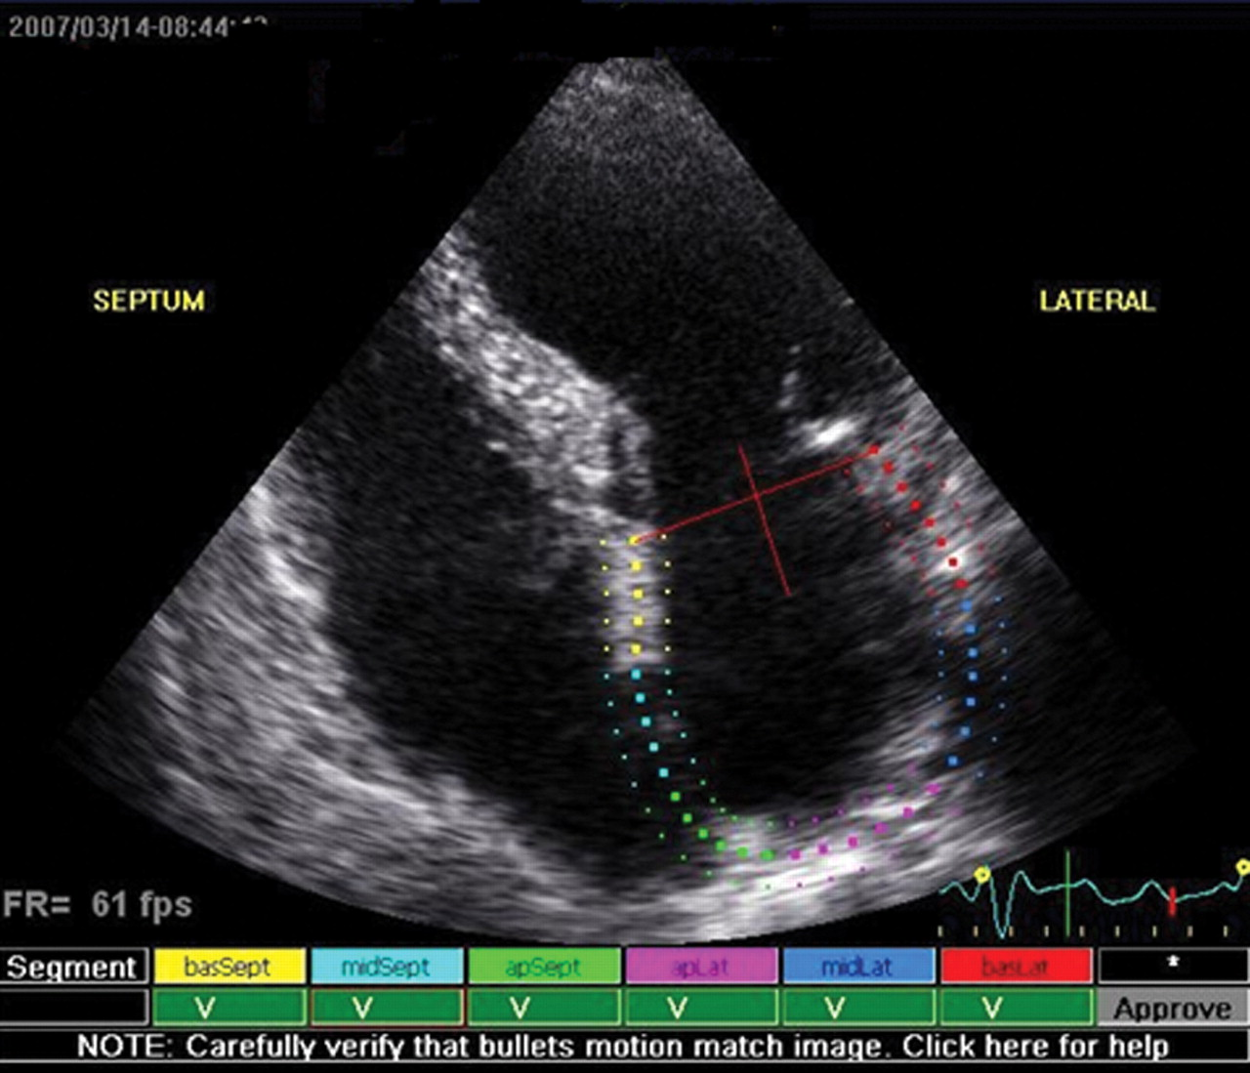
Figure 1 Evaluation of atrial deformation according to the speckle-tracking technique. Left atrial endocardial contour ...
Notes:
Figure 1 Evaluation of atrial deformation according to the speckle-tracking technique. Left atrial endocardial contour is traced in a four-chamber view. The thickness of the region of interest to be considered is then defined. The software automatically tracks atrial wall, allowing real-time fine adjustments, and in-motion verification.
Unless provided in the caption above, the following copyright applies to the content of this slide: Published on behalf of the European Society of Cardiology. All rights reserved. © The Author 2010. For permissions please email: journals.permissions@oxfordjournals.org

Slide 2
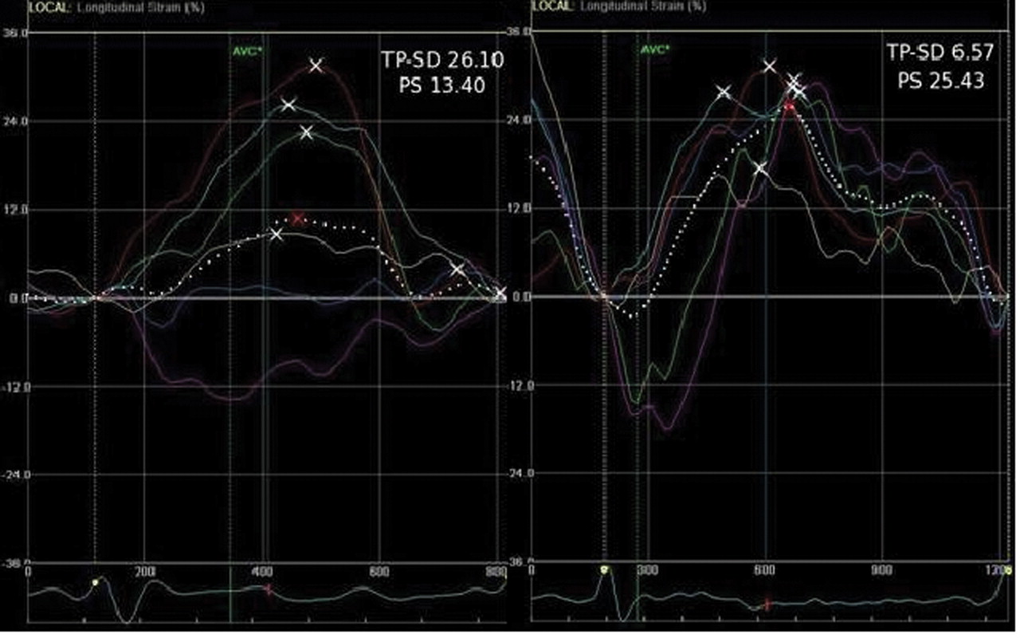
Figure 2 Strain curves of the same patient as in Figure 1 , examined during atrial fibrillation (left) and after 1 ...
Notes:
Figure 2 Strain curves of the same patient as in Figure 1 , examined during atrial fibrillation (left) and after 1 month of sinus rhythm persistence (right). Each curve represents one of the six left atrial wall segments; the dotted line is the mean strain (global strain). Peaks of each curve are marked with a white cross; the peak of the global strain curve (PS) is marked with a red cross. Times-to-peak are normalized to R–R′ interval. During sinus rhythm, a lower time-to-peak standard deviation (TP-SD) and a greater PS are observed (see values in figure).
Unless provided in the caption above, the following copyright applies to the content of this slide: Published on behalf of the European Society of Cardiology. All rights reserved. © The Author 2010. For permissions please email: journals.permissions@oxfordjournals.org

Slide 3
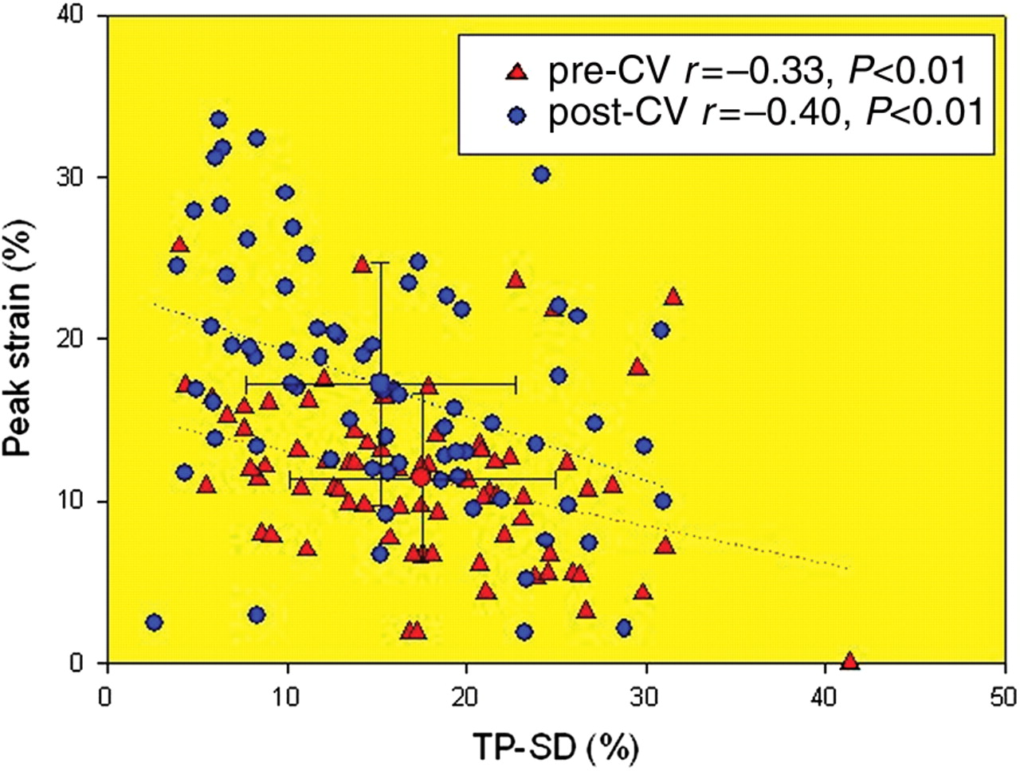
Figure 3 Relationship between atrial time-to-peak standard deviation (TP-SD) and average peak strain before and after ...
Notes:
Figure 3 Relationship between atrial time-to-peak standard deviation (TP-SD) and average peak strain before and after electrical cardioversion (CV). There is a significant improvement of both parameters after 1 month of sinus rhythm (see text for details).
Unless provided in the caption above, the following copyright applies to the content of this slide: Published on behalf of the European Society of Cardiology. All rights reserved. © The Author 2010. For permissions please email: journals.permissions@oxfordjournals.org

Slide 4
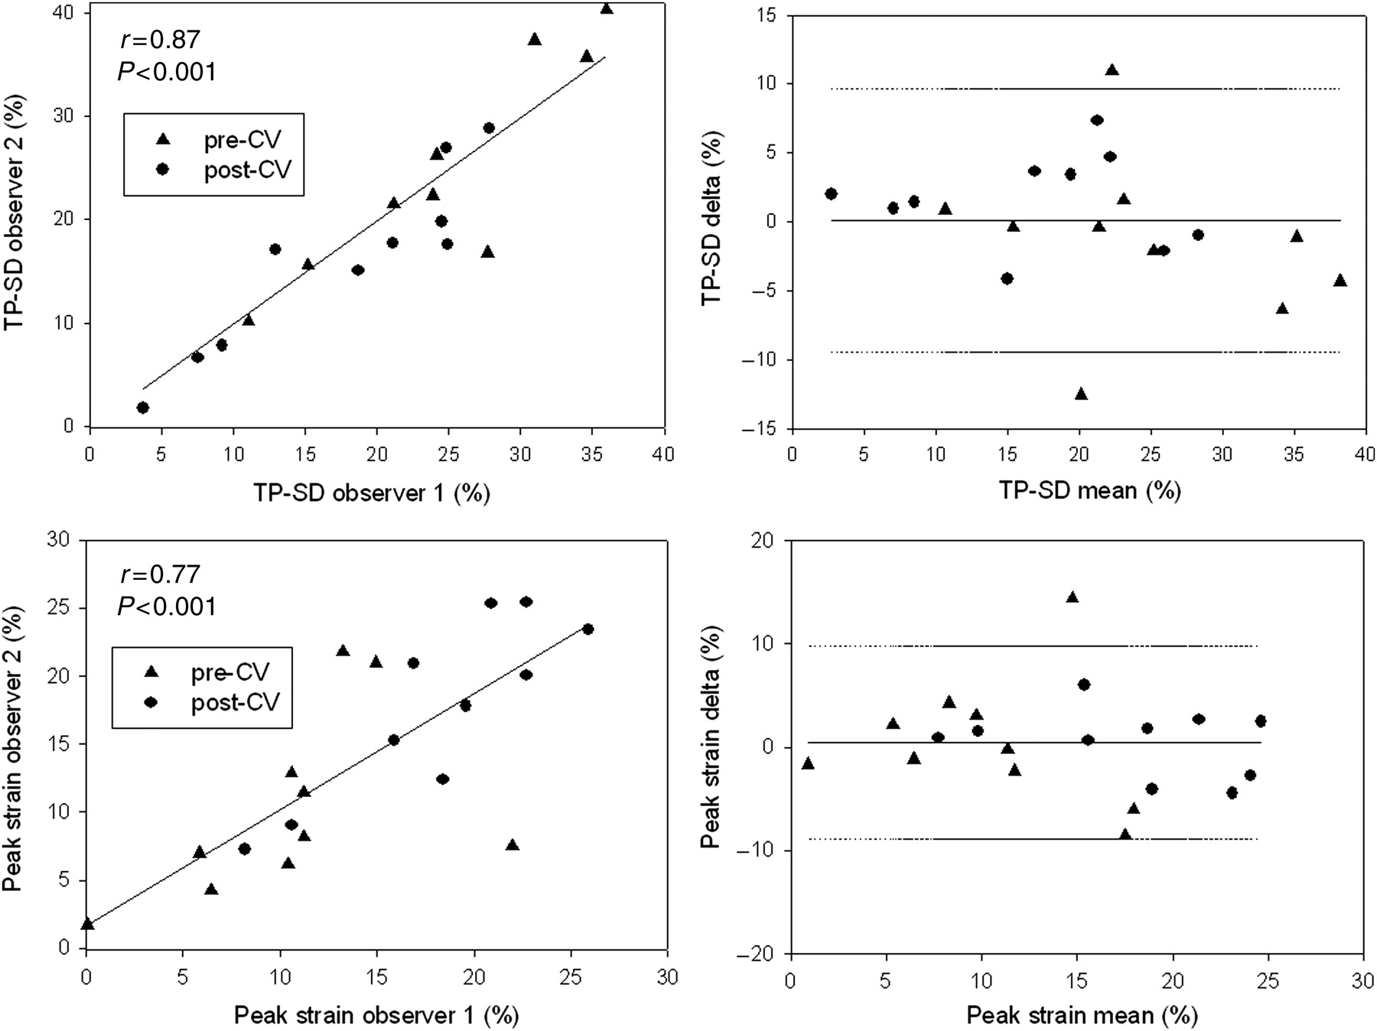
Figure 4 (Left) Plots of atrial asynchrony measurements (top), quantified as time-to-peak standard deviation (TP-SD) ...
Notes:
Figure 4 (Left) Plots of atrial asynchrony measurements (top), quantified as time-to-peak standard deviation (TP-SD) and peak strain (bottom), assessed by two different observers. (Right) Interobserver mean differences ( y -axis) of asynchrony (top) and peak strain (bottom) plotted against their means ( x -axis).
Unless provided in the caption above, the following copyright applies to the content of this slide: Published on behalf of the European Society of Cardiology. All rights reserved. © The Author 2010. For permissions please email: journals.permissions@oxfordjournals.org

