Slide 1
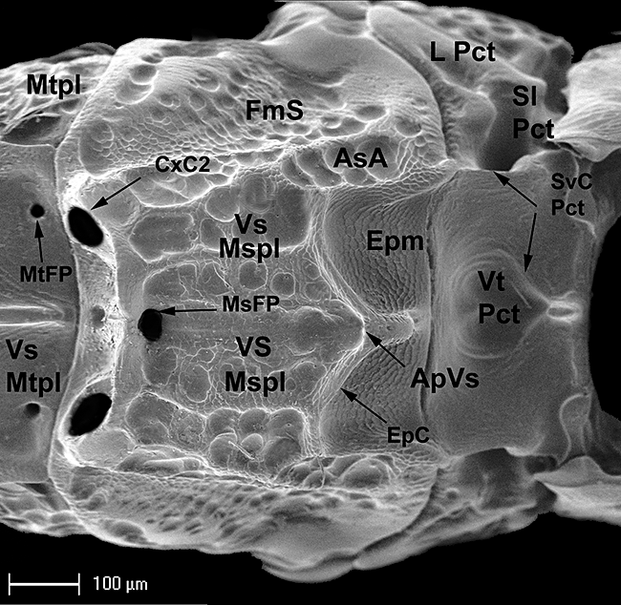
Figure 15 Aximopsis sp. from Colombia, mesopleuron in ventral view: AsA, adscrobal area; ApVs, anterior projection of ...
Notes:
Figure 15 Aximopsis sp. from Colombia, mesopleuron in ventral view: AsA, adscrobal area; ApVs, anterior projection of ventral shelf; CxC2, midcoxal cavities; EpC, epicnemial carina; Epm, epicnemium; FmS, femoral scrobe (= femoral depression); L Pct, lateral prepectus; MsFP, mesofurcal pit; MtFP, metafurcal pit; Mtpl, metapleuron; Sl Pct, sublateral prepectus; Pct, subventral carinae of prepectus; VS Mspl, ventral shelf of mesopleuron; VS Mtpl, ventral shelf of metapleuron; Vt Pct, ventral prepectus.
Unless provided in the caption above, the following copyright applies to the content of this slide:

Slide 2
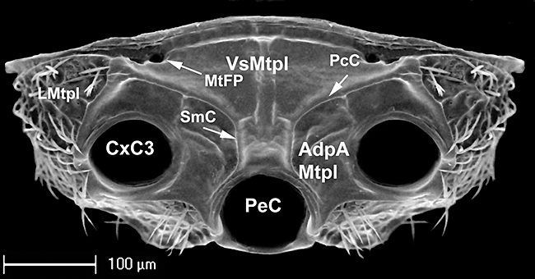
Figure 16 Eurytoma cressoni, metapleuron in ventral view: AdpA, adpetiolar area; CxC3, hind coxal cavities; PcC, ...
Notes:
Figure 16 Eurytoma cressoni, metapleuron in ventral view: AdpA, adpetiolar area; CxC3, hind coxal cavities; PcC, precoxal carinae; PeC, petiolar cavity; LMtpl, lateral metapleuron; MtFP, metafurcal pit; SmC, submedian carinae; VS Mtpl, ventral shelf of metapleuron.
Unless provided in the caption above, the following copyright applies to the content of this slide:

Slide 3
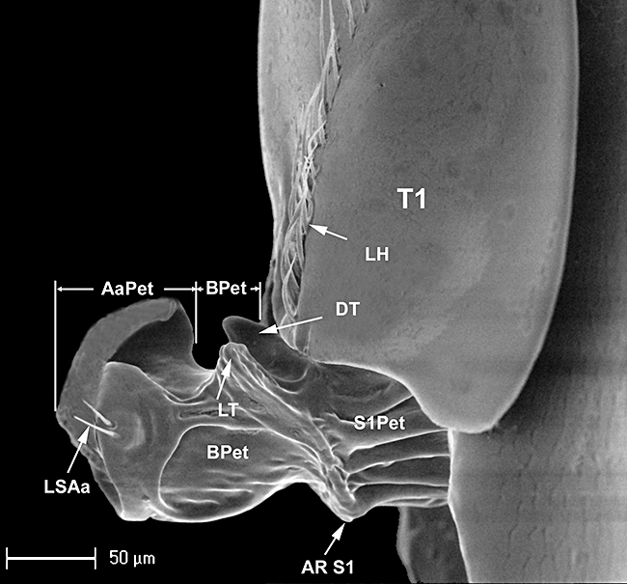
Figure 17 Bruchophagus caucasicus, gastral petiole in lateral view: AaPet, articular area of petiole; AR S1, anterior ...
Notes:
Figure 17 Bruchophagus caucasicus, gastral petiole in lateral view: AaPet, articular area of petiole; AR S1, anterior ridge delimiting petiolar part of first gastral sternum (S1) from petiole; BPet, body of petiole; DT, dorsal tooth; LH, line of hairs; LSAa, lateral setae on articular area; LT, lateral tooth; S1Pet, Petiolar part of the first gastral sternite; T1, first gastral tergite.
Unless provided in the caption above, the following copyright applies to the content of this slide:

Slide 4
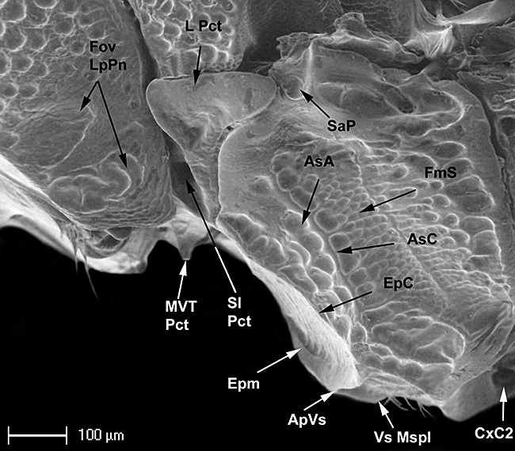
Figure 14 Eurytoma Cébazan, pronotum and mesonotum in lateral view: AsA, adscrobal area; AsC, adscrobal carina; ApVs, ...
Notes:
Figure 14 Eurytoma Cébazan, pronotum and mesonotum in lateral view: AsA, adscrobal area; AsC, adscrobal carina; ApVs, anterior projection of the ventral shelf; CxC2, midcoxal cavities; EpC, epicnemial carina; Epm, epicnemium; FmS, femoral scrobe (= femoral depression); Fov LpPn, foveae on lateral panel of pronotum; L Pct, lateral prepectus; MVT Pct, medioventral tooth of prepectus; SaP, subalar pit; Sl Pct, sublateral prepectus; Vs Mspl, ventral shelf of mesopleuron.
Unless provided in the caption above, the following copyright applies to the content of this slide:

Slide 5
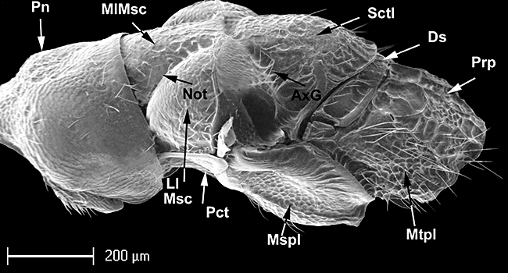
Figure 13 Tetramesa fulvicollis s, mesosoma in lateral view: AxG, axillar groove; Ds, dorsellum; Ll Msc, lateral lobe ...
Notes:
Figure 13 Tetramesa fulvicollis s, mesosoma in lateral view: AxG, axillar groove; Ds, dorsellum; Ll Msc, lateral lobe of mesoscutum; MlMsc, midlobe of mesoscutum; Mspl, mesopleuron; Mtpl, metapleuron; Not, notaulus; Pct, prepectus, Pn, pronotum; Prp, propodeum; Sctl, scutellum.
Unless provided in the caption above, the following copyright applies to the content of this slide:

Slide 6
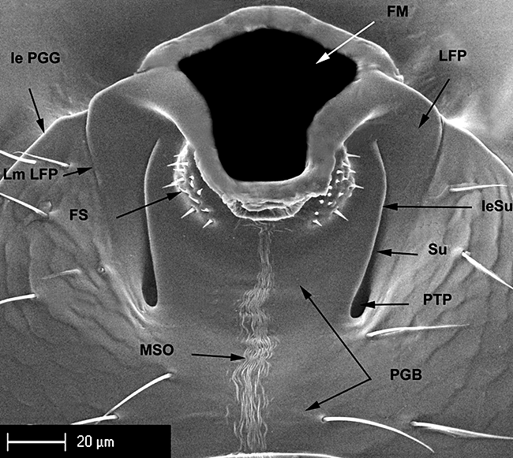
Figure 12 Eurytoma aspila, postgenal bridge (PGB): FM, Foramen magnum; FS, foraminal setae; Ie PGG, inner edge of the ...
Notes:
Figure 12 Eurytoma aspila, postgenal bridge (PGB): FM, Foramen magnum; FS, foraminal setae; Ie PGG, inner edge of the postgenal groove; IeSu, inner edge of the sulci; LFP, lateral foraminal plate; Lm LFP, Lateral margin of the lateral foraminal plate; MSO, median stripe of ornamentation on the postgenal bridge; PGB, postgenal bridge; PTP, posterior tentorial pits; Su, Sulci of the postgenal bridge.
Unless provided in the caption above, the following copyright applies to the content of this slide:

Slide 7
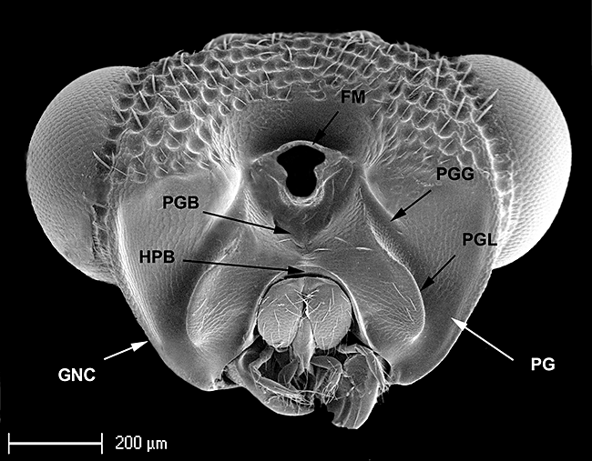
Figure 11 Aximopsis from Colombia, head in posterior view: FM, Foramen magnum; GNC, genal carina; HPB, hypostomal ...
Notes:
Figure 11 Aximopsis from Colombia, head in posterior view: FM, Foramen magnum; GNC, genal carina; HPB, hypostomal bridge; PG, postgena; PGB, postgenal bridge; PGG, postgenal groove; PGL, postgenal lamina.
Unless provided in the caption above, the following copyright applies to the content of this slide:

Slide 8
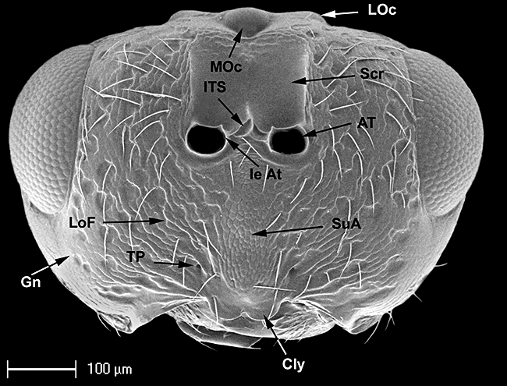
Figure 10 Eurytominae from Ecuador, head in frontal view: AT, antennal torulus; Cly, clypeus; Gn, gena (= malar space); ...
Notes:
Figure 10 Eurytominae from Ecuador, head in frontal view: AT, antennal torulus; Cly, clypeus; Gn, gena (= malar space); Ie At, inner edge of antenna torulus; ITS, intertorular space (= interantenal projection, interantennal space); LOc, Lateral ocellus; LoF, lower face; MOc, median ocellus; Scr, scrobal depression (= antennal scrobes); SuA, supraclypeal area; TP, tentorial pit.
Unless provided in the caption above, the following copyright applies to the content of this slide:

Slide 9
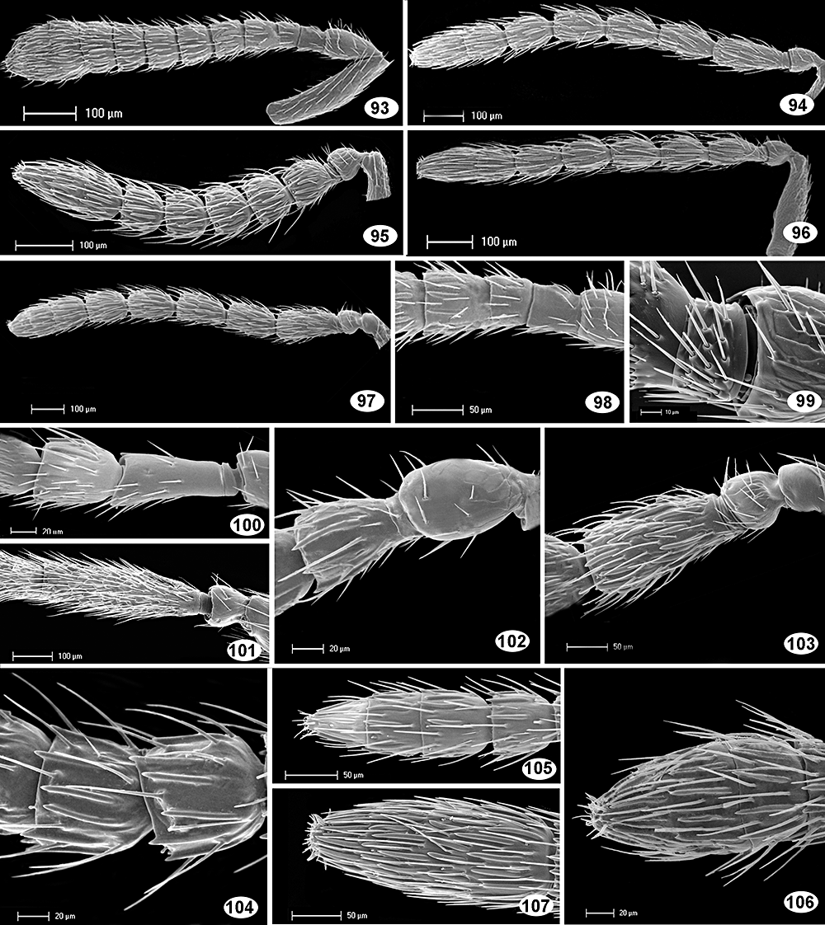
Figures 93–107 Figures 93–97: female antenna–93, ArchiRileya Cicada; 94, Eurytoma ochraceipes; 95, Eurytoma volkovi; 96, ...
Notes:
Figures 93–107 Figures 93–97: female antenna–93, ArchiRileya Cicada; 94, Eurytoma ochraceipes; 95, Eurytoma volkovi; 96, Eurytoma leguminum; 97, Eurytoma braconidis. Figures 98, 100–103: pedicel and flagellomeres 1–3–98, ArchiRileya Cicada; 100, Systole Asilah; 101, Aiolomorphus rhopaloides; 102, Bruchophagus Alicante; 103, Eurytoma braconidis. Figure 99: first flagellomere; Eurytoma Cébazan. Figure 104: flagellomeres 5–6; Tetramesa linearis. Figures 105–107: female clava–105, Systole Asilah; 106, Bruchophagus Alicante; 107, Eurytoma Cébazan.
Unless provided in the caption above, the following copyright applies to the content of this slide:

Slide 10
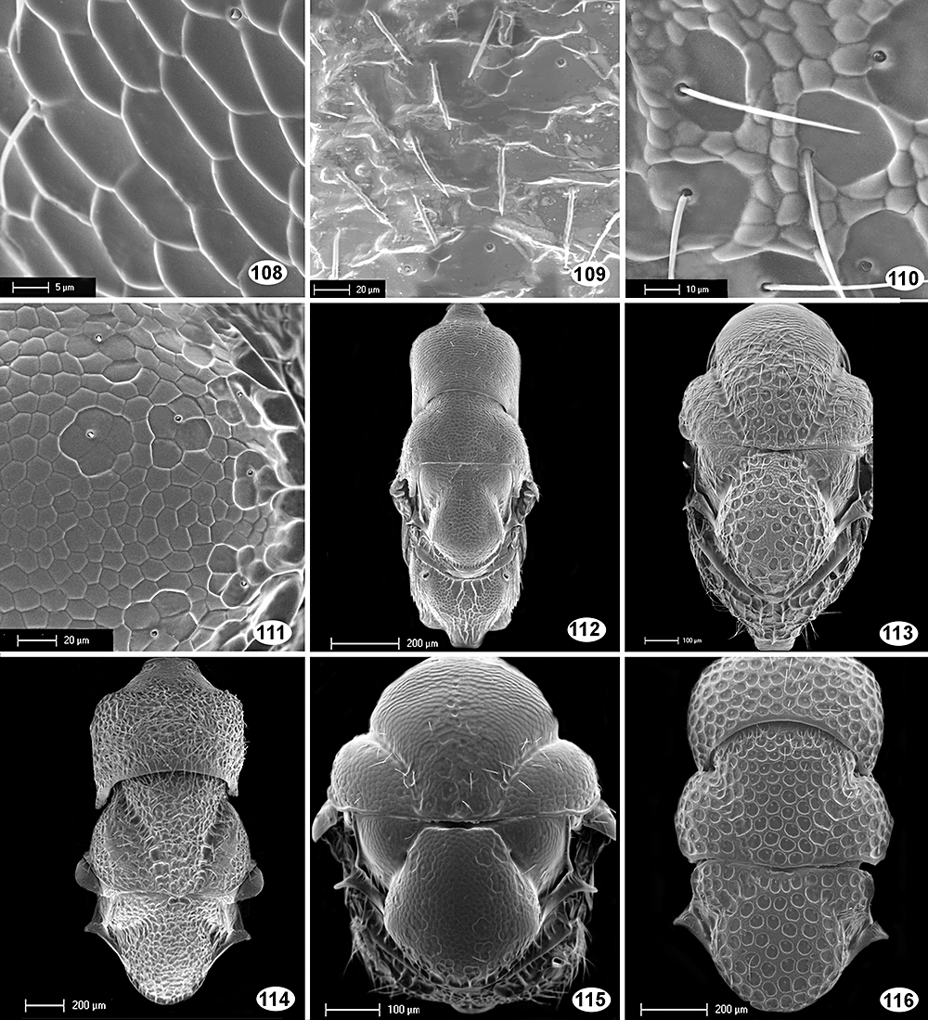
Figures 108–116 Figures 108–111: patterns of sculpture–108, Buresium rufum(lower face); 109, Bruchophagus bajarii(scutellum); ...
Notes:
Figures 108–116 Figures 108–111: patterns of sculpture–108, Buresium rufum(lower face); 109, Bruchophagus bajarii(scutellum); 110, Eurytominae Ecuador (scutellum); 111, Pseudosystole hofferi(scutellum). Figures 112–116: Mesosoma in dorsal view; 112, Buresium rufum; 113, Eurytominae Ecuador; 114, Tetramesa romana; 115, Pseudosystole hofferi; 116, Aximogastra Guinea.
Unless provided in the caption above, the following copyright applies to the content of this slide:

Slide 11
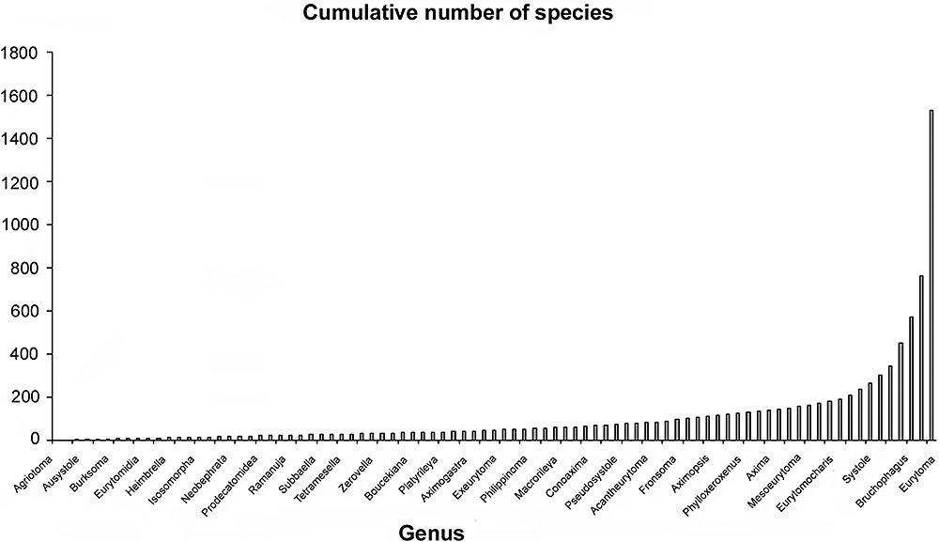
Figure 2 Cumulative number of described species of Eurytomidae distributed from less diverse genera to most diverse. ...
Notes:
Figure 2 Cumulative number of described species of Eurytomidae distributed from less diverse genera to most diverse. Data from Noyes (2002).
Unless provided in the caption above, the following copyright applies to the content of this slide:

Slide 12
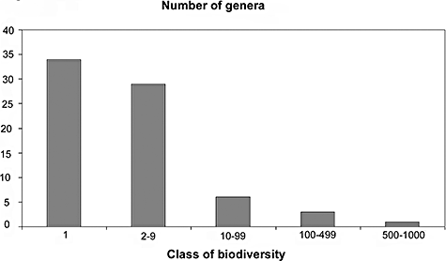
Figure 1 Described species of Eurytomidae: classes of biodiversity (number of species described within each genus) ...
Notes:
Figure 1 Described species of Eurytomidae: classes of biodiversity (number of species described within each genus) according to genus. Data from Noyes (2002).
Unless provided in the caption above, the following copyright applies to the content of this slide:

Slide 13
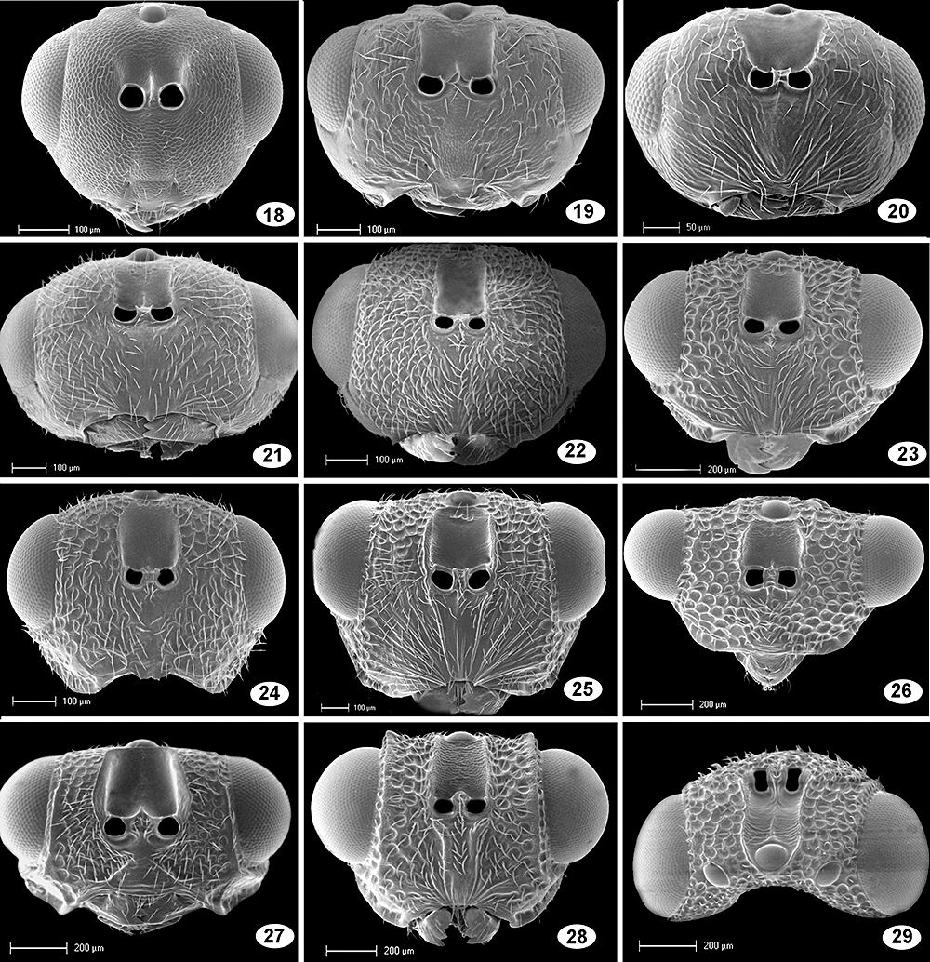
Figures 18–29 Figures 18–28: head in frontal view–18, Buresium rufum; 19, Eurytominae Ecuador; 20, Eurytoma Mourèze; 21, ...
Notes:
Figures 18–29 Figures 18–28: head in frontal view–18, Buresium rufum; 19, Eurytominae Ecuador; 20, Eurytoma Mourèze; 21, Bruchophagus Guyoniana; 22, Eurytoma cressoni; 23, Phylloxeroxenus San Alberto; 24, Eurytoma dentata; 25, Eurytoma braconidis; 26, Axima brevicornis; 27, Eurytoma gyorfii; 28, Aximopsis Colombia 2. Figure 29. Head in dorsal view; Bephratoides Shushufindi.
Unless provided in the caption above, the following copyright applies to the content of this slide:

Slide 14
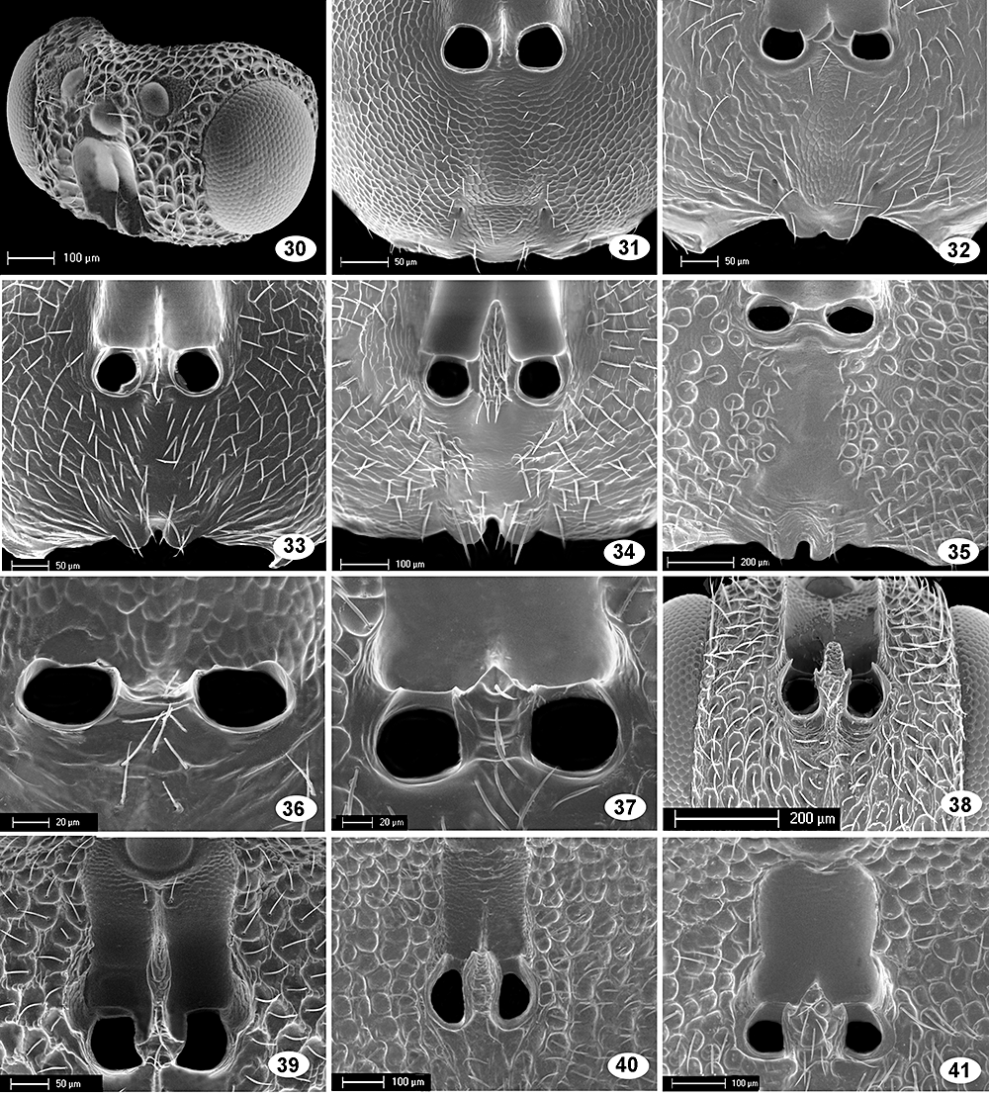
Figures 30–41 Figure 30: head in laterodorsal view–30, Prodecatoma maculiventris. Figures 31–35: lower face and ...
Notes:
Figures 30–41 Figure 30: head in laterodorsal view–30, Prodecatoma maculiventris. Figures 31–35: lower face and intertorular space (ITS); 31, Buresium rufum; 32, Eurytominae Ecuador; 33, Sycophila Benin; 34, Ficomila Gabon; 35, Bephratelloides pomorum. Figures 36, 37: ITS–36, Tetramesa fulvicollis; 37, Eurytoma collaris. Figures 38–41: antennal scrobes–38, Aximogastra Ecuador; 39, Prodecatoma philodendri; 40, Paradecatoma Combretum 2; 41, Eurytoma nodularis.
Unless provided in the caption above, the following copyright applies to the content of this slide:

Slide 15
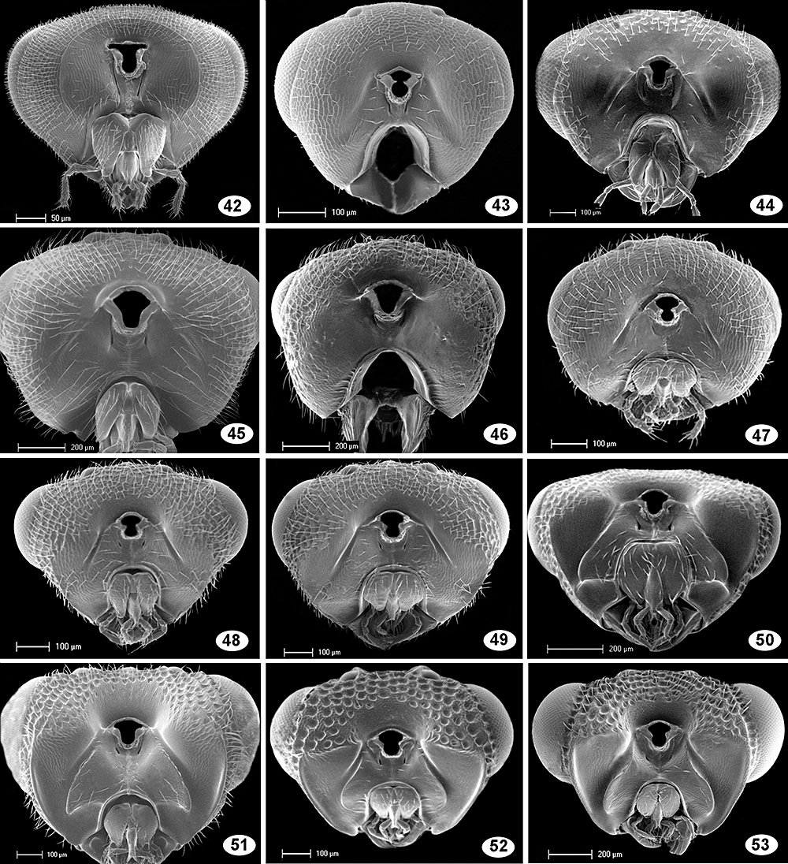
Figures 42–53 Head in posterior view: 42, Glyphomerus stigma; 43, Buresium rufum; 44, Aranedra millsi; 45, Aiolomorphus ...
Notes:
Figures 42–53 Head in posterior view: 42, Glyphomerus stigma; 43, Buresium rufum; 44, Aranedra millsi; 45, Aiolomorphus rhopaloides; 46, Tetramesa romana; 47, Bruchophagus Alicante; 48, Bruchophagus phlei; 49, Bruchophagus caucasicus; 50, Eurytoma compressa; 51, Bephratoides Shushufindi; 52, Conoaxima affinis; 53, Aximopsis Colombia 1.
Unless provided in the caption above, the following copyright applies to the content of this slide:

Slide 16
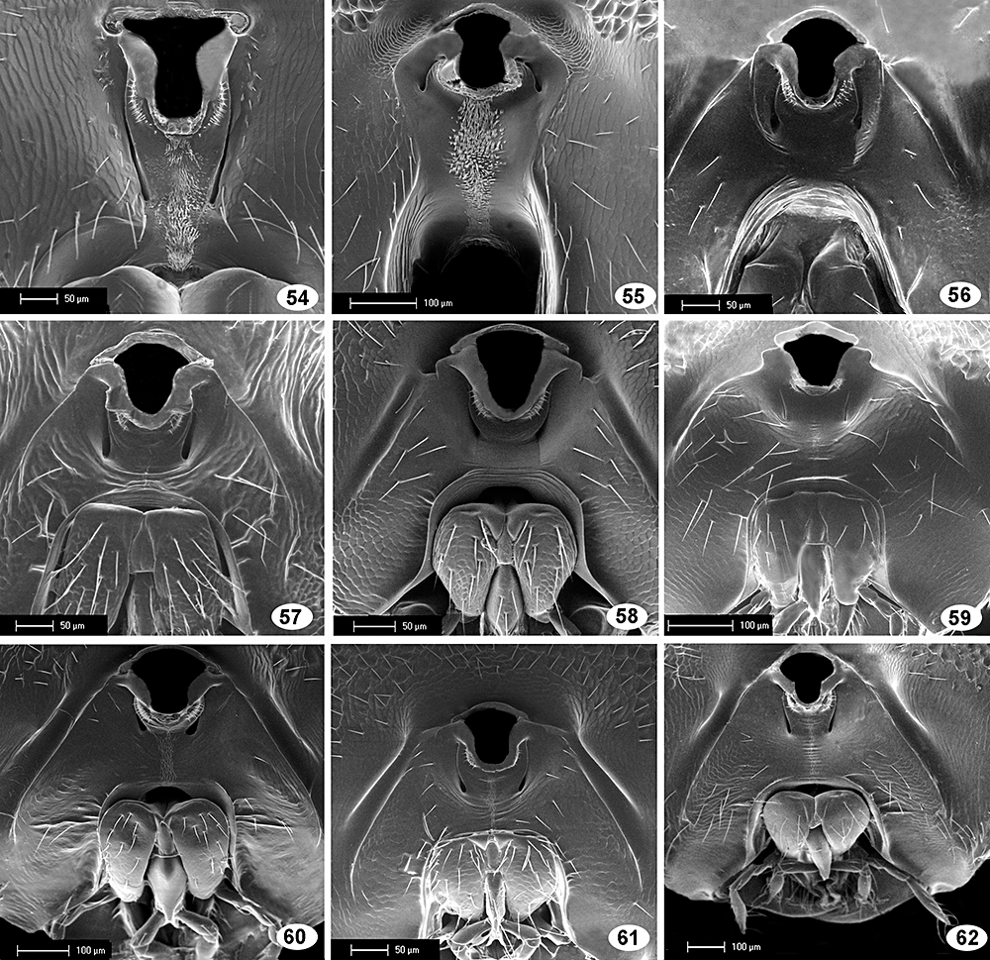
Figures 54–62 Postgena and postgenal bridge (PGB): 54, Glyphomerus stigma; 55, Hockeria unicolor; 56, Aranedra millsi; 57, ...
Notes:
Figures 54–62 Postgena and postgenal bridge (PGB): 54, Glyphomerus stigma; 55, Hockeria unicolor; 56, Aranedra millsi; 57, Tetramesa Dordogne; 58, Isosomodes Costa Rica; 59, Sycophila biguttata; 60, Prodecatomidea Cameroon; 61, Eurytoma ficusgallae; 62, Paradecatoma Combretum 2.
Unless provided in the caption above, the following copyright applies to the content of this slide:

Slide 17
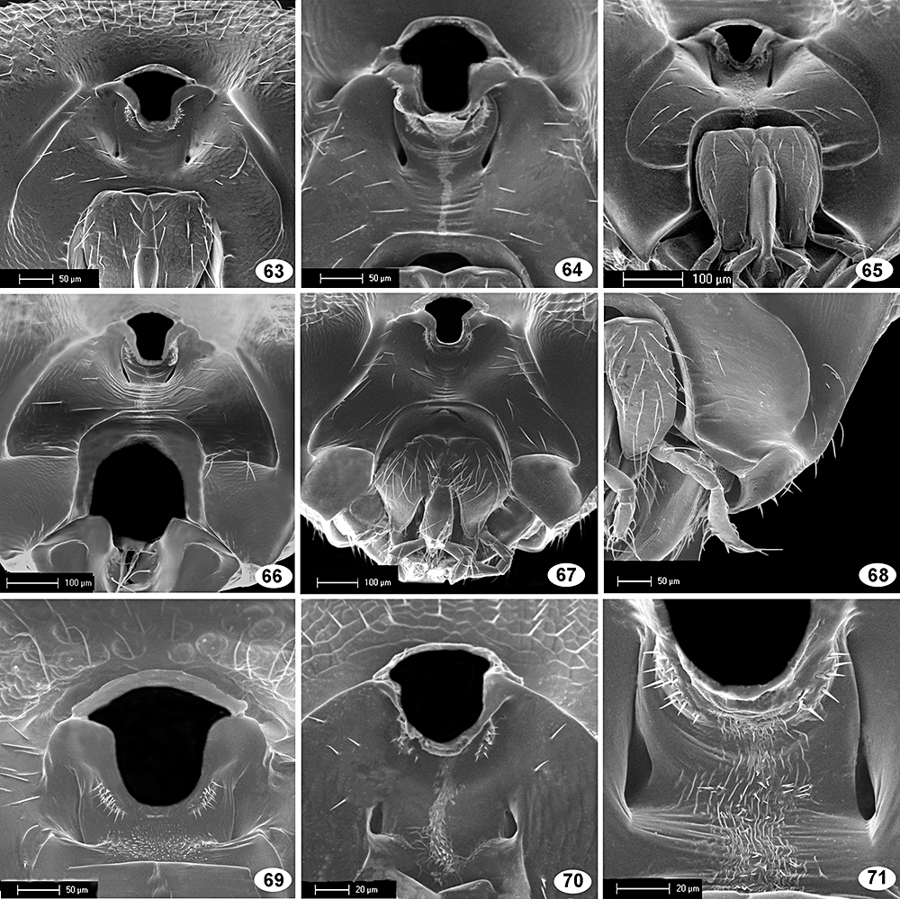
Figures 63–71 Figures 63–67: postgena and postgenal bridge–63, Eurytoma obtusiventriz; 64, Eurytoma sp., braconidis species ...
Notes:
Figures 63–71 Figures 63–67: postgena and postgenal bridge–63, Eurytoma obtusiventriz; 64, Eurytoma sp., braconidis species group; 65, Eurytoma San Alberto 1; 66, Syceurytoma ficus; 67, Eurytoma plotnikovi. Figure 68: ventral part of postgena–Eurytoma braconidis. Figures 69–71: postgenal bridge; 69, Heimbra opaca; 70, Rileya pulchra; 71, Eurytominae Ecuador.
Unless provided in the caption above, the following copyright applies to the content of this slide:

Slide 18
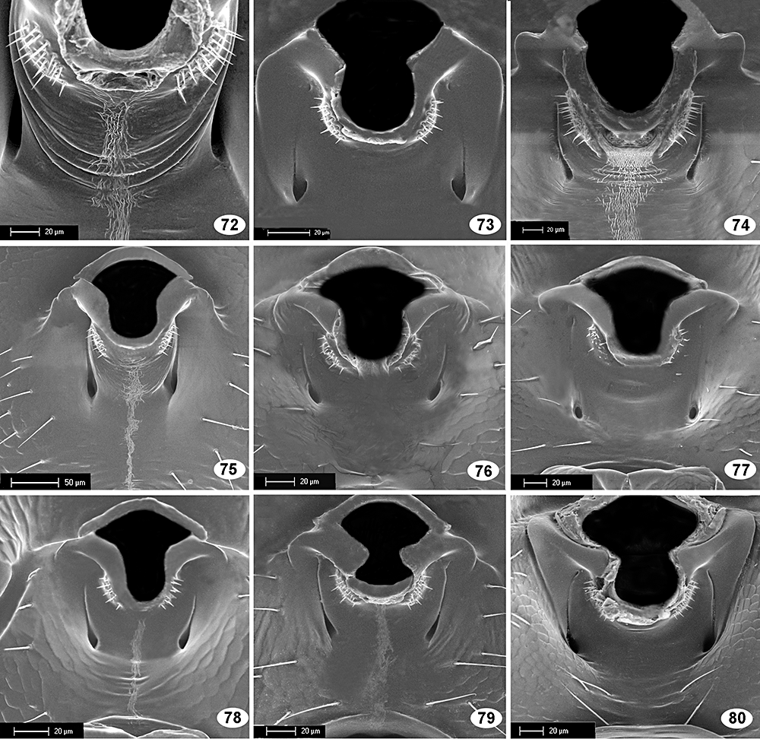
Figures 72–80 Postgenal bridge: 72, Aiolomorphus rhopaloides; 73, Pseudosystole hofferi; 74, Ficomila Gabon; 75, Risbecoma ...
Notes:
Figures 72–80 Postgenal bridge: 72, Aiolomorphus rhopaloides; 73, Pseudosystole hofferi; 74, Ficomila Gabon; 75, Risbecoma capensis; 76, Eurytoma cressoni; 77, Eurytoma obtusiventris; 78, Eurytoma pistaciae; 79, Bruchophagus phlei; 80, Axima brevicornis.
Unless provided in the caption above, the following copyright applies to the content of this slide:

Slide 19
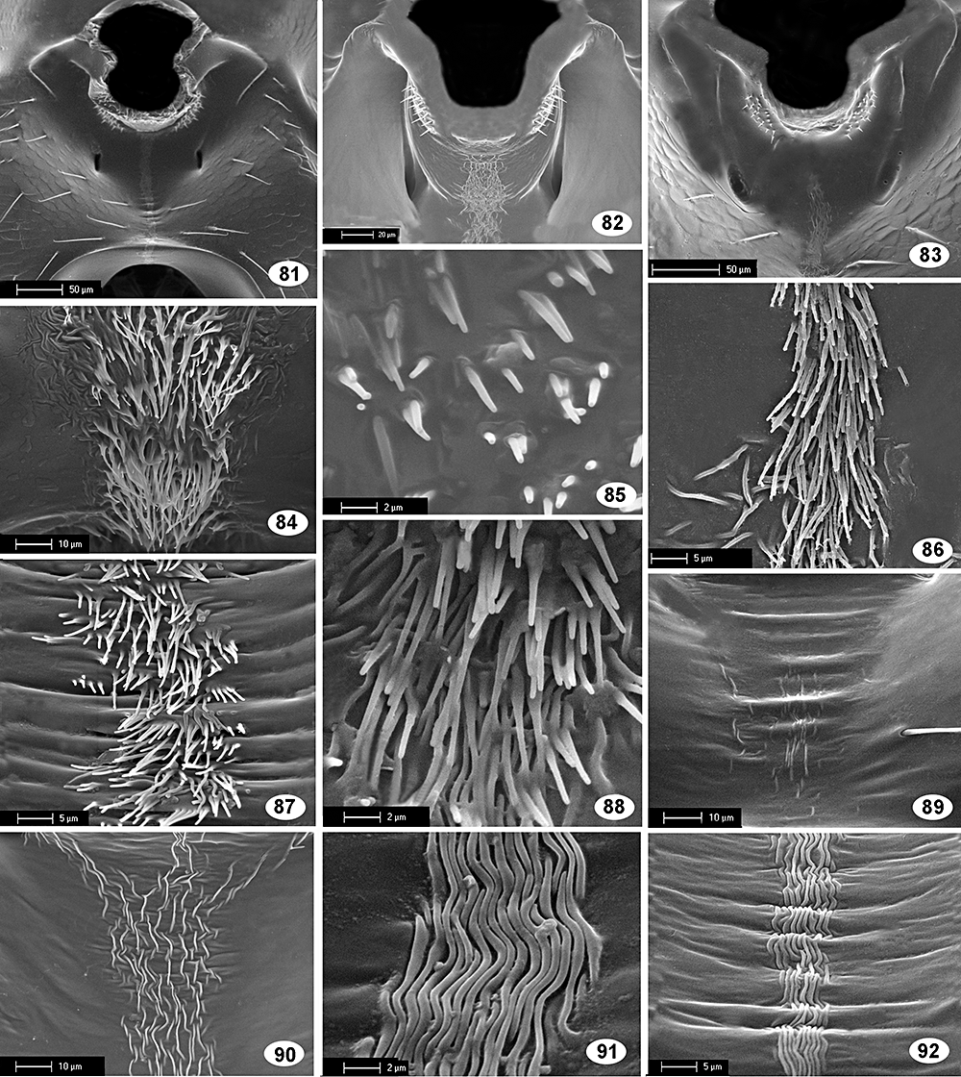
Figures 81–92 Figures 81–83: postgenal bridge–81, Eurytoma Cébazan; 82, Risbecoma capensis; 83, Aximopsis Colombia 1. ...
Notes:
Figures 81–92 Figures 81–83: postgenal bridge–81, Eurytoma Cébazan; 82, Risbecoma capensis; 83, Aximopsis Colombia 1. Figures 84–92: postgenal bridge, ornamentation of median stripe–84, Glyphomerus stigma; 85, Heimbra opaca; 86, Rileya pulchra; 87, Aximogastra Guinea; 88, Bephratoides Shushufindi; 89, Eurytoma cressoni; 90, Prodecatomidea Cameroon; 91, Eurytoma morio; 92, Eurytoma braconidis.
Unless provided in the caption above, the following copyright applies to the content of this slide:

Slide 20
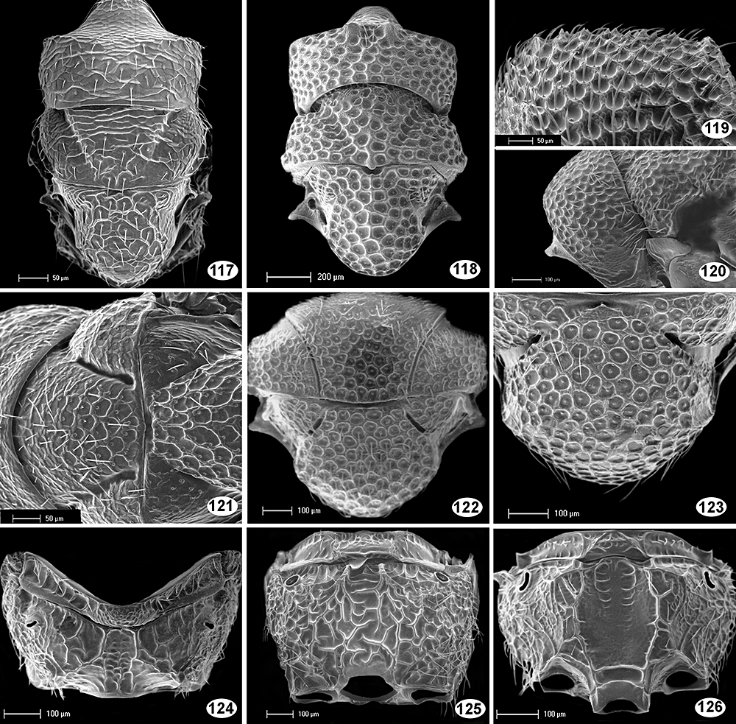
Figures 117–126 Figures 117, 118: mesosoma in dorsal view–117, Eurytoma Mourèze; 118, Aximopsis Colombia 2. Figure 119: ...
Notes:
Figures 117–126 Figures 117, 118: mesosoma in dorsal view–117, Eurytoma Mourèze; 118, Aximopsis Colombia 2. Figure 119: Dorsal part of pronotum in lateral view; Bephratoides Shushufindi. Figure 120: pronotum in lateral view; Eurytoma dentata. Figures 121, 122: mesonotum in dorsal view–121, Eurytoma aspila; 122, Eurytoma ochraceipes. Figure 123: scutellum; Eurytoma fumipennis. Figures 124–126: Propodeum in dorsal view; 124, ArchiRileya Cicada; 125, Tetramesa romana; 126, Sycophila Benin.
Unless provided in the caption above, the following copyright applies to the content of this slide:

Slide 21
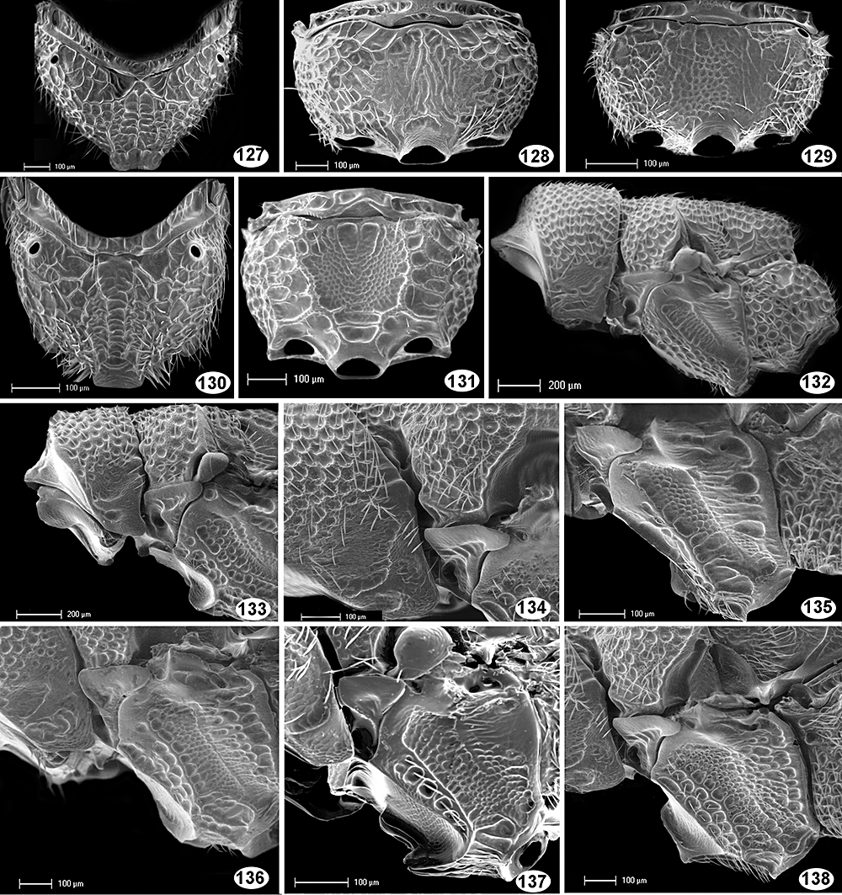
Figures 127–138 Figures 127–131: propodeum–127, Sycophila biguttata; 128, Eurytoma ochraceipes; 129, Bruchophagus roddi; 130, ...
Notes:
Figures 127–138 Figures 127–131: propodeum–127, Sycophila biguttata; 128, Eurytoma ochraceipes; 129, Bruchophagus roddi; 130, Eurytoma collaris; 131, Conoaxima affinis. Figure 132: mesosoma in lateral view; Bephratoides Shushufindi. Figure 133: Mesosoma, anterior part in lateral view; Aximopsis Colombia 1. Figure 134: Pronotum and prepectus in lateral view; Eurytoma braconidis. Figures 135–138: mesopleuron in lateral view; 135, Eurytoma dentata; 136, Eurytoma Cébazan; 137, Plutarchia bicariniventris; 138, Eurytoma braconidis.
Unless provided in the caption above, the following copyright applies to the content of this slide:

Slide 22
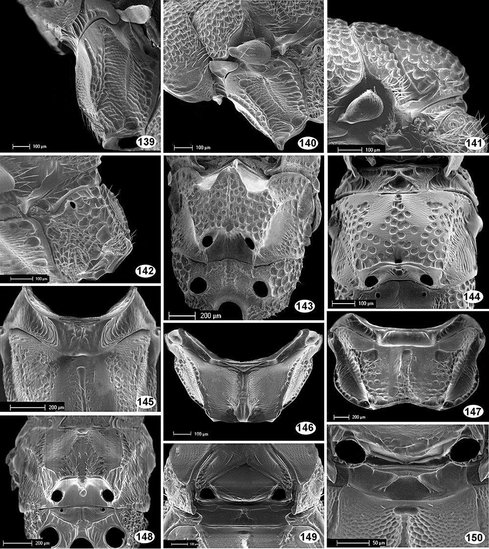
Figures 139–150 Figures 139, 140: Mesopleuron in lateral view–139, Bruchophagus squamea; 140, Eurytoma compressa. Figure 141: ...
Notes:
Figures 139–150 Figures 139, 140: Mesopleuron in lateral view–139, Bruchophagus squamea; 140, Eurytoma compressa. Figure 141: scutellum in lateral view; Eurytoma Peru 1. Figure 142: propodeum in lateral view; 142, Eurytoma dentata. Figures 143, 144, 148: meso- and metapleuron in ventral view–143, Heimbra opaca; 144, Aximogastra Guinea; 148, Prodecatomidea Cameroon. Figures 146, 147: mesopleuron in anterior view; 146, Syceurytoma ficus; 147, Bephratelloides pomorum. Figures 145, 149, 150: prepectus in ventral view; 145, Tetramesa romana; 149, Bruchophagus Alicante; 150, Phylloxeroxenus San Alberto 2.
Unless provided in the caption above, the following copyright applies to the content of this slide:

Slide 23
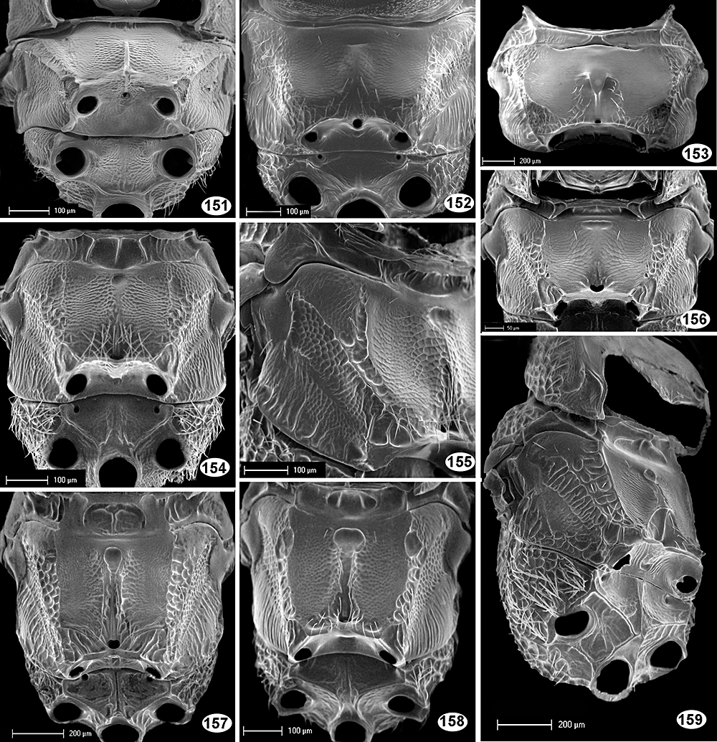
Figures 151–159 Figures 151, 152, 154, 157, 158: meso- and metapleuron in ventral view–151, Rileya pulchra; 152, Bruchophagus ...
Notes:
Figures 151–159 Figures 151, 152, 154, 157, 158: meso- and metapleuron in ventral view–151, Rileya pulchra; 152, Bruchophagus Guyoniana; 154, Bruchophagus phlei; 157, Eurytoma lepidopterae; 158, Tenuipetiolus Guadeloupe. Figures 153 and 156: mesopleuron in ventral view–153, Ficomila Gabon; 156, Eurytoma Senegal. Figure 155: mesopleuron in lateroventral view; Bruchophagus caucasicus. Figure 159: mesosoma in lateroventral view; Eurytoma San Alberto 1.
Unless provided in the caption above, the following copyright applies to the content of this slide:

Slide 24
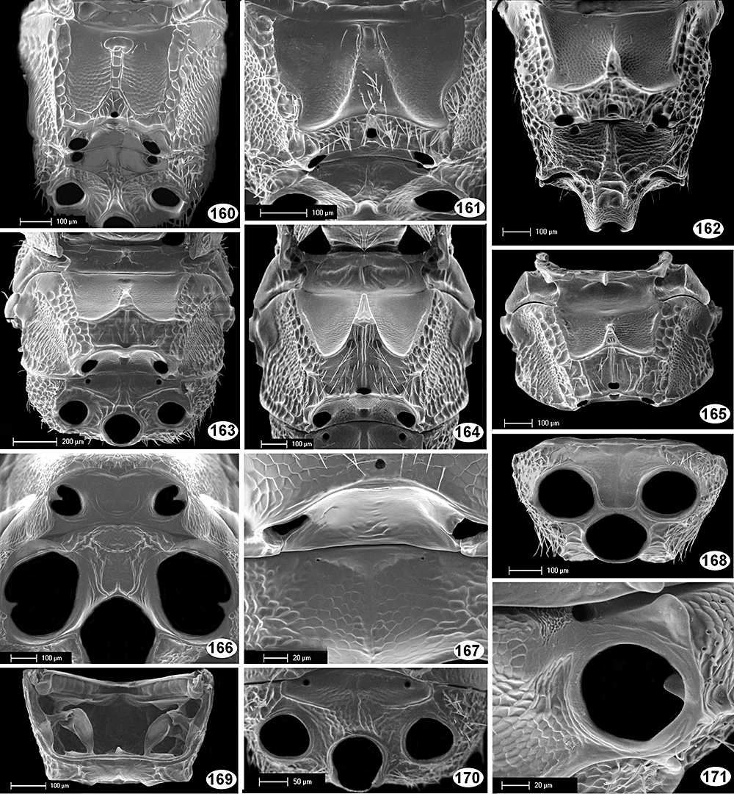
Figures 160–171 Figures 160–164: meso- and metapleuron in ventral view–160, Prodecatoma maculiventris; 161, Eurytoma ...
Notes:
Figures 160–171 Figures 160–164: meso- and metapleuron in ventral view–160, Prodecatoma maculiventris; 161, Eurytoma ficusgallae; 162, Axima brevicornis; 163, Eurytoma Cébazan; 164, Eurytoma braconidis. Figure 165: mesopleuron in ventral view; Conoaxima affinis. Figures 166, 167, 168, 170: metapleuron in ventral view; 166, Glyphomerus stigma; 167, Buresium rufum; 168, Archirileya Cicada; 170, Bruchophagus Alicante. Figure 169: metapleuron (after dissection) in anterior view (internal skeleton visible)–Archirileya Cicada. Figure 171: hind coxal cavity and metafurcal pit (enlarged)–Rileya pulchra.
Unless provided in the caption above, the following copyright applies to the content of this slide:

Slide 25
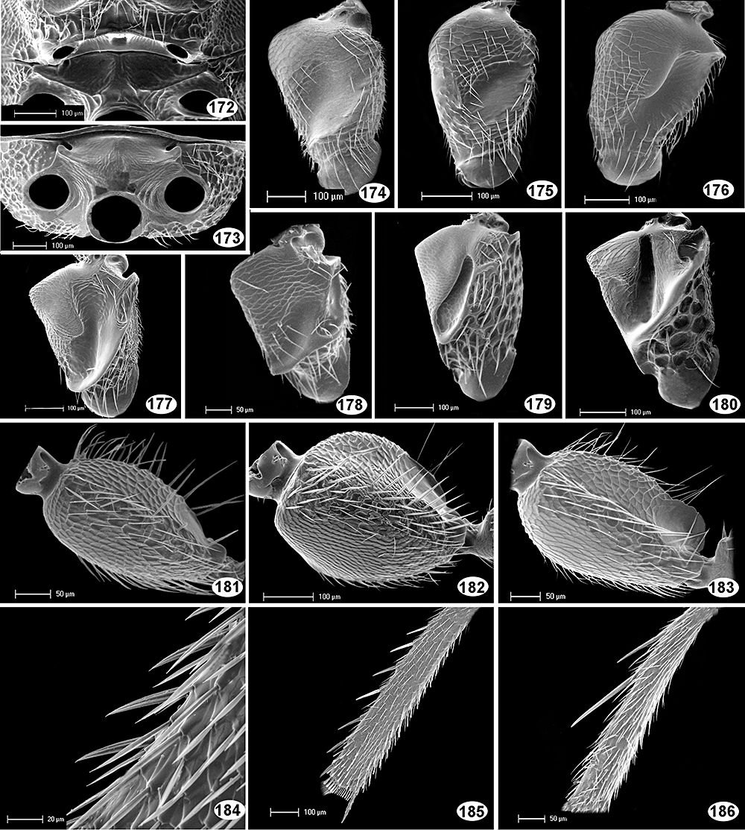
Figures 172–186 Figures 172, 173: metapleuron in ventral view–172, Eurytoma obtusiventris; 173, Eurytoma ochraceipes. Figures ...
Notes:
Figures 172–186 Figures 172, 173: metapleuron in ventral view–172, Eurytoma obtusiventris; 173, Eurytoma ochraceipes. Figures 174–180: fore coxa in anterior view–174, Bruchophagus squamea; 175, Bruchophagus Alicante; 176, Eurytoma robusta; 177, Eurytoma Cébazan; 178, Eurytoma dentata; 179, Axima brevicornis; 180, Aximopsis Colombia 1. Figures 181–183: hind coxa in lateral view–181, Bruchophagus phlei; 182, Eurytoma Cébazan; 183, Eurytoma morio. Figure 184: hind tibia, part (enlarged)–Eurytoma Cébazan. Figures 185, 186: hind tibia in lateral view–185, Sycophila biguttata; 186, Eurytoma Combodia.
Unless provided in the caption above, the following copyright applies to the content of this slide:

Slide 26
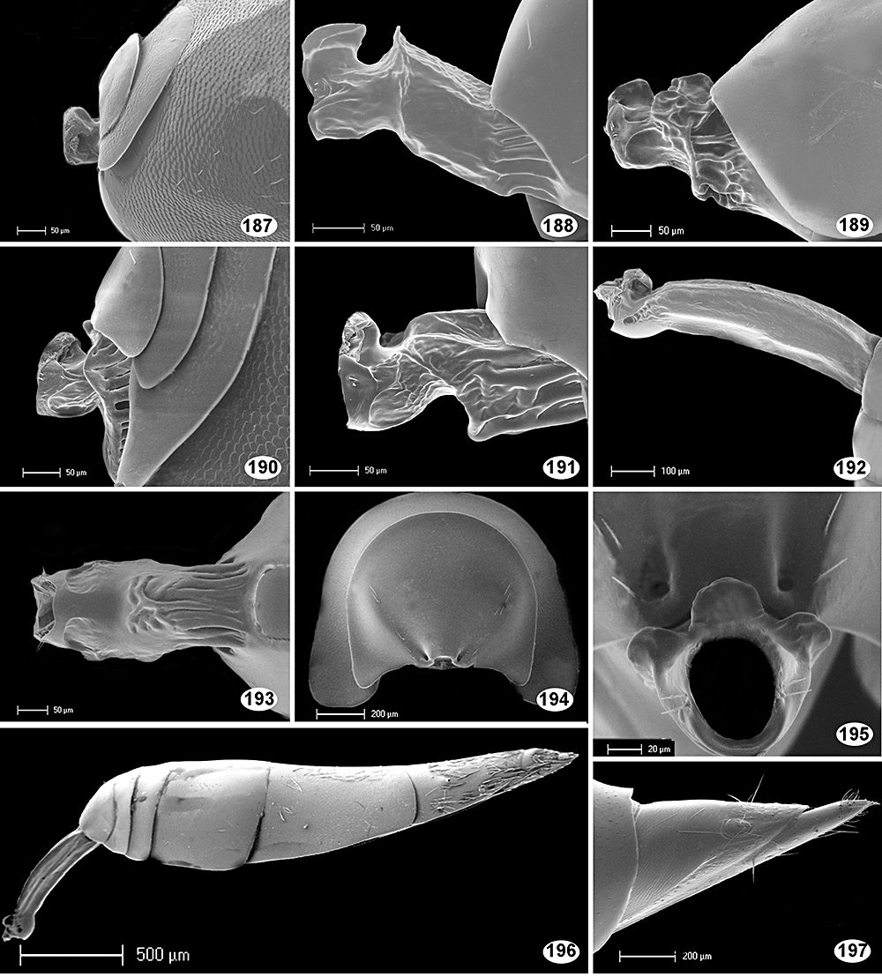
Figures 187–197 Figures 187–192: petiole and base of gaster in lateral view; 187, Rileya pulchra; 188, Eurytominae Ecuador; ...
Notes:
Figures 187–197 Figures 187–192: petiole and base of gaster in lateral view; 187, Rileya pulchra; 188, Eurytominae Ecuador; 189, Tetramesa fulvicollis; 190, Eurytoma cressoni; 191, Phylloxeroxenus San Alberto; 192, Axima brevicornis. Figure 193: petiole in ventral view–Eurytoma nodularis. Figure 194: base of gaster in frontal view–Bruchophagus squamea. Figure 195: petiole and median part of first gastral tergite in frontal view–Eurytoma volkovi. Figure 196: petiole and gaster–Axima brevicornis. Figure 197: syntergum in lateral view–Eurytoma amygdali.
Unless provided in the caption above, the following copyright applies to the content of this slide:

Slide 27
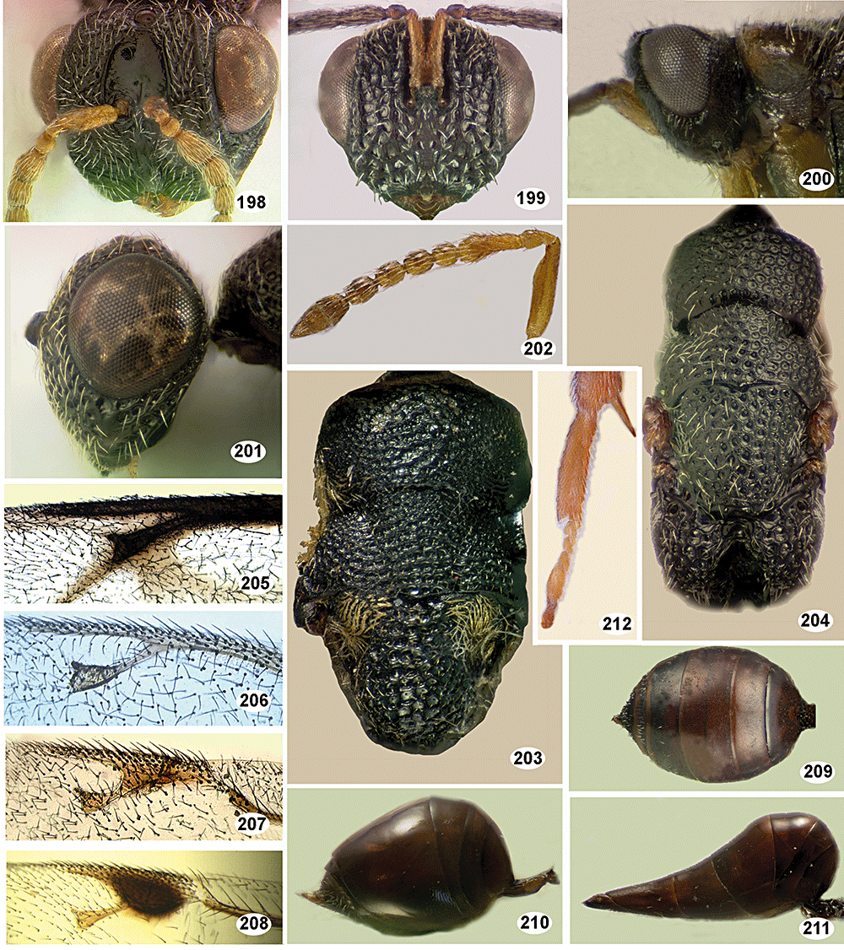
Figures 198–212 Figures 198, 199: head in frontal view–198, Philolema carinigena; 199, Aximogastroma longigastris. Figures ...
Notes:
Figures 198–212 Figures 198, 199: head in frontal view–198, Philolema carinigena; 199, Aximogastroma longigastris. Figures 200, 201: head and pronotum in lateral view; 200, Masneroma angulifera; 201, Banyoma philippinensis. Figure 202: female antenna–Endobia donacis. Figures 203, 204: mesosoma in dorsal view–203, Ramanuja swarmanus; 204, Banyoma philippinensis. Figures 205–208: marginal, stigmal, and postmarginal veins of forewing–205, Aiolomorphus rhopaloides; 206, Eurytoma sp., ros species group; 207, Eurytoma sp., morio species group; 208, Sycophila kestraneura. Figure 209: gaster in dorsal view–Prodecatomidea bekiliens. Figures 210, 211: gaster in lateral view–210, Gibsonoma budhai; 211, Aximogastroma longigastris. Figure 212: hind tarsus; Endobia donacis.
Unless provided in the caption above, the following copyright applies to the content of this slide:

Slide 28
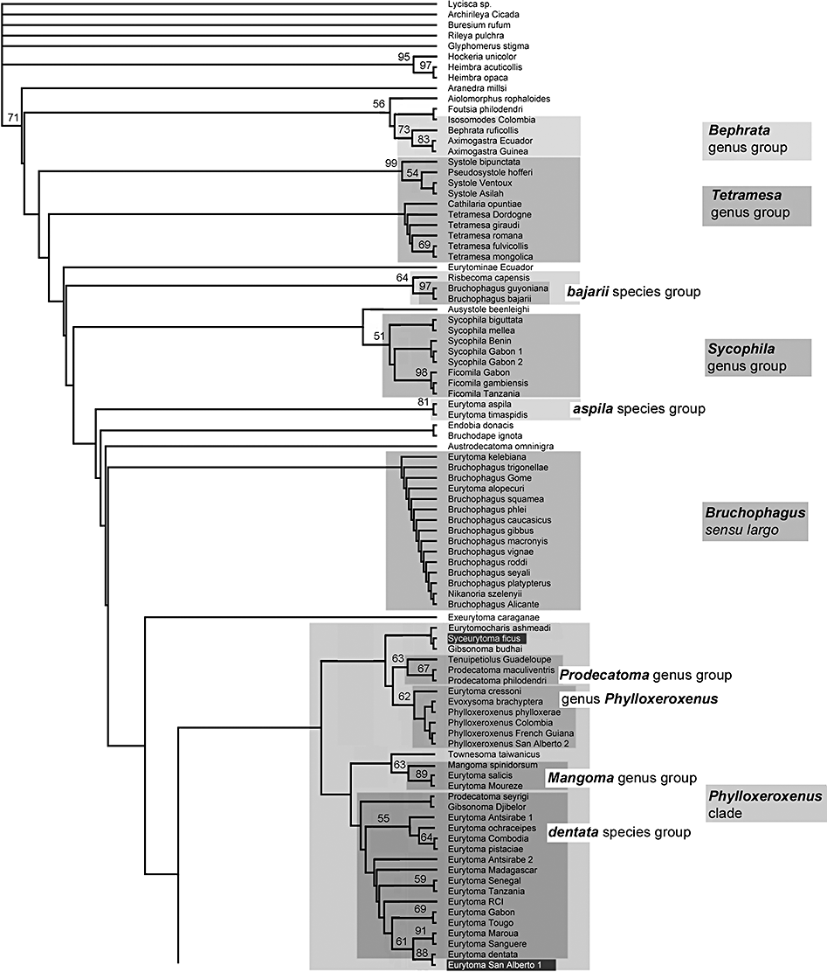
Figure 3 Cladogram 1. Phylogeny of the Eurytominae: strict consensus tree (= CS) of the equally weighted trees (n = ...
Notes:
Figure 3 Cladogram 1. Phylogeny of the Eurytominae: strict consensus tree (= CS) of the equally weighted trees (n = 35). Study carried out with 150 morphological characters and 178 taxa using a ‘consensus weighting approach’ as defined in the text (Step 3 of Analysis 1). Boostrap values are given above the branches. Length of the tree: 165.96; consistency index, CI = 0.275; retention index, RI = 0.844; rescaled consistency index, RC = 0.232. The generic groups, large genera, and some species groups, as defined in the text, are shaded. The Bephra group is not monophyletic on this cladogram. Syceurytoma ficus and the Eurytoma from San Alberto were finally excluded from the Phylloxeroxenus clade; they are shaded in dark grey to underline an ambiguous placement on this cladogram. Plutarchia always branches within the genus Philolema sensu largo in all cladograms. As this placement seems doubtful the genus is also superimposed. Putative placement of the type species for each of the largest genera is indicated.
Unless provided in the caption above, the following copyright applies to the content of this slide:

Slide 29
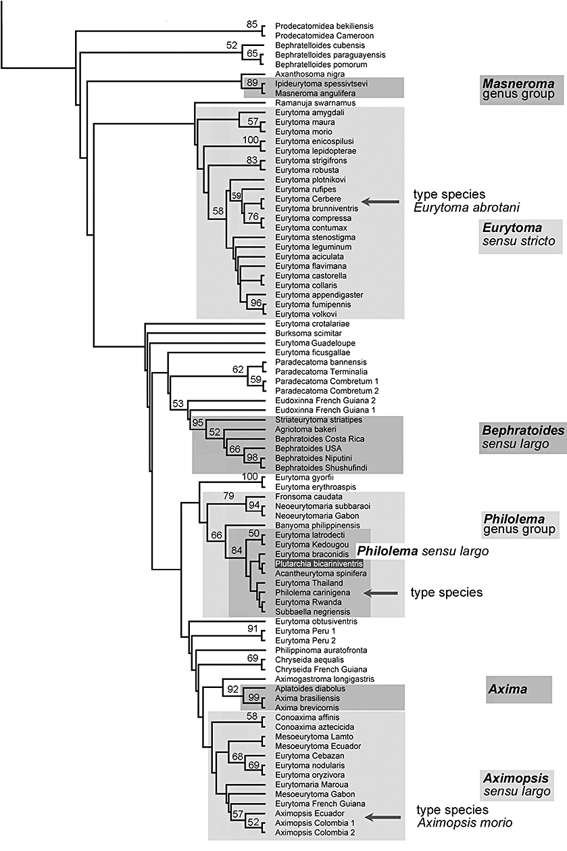
Figure 3 Cladogram 1. Phylogeny of the Eurytominae: strict consensus tree (= CS) of the equally weighted trees (n = ...
Notes:
Figure 3 Cladogram 1. Phylogeny of the Eurytominae: strict consensus tree (= CS) of the equally weighted trees (n = 35). Study carried out with 150 morphological characters and 178 taxa using a ‘consensus weighting approach’ as defined in the text (Step 3 of Analysis 1). Boostrap values are given above the branches. Length of the tree: 165.96; consistency index, CI = 0.275; retention index, RI = 0.844; rescaled consistency index, RC = 0.232. The generic groups, large genera, and some species groups, as defined in the text, are shaded. The Bephra group is not monophyletic on this cladogram. Syceurytoma ficus and the Eurytoma from San Alberto were finally excluded from the Phylloxeroxenus clade; they are shaded in dark grey to underline an ambiguous placement on this cladogram. Plutarchia always branches within the genus Philolema sensu largo in all cladograms. As this placement seems doubtful the genus is also superimposed. Putative placement of the type species for each of the largest genera is indicated.
Unless provided in the caption above, the following copyright applies to the content of this slide:

Slide 30
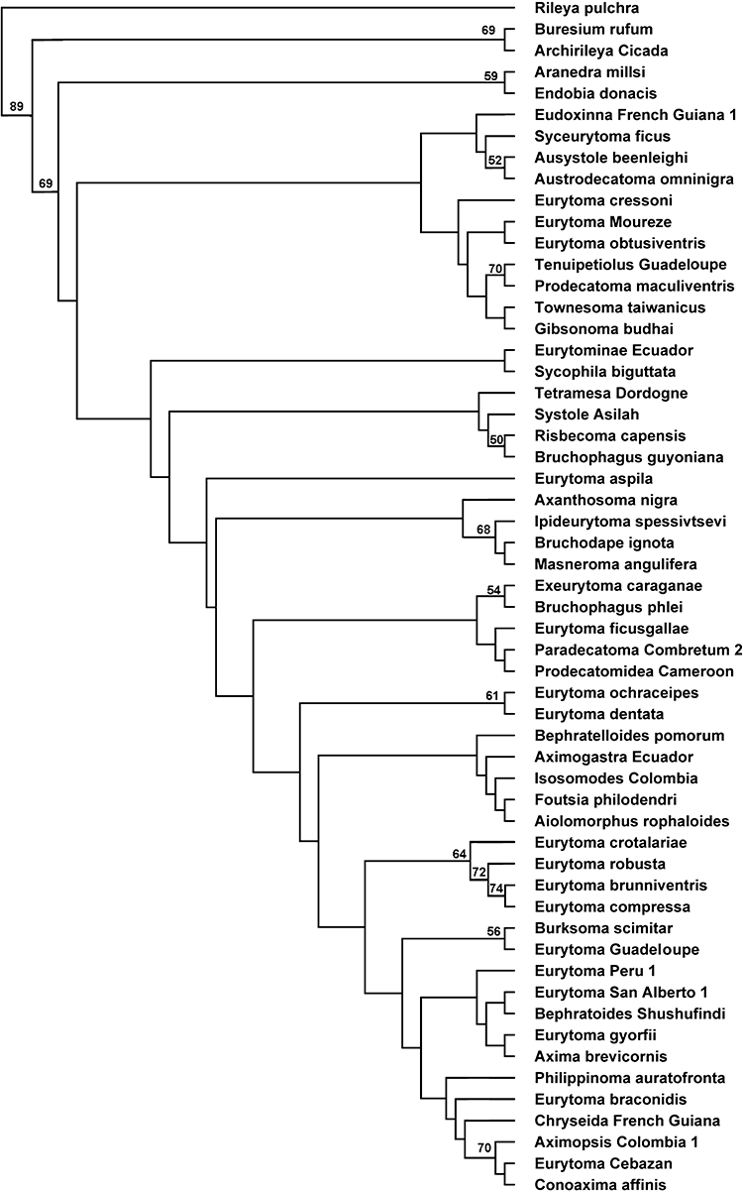
Figure 4 Cladogram 2. Phylogeny of the Eurytominae: strict consensus tree (CS) of the equally weighted trees (n= 35). ...
Notes:
Figure 4 Cladogram 2. Phylogeny of the Eurytominae: strict consensus tree (CS) of the equally weighted trees (n= 35). Study carried out with 150 morphological characters and 56 taxa using a ‘successive approach’ as defined in the text (Step 4 of Analysis 1). Bootstrap values are given above the branches. Length of the tree: 262.92; consistency index, CI = 0.353; retention index, RI = 0.856; rescaled consistency index, RC = 0.302.
Unless provided in the caption above, the following copyright applies to the content of this slide:

Slide 31
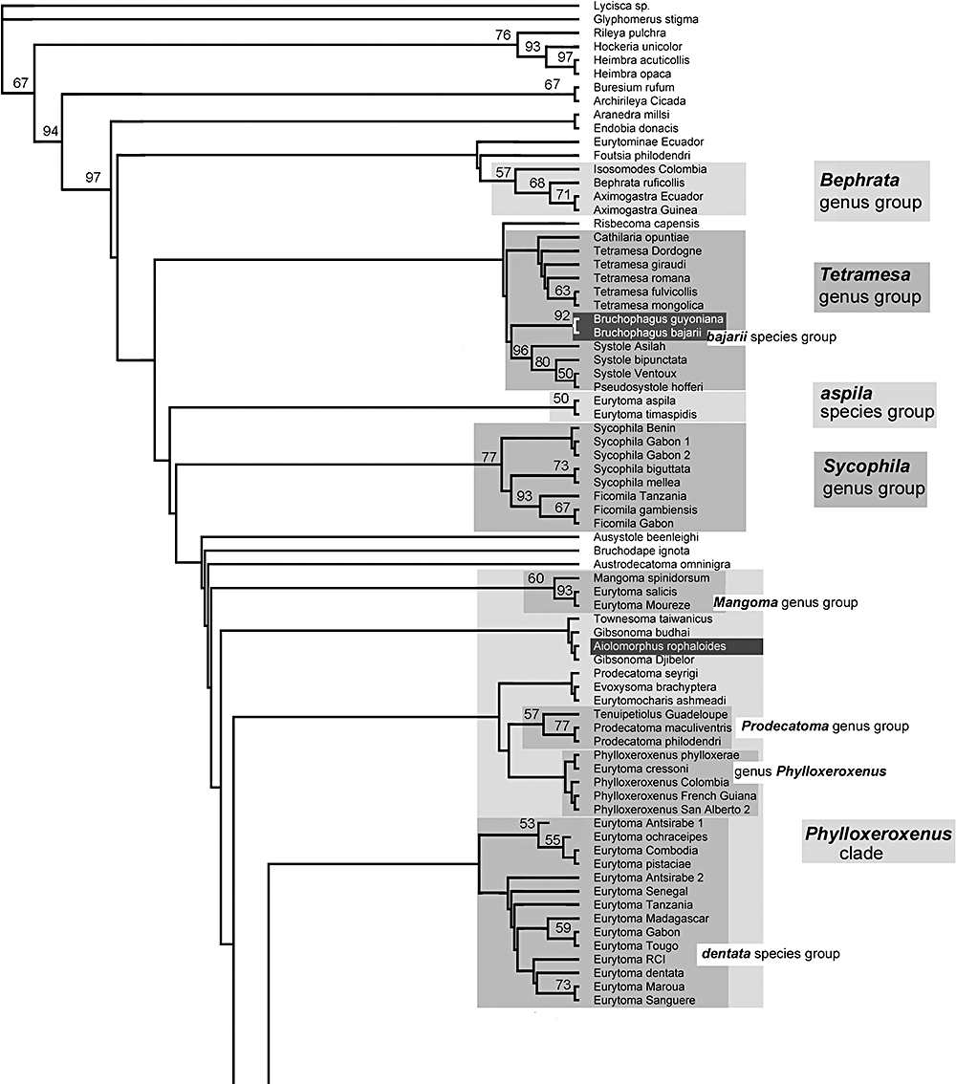
Figure 5 (A) Cladogram 3A. Phylogeny of the Eurytominae: strict consensus tree (CS) of the equally weighted trees (n= ...
Notes:
Figure 5 (A) Cladogram 3A. Phylogeny of the Eurytominae: strict consensus tree (CS) of the equally weighted trees (n= 45). Study carried out with 156 morphological characters and 178 taxa using a ‘successive approach’ as defined in the text (Step 5 of Analysis 1). Bootstrap values are given above the branches. Length of the tree: 463.459; consistency index, CI = 0.201; retention index, RI = 0.813; rescaled consistency index, RC = 0.164. The generic groups, the large genera, and some species groups, as defined in the text, are shaded. The bajarii species group is included here in the Tetramesa genus group, whereas it branches within the Risbecoma genus group in other cladograms. It is therefore shaded in dark grey to denote an ambiguous placement. The same is true for Aiolomorphus rhopaloides, which generally branches on a basal node of Eurytominae, not within the Phylloxeroxenus clade. Putative placement of the type species for each of the largest genera is indicated. (B) Cladogram 3B. Cladogram 3 with feeding habits, when known, mapped on cladogram 3: phytophagous vs. entomophagus. Taxa not shaded or surrounded denote unknown or ambiguous feeding habit.
Unless provided in the caption above, the following copyright applies to the content of this slide:

Slide 32
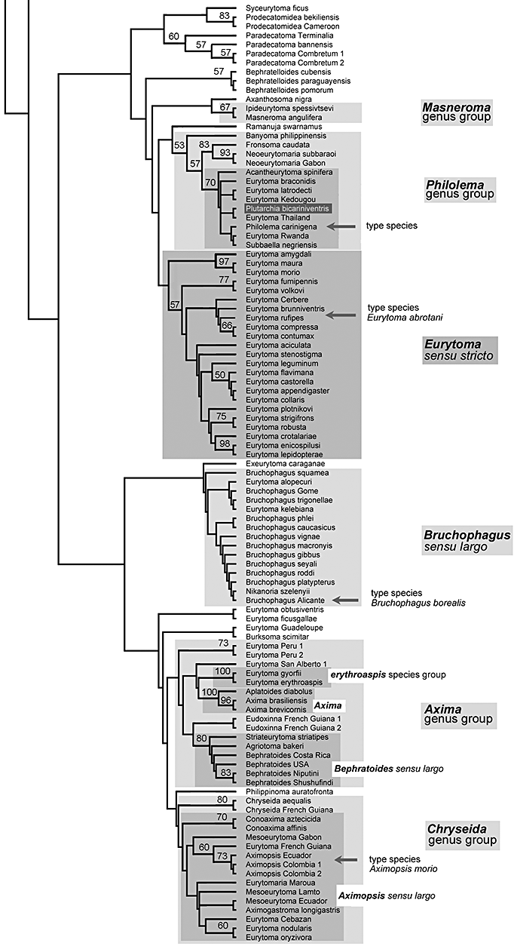
Figure 5 (A) Cladogram 3A. Phylogeny of the Eurytominae: strict consensus tree (CS) of the equally weighted trees (n= ...
Notes:
Figure 5 (A) Cladogram 3A. Phylogeny of the Eurytominae: strict consensus tree (CS) of the equally weighted trees (n= 45). Study carried out with 156 morphological characters and 178 taxa using a ‘successive approach’ as defined in the text (Step 5 of Analysis 1). Bootstrap values are given above the branches. Length of the tree: 463.459; consistency index, CI = 0.201; retention index, RI = 0.813; rescaled consistency index, RC = 0.164. The generic groups, the large genera, and some species groups, as defined in the text, are shaded. The bajarii species group is included here in the Tetramesa genus group, whereas it branches within the Risbecoma genus group in other cladograms. It is therefore shaded in dark grey to denote an ambiguous placement. The same is true for Aiolomorphus rhopaloides, which generally branches on a basal node of Eurytominae, not within the Phylloxeroxenus clade. Putative placement of the type species for each of the largest genera is indicated. (B) Cladogram 3B. Cladogram 3 with feeding habits, when known, mapped on cladogram 3: phytophagous vs. entomophagus. Taxa not shaded or surrounded denote unknown or ambiguous feeding habit.
Unless provided in the caption above, the following copyright applies to the content of this slide:

Slide 33
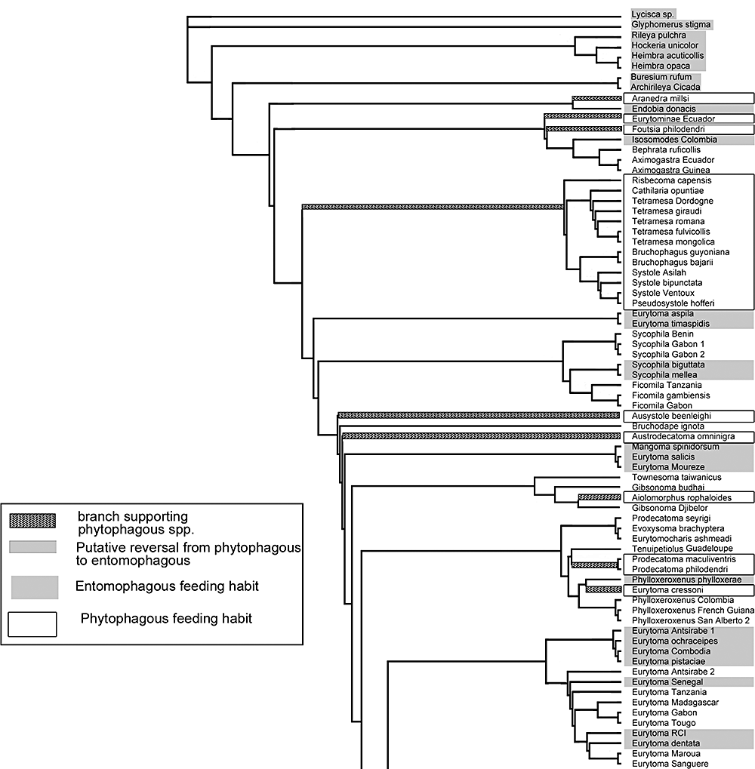
Figure 5 (A) Cladogram 3A. Phylogeny of the Eurytominae: strict consensus tree (CS) of the equally weighted trees (n= ...
Notes:
Figure 5 (A) Cladogram 3A. Phylogeny of the Eurytominae: strict consensus tree (CS) of the equally weighted trees (n= 45). Study carried out with 156 morphological characters and 178 taxa using a ‘successive approach’ as defined in the text (Step 5 of Analysis 1). Bootstrap values are given above the branches. Length of the tree: 463.459; consistency index, CI = 0.201; retention index, RI = 0.813; rescaled consistency index, RC = 0.164. The generic groups, the large genera, and some species groups, as defined in the text, are shaded. The bajarii species group is included here in the Tetramesa genus group, whereas it branches within the Risbecoma genus group in other cladograms. It is therefore shaded in dark grey to denote an ambiguous placement. The same is true for Aiolomorphus rhopaloides, which generally branches on a basal node of Eurytominae, not within the Phylloxeroxenus clade. Putative placement of the type species for each of the largest genera is indicated. (B) Cladogram 3B. Cladogram 3 with feeding habits, when known, mapped on cladogram 3: phytophagous vs. entomophagus. Taxa not shaded or surrounded denote unknown or ambiguous feeding habit.
Unless provided in the caption above, the following copyright applies to the content of this slide:

Slide 34
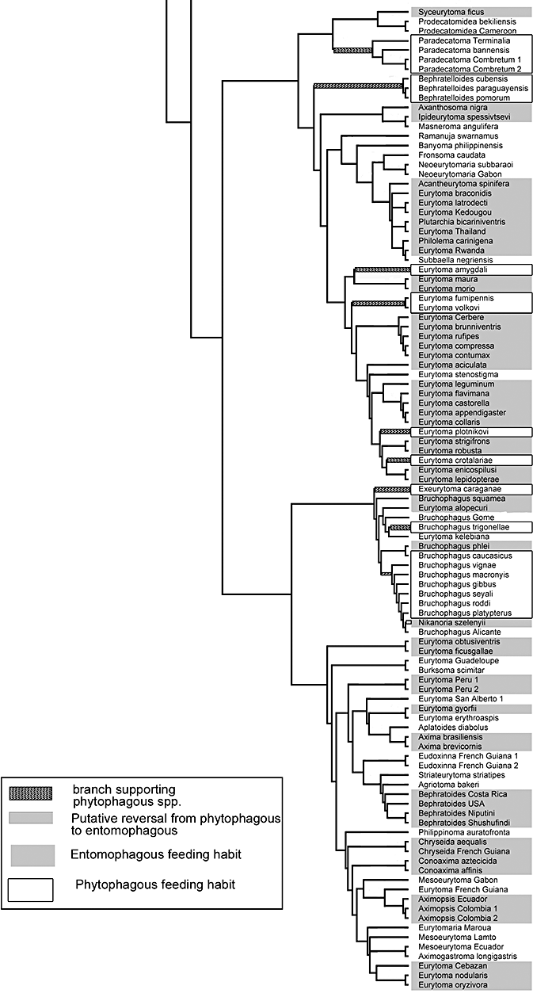
Figure 5 (A) Cladogram 3A. Phylogeny of the Eurytominae: strict consensus tree (CS) of the equally weighted trees (n= ...
Notes:
Figure 5 (A) Cladogram 3A. Phylogeny of the Eurytominae: strict consensus tree (CS) of the equally weighted trees (n= 45). Study carried out with 156 morphological characters and 178 taxa using a ‘successive approach’ as defined in the text (Step 5 of Analysis 1). Bootstrap values are given above the branches. Length of the tree: 463.459; consistency index, CI = 0.201; retention index, RI = 0.813; rescaled consistency index, RC = 0.164. The generic groups, the large genera, and some species groups, as defined in the text, are shaded. The bajarii species group is included here in the Tetramesa genus group, whereas it branches within the Risbecoma genus group in other cladograms. It is therefore shaded in dark grey to denote an ambiguous placement. The same is true for Aiolomorphus rhopaloides, which generally branches on a basal node of Eurytominae, not within the Phylloxeroxenus clade. Putative placement of the type species for each of the largest genera is indicated. (B) Cladogram 3B. Cladogram 3 with feeding habits, when known, mapped on cladogram 3: phytophagous vs. entomophagus. Taxa not shaded or surrounded denote unknown or ambiguous feeding habit.
Unless provided in the caption above, the following copyright applies to the content of this slide:

Slide 35
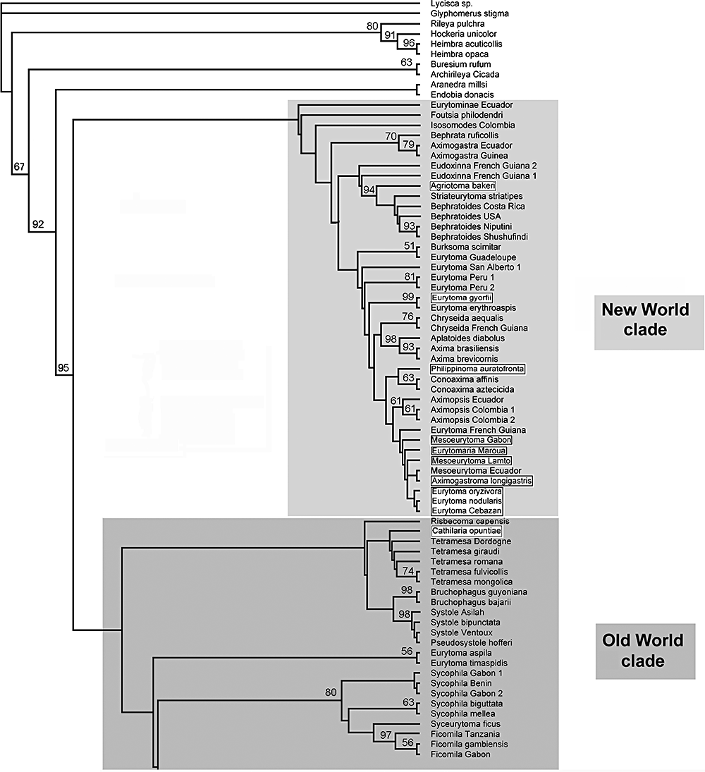
Figure 6 Cladogram 4. Phylogeny of the Eurytominae: strict consensus tree (CS) of the equally weighted trees (n= 45). ...
Notes:
Figure 6 Cladogram 4. Phylogeny of the Eurytominae: strict consensus tree (CS) of the equally weighted trees (n= 45). Study carried out with 156 morphological characters and 178 taxa using a ‘successive approach’ as defined in the text (Step 5 of Analysis 1). Bootstrap values are given above the branches. Length of the tree: 464.433; consistency index, CI = 0.204; retention index, RI = 0.814; rescaled consistency index, RC = 0.166. Two large clades, including species distributed in the New World and in the Old World, respectively, are shaded. Species or genera conflicting with the general distribution are outlined.
Unless provided in the caption above, the following copyright applies to the content of this slide:

Slide 36
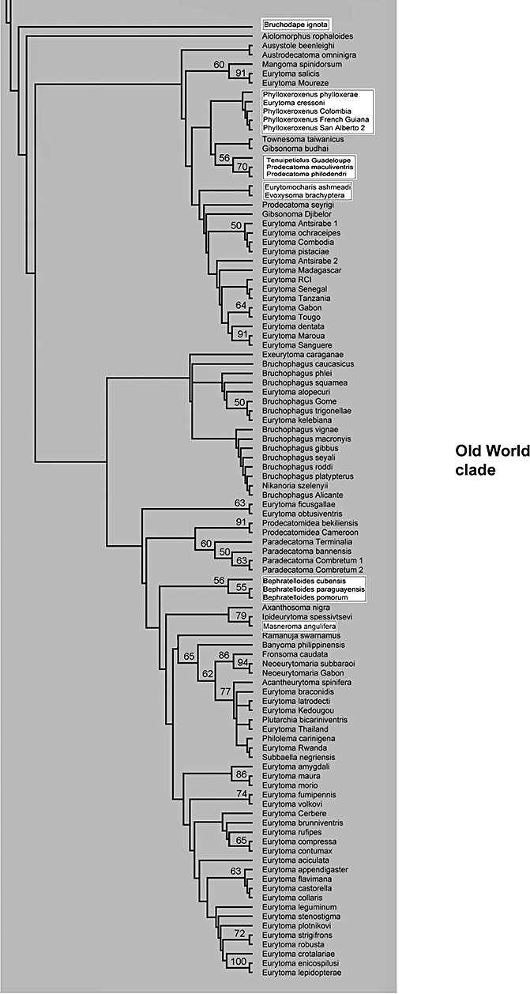
Figure 6 Cladogram 4. Phylogeny of the Eurytominae: strict consensus tree (CS) of the equally weighted trees (n= 45). ...
Notes:
Figure 6 Cladogram 4. Phylogeny of the Eurytominae: strict consensus tree (CS) of the equally weighted trees (n= 45). Study carried out with 156 morphological characters and 178 taxa using a ‘successive approach’ as defined in the text (Step 5 of Analysis 1). Bootstrap values are given above the branches. Length of the tree: 464.433; consistency index, CI = 0.204; retention index, RI = 0.814; rescaled consistency index, RC = 0.166. Two large clades, including species distributed in the New World and in the Old World, respectively, are shaded. Species or genera conflicting with the general distribution are outlined.
Unless provided in the caption above, the following copyright applies to the content of this slide:

Slide 37
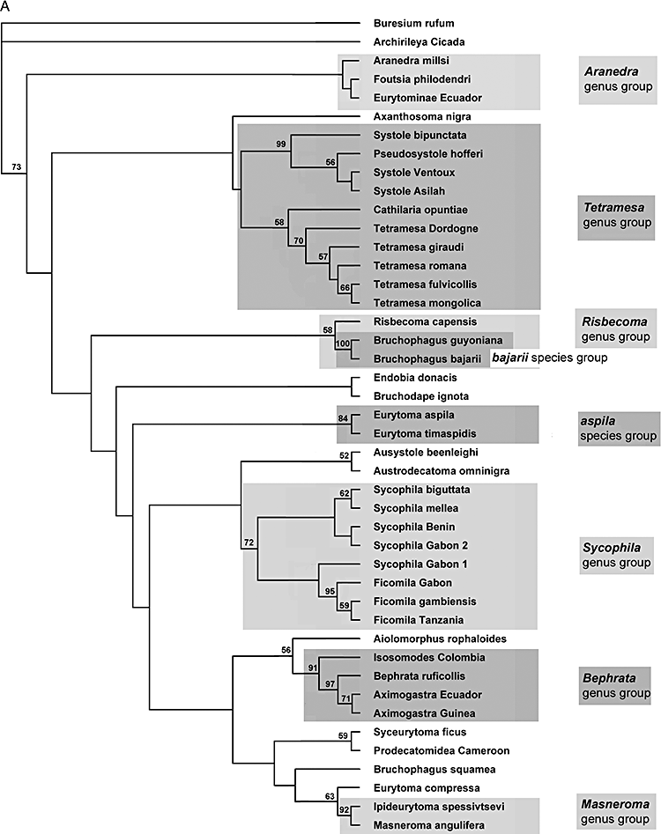
Figure 7 (A) Cladogram 5A. Phylogeny of the basal zone of the Eurytominae: strict consensus tree (CS) of the equally ...
Notes:
Figure 7 (A) Cladogram 5A. Phylogeny of the basal zone of the Eurytominae: strict consensus tree (CS) of the equally weighted trees (n= 3). Study carried out with 156 morphological characters and 44 taxa (Analysis 2). Bootstrap values are given above the branches. Length of the tree: 170.255; consistency index, CI = 0.425; retention index, RI = 0. 766; rescaled consistency index, RC = 0.325. The generic groups, the large genera, and some species groups, as defined in the text, are shaded. (B) Cladogram 5B. Phylogeny of the basal zone of the Eurytominae: CS of the equally weighted trees (n= 9). Study carried out with 156 morphological characters and 44 taxa (Analysis 2), implementing another weighting for some characters. Bootstrap values are given above the branches. Length of the tree: 217.700; CI = 0.491; RI = 0.775; RC = 0.380. The generic groups, large genera, and some species groups, as defined in the text, are shaded. The Aranedra genus group is paraphyletic here.
Unless provided in the caption above, the following copyright applies to the content of this slide:

Slide 38
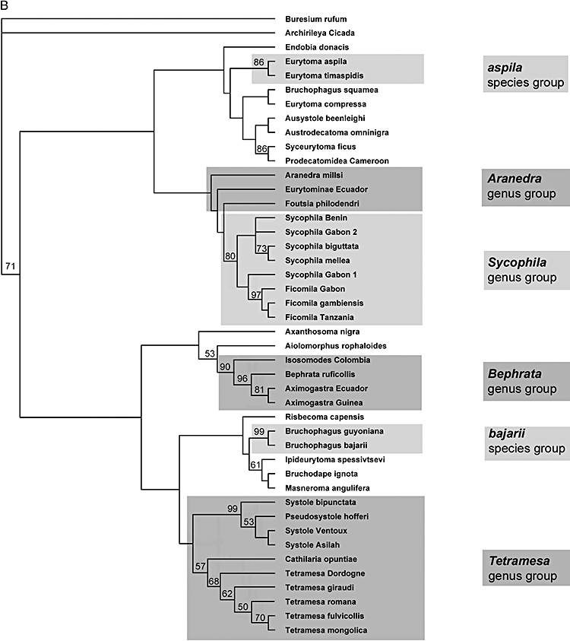
Figure 7 (A) Cladogram 5A. Phylogeny of the basal zone of the Eurytominae: strict consensus tree (CS) of the equally ...
Notes:
Figure 7 (A) Cladogram 5A. Phylogeny of the basal zone of the Eurytominae: strict consensus tree (CS) of the equally weighted trees (n= 3). Study carried out with 156 morphological characters and 44 taxa (Analysis 2). Bootstrap values are given above the branches. Length of the tree: 170.255; consistency index, CI = 0.425; retention index, RI = 0. 766; rescaled consistency index, RC = 0.325. The generic groups, the large genera, and some species groups, as defined in the text, are shaded. (B) Cladogram 5B. Phylogeny of the basal zone of the Eurytominae: CS of the equally weighted trees (n= 9). Study carried out with 156 morphological characters and 44 taxa (Analysis 2), implementing another weighting for some characters. Bootstrap values are given above the branches. Length of the tree: 217.700; CI = 0.491; RI = 0.775; RC = 0.380. The generic groups, large genera, and some species groups, as defined in the text, are shaded. The Aranedra genus group is paraphyletic here.
Unless provided in the caption above, the following copyright applies to the content of this slide:

Slide 39
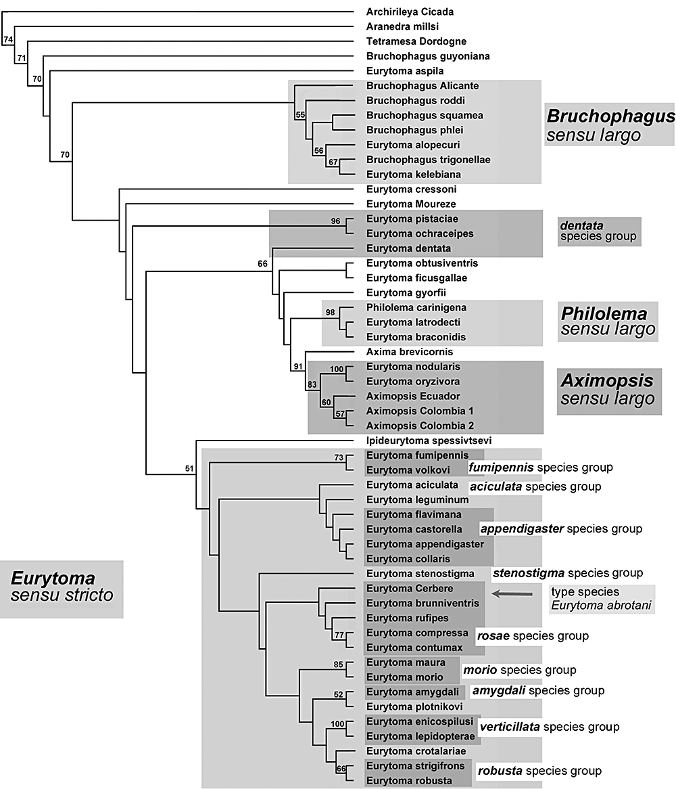
Figure 8 Cladogram 6. Phylogeny of the species classified in Eurytoma: strict consensus tree (CS) of the equally ...
Notes:
Figure 8 Cladogram 6. Phylogeny of the species classified in Eurytoma: strict consensus tree (CS) of the equally weighted trees (n= 2). Study carried out with 156 morphological characters and 37 taxa (Analysis 3). Bootstrap values are given above the branches. Length of the tree: 188.58; consistency index, CI = 0.388; retention index, RI = 0. 791; rescaled consistency index, RC = 0.307. The generic groups, the large genera, and some species groups, as defined in the text, are shaded. The dentata species group is not monophyletic on this cladogram.
Unless provided in the caption above, the following copyright applies to the content of this slide:

Slide 40
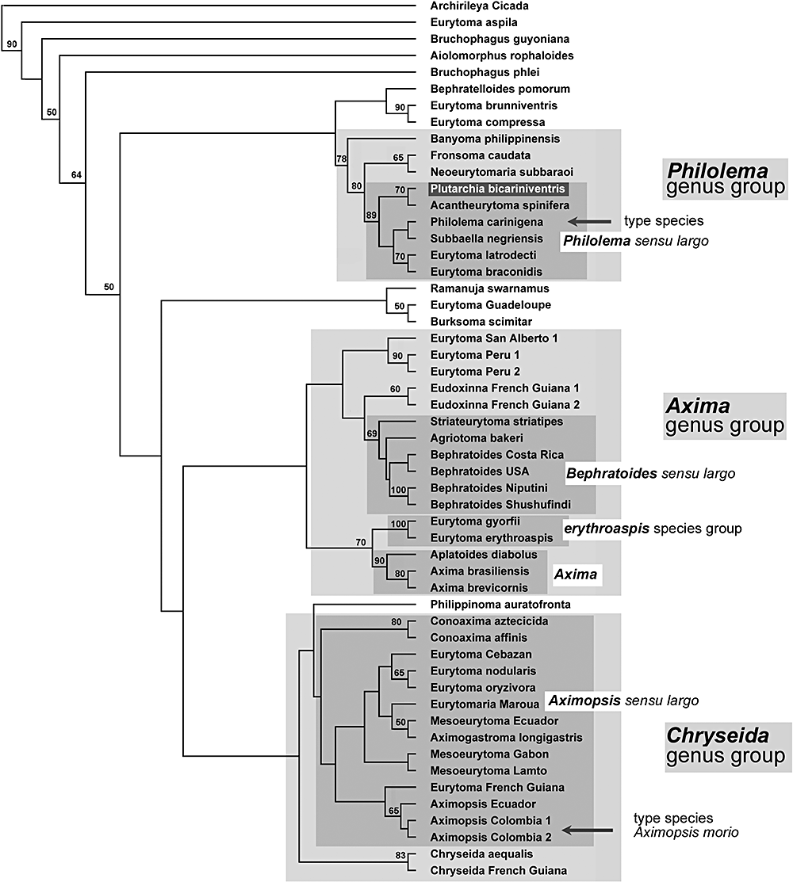
Figure 9 Cladogram 7. Phylogeny of the terminal zone of the Eurytominae: unique tree obtained. Study carried out with ...
Notes:
Figure 9 Cladogram 7. Phylogeny of the terminal zone of the Eurytominae: unique tree obtained. Study carried out with 156 morphological characters and 44 taxa (Analysis 4). Bootstrap values are given above the branches. Length of the tree: 168.672; consistency index, CI = 0.356; retention index, RI = 0.780; rescaled consistency index, RC = 0.280. The generic groups, large genera, and some species groups, as defined in the text, are shaded.
Unless provided in the caption above, the following copyright applies to the content of this slide:

