Slide 1
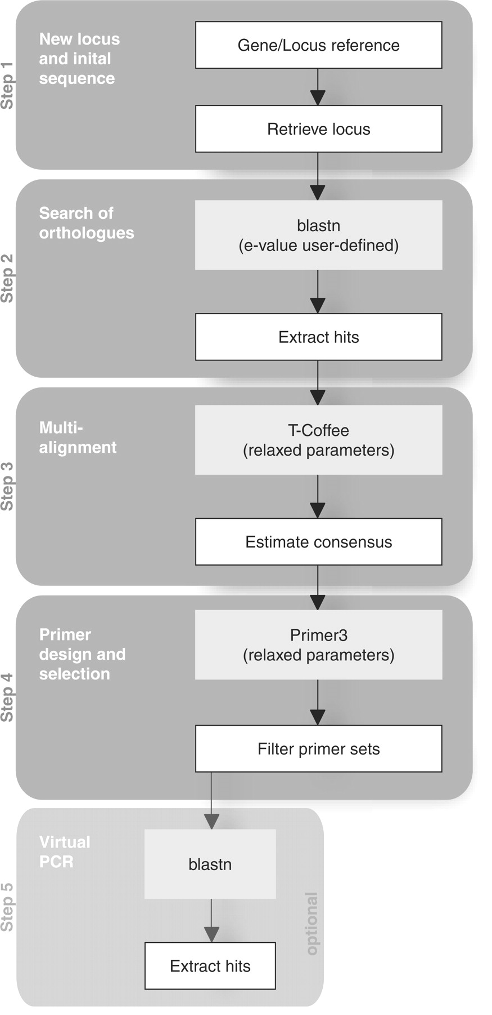
Figure 1. Schematic diagram of the UniPrime algorithm. Steps carried out by UniPrime are shown in white boxes. Steps ...
Notes:
Figure 1. Schematic diagram of the UniPrime algorithm. Steps carried out by UniPrime are shown in white boxes. Steps performed by external programs, are shown in grey boxes. The five main functions of UniPrime are highlighted.
Unless provided in the caption above, the following copyright applies to the content of this slide: © 2008 The Author(s)This is an Open Access article distributed under the terms of the Creative Commons Attribution Non-Commercial License (http://creativecommons.org/licenses/by-nc/2.0/uk/) which permits unrestricted non-commercial use, distribution, and reproduction in any medium, provided the original work is properly cited.

Slide 2
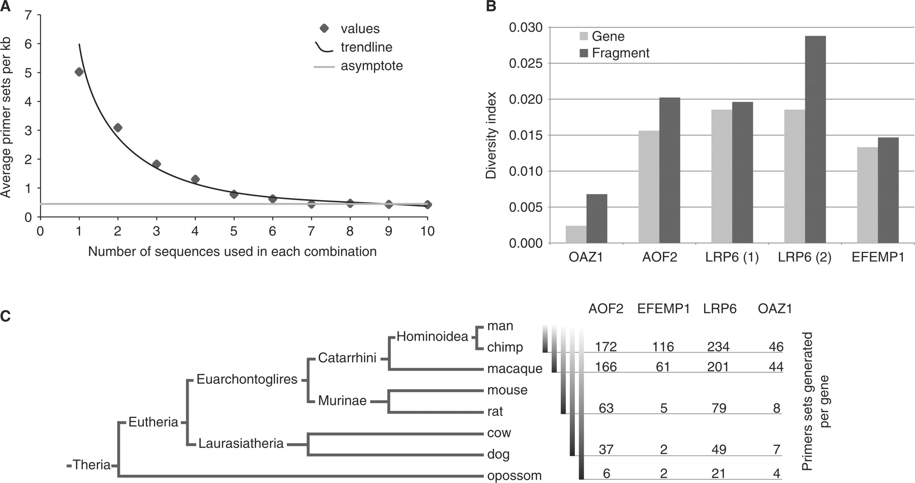
Figure 2. ( A ) Impact of the number of sequences used for the alignment on the primer selection. The number of ...
Notes:
Figure 2. ( A ) Impact of the number of sequences used for the alignment on the primer selection. The number of sequence used for the multi-alignment step varied from 1 to 10. The number of primer sets selected is expressed in primer sets per kb. The 200 random mammalian genes were used from 1 to 300 kb-long. The curve is asymptotic to a value of 0.5 primer set per kilobase (grey line). ( B ) Sequence diversity. Diversity indices (average number of variation per site) across the alignment of the entire gene (light grey) and of the amplified fragment (dark grey). The amplified regions are more variable than the complete gene as is expected due to the primer design process. ( C ) Primers sets generated per gene. For each gene, the number of primer sets generated is assessed across phylogenetic distances.
Unless provided in the caption above, the following copyright applies to the content of this slide: © 2008 The Author(s)This is an Open Access article distributed under the terms of the Creative Commons Attribution Non-Commercial License (http://creativecommons.org/licenses/by-nc/2.0/uk/) which permits unrestricted non-commercial use, distribution, and reproduction in any medium, provided the original work is properly cited.

Slide 3
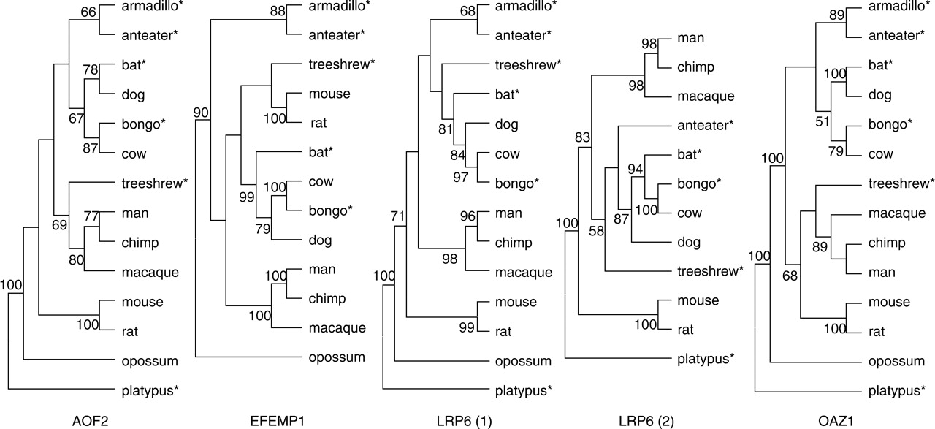
Figure 3. Benchmark ML bootstrap consensus trees based on our amplified fragments (indicated by *) and retrieved ...
Notes:
Figure 3. Benchmark ML bootstrap consensus trees based on our amplified fragments (indicated by *) and retrieved aligned sequences. Bootstrap support over 50% is shown.
Unless provided in the caption above, the following copyright applies to the content of this slide: © 2008 The Author(s)This is an Open Access article distributed under the terms of the Creative Commons Attribution Non-Commercial License (http://creativecommons.org/licenses/by-nc/2.0/uk/) which permits unrestricted non-commercial use, distribution, and reproduction in any medium, provided the original work is properly cited.

Slide 4
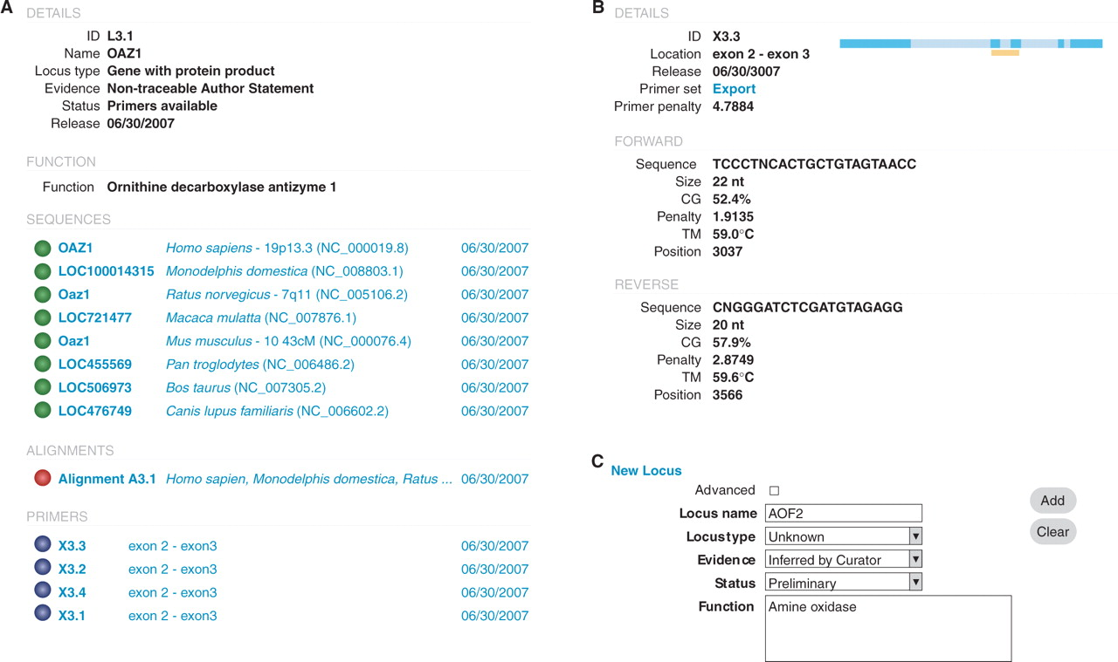
Figure 4. Screenshot of UniPrime web interface. ( A ) Detail of the output for the OAZ1 locus, including the sequences ...
Notes:
Figure 4. Screenshot of UniPrime web interface. ( A ) Detail of the output for the OAZ1 locus, including the sequences retrieved, the alignment and the primers available. ( B ) Details of one the primer sets generated. ( C ) Screenshot of the manual entry of a new locus (step 1).
Unless provided in the caption above, the following copyright applies to the content of this slide: © 2008 The Author(s)This is an Open Access article distributed under the terms of the Creative Commons Attribution Non-Commercial License (http://creativecommons.org/licenses/by-nc/2.0/uk/) which permits unrestricted non-commercial use, distribution, and reproduction in any medium, provided the original work is properly cited.

