Slide 1
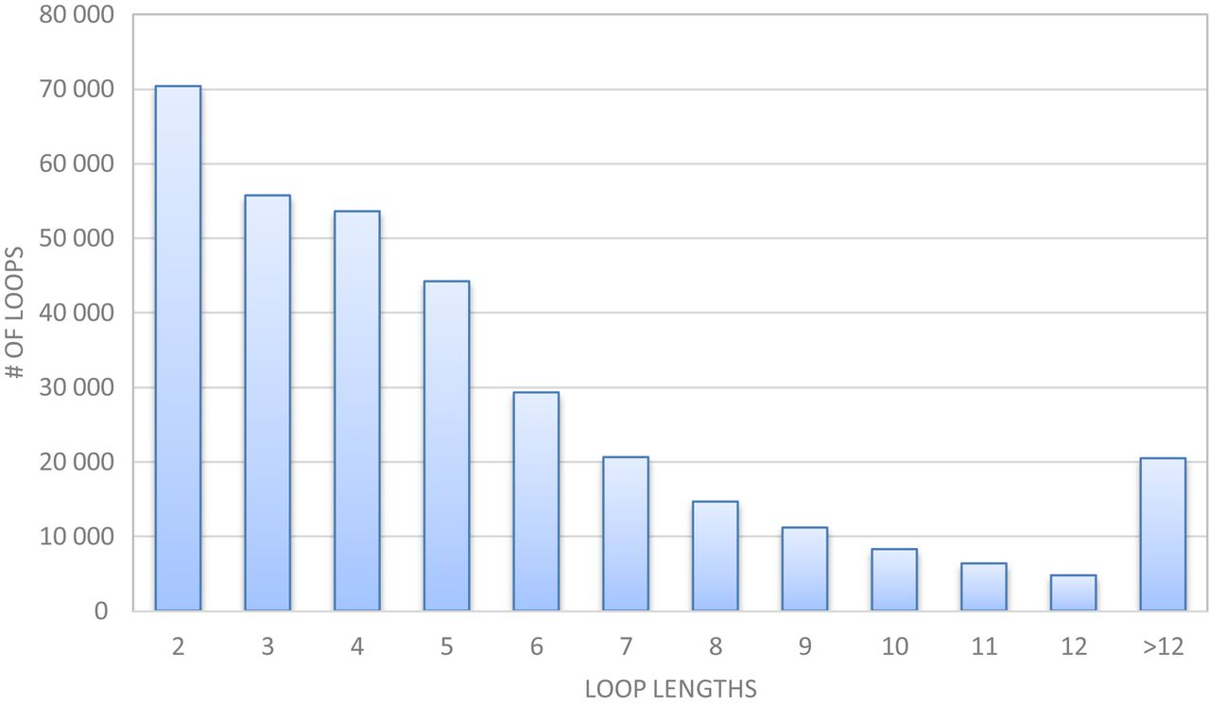
Figure 1. Distribution of loop lengths in the protein chain list generated by the PISCES server on April 13, 2016 ...
Notes:
Figure 1. Distribution of loop lengths in the protein chain list generated by the PISCES server on April 13, 2016 containing 18 275 chains with 2.0A resolution, 90% sequence identity and 0.25 R-factor cutoff.
Unless provided in the caption above, the following copyright applies to the content of this slide: © The Author(s) 2016. Published by Oxford University Press on behalf of Nucleic Acids Research.This is an Open Access article distributed under the terms of the Creative Commons Attribution License (http://creativecommons.org/licenses/by-nc/4.0/), which permits non-commercial re-use, distribution, and reproduction in any medium, provided the original work is properly cited. For commercial re-use, please contact journals.permissions@oup.com

Slide 2
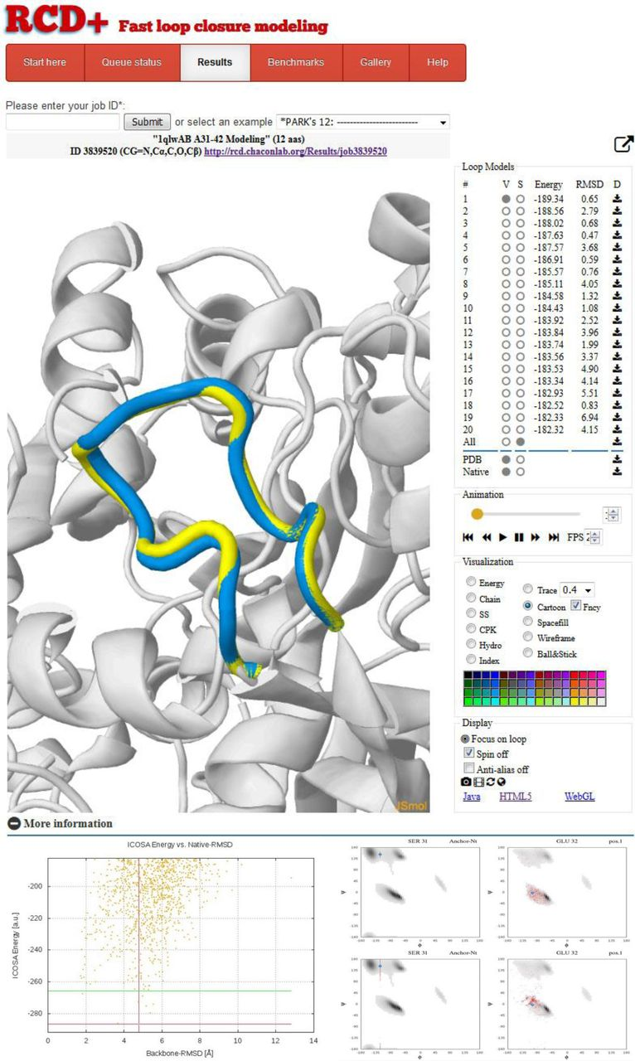
Figure 2. Sample results page provided by the server for a bacterial hydrolase loop (PDB-ID 1qwl). In this case, for ...
Notes:
Figure 2. Sample results page provided by the server for a bacterial hydrolase loop (PDB-ID 1qwl). In this case, for validation proposes only, the native loop (yellow) is displayed superimposed with the predicted lowest energy model in the JSmol visualization panel. On the right, the 20 top-ranked loop models are sorted by energy and can be easily selected to activate visualization and customize representation. The RMSD versus ICOSA energy plots and the Ramachandran distributions are shown in the bottom part.
Unless provided in the caption above, the following copyright applies to the content of this slide: © The Author(s) 2016. Published by Oxford University Press on behalf of Nucleic Acids Research.This is an Open Access article distributed under the terms of the Creative Commons Attribution License (http://creativecommons.org/licenses/by-nc/4.0/), which permits non-commercial re-use, distribution, and reproduction in any medium, provided the original work is properly cited. For commercial re-use, please contact journals.permissions@oup.com

Slide 3
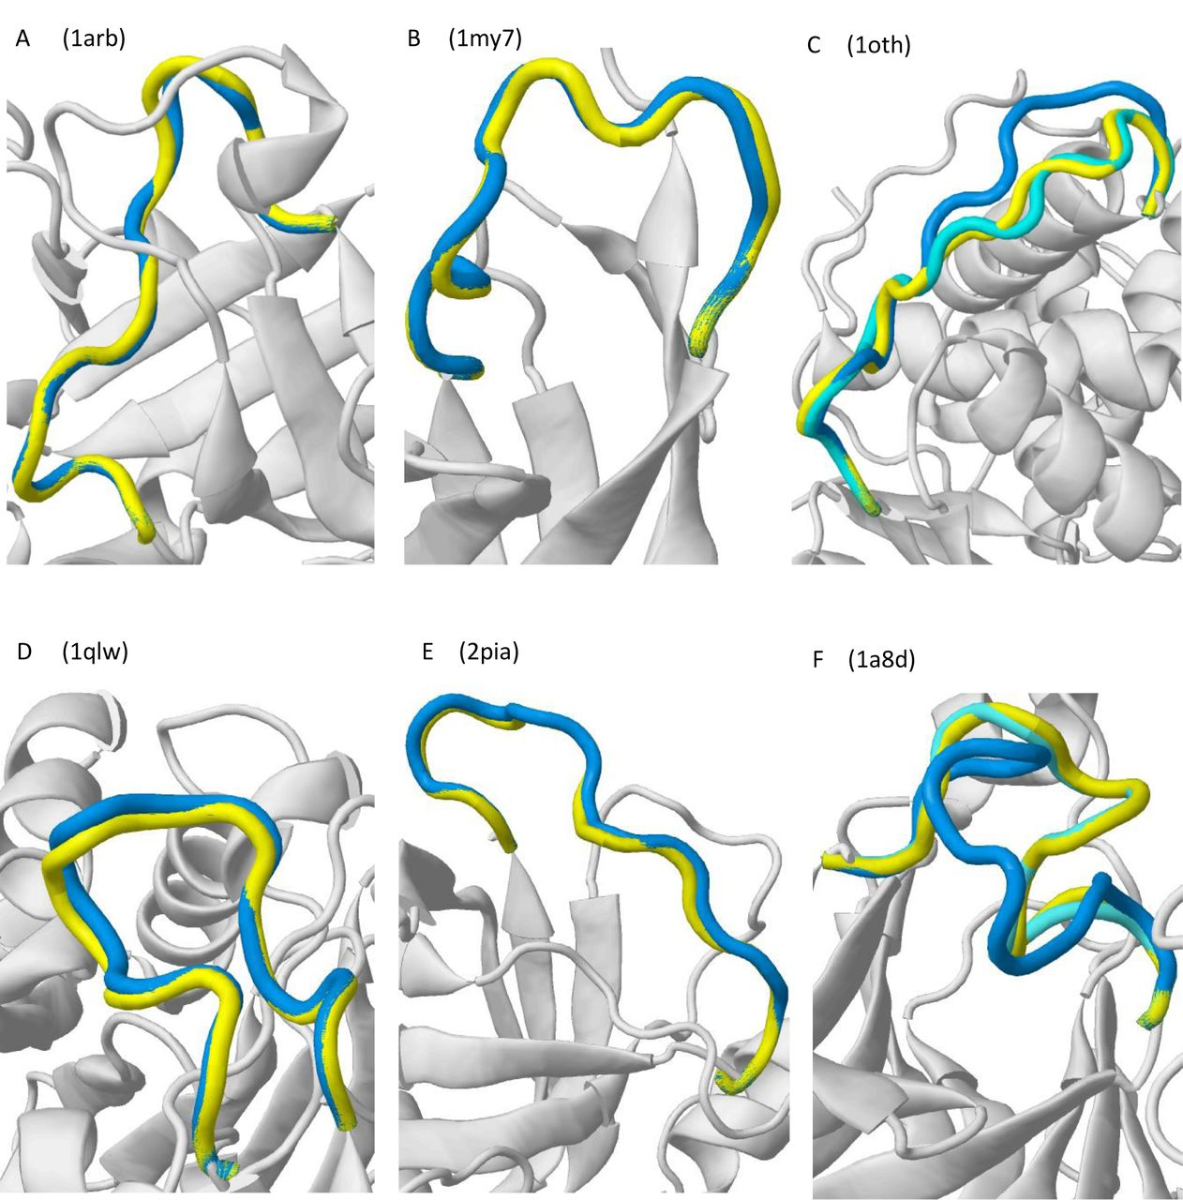
Figure 3. Illustrative cases of the server performance with benchmark test cases. In all the cases, the first ranked ...
Notes:
Figure 3. Illustrative cases of the server performance with benchmark test cases. In all the cases, the first ranked model (lowest energy) is depicted in blue, the native loop in yellow and the protein environment in gray. Alternative solutions found in the 12nd best (1oth) and 2nd best (1a8d) top-ranked predictions are colored in cyan.
Unless provided in the caption above, the following copyright applies to the content of this slide: © The Author(s) 2016. Published by Oxford University Press on behalf of Nucleic Acids Research.This is an Open Access article distributed under the terms of the Creative Commons Attribution License (http://creativecommons.org/licenses/by-nc/4.0/), which permits non-commercial re-use, distribution, and reproduction in any medium, provided the original work is properly cited. For commercial re-use, please contact journals.permissions@oup.com

