Slide 1
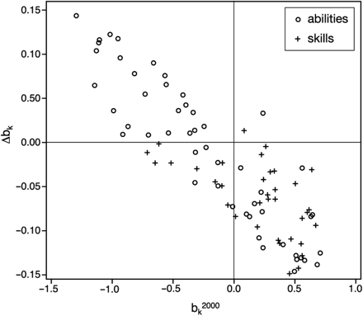
Figure 1. Relationship of Δb_{k} to b²⁰⁰⁰_{k} from ...
Notes:
Figure 1. Relationship of Δbk to b2000k from regressions of human capital indexes on the logarithm of metropolitan population, 2000 and 2006.
Unless provided in the caption above, the following copyright applies to the content of this slide: © The Author (2008). Published by Oxford University Press. All rights reserved. For Permissions, please email: journals.permissions@oxfordjournals.org

