Slide 1
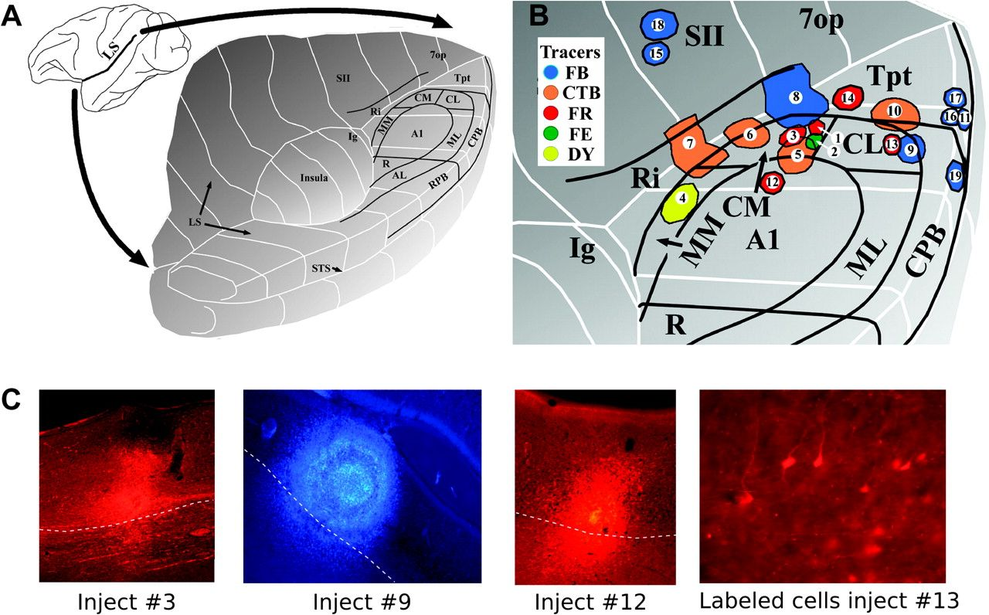
Figure 1. (A) Three-dimensional schematic of the opened lateral sulcus showing the approximate location of the cortical ...
Notes:
Figure 1. (A) Three-dimensional schematic of the opened lateral sulcus showing the approximate location of the cortical areas in auditory cortex. (B) Enlarged view showing the locations of the 19 injection sites described in the text (modified from Smiley et al. 2007). The sites are numbered as in Table 1. The different tracers are color coded as shown in the inset. FR, fluoro-ruby; FE, fluoro-emerald; DY, diamidino yellow. (C) Photomicrographs show injection site in areas CM (injection no. 3), CL/CPB (no. 9), and A1 (no. 12). Labeled cells in V2 after injection in area CL (case no. 13).
Unless provided in the caption above, the following copyright applies to the content of this slide: © The Author 2009. Published by Oxford University Press. All rights reserved. For permissions, please e-mail: journals.permissions@oxfordjournals.org

Slide 2
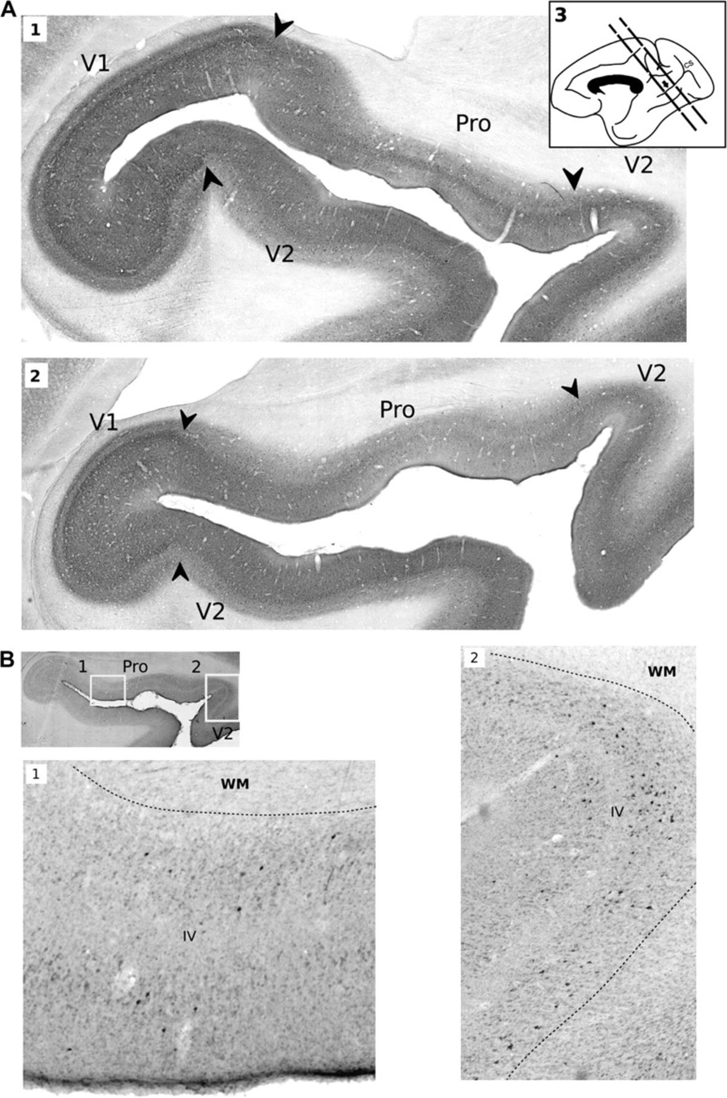
Figure 2. Histological sections are shown to illustrate the topography of visual cortical areas and labeling in ...
Notes:
Figure 2. Histological sections are shown to illustrate the topography of visual cortical areas and labeling in calcarine sulcus (CS), white matter (WM), and layer IV (IV). This example is taken from injection 10, which was located in gyral Tpt (MAB CTb). (A1) and (A2) Parvalbumin immunolabeling shows the limits between cortical areas in CS. (A3) A drawing of the medial view of the monkey brain shows the location of histological sections where labeled cells were found in the CS. (B1) and (B2) The laminar distribution of cells labeled with retrograde tracer is shown at higher magnification, in sections processed for CTb immunolabeling. The inset at left shows the origin of the micrographs in prostriata (B1) and V2 (B2).
Unless provided in the caption above, the following copyright applies to the content of this slide: © The Author 2009. Published by Oxford University Press. All rights reserved. For permissions, please e-mail: journals.permissions@oxfordjournals.org

Slide 3
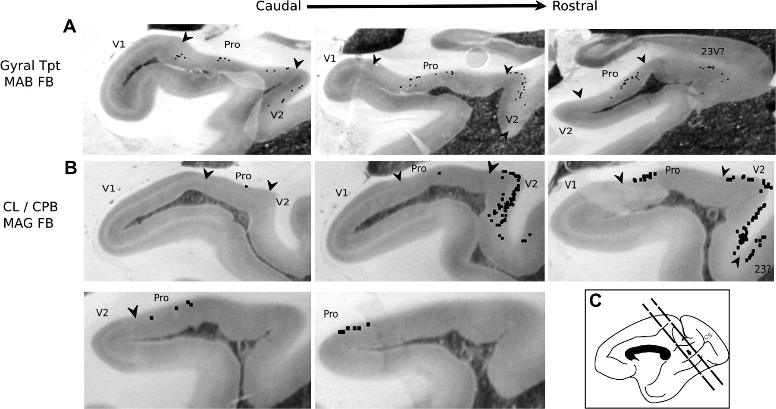
Figure 3. The distribution of individual labeled cells (black squares) produced by 2 different injections is shown, ...
Notes:
Figure 3. The distribution of individual labeled cells (black squares) produced by 2 different injections is shown, plotted directly onto photomicrographs of histological sections. In each example, consecutive 0.96-mm–spaced sections are arranged in caudal-to-rostral order. (A) Injection 16 (MAB FB) in gyral Tpt resulted in labeled cells mainly in infragranular layers in areas prostriata and V2, in 3 consecutive sections. (B) Injection 9 (MAG FB) in CL/CPB resulted in labeled cells across 5 consecutive sections, with comparatively more labeling in V2 than prostriata.
Unless provided in the caption above, the following copyright applies to the content of this slide: © The Author 2009. Published by Oxford University Press. All rights reserved. For permissions, please e-mail: journals.permissions@oxfordjournals.org

Slide 4
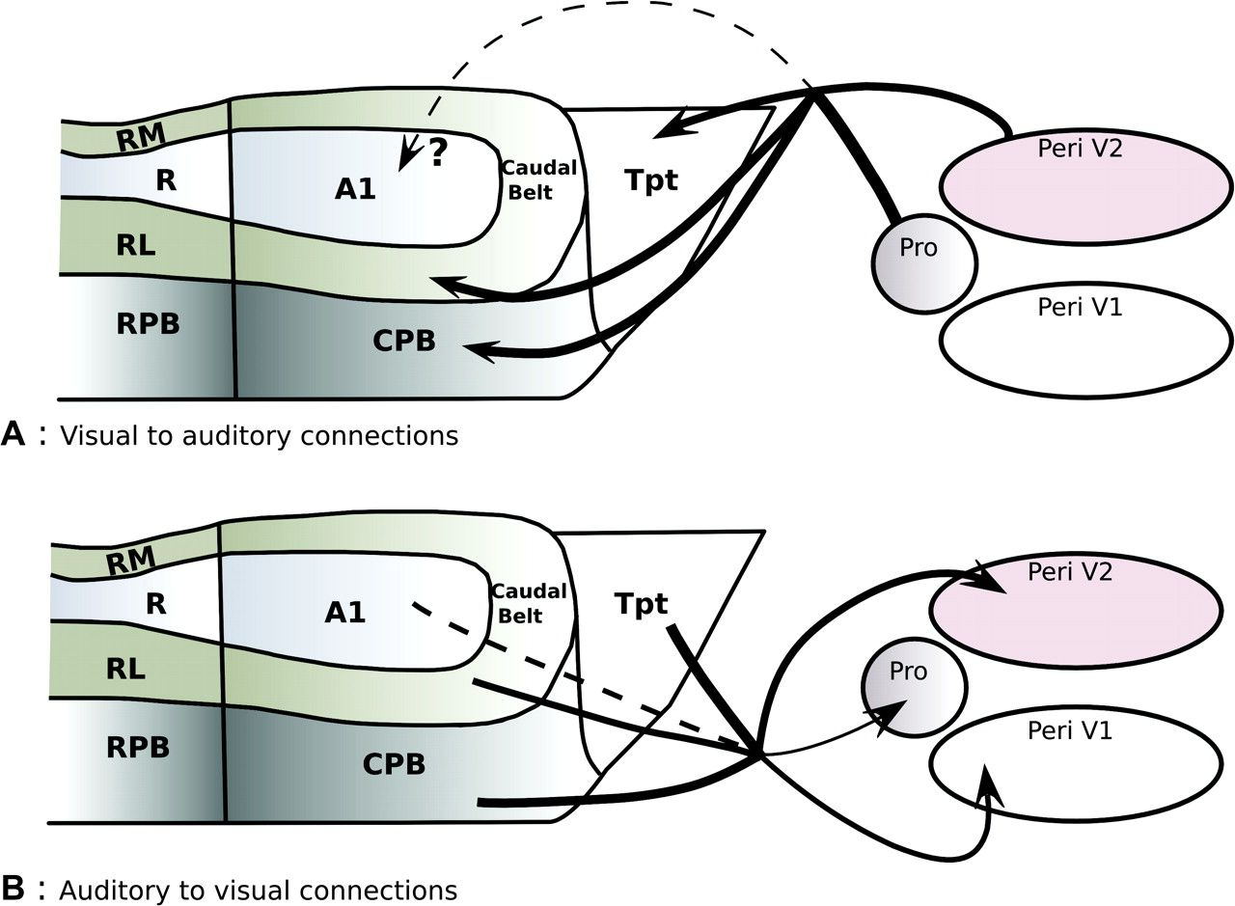
Figure 4. Summary of cortical pathways described between caudal auditory cortex and low-level visual areas. (A) The ...
Notes:
Figure 4. Summary of cortical pathways described between caudal auditory cortex and low-level visual areas. (A) The present study demonstrated projections from the peripheral visual field representation in V2 (Peri V2) and prostriata (Pro) to caudal auditory areas. (B) The reciprocal projections from caudal auditory areas to early visual areas were previously described by Falchier et al. (2002) and Rockland and Ojima (2003). The thickness of arrows is proportional to their relative abundance. Dashed lines represent weak connections (A1 to visual) or putative pathways (visual cortex to A1, upper panel).
Unless provided in the caption above, the following copyright applies to the content of this slide: © The Author 2009. Published by Oxford University Press. All rights reserved. For permissions, please e-mail: journals.permissions@oxfordjournals.org

