Slide 1
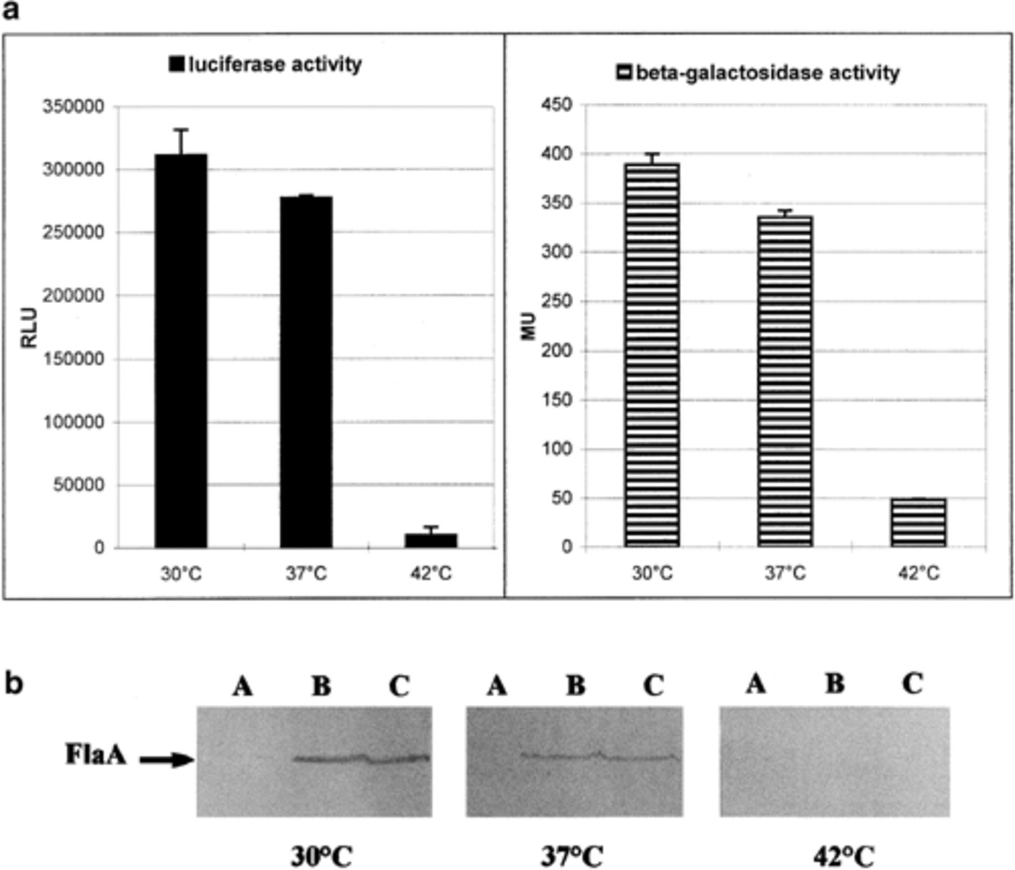
1 Effects of temperature and growth phase on flagellin expression of L. pneumophila strain Corby (pKH23, ...
Notes:
1 Effects of temperature and growth phase on flagellin expression of L. pneumophila strain Corby (pKH23, pflaA-luxAB fusion or pKH12, pflaA-lacZ fusion). To determine the effects of growth temperature on flaA expression (a), cells were grown in YEB medium at 30°C, 37°C or 42°C to the late exponential growth phase and luciferase activity (RLU) was measured. β-Galactosidase activity is given in Miller units (MU). Error bars indicate the S.E.M. obtained from three independent experiments. b: Western blot analysis of total cell extracts of bacteria grown at different temperatures (as indicated) and harvested at different growth phases using an antiflagellin antiserum: (A) exponential, (B) late exponential and (C) onset of stationary growth phase. c, d: Measurement of the OD600 for bacterial growth in YEB at 30°C (filled squares), relative light units (RLU) for the luciferase activity (open circles) and Northern blot analysis for flaA mRNA determination (D; lanes 1–4, RNA agarose gel electrophoresis; lanes 5–8, Northern blot); lanes 1, 5, 0.5 A (OD600)/10 h (h of incubation); lane 2, 6, 2.0 A/20 h; lanes 3, 7, 2.4 A/42 h; lanes 4, 8, 2.5 A/72 h.
Unless provided in the caption above, the following copyright applies to the content of this slide: © 1999 Federation of European Microbiological Societies. Published by Elsevier Science B. V. All rights reserved.

Slide 2
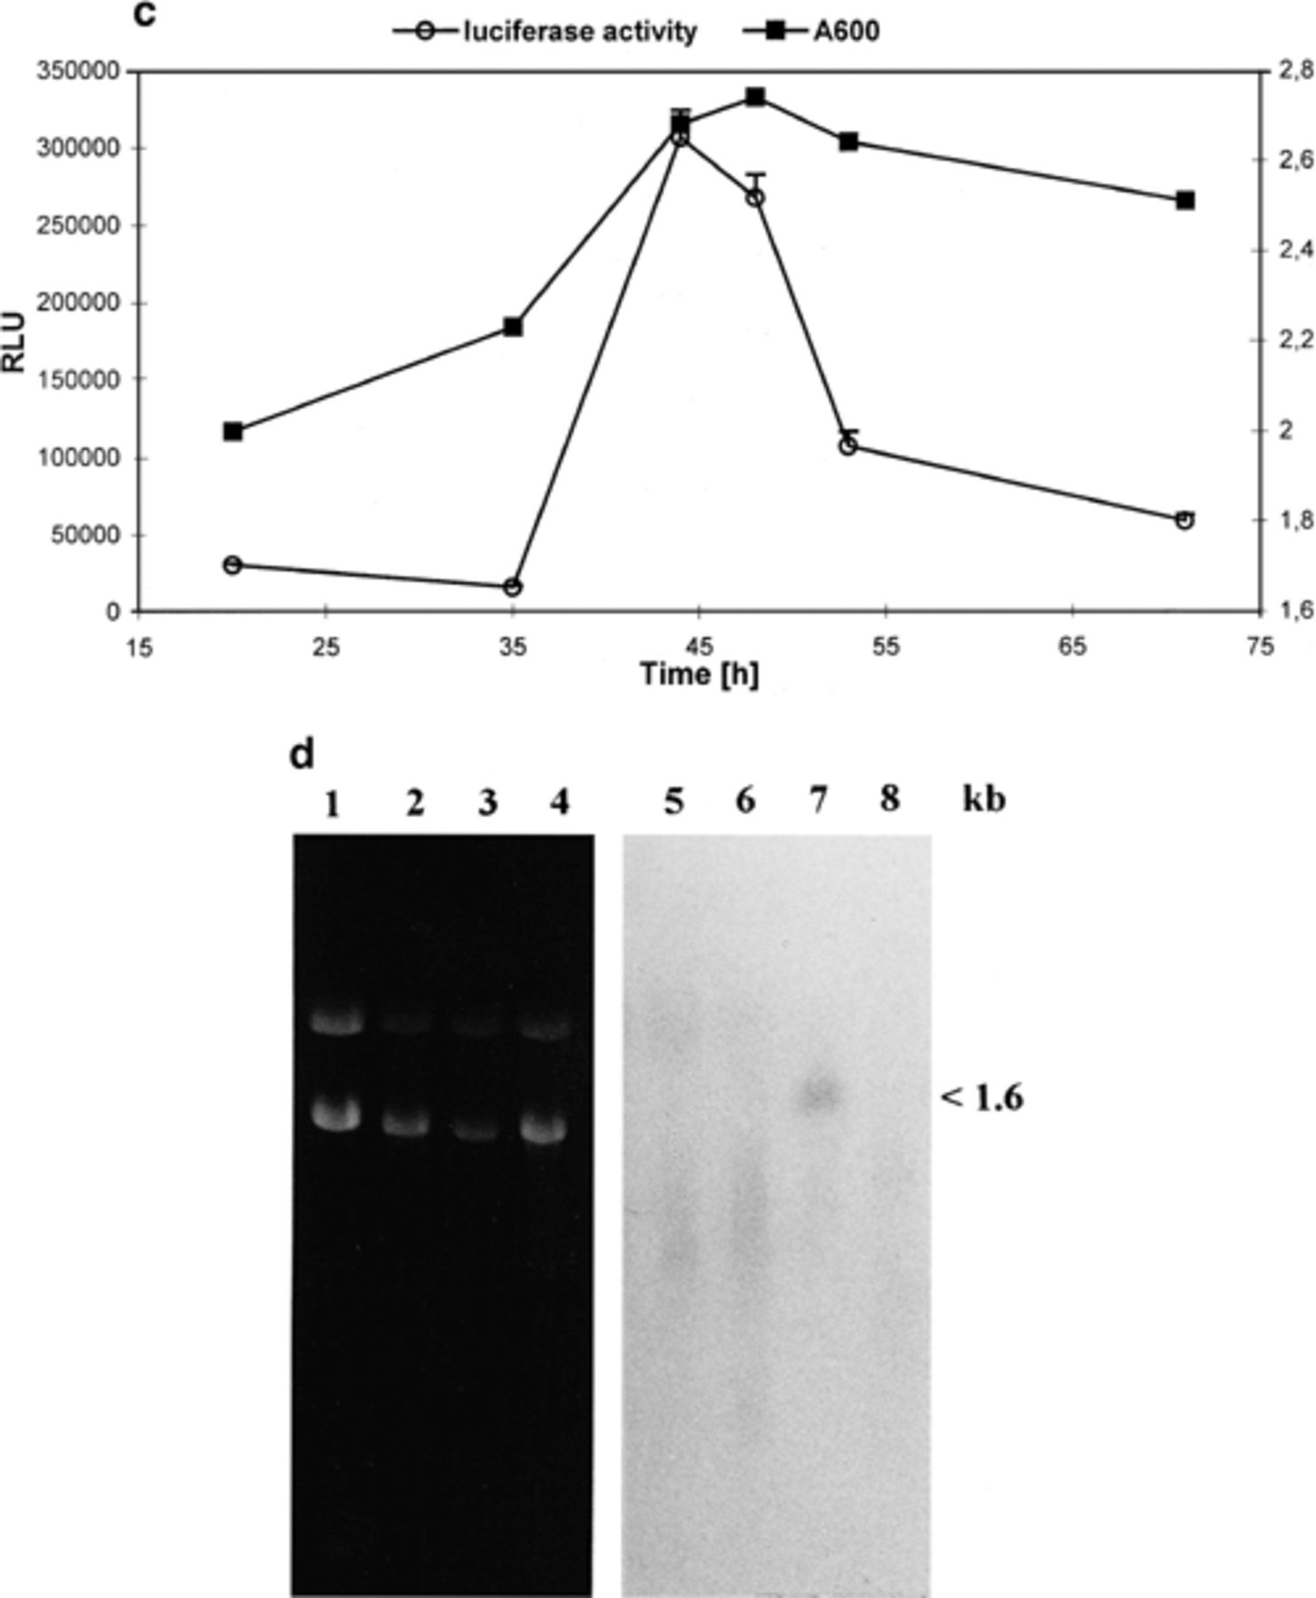
1 Effects of temperature and growth phase on flagellin expression of L. pneumophila strain Corby (pKH23, ...
Notes:
1 Effects of temperature and growth phase on flagellin expression of L. pneumophila strain Corby (pKH23, pflaA-luxAB fusion or pKH12, pflaA-lacZ fusion). To determine the effects of growth temperature on flaA expression (a), cells were grown in YEB medium at 30°C, 37°C or 42°C to the late exponential growth phase and luciferase activity (RLU) was measured. β-Galactosidase activity is given in Miller units (MU). Error bars indicate the S.E.M. obtained from three independent experiments. b: Western blot analysis of total cell extracts of bacteria grown at different temperatures (as indicated) and harvested at different growth phases using an antiflagellin antiserum: (A) exponential, (B) late exponential and (C) onset of stationary growth phase. c, d: Measurement of the OD600 for bacterial growth in YEB at 30°C (filled squares), relative light units (RLU) for the luciferase activity (open circles) and Northern blot analysis for flaA mRNA determination (D; lanes 1–4, RNA agarose gel electrophoresis; lanes 5–8, Northern blot); lanes 1, 5, 0.5 A (OD600)/10 h (h of incubation); lane 2, 6, 2.0 A/20 h; lanes 3, 7, 2.4 A/42 h; lanes 4, 8, 2.5 A/72 h.
Unless provided in the caption above, the following copyright applies to the content of this slide: © 1999 Federation of European Microbiological Societies. Published by Elsevier Science B. V. All rights reserved.

Slide 3
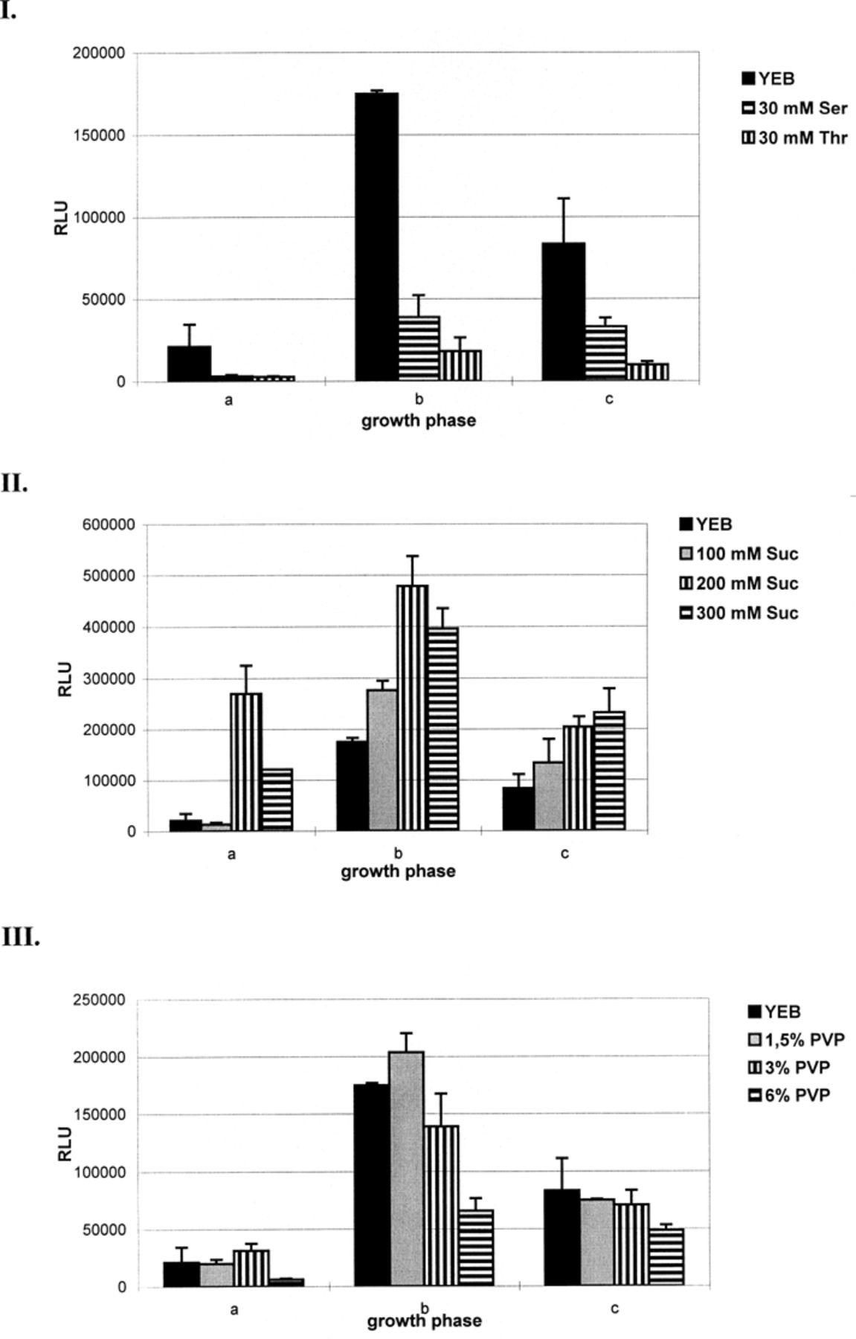
2 Effects of amino acids, osmolarity and viscosity on the flagellin expression of L. pneumophila strain Corby ...
Notes:
2 Effects of amino acids, osmolarity and viscosity on the flagellin expression of L. pneumophila strain Corby (pKH23, pflaA-luxAB fusion). I: To study the influence of the carbon source on flaA expression cells were grown in YEB medium at 37°C or supplemented with 30 mM serine (Ser) or 30 mM threonine (Thr). II: The effect of osmolarity on flaA expression was determined for cells grown in YEB medium at 37°C supplemented with 100, 200 or 300 mM sucrose (Suc). III: The significance of the viscosity of the growth medium for flaA expression of L. pneumophila was tested by adding 1.5%, 3% or 6% polyvinylpyrrolidone (PVP) to the YEB medium where cells were grown at 37°C. Cells were harvested at different growth phases: (a) exponential, (b) late exponential and (c) onset of stationary growth phase. The luciferase activity is expressed in RLU. Error bars indicate the S.E.M. obtained from three independent experiments.
Unless provided in the caption above, the following copyright applies to the content of this slide: © 1999 Federation of European Microbiological Societies. Published by Elsevier Science B. V. All rights reserved.

Slide 4
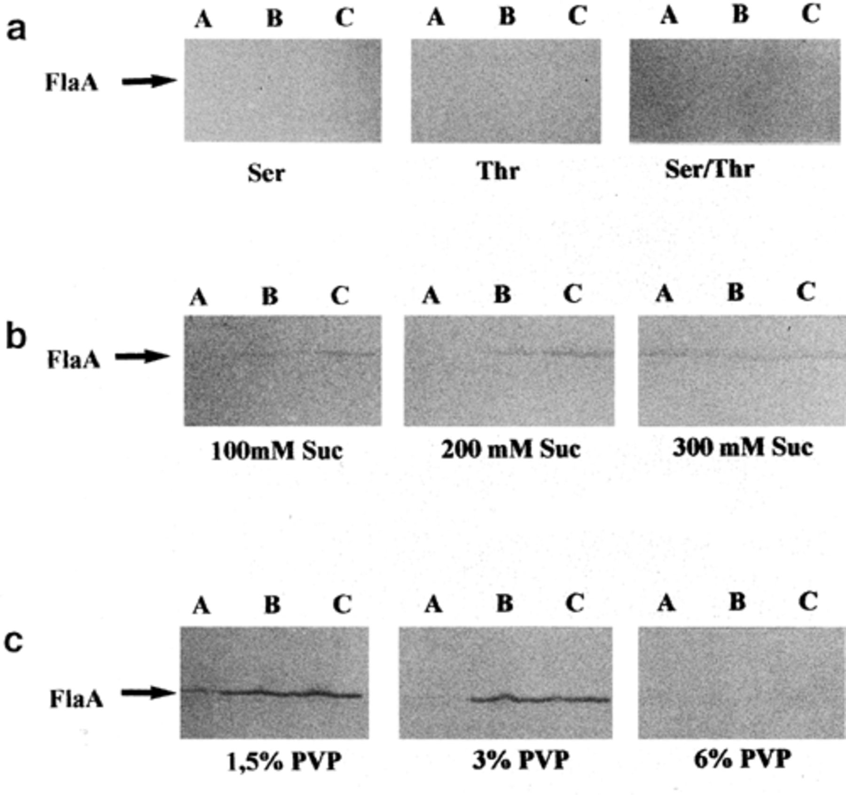
3 Western blot analysis of total cell extracts of bacteria grown at different environmental conditions: (a) YEB ...
Notes:
3 Western blot analysis of total cell extracts of bacteria grown at different environmental conditions: (a) YEB medium supplemented with 30 mM serine, 30 mM threonine or both; (b) YEB supplemented with 100, 200 or 300 mM sucrose; (c) YEB supplemented with 1.5%, 3% or 6% PVP. Cells were grown at 37°C and harvested at different growth phases: (A) exponential, (B) late exponential/onset of stationary growth phase, (C) stationary growth phase. Western blotting was performed using an antiflagellin antiserum.
Unless provided in the caption above, the following copyright applies to the content of this slide: © 1999 Federation of European Microbiological Societies. Published by Elsevier Science B. V. All rights reserved.

