Slide 1
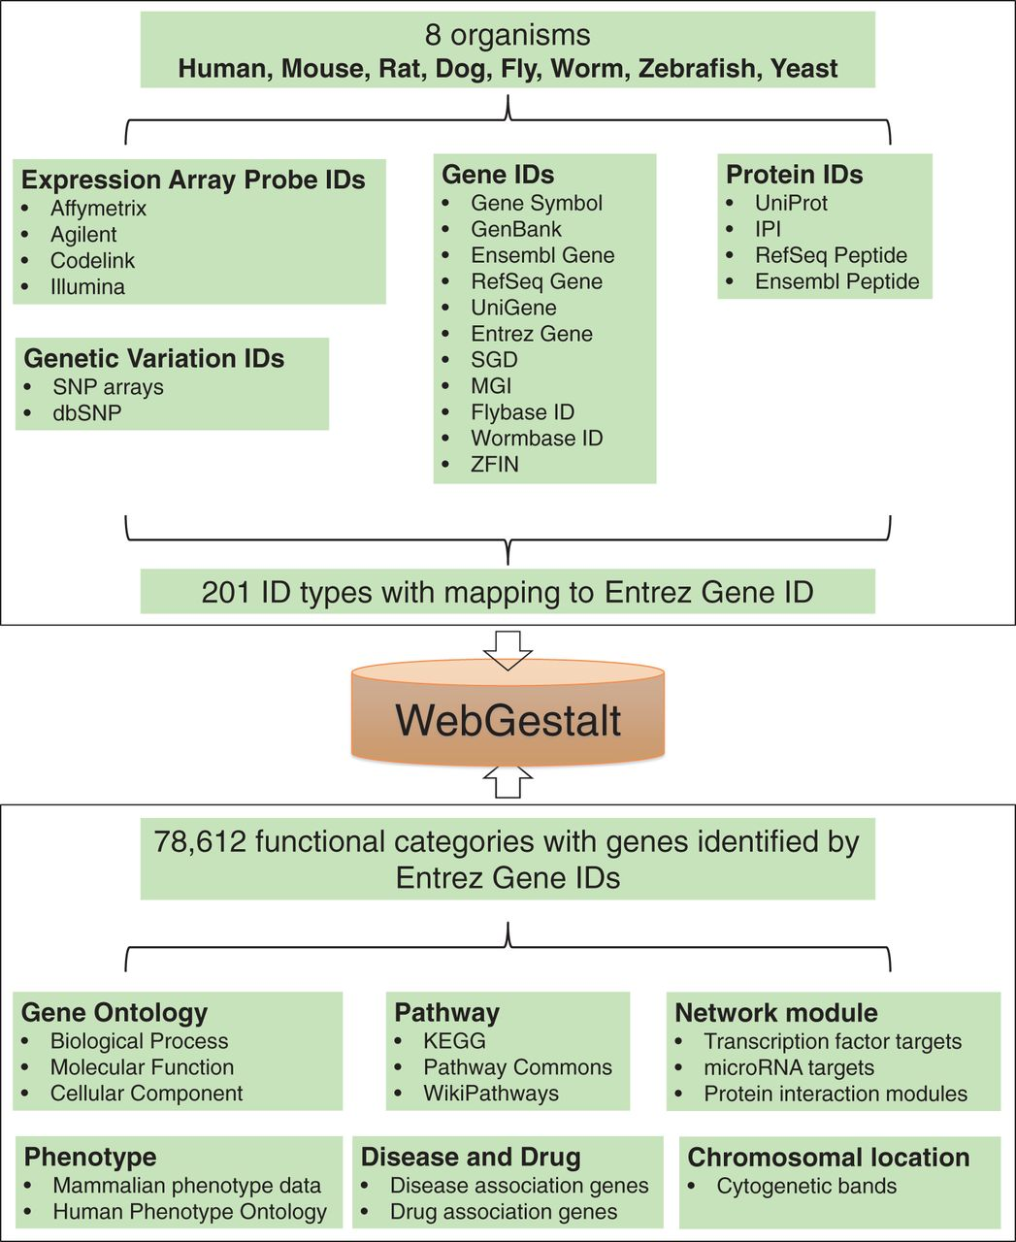
Figure 1. Summary of organisms, gene identifiers and functional categories supported by WebGestalt.
Notes:
Figure 1. Summary of organisms, gene identifiers and functional categories supported by WebGestalt.
Unless provided in the caption above, the following copyright applies to the content of this slide: © The Author(s) 2013. Published by Oxford University Press.This is an Open Access article distributed under the terms of the Creative Commons Attribution License (http://creativecommons.org/licenses/by/3.0/), which permits unrestricted reuse, distribution, and reproduction in any medium, provided the original work is properly cited.

Slide 2
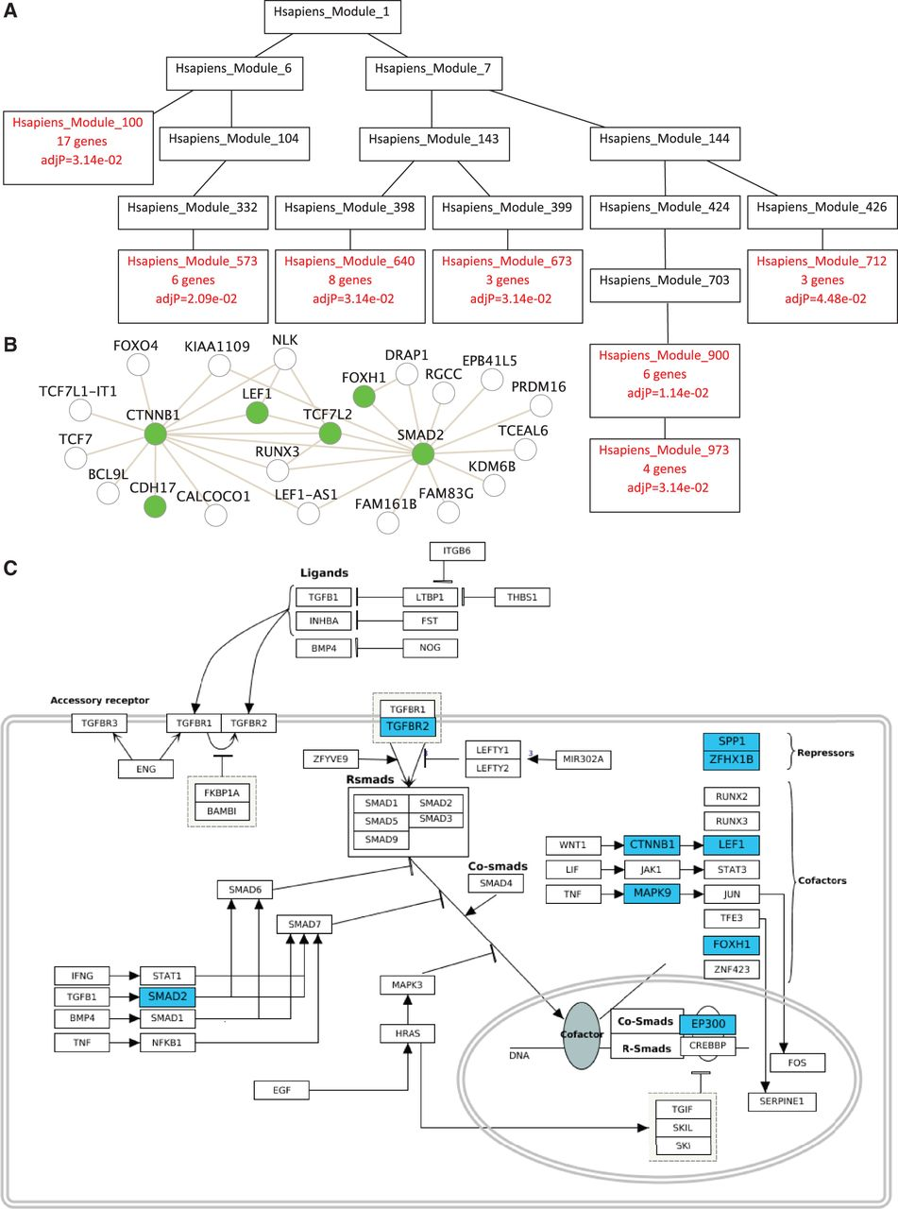
Figure 2. New visualization features in WebGestalt. (A) Visualization of the enriched protein interaction network ...
Notes:
Figure 2. New visualization features in WebGestalt. (A) Visualization of the enriched protein interaction network modules in a DAG. (B) Visualization of input genes and their direct neighbors in an enriched module using a node-link diagram. (C) Visualization of input genes in an enriched pathway from the WikiPathways database.
Unless provided in the caption above, the following copyright applies to the content of this slide: © The Author(s) 2013. Published by Oxford University Press.This is an Open Access article distributed under the terms of the Creative Commons Attribution License (http://creativecommons.org/licenses/by/3.0/), which permits unrestricted reuse, distribution, and reproduction in any medium, provided the original work is properly cited.

