Slide 1
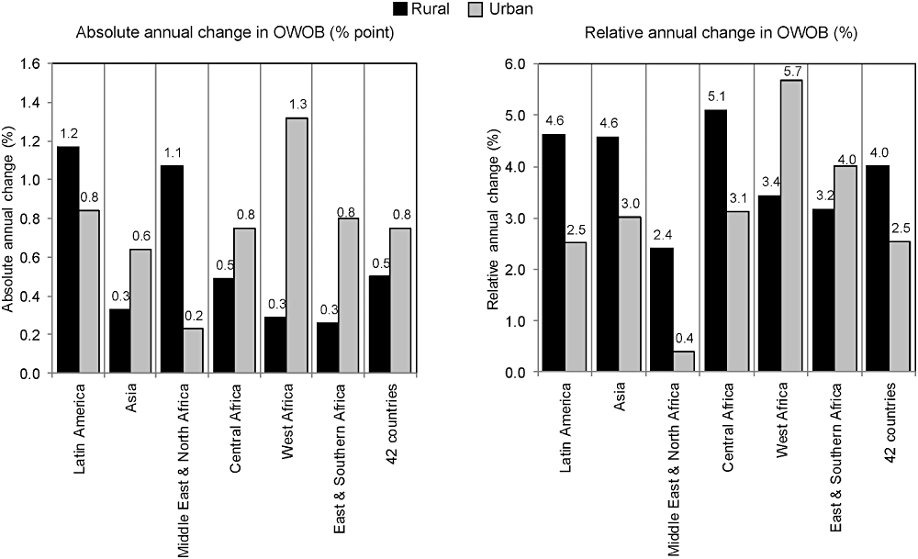
Figure 1 Absolute and relative annual percentage-point changes in weighted prevalence of overweight and obesity ...
Notes:
Figure 1 Absolute and relative annual percentage-point changes in weighted prevalence of overweight and obesity (BMI ≥ 25) among women in rural and urban areas of 42 countries by region (N = 42).
Unless provided in the caption above, the following copyright applies to the content of this slide: © 2012 International Life Sciences Institute

