Slide 1
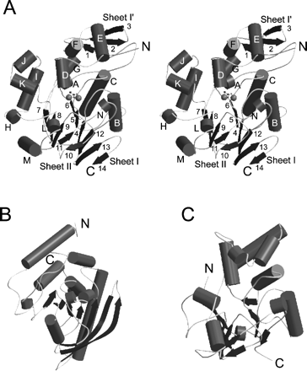
Fig. 1. The overall structures of CAPTPase, and other PTPase and PS/TPase. (A) The overall structure of ...
Notes:
Fig. 1. The overall structures of CAPTPase, and other PTPase and PS/TPase. (A) The overall structure of native CAPTPase is shown as a stereo representation. Spheres represent metal ions. (B) and (C) show the overall structures of yersinia PTPase and λPS/TPase, respectively. α-Helices and β-strands are represented by cylinders and arrows, respectively.
Unless provided in the caption above, the following copyright applies to the content of this slide:

Slide 2
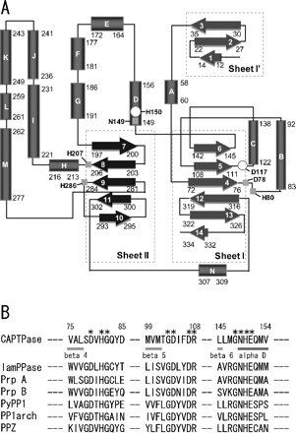
Fig. 2. Secondary structure diagram (A) and the conserved amino acid residues (B) of CAPTPase. (A) α-Helices ...
Notes:
Fig. 2. Secondary structure diagram (A) and the conserved amino acid residues (B) of CAPTPase. (A) α-Helices and β-strands are represented by boxes and arrows, respectively. Numbers indicate the residue numbers at the beginning and end of the respective secondary structures. Circles and squares represent the residues (His150 and Asp117) essential for the catalysis and those involved in the binding of metal ions, respectively. (B) Each amino acid is shown in a one-letter code. The numbers above the alignments correspond to the amino acid numbers for the N-terminus of CAPTPase expressed in E. coli. Asterisks indicate amino acids identical in all phosphatases. Dark and light grey represent α-helix D, and β-strands 4, 5, and 6 of CAPTPase, respectively. CAPTPase, cold-active protein-tyrosine phosphtase (18); lamPPase, bacteriophage λ protein-phosphatase (19); Prp A and PrpB, E. coli phosphoprotein phosphatases (38); PyPP1, P. abyssi protein-serine/threonine phosphatase (39); PP1arch, S. solfataricus protein-serine/threonine phosphatase (40); PPZ, S. cerevisiae phosphoprotein phosphatase PP-Z1 (41).
Unless provided in the caption above, the following copyright applies to the content of this slide:

Slide 3
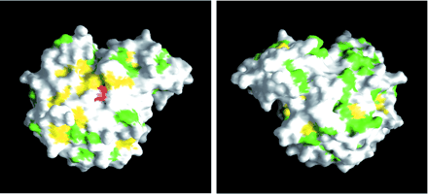
Fig. 3. Moleculer surface of CAPTPase. The right-hand view shows the left-hand view rotated by 180°. Metal ...
Notes:
Fig. 3. Moleculer surface of CAPTPase. The right-hand view shows the left-hand view rotated by 180°. Metal ions in the catalytic site are shown in red. The aromatic and hydrophobic residues on the surface of CAPTPase are colored yellow and green, respectively.
Unless provided in the caption above, the following copyright applies to the content of this slide:

Slide 4
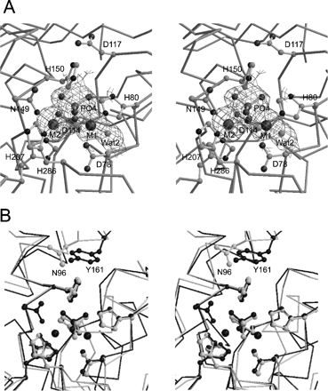
Fig. 4. Stereoviews of the catalytic site of P_{i}-bound CAPTPase. (A) The side chains of the ...
Notes:
Fig. 4. Stereoviews of the catalytic site of Pi-bound CAPTPase. (A) The side chains of the residues essential for the catalytic reaction and metal binding are represented on the main chain. Large spheres indicate metal ions. An |Fo| – |Fc| omit map around the phosphate and metal ions is plotted at +1.5σ. (B) The main chains and side chains of the amino acid residues, phosphate/sulfate ions, and metal ions, which are located at the catalytic sites of Pi-bound CAPTPase and λPS/TPase, are shown in black and grey, respectively, as a stereo representation.
Unless provided in the caption above, the following copyright applies to the content of this slide:

Slide 5
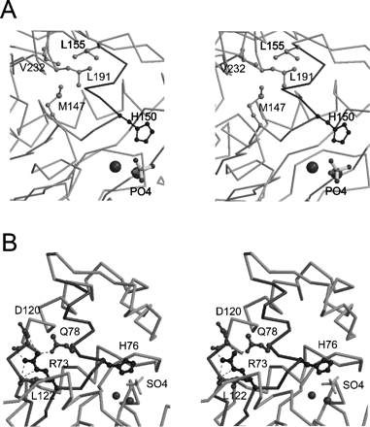
Fig. 5. Stereoviews of the loop structures located behind the catalytic sites of CAPTPase and λPS/TPase. (A) ...
Notes:
Fig. 5. Stereoviews of the loop structures located behind the catalytic sites of CAPTPase and λPS/TPase. (A) The structure around αD (dark grey) of CAPTPase is shown with the side chains of Met147, Leu155, Leu191 and Val232 (light grey), and His150 (black). (B) The structure of λPS/TPase is shown with the side chains of Gln78, Asp120, Leu122, Arg73 and His76 (black). The latter histidine residue corresponds to His150 in CAPTPase. Spheres are metal ions in CAPTPase and λPS/TPase.
Unless provided in the caption above, the following copyright applies to the content of this slide:

