Slide 1
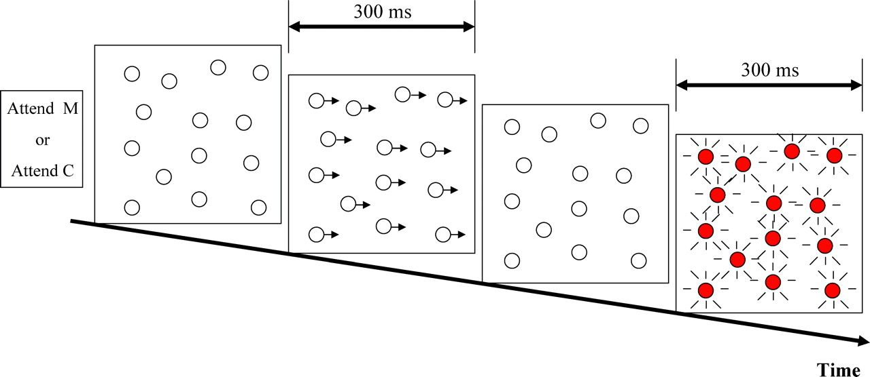
Figure 1. Schematic diagram of the experimental design. Each block of trials started with a symbolic cue indicating the ...
Notes:
Figure 1. Schematic diagram of the experimental design. Each block of trials started with a symbolic cue indicating the stimulus feature to be attended (motion or color). The dots were stationary in the interstimulus interval and then either moved rightwards or changed color for 300 ms. Motion and color stimuli were presented equiprobably, in random order. For each feature there were 2 alternative stimuli (fast vs. slow movement and red vs. orange color change). Subjects were instructed to press a button as quickly as possible upon detecting fast motion when motion was the attended feature or the orange color change when color was the attended feature.
Unless provided in the caption above, the following copyright applies to the content of this slide: © The Author 2007. Published by Oxford University Press. All rights reserved. For permissions, please e-mail: journals.permissions@oxfordjournals.org

Slide 2
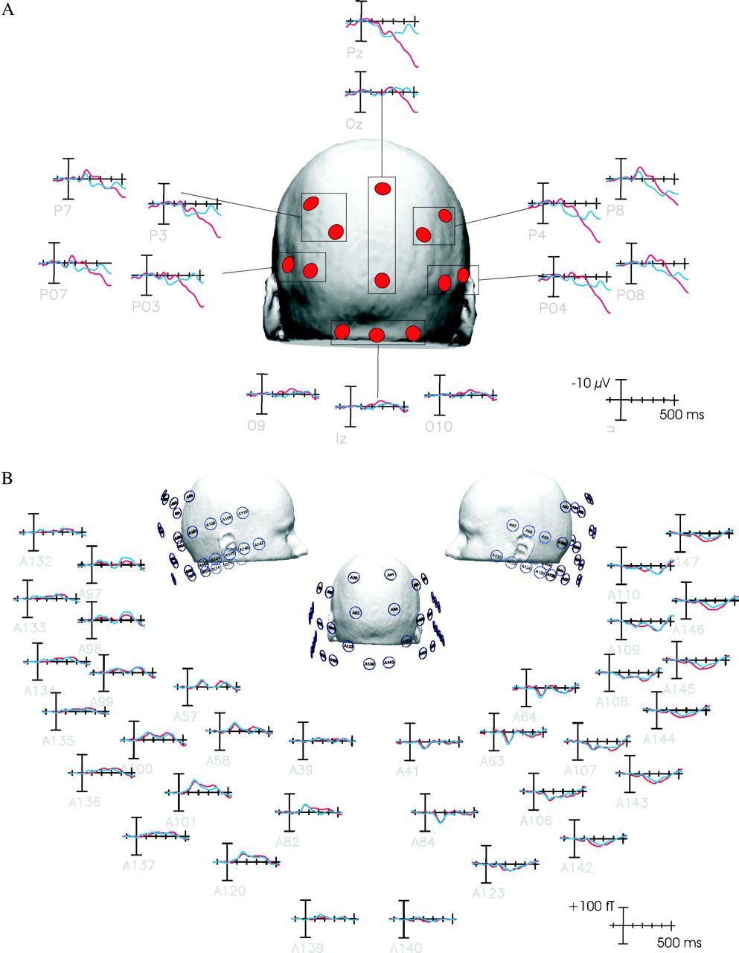
Figure 2. (A) ERP waveforms elicited by the motion stimulus under attended (red tracings) and unattended (blue ...
Notes:
Figure 2. (A) ERP waveforms elicited by the motion stimulus under attended (red tracings) and unattended (blue tracings) conditions, averaged over all subjects. (B) ERF waveforms elicited by the motion stimulus under attended and unattended conditions, averaged over all subjects.
Unless provided in the caption above, the following copyright applies to the content of this slide: © The Author 2007. Published by Oxford University Press. All rights reserved. For permissions, please e-mail: journals.permissions@oxfordjournals.org

Slide 3
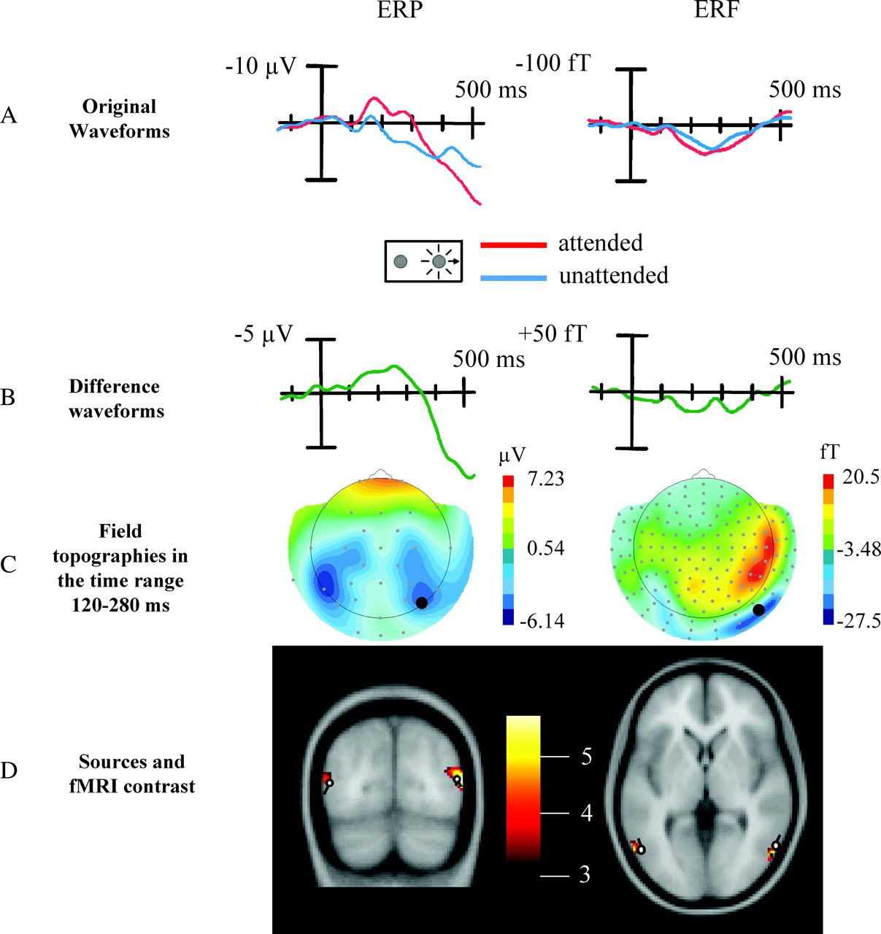
Figure 3. The effect of attention on the processing of motion. (A) Concurrently recorded ERP and ERF waveforms elicited ...
Notes:
Figure 3. The effect of attention on the processing of motion. (A) Concurrently recorded ERP and ERF waveforms elicited by the slow motion stimulus (standards) when motion was attended (red tracings) and unattended (blue tracings), averaged over all subjects. Time zero of recording epoch is when the dot array begins to move. Recording sites are indicated with dots on part C. (B) Difference waveforms formed by subtracting the unattended from the attended waveforms shown in part A. (C) Topographical field distributions of the ERP and ERF difference waveforms shown in part B averaged over the time range 110–280 ms. (D) Locations of estimated source dipoles accounting for the surface topography of the difference waveforms shown in part C coregistered with fMRI activations in the corresponding contrast (attended vs. unattended motion trials).
Unless provided in the caption above, the following copyright applies to the content of this slide: © The Author 2007. Published by Oxford University Press. All rights reserved. For permissions, please e-mail: journals.permissions@oxfordjournals.org

Slide 4
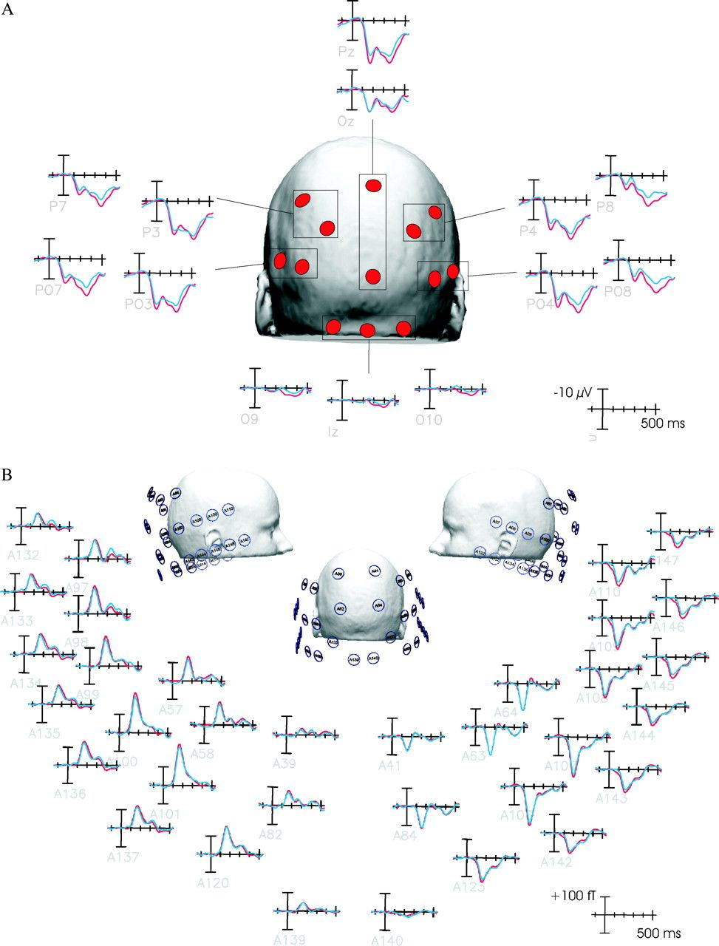
Figure 4. (A) ERP waveforms elicited by the standard color change stimulus under attended (red tracings) and unattended ...
Notes:
Figure 4. (A) ERP waveforms elicited by the standard color change stimulus under attended (red tracings) and unattended (blue tracings) conditions averaged over all subjects. (B) ERF waveforms elicited by the color change stimulus in attended and unattended conditions averaged over all subjects.
Unless provided in the caption above, the following copyright applies to the content of this slide: © The Author 2007. Published by Oxford University Press. All rights reserved. For permissions, please e-mail: journals.permissions@oxfordjournals.org

Slide 5
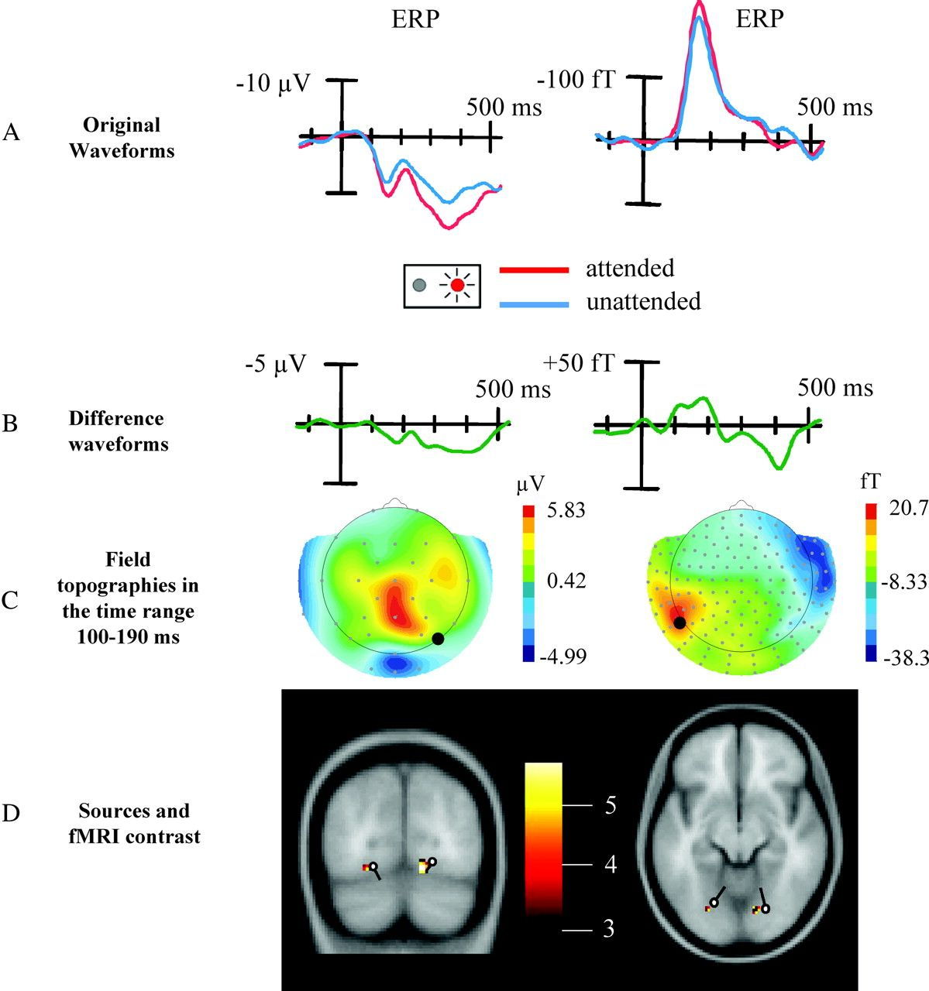
Figure 5. The effect of attention on the processing of color. (A) Concurrently recorded ERP and ERF waveforms elicited ...
Notes:
Figure 5. The effect of attention on the processing of color. (A) Concurrently recorded ERP and ERF waveforms elicited by the standard color change (to red) stimulus averaged over all subjects on trials when color was attended (red tracings) and unattended (blue tracings). (B) Difference waveforms formed by subtracting the unattended from the attended waveforms shown in part A. (C) Topographical field distributions of difference ERP and ERF waveforms shown in part B averaged over the time range 105–210 ms. (D) Locations of estimated source dipoles accounting for the surface topography of the difference ERP and ERF waveforms shown in part C coregistered with fMRI activations in the corresponding contrast (attended vs. unattended color trials). Note that given the orientation of the dipolar sources, the magnetic field configurations elicited by each source are very similar (left positivity–right negativity shown in part C) but are spatially shifted corresponding to the distance between the source locations. This results in an overlap of a negative (from the source located in the left fusiform gyrus) and a positive magnetic field (from the source located in the right fusiform gyrus) in the central part of the topographical distribution canceling each other out. Consequently, a nearly isoelectric field distribution can be observed centrally.
Unless provided in the caption above, the following copyright applies to the content of this slide: © The Author 2007. Published by Oxford University Press. All rights reserved. For permissions, please e-mail: journals.permissions@oxfordjournals.org

Slide 6
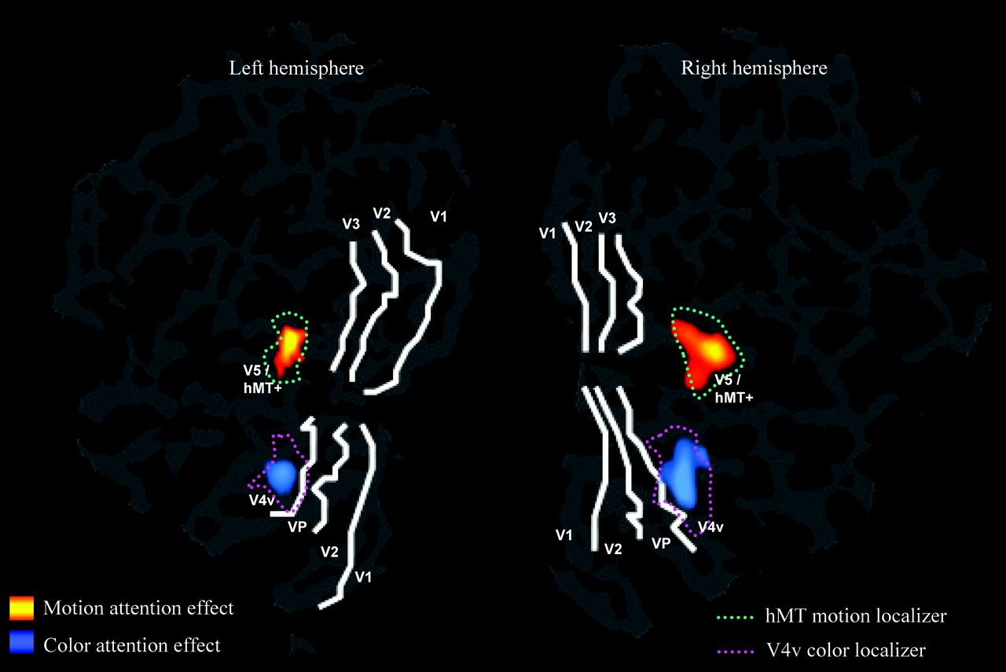
Figure 6. Hemodynamic attention effects of a representative subject projected on flattened cortical surfaces of the 2 ...
Notes:
Figure 6. Hemodynamic attention effects of a representative subject projected on flattened cortical surfaces of the 2 hemispheres. The event-related hemodynamic activation for the contrast attended versus unattended motion is shown in red. The corresponding activation for the contrast attended versus unattended color is shown in blue. The borders between the visual areas were defined by retinotopic mapping. Motion (green dotted line) and color (pink dotted line) localizers were obtained by contrasting all moving and all color change stimuli, respectively, versus the stationary isoluminant gray stimuli in the baseline. Note that the localizers also elicited activity to a smaller extent in earlier visual areas (V1, V2, V3, V3a) not shown in the figure.
Unless provided in the caption above, the following copyright applies to the content of this slide: © The Author 2007. Published by Oxford University Press. All rights reserved. For permissions, please e-mail: journals.permissions@oxfordjournals.org

