Slide 1
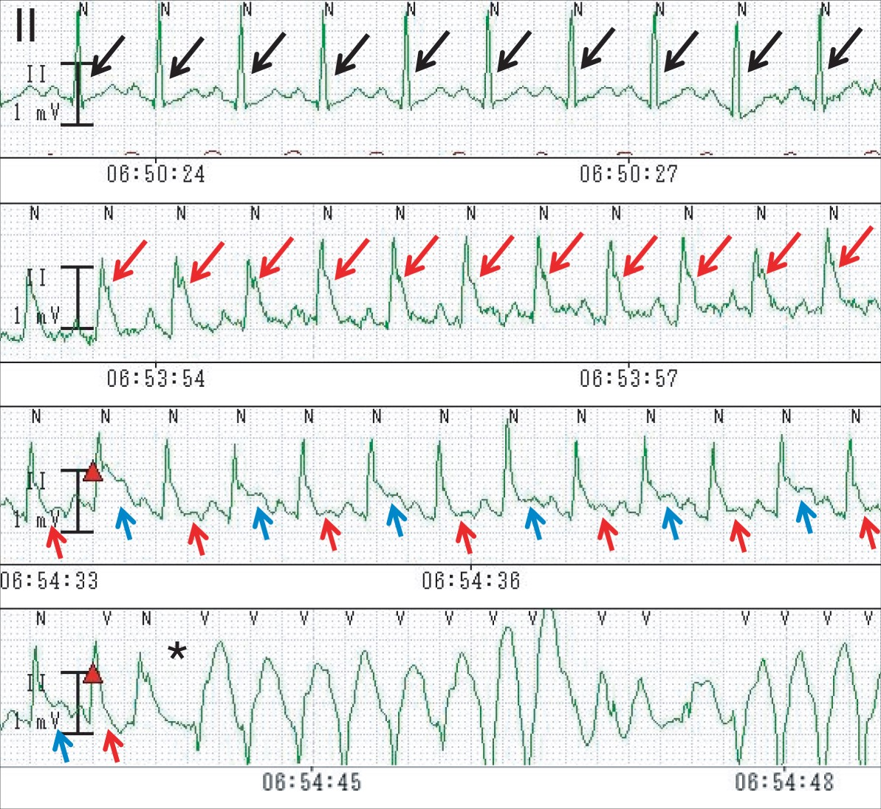
Notes:
Unless provided in the caption above, the following copyright applies to the content of this slide: Published on behalf of the European Society of Cardiology. All rights reserved. © The Author 2017. For permissions please email: journals.permissions@oup.com.

