Slide 1
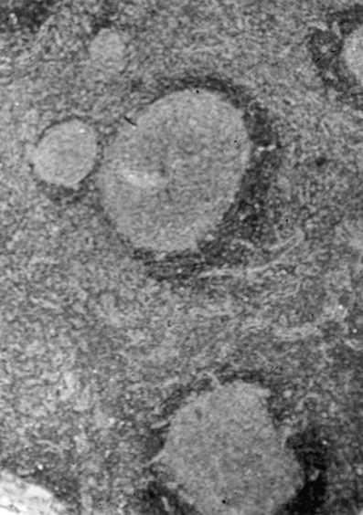
Figure 1 A lymph node biopsy specimen from a patient with HIV-related multicentric Castleman's disease; the stained ...
Notes:
Figure 1 A lymph node biopsy specimen from a patient with HIV-related multicentric Castleman's disease; the stained preparation shows germinal center hyperplasia with a diminished mantle zone (hematoxy-lin-eosin stain; original magnification, ×250).
Unless provided in the caption above, the following copyright applies to the content of this slide: © 2000 by the Infectious Diseases Society of America

Slide 2
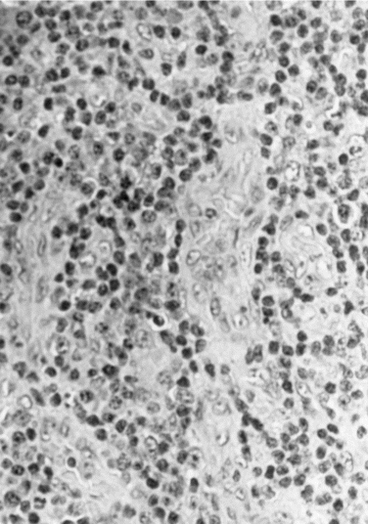
Figure 2 A lymph node biopsy specimen from a patient with HIV-related multicentric Castleman's disease; the stained ...
Notes:
Figure 2 A lymph node biopsy specimen from a patient with HIV-related multicentric Castleman's disease; the stained preparation shows vascular proliferation and plasmacytosis (hematoxylin-eosin stain; original magnification, ×400).
Unless provided in the caption above, the following copyright applies to the content of this slide: © 2000 by the Infectious Diseases Society of America

