Slide 1
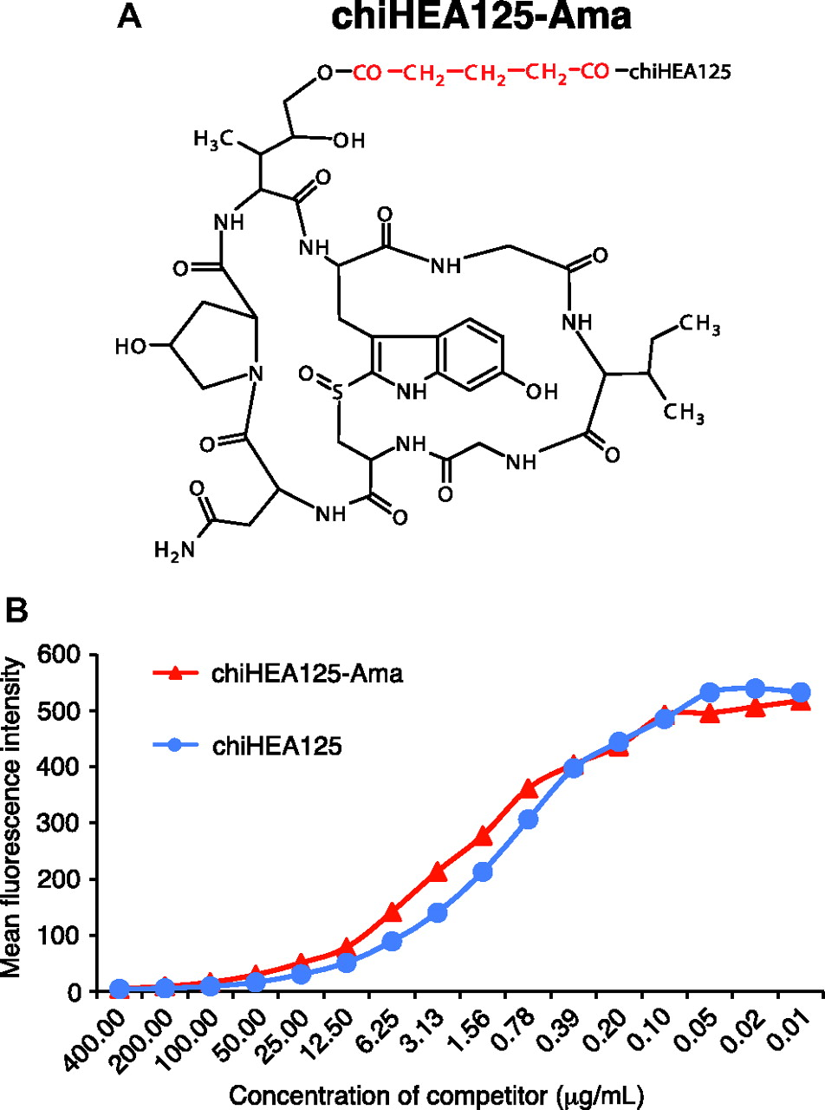
Figure 1 Structure and binding of α-amanitin-conjugated chiHEA125 monoclonal antibody to epithelial cell adhesion ...
Notes:
Figure 1 Structure and binding of α-amanitin-conjugated chiHEA125 monoclonal antibody to epithelial cell adhesion molecule (EpCAM). The antibody–drug conjugate chiHEA125-Ama was generated by a chemical cross-linking of a toxin α-amanitin with chiHEA125, a chimerized anti-EpCAM monoclonal antibody using glutarate as a linker. Binding of chiHEA125-Ama vs nonconjugated chiHEA125 antibody to EpCAM-expressing Colo205 colon cancer cells was analyzed in a binding competition assay by flow cytometry. A ) Structure of chiHEA125-Ama and α-amanitin conjugation site for chiHEA125 immunoglobulin G (IgG). B ) Binding of α-amanitin-conjugated chiHEA125 IgG (chiHEA125-Ama) and parental nonconjugated chiHEA125 IgG to the target antigen EpCAM using Colo205 cells. Cells (2 × 10 7 cells per mL) were incubated with serial dilutions of chiHEA125-Ama or chiHEA125 ranging from 400 μg/mL to 10 ng/mL of IgG at final dilution and analyzed by flow cytometry. Mean fluorescence intensity was quantified using CellQuest software. Results are representatives of two independent experiments performed in triplicate. Ama = α-amanitin.
Unless provided in the caption above, the following copyright applies to the content of this slide: © The Author 2012. Published by Oxford University Press.

Slide 2
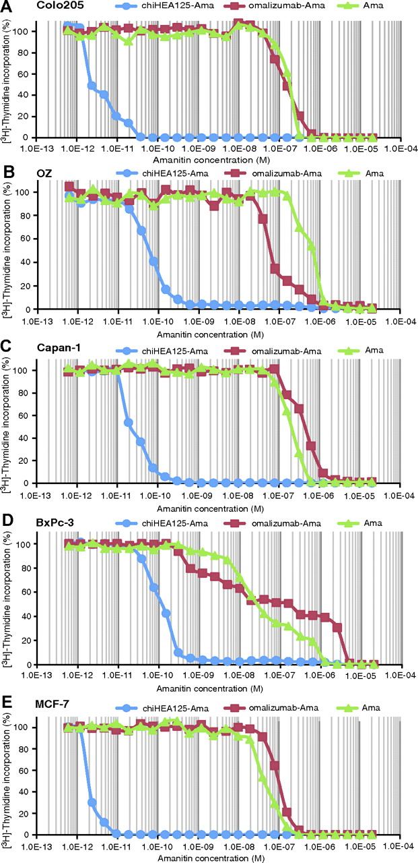
Figure 2 Effect of chiHEA125-Ama on proliferation of multiple carcinoma cell lines in vitro. Effect of chiHEA125-Ama ...
Notes:
Figure 2 Effect of chiHEA125-Ama on proliferation of multiple carcinoma cell lines in vitro. Effect of chiHEA125-Ama on cancer cells proliferation was analyzed by a standard [ 3 H]-thymidine incorporation assay. ChiHEA125-Ama, control α-amanitin-conjugated anti-human IgE monoclonal antibody (omalizumab-Ama) and unconjugated α-amanitin were added to cultured carcinoma cells at the indicated doses and the percentage of [ 3 H]-thymidine incorporating cells was evaluated after 96 hours of incubation. The logarithmic x -axis shows the concentrations of chiHEA125-Ama, omalizumab-Ama, and free α-amanitin in a scale. A ) Human colorectal cancer cell line Colo205. B ) Human bile duct cancer cell line OZ. C ) Human pancreatic cell line Capan-1. D ) Human pancreatic cell line BxPc-3. E ) Human breast cancer cell line MCF-7. Results are representatives of six independent experiments with MCF-7 cells, four independent experiments with Capan-1, three independent experiments with BxPc-3 and OZ cells, and one independent experiment with Colo205 cells, all performed in triplicate. Ama = α-amanitin.
Unless provided in the caption above, the following copyright applies to the content of this slide: © The Author 2012. Published by Oxford University Press.

Slide 3
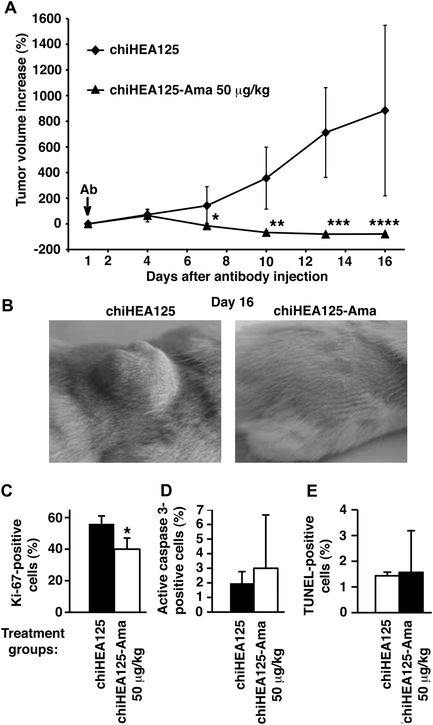
Figure 3 Efficiency of a single dose of chiHEA125-Ama on BxPc-3 tumor growth in vivo. Mice bearing 10-day-old ...
Notes:
Figure 3 Efficiency of a single dose of chiHEA125-Ama on BxPc-3 tumor growth in vivo. Mice bearing 10-day-old xenograft BxPc-3 pancreatic carcinomas received a single intraperitoneal injection of chiHEA125-Ama at a dose of 50 μg/kg with respect to α-amanitin (corresponding to 2.0 mg IgG/kg) (n = 6 mice). Control mice received unconjugated chiHEA125 monoclonal antibody (15 mg/kg) (n = 4 mice). A ) Tumor growth was measured every third day, and data are presented as a relative tumor volume increase starting from treatment initiation. Error bars correspond to 95% confidence intervals. * P = .04, ** P = .01, *** P = .005, **** P = .019; calculated using a two-sided Student's t test. An arrow indicates time of chiHEA125 or chiHEA125-Ama administration. B ) Representative BxPc-3 tumors at the endpoint of the treatment, day 16. Magnification = ×2.5. C ) Proliferation of tumor cells in BxPc-3 tumors that were visually detectable after chiHEA125-Ama treatment was investigated by immunohistochemistry for Ki-67 on day 16. Ki-67-positive cells were counted under ×400 magnification in 10 random fields of vision (n = 3–4 mice per group). Data are presented as the percentage of Ki-67-positive cells per total tumor cellular mass. * P = .0014; calculated using a two-sided Student's t test. Error bars correspond to upper 95% confidence intervals. D ) Analysis of apoptosis in BxPc-3 tumors that were visually detectable after chiHEA125-Ama treatment using immunohistochemical staining for active caspase 3. Error bars correspond to upper 95% confidence intervals. E ) Analysis of apoptosis in BxPc-3 tumors using a Terminal Deoxynucleotidyl Transferase dUTP Nick End Labeling (TUNEL) assay. Active caspase 3–positive and TUNEL-positive cells were counted under ×400 magnification in 10 random fields of vision (n = 3–4 mice per group). Data are presented as the percentage of positive cells per total tumor cellular mass. Error bars correspond to upper 95% confidence intervals. Ama = α-amanitin.
Unless provided in the caption above, the following copyright applies to the content of this slide: © The Author 2012. Published by Oxford University Press.

Slide 4
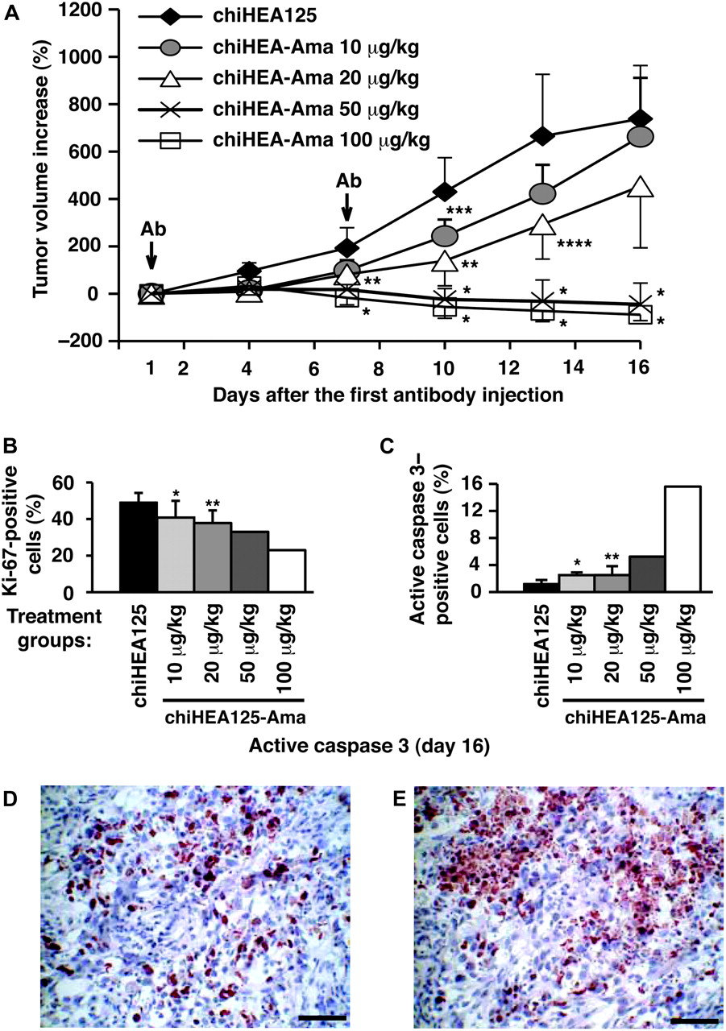
Figure 4 Efficiency of two doses of chiHEA125-Ama on BxPc-3 tumor growth in vivo. Dose titration experiments with two ...
Notes:
Figure 4 Efficiency of two doses of chiHEA125-Ama on BxPc-3 tumor growth in vivo. Dose titration experiments with two intraperitoneal injections of chiHEA125-Ama, administered 1 week apart. Mice bearing 10-day-old xenograft BxPc-3 tumors received intraperitoneal injections of chiHEA125-Ama (10, 20, 50, and 100 μg/kg, corresponding to 0.4, 0.8, 2.0, or 4.0 mg IgG/kg, respectively; n = 8, 7, 10, 10 mice per group, respectively) or control unconjugated chiHEA125 monoclonal antibody (5 mg/kg) (n = 9 mice). A ) Tumor growth was measured every third day, and data are presented as a relative tumor volume increase after the first antibody injection. Error bars correspond to upper or lower 95% confidence intervals. * P < .001, ** P = .001, *** P = .019, **** P = .013 (two-sided Student's t test). Arrows indicate time of chiHEA125 or chiHEA125-Ama (antibody) administration. B ) Effects of different doses of chiHEA125-Ama (10 μg/kg, n = 5 mice; 20 μg/kg, n = 5 mice; 50 μg/kg, n = 2 mice; and 100 μg/kg, n = 1 mouse, corresponding to 0.4, 0.8, 2.0, or 4.0 mg IgG/kg, respectively) and unconjugated chiHEA125 antibodies (5 mg/kg, n = 5 mice) on cell proliferation in BxPc-3 tumors that were visually detectable after chiHEA125-Ama treatment were analyzed by immunohistochemistry on day 16. C ) Effects of different doses of chiHEA125-Ama (10 μg/kg, n = 5 mice; 20 μg/kg, n = 5 mice; 50 μg/kg, n = 2 mice; and 100 μg/kg, n = 1 mouse, corresponding to 0.4, 0.8, 2.0, or 4.0 mg IgG/kg, respectively) and unconjugated chiHEA125 Abs (5 mg/kg, n = 5 mice) on tumor cell apoptosis in BxPc-3 tumors that were visually detectable after chiHEA125-Ama treatment were analyzed by immunohistochemistry on day 16. Ki-67-positive or active caspase 3–positive cells were counted under ×400 magnification in 10 random fields of vision. Data are presented as the percentage of positive cells per total tumor cellular mass. * P = .045, ** P = .006 (for active caspase 3, * P < .001 and ** P = .036) (two-sided Student's t test). Error bars correspond to upper 95% confidence intervals. D ) Representative images of active caspase 3 staining of BxPc-3 tumor treated with two injections of chiHEA125-Ama at a dose of 100 μg/kg at the endpoint of the experiment at day 16. E ) There were areas within the tumor with almost 50%–70% of active caspase 3–positive tumor cells ( red ). Scale bar = 50 μm. Ama = α-amanitin.
Unless provided in the caption above, the following copyright applies to the content of this slide: © The Author 2012. Published by Oxford University Press.

Slide 5
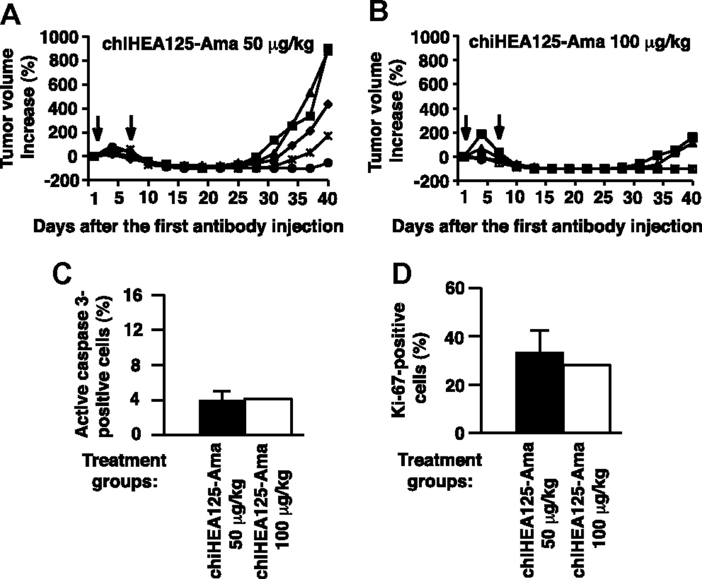
Figure 5 Long-term efficiency of two injections of chiHEA125-Ama at doses of 50 and 100 μg/kg of α-amanitin on BxPc-3 ...
Notes:
Figure 5 Long-term efficiency of two injections of chiHEA125-Ama at doses of 50 and 100 μg/kg of α-amanitin on BxPc-3 tumor growth in vivo. BxPc-3 tumor growth recurrence after two intraperitoneal injections of chiHEA125-Ama, administered 1 week apart, was monitored for a period of 40 days after the first chiHEA125-Ama injection. A ) Mice bearing 10-day-old xenograft BxPc-3 tumors (n = 5 mice) received two intraperitoneal injections of chiHEA125-Ama at a dose of 50 μg/kg, corresponding to 2.0 mg IgG/kg. B ) Mice bearing 10-day-old xenograft BxPc-3 tumors (n = 5 mice) received two intraperitoneal injections of chiHEA125-Ama at a dose of 100 μg/kg, corresponding to 4.0 mg IgG/kg. Tumor growth was measured every third day. The relative tumor volume increase of individual tumors is shown. Arrows indicate time of chiHEA125-Ama administration. C ) Apoptosis was analyzed by immunohistochemistry at day 40 after the first chiHEA125-Ama injection (chiHEA125-Ama 50 μg/kg n = 5 mice, chiHEA125-Ama 100 μg/kg n = 2 mice). D ) Tumor cell proliferation was analyzed by immunohistochemistry at day 40 after the first chiHEA125-Ama injection (chiHEA125-Ama 50 μg/kg n = 5 mice, chiHEA125-Ama 100 μg/kg n = 2 mice). Active caspase 3–positive or Ki-67-positive cells were counted under ×400 magnification in 10 random fields of vision. Data are presented as the percentage of positive cells per total tumor cellular mass. Error bars correspond to upper 95% confidence intervals. Ama = α-amanitin.
Unless provided in the caption above, the following copyright applies to the content of this slide: © The Author 2012. Published by Oxford University Press.

Slide 6
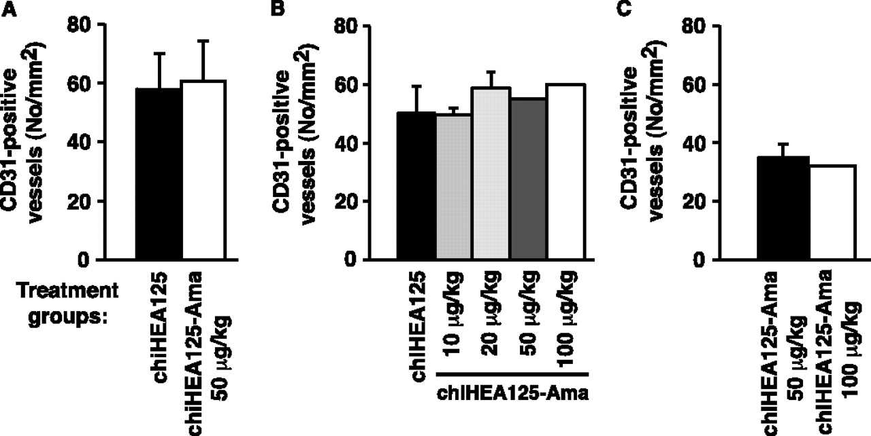
Figure 6 Effects chiHEA125-Ama treatment on blood vessel density in BxPc-3 tumor xenografts. The density of blood ...
Notes:
Figure 6 Effects chiHEA125-Ama treatment on blood vessel density in BxPc-3 tumor xenografts. The density of blood vessels in BxPc-3 tumors was analyzed by immunohistochemistry using cluster of differentiation 31 (CD31) as a marker of endothelial cells. CD31-positive blood vessels were counted in 10 random fields of vision ×100 magnification. Data in each treatment group are presented as the mean number of CD31-positive blood vessels per mm 2 of tumor tissue. A ) Effect of a single dose of chiHEA125-Ama (50 μg/kg) (n = 4 mice) and unconjugated chiHEA125 monoclonal antibody (mAb) (15 mg/kg) (n = 3 mice) on angiogenesis in BxPc-3 tumors was determined at the endpoint at day 16. Error bars correspond to upper 95% confidence intervals. B ) Effects of two injections of different doses of chiHEA125-Ama (10 μg/kg, n = 5 mice; 20 μg/kg, n = 4 mice; 50 μg/kg, n = 2 mice; and 100 μg/kg, n = 1 mouse) and unconjugated chiHEA125 mAb (5 mg/kg, n = 4 mice), administered 1 week apart, on BxPc-3 tumor angiogenesis evaluated at day 16 after the first antibody injection. Error bars correspond to upper 95% confidence intervals. C ) The density of CD31-positive blood vessels in BxPc-3 tumors that received chiHEA125-Ama at doses of 50 μg/kg (n = 4 mice) or 100 μg/kg (n = 2 mice) evaluated at day 40 after the first antibody injection. Error bars correspond to upper 95% confidence intervals. Ama = α-amanitin.
Unless provided in the caption above, the following copyright applies to the content of this slide: © The Author 2012. Published by Oxford University Press.

