Slide 1
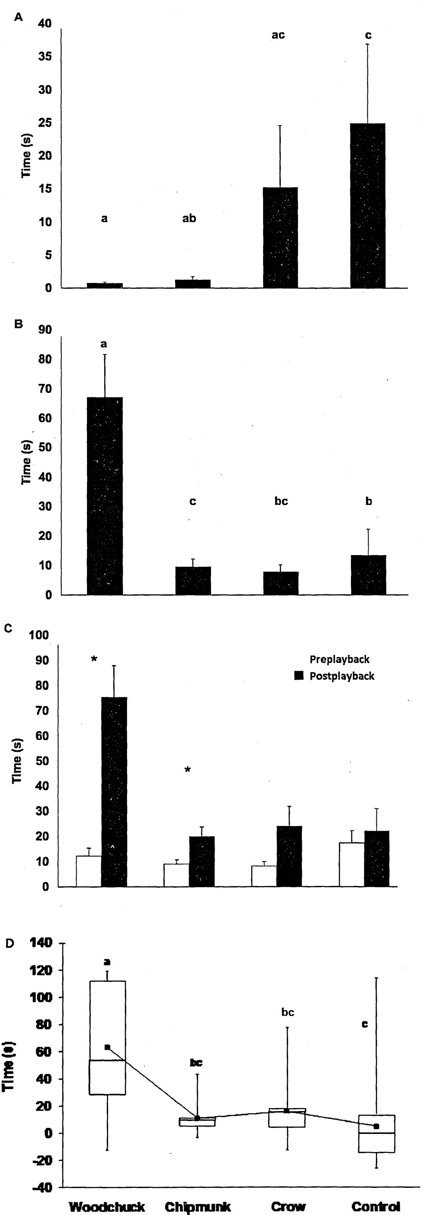
Fig. 1 Mean ± SE responses to playbacks of alarm calls or control calls by woodchucks (Marmota monax; n = 13). A) ...
Notes:
Fig. 1 Mean ± SE responses to playbacks of alarm calls or control calls by woodchucks (Marmota monax; n = 13). A) time to initial antipredator response, B) duration of initial response, C) time spent vigilant preplayback (white bars) and postplayback (black bars), and D) difference in vigilance among call types, by woodchucks. Box plots show median and interquartile range from 25th to 75th percentiles. Whiskers above and below the box indicate minimum and maximum values. ■ indicates mean difference in vigilance for each call type. Different letters indicate significant differences among call types based on Wilcoxon signed-rank tests.
Unless provided in the caption above, the following copyright applies to the content of this slide: © 2011 American Society of Mammalogists

