Slide 1
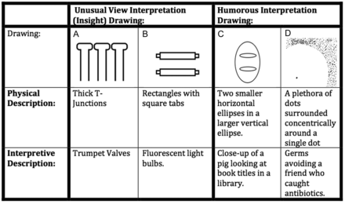
Figure 1. Examples of the 4 conditions. Credits: (A and B): Adopted from Nishimoto et al. (2010). (C and D): Droodles ...
Notes:
Figure 1. Examples of the 4 conditions. Credits: (A and B): Adopted from Nishimoto et al. (2010). (C and D): Droodles excerpts from “Droodles - the Classic Collection” © 2000 by Tallfellow press, Los Angeles. Used by Permission. All rights reserved. (C): Droodle orientation and caption differs from the original Droodle.
Unless provided in the caption above, the following copyright applies to the content of this slide: © The Author 2013. Published by Oxford University Press. All rights reserved. For Permissions, please e-mail: journals.permissions@oup.com

Slide 2
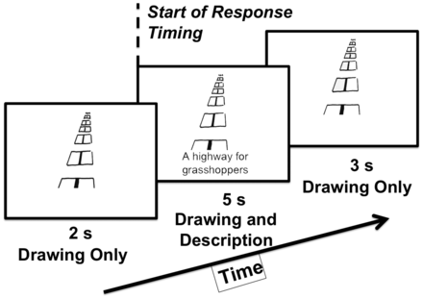
Figure 2. The temporal arrangement of a trial in the fMRI experiment. Droodles excerpts from “Droodles - the Classic ...
Notes:
Figure 2. The temporal arrangement of a trial in the fMRI experiment. Droodles excerpts from “Droodles - the Classic Collection” © 2000 by Tallfellow press, Los Angeles. Used by Permission. All rights reserved.
Unless provided in the caption above, the following copyright applies to the content of this slide: © The Author 2013. Published by Oxford University Press. All rights reserved. For Permissions, please e-mail: journals.permissions@oup.com

Slide 3
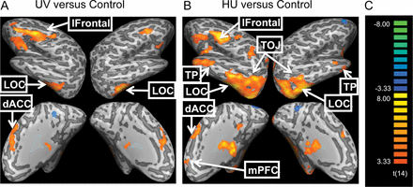
Figure 3. (A) BOLD response to Unusual View (UV) Interpretation “Insight” Drawings minus their physical description ...
Notes:
Figure 3. (A) BOLD response to Unusual View (UV) Interpretation “Insight” Drawings minus their physical description controls (UVcont). (B) Humorous Interpretation (HU) Drawings minus their physical description controls (HUcont). (C) Color scale of t-values. Maps are displayed at a threshold of P < 0.005 uncorrected. Note: right side of the brain is on the right. TP, temporal pole; LOC, lateral occipital complex; TOJ, temporo-occipital junction; dACC, dorsal anterior cingulated cortex (supplementary motor area); mPFC, medial prefrontal cortex.
Unless provided in the caption above, the following copyright applies to the content of this slide: © The Author 2013. Published by Oxford University Press. All rights reserved. For Permissions, please e-mail: journals.permissions@oup.com

Slide 4
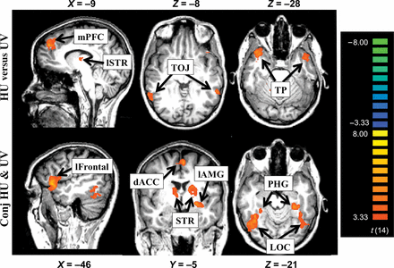
Figure 4. Top—regions activated for HU but not UV (based on the contrast: [HU − HU_{cont}] − [UV − ...
Notes:
Figure 4. Top—regions activated for HU but not UV (based on the contrast: [HU − HUcont] − [UV − UVcont]). Bottom—regions activated for both HU − HUcont and UV − UVcont as revealed by conjunction analysis. All maps are displayed with a threshold of P < 0.005, uncorrected. TP, temporal pole; TOJ, temporo-occipital junction; PHG, parahippocampal gyrus; LOC, lateral occipital complex; mPFC, medial prefrontal cortex; lAMG, left amygdala; STR, striatum; dACC, dorsal anterior cingulate cortex (this area of activation includes SMA, supplementary motor area). Figures conform to radiology conventions, with left side on the right.
Unless provided in the caption above, the following copyright applies to the content of this slide: © The Author 2013. Published by Oxford University Press. All rights reserved. For Permissions, please e-mail: journals.permissions@oup.com

Slide 5
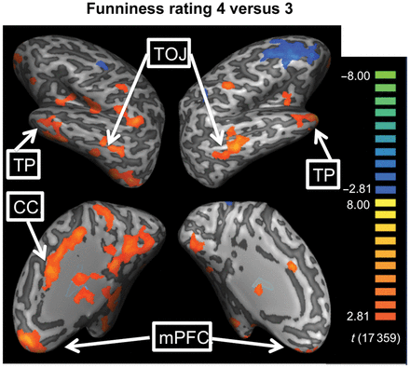
Figure 5. A contrast map of HU drawings rated 4—“Funny” minus those rated 3—“a little funny” for a threshold of P < ...
Notes:
Figure 5. A contrast map of HU drawings rated 4—“Funny” minus those rated 3—“a little funny” for a threshold of P < 0.005. mPFC, medial prefrontal cortex; TP, temporal pole; TOJ, temporo-occipital junction; CC, cingulate cortex.
Unless provided in the caption above, the following copyright applies to the content of this slide: © The Author 2013. Published by Oxford University Press. All rights reserved. For Permissions, please e-mail: journals.permissions@oup.com

Slide 6
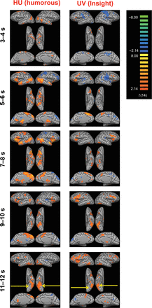
Figure 6. Time course of activation for the HU and UV conditions minus their controls, for P < 0.05, uncorrected (the ...
Notes:
Figure 6. Time course of activation for the HU and UV conditions minus their controls, for P < 0.05, uncorrected (the relaxed threshold here is for presentation purposes only, all analysis and other figures used a P < 0.005 threshold). Notice that activation in LOC increases (relative to controls) starting around 9 s (or a little earlier) after the beginning of the trial, suggesting a reinterpretation of the drawing.
Unless provided in the caption above, the following copyright applies to the content of this slide: © The Author 2013. Published by Oxford University Press. All rights reserved. For Permissions, please e-mail: journals.permissions@oup.com

